Slide 1

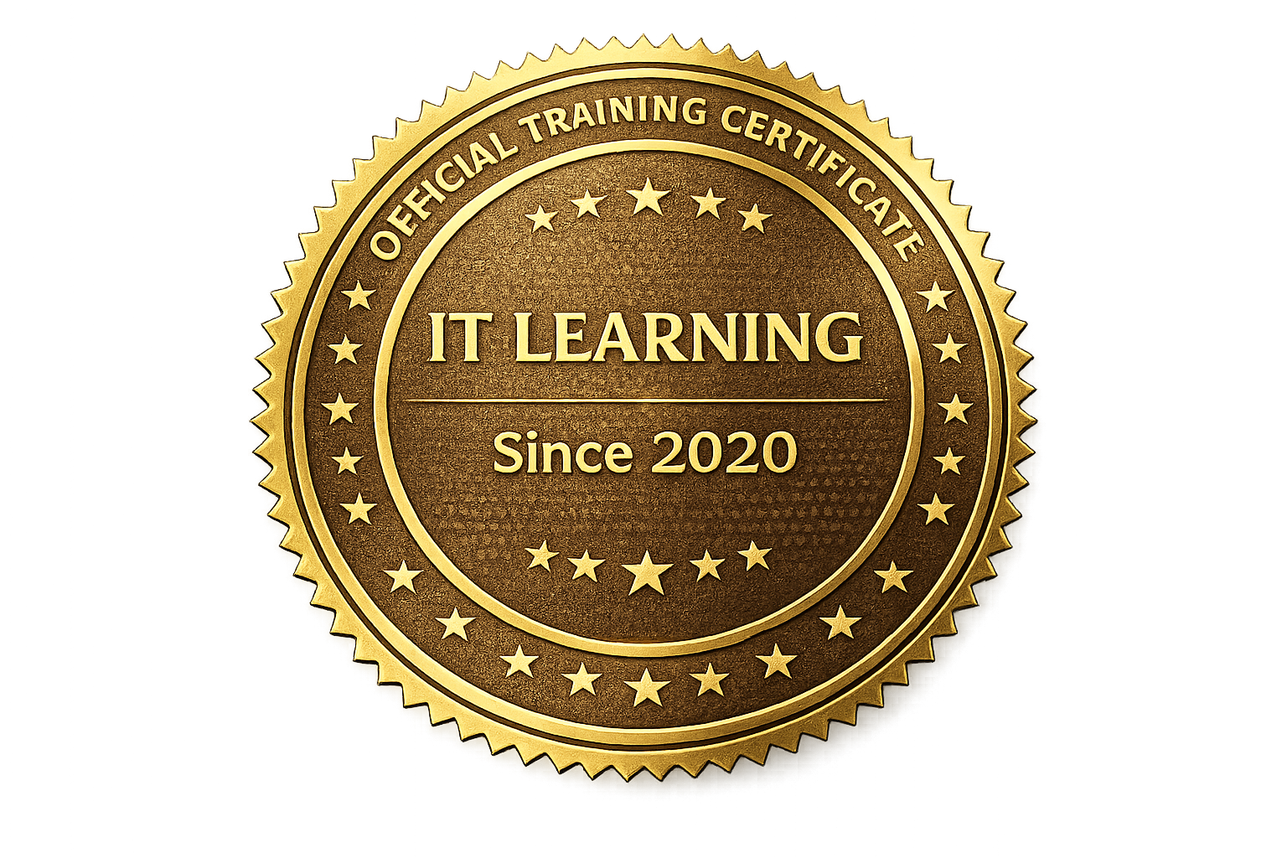


CERTIFICATE
OF COMPLETION
Abdulaziz hisham hazza
has successfully completed all requirements and criteria for
“Networking Fundamentals and Switching Technologies – Training Program”
Comprehensive coverage of Introduction to Networks (ITN), including VLANs, Inter-VLAN Routing, Spanning Tree Protocol (STP), EtherChannel, and DHCPv4/DHCPv6 configuration
IT Learning and Troubleshooting
SIGNATURE
Issued on: Jan 2026
Certificate ID: ITR-NET-2410-009
Mostafa Othman
Founder & Lead Instructor

