Slide 1

Operating systems
Made by :
Ahmed Mohamed Gaber

Slide 2
What we are going to present :
SJF non preemptive
LJF
ROUND ROBBIN
PRIORITY
SJF preemptive
FCFS

Slide 3
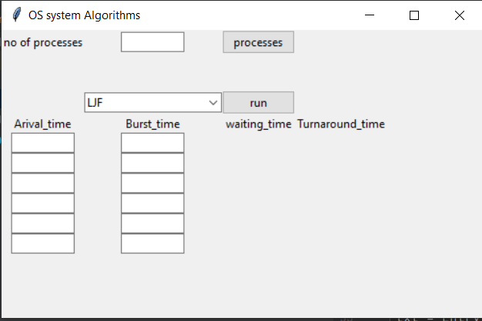
Python GUI

Slide 4

Queue

Slide 5
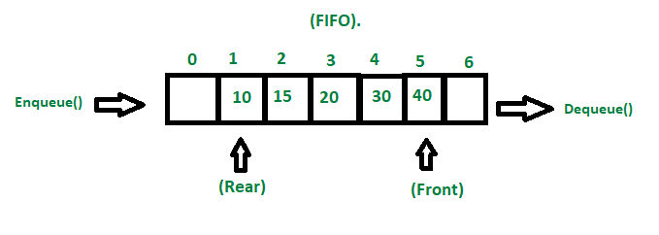
Queue using array
Queue : is a linear data structure that is open at both ends and the operations are performed in First In First Out (FIFO) order.
Note: Conditions
empty queue: (Rear=-1 and front=-1)
1 element in the queue: (Rear = front=0 or any number) then
Next step rear=front=-1
Full queue: (rear=capacity-1 (last element of array))
// typedef enum {// false,// true//
}
bool;

Slide 6
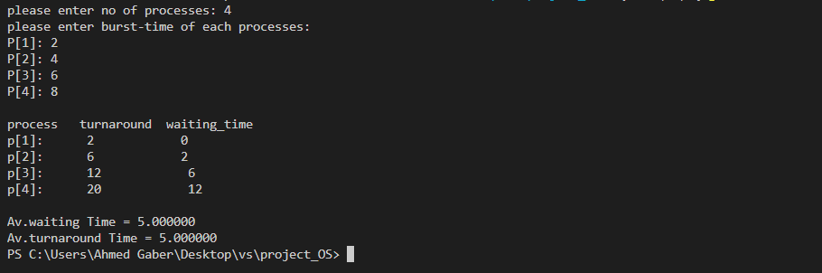
SJF
Sorting the processes ascendingly
Comparing both arrays to find the process number after sorting

Slide 7
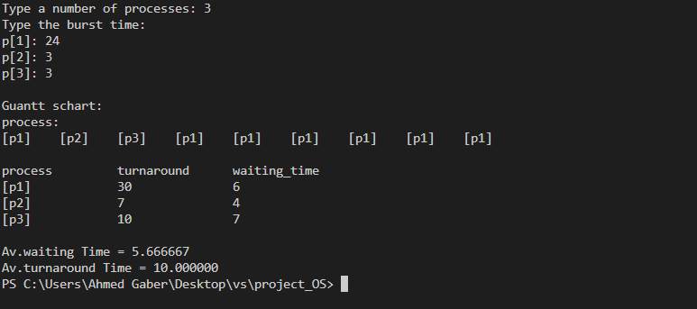
Round robbin
we are using a struct to make a queue named Queue, it includes all the functions ( enqueue, dequeue and front)
Making a while loop till the queue is empty
First, we check if the process value is less than quantum time or not then dequeue it from queue
If it is, we are adding the value of process to completion time then subtract from its process time quantum number then dequeue it and enqueue it again
Else adding the quantum value to completion time
Each time process finish it puts it’s completion time in an array and number of this process in another array

Slide 8
Round robbin

Slide 9
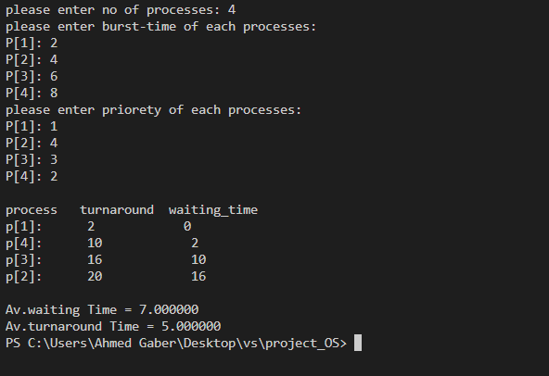
priority
Sorting the processes according to their priority from largest to smallest
Comparing both arrays to find the processes number after sorting

Slide 10
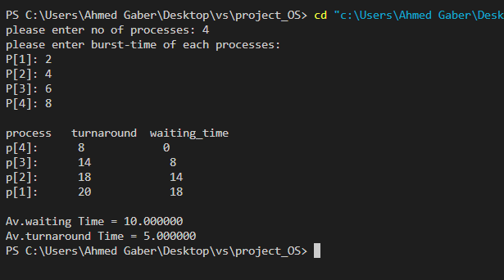
LJF
Sorting the processes from largest to smallest
comparing both arrays to find the processes number after sorting

Slide 11
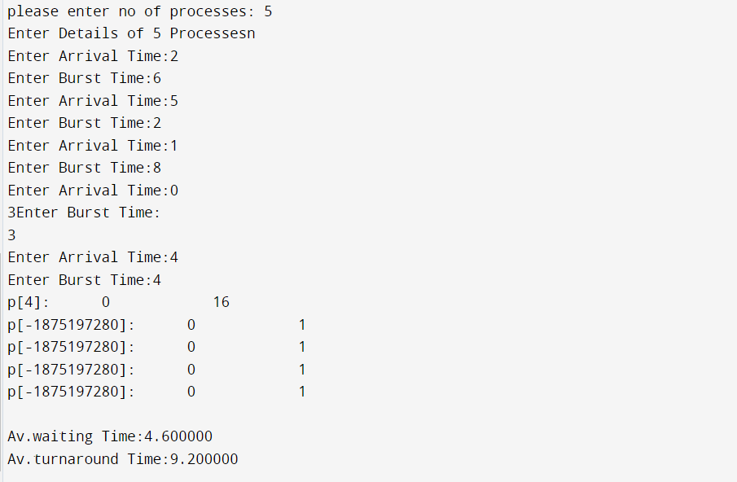
SJF preemptive
A while loop to check if the arrival time is smaller than the original time and to check if the burst time is larger than zero.

Slide 12
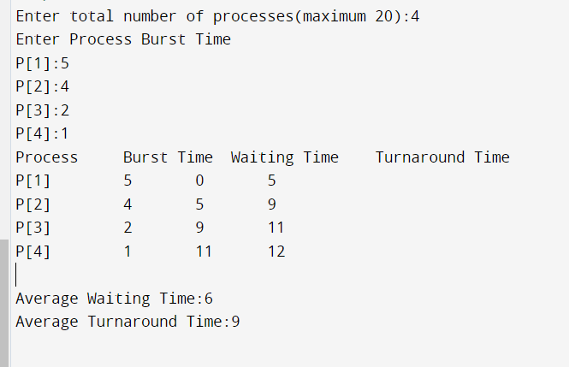
FCFS :
We assume that processes are written in order of arrival then we calculate turn around, waiting time, average waiting and average turnaround using the rules.

Slide 13
Any questions ?

