Slide 1
Standard functions in assembly language and their usage
By Mammadov Ahmed

Slide 2
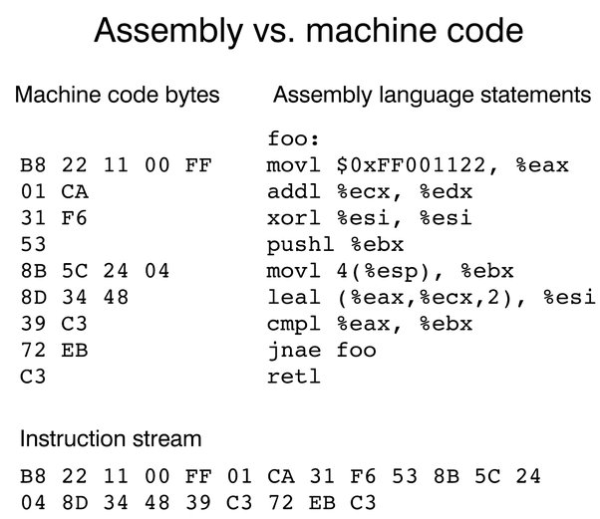
Assembler Language
In 1952, grace hopper, an american woman, created assembler, the world's first mnemonic programming language. Its name is derived from the english word "assemble", which means "to assemble". It included a system of mnemonic commands (command lists), a library of procedures, and a special program to convert program texts into machine code.
Assembler is unlike any other programming language and is a completely different language. The fact that the assembler language is a 2nd generation language and the development of 3rd generation languages ​​on the assembler does not mean that the assembler language is outdated and is no longer used. Assembler language is very important in programming today, and to imagine modern programming without it is like to imagine a computer without a processor. Assembler language is currently being developed, various standards are being developed and tested by various institutes and IT companies.
The possibilities of assembler language are endless. The possibilities of other languages ​​are finite.
For example, only a program written in assembler can control the processor's response to external and internal signals. However, it is possible to manage memory access modes with a program written in assembler language.Assembler is currently only used in system programming.

Slide 3
Functions
All rules and methods applied to procedures apply to functions.
The purpose of a function is to return some open value. The purpose of the procedure is to perform some operations. We use proc / endp directives to declare a function in assembly language. All rules and methods applied to procedures apply to functions.
Programmers use functions to divide their programs into parts.
To ensure that programmers work together in groups, they need to be able to divide the program into different parts. This division is determined by a clearly defined agreement between them. In this way, different parts can be developed and tested by different creators, which allows several creators to work on the same project.
A normal program usually consists of 100 or 1000 small and well-written functions.

Slide 4
How functions work?
The functions consist of several parts:
The name of the functions
A function name is an expression that contains the start address of the function code. To specify a function name, simply place the function name at the beginning of the function code.
Function parameters
The parameters of a function are the information given to the function when it is called. For example, consider the sinusoidal function we know from mathematics. If we ask the computer the sine of an angle of 30 degrees, then 30 degrees will be the parameter of this function. Other features may require more settings.
Local variables
Local variables are the part of memory used by a function during execution, which is discarded when the function returns. You can take it as a draft paper. Each time the function is activated, it takes up as much paper as it needs and is discarded when it finishes its work. One function does not see the local variables of another function.
Static variables
Static variables are parts of memory that the function uses, but does not discard it when the function ends, and uses it again the next time the function is called. The information in this section is not visible to the rest of the program, ie the information contained herein cannot be read or modified. Static variables are only used when needed because they can cause unexpected problems.
Global variables
Global variables are the part of memory that a function uses, but these variables are declared outside the function. Return address The return address is an "invisible" parameter of the function, so it is not used directly. This parameter indicates from which address the program should continue to run after the function is finished.

Slide 5
Assembler functions that work by calling c
The most basic concept of assembler language is STAK.
A stack is an array-like data structure in the memory in which data can be stored and removed from a location called the 'top' of the stack. The data that needs to be stored is 'pushed' into the stack and data to be retrieved is 'popped' out from the stack.
For normal operation of functions, each program allocates a special place in the kernel memory called a stack.
Although this is confusing, we accept that something has been added to the stack or that the removal operations are performed on top of it.
A register that contains information that can be retrieved from the stack or placed on the stack.
However, when a function is executed, you can place other information on the stack, such as setting the parameters of other functions, which in turn will change the value of% esp.

Slide 6
Loss of registry costs
It is only clear that the value of the% ebp register will not change. The price of% eax will change precisely, and it is likely that others will change as well.
If the value of any register is required after the function returns, the values of these registers must be placed on the stack before the function parameters. After you return the function and remove the parameters from the stack, we can restore the previous values of these registers using the popl instruction.

Slide 7
Recursive functions
Firstly let’s talk about recursive function.
The program calculates the factorial of a given number. The factorial is the product of a given number and all numbers between that number and 1. For example, the factorial of 7 is 7 * 6 * 5 * 4 * 3 * 2 * 1, and the factorial of 4 is 4 * 3 * 2 * 1.
The factorial of a given number is equal to the product of the factorial of that number and 1 unit smaller than that number. For example, a factorial of 4 is equal to a product of a factor of 4 to 3, a factor of 3 is equal to a product of a factor of 3 to 2, a factor of 2 is equal to a product of a factor of 2 to 1, and a factor of 1 is equal to 1.
This appointment is called recursion. That is, within the function, the function itself is referenced. However, in this case, the end of the function must be taken into account, otherwise when the function is called, it will also appeal to itself, and it will itself ... and as a result, an infinite process will be obtained. Completion is the condition that determines the cessation of recursion.

Slide 8
Return the results of the functions to the register
Like settings, 80x86 notes are the best place to return function results.
The getc routine in the UCR Standard Library is a good example of a function.
Use First Last
Bytes: al, ah, dl, dh, cl, ch, bl, bh
Words: ax, dx, cx, si, di, bx
Double words: dx:ax eax, On pre-80386
edx, ecx, esi, edi, ebx On 80386 and later.
16-bitOffsets: bx, si, di, dx
32-bit Offsets: ebx, esi , edi, eax, ecx, edx
Segmented Pointers:es:di, es:bx, dx:ax, es:si Do not use DS.

Slide 9
Return function results in a stack
Another good place where we can return function results is the stack.
The main idea here is to click on a set of fake values to create space for the function result.

Slide 10
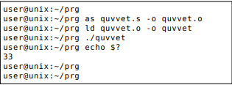
PRACTICE
We will consider the force function here. To the power function we will pass the parameter: the number and the force we want to increase this number. For example, if we give the numbers 2 and 3 as parameters, the function will increase the power of 2 from the 3rd power, ie 2 * 2 * 2 and return 8 as a result. In order to simplify the program, we will use only numbers greater than 1 and 1.
To turn it into a form that a computer can execute, we need to assemble and coordinate it.
First we have to do the assembly.
We enter the command.

Slide 11
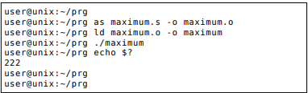
Result
In this course, we talked about the standard functions of assembler language and their use.
Here we talked about different functions and solved examples on them.

