Slide 1
Methods of Proof

Slide 2
In this slide set…
Rules of inference for propositions
Rules of inference for quantified statements
Ten methods of proof

Slide 3
Proof methods in this slide set
Logical equivalences
  via truth tables
  via logical equivalences
Set equivalences
  via membership tables
  via set identities
  via mutual subset proof
  via set builder notation and logical equivalences
Rules of inference
  for propositions
  for quantified statements
Pigeonhole principle
Combinatorial proofs
Ten proof methods in section 1.5:
  Direct proofs
  Indirect proofs
  Vacuous proofs
  Trivial proofs
  Proof by contradiction
  Proof by cases
  Proofs of equivalence
  Existence proofs
    Constructive
    Non-constructive
  Uniqueness proofs
  Counterexamples
Induction
  Weak mathematical induction
  Strong mathematical induction
  Structural induction

Slide 4
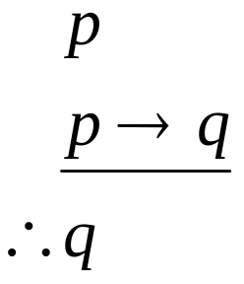
Modus Ponens
Consider (p ∧ (p→q)) → q
p | q | p→q | p∧(p→q)) | (p∧(p→q)) → q
T | T | T | T | T
T | F | F | F | T
F | T | T | F | T
F | F | T | F | T

Slide 5
Modus Ponens example
Assume you are given the following two statements:
  “you are in this class”
  “if you are in this class, you will get a grade”
Let p = “you are in this class”
Let q = “you will get a grade”
By Modus Ponens, you can conclude that you will get a grade

Slide 6
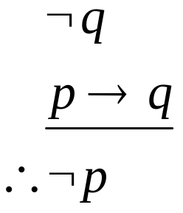
Modus Tollens
Assume that we know: ¬q and p → q
  Recall that p → q = ¬q → ¬p
Thus, we know ¬q and ¬q → ¬p
We can conclude ¬p

Slide 7
Modus Tollens example
Assume you are given the following two statements:
  “you will not get a grade”
  “if you are in this class, you will get a grade”
Let p = “you are in this class”
Let q = “you will get a grade”
By Modus Tollens, you can conclude that you are not in this class

Slide 8
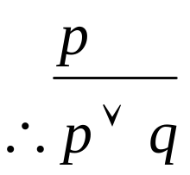
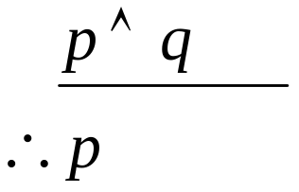
Addition & Simplification
Addition: If you know that p is true, then p ∨ q will ALWAYS be true
Simplification: If p ∧ q is true, then p will ALWAYS be true

Slide 9
Example of proof
  “It is not sunny this afternoon and it is colder than yesterday”
  “We will go swimming only if it is sunny”
  “If we do not go swimming, then we will take a canoe trip”
  “If we take a canoe trip, then we will be home by sunset”
Does this imply that “we will be home by sunset”?
  “It is not sunny this afternoon and it is colder than yesterday”
  “We will go swimming only if it is sunny”
  “If we do not go swimming, then we will take a canoe trip”
  “If we take a canoe trip, then we will be home by sunset”
Does this imply that “we will be home by sunset”?
  “It is not sunny this afternoon and it is colder than yesterday”
  “We will go swimming only if it is sunny”
  “If we do not go swimming, then we will take a canoe trip”
  “If we take a canoe trip, then we will be home by sunset”
Does this imply that “we will be home by sunset”?
  “It is not sunny this afternoon and it is colder than yesterday”
  “We will go swimming only if it is sunny”
  “If we do not go swimming, then we will take a canoe trip”
  “If we take a canoe trip, then we will be home by sunset”
Does this imply that “we will be home by sunset”?
  “It is not sunny this afternoon and it is colder than yesterday”
  “We will go swimming only if it is sunny”
  “If we do not go swimming, then we will take a canoe trip”
  “If we take a canoe trip, then we will be home by sunset”
Does this imply that “we will be home by sunset”?
Example 6 of Rosen, section 1.5
We have the hypotheses:
  “It is not sunny this afternoon and it is colder than yesterday”
  “We will go swimming only if it is sunny”
  “If we do not go swimming, then we will take a canoe trip”
  “If we take a canoe trip, then we will be home by sunset”
Does this imply that “we will be home by sunset”?
¬p ∧ q
r → p
¬r → s
s → t
t
p
q
r
s
t

Slide 10
Example of proof
¬p ∧ q 1st hypothesis
¬p Simplification using step 1
r → p 2nd hypothesis
¬r Modus tollens using steps 2 & 3
¬r → s 3rd hypothesis
s Modus ponens using steps 4 & 5
s → t 4th hypothesis
t Modus ponens using steps 6 & 7

Slide 11
So what did we show?
We showed that:
  [(¬p ∧ q) ∧ (r → p) ∧ (¬r → s) ∧ (s → t)] → t
  That when the 4 hypotheses are true, then the implication is true
  In other words, we showed the above is a tautology!

Slide 12
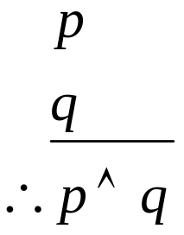
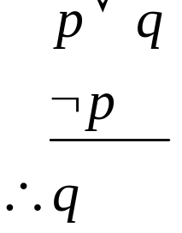
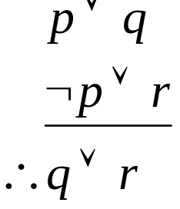
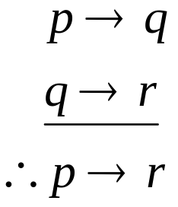
More rules of inference
Conjunction: if p and q are true separately, then p∧q is true
Disjunctive syllogism: If p∨q is true, and p is false, then q must be true
Resolution: If p∨q is true, and ¬p∨r is true, then q∨r must be true
Hypothetical syllogism: If p→q is true, and q→r is true, then p→r must be true

Slide 13
Example of proof
Rosen, section 1.5, question 4
Given the hypotheses:
  “If it does not rain or if it is not foggy, then the sailing race will be held and the lifesaving demonstration will go on”
  “If the sailing race is held, then the trophy will be awarded”
  “The trophy was not awarded”
Can you conclude: “It rained”?
(¬r ∨ ¬f) →
(s ∧ l)
s → t
¬t
r

Slide 14
Example of proof
¬t 3rd hypothesis
s → t 2nd hypothesis
¬s Modus tollens using steps 2 & 3
(¬r∨¬f)→(s∧l) 1st hypothesis
¬(s∧l)→¬(¬r∨¬f) Contrapositive of step 4
(¬s∨¬l)→(r∧f) DeMorgan’s law and double negation law
¬s∨¬l Addition from step 3
r∧f Modus ponens using steps 6 & 7
r Simplification using step 8

Slide 15
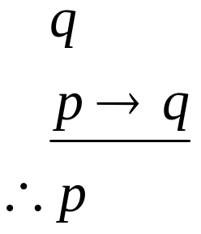
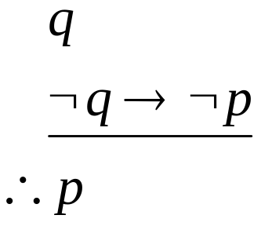
Modus Badus
Fallacy of affirming the conclusion
Consider the following:
Is this true?
p | q | p→q | q∧(p→q)) | (q∧(p→q)) → p
T | T | T | T | T
T | F | F | F | T
F | T | T | T | F
F | F | T | F | T
Not a
valid
rule!

Slide 16
Modus Badus example
Assume you are given the following two statements:
  “you will get a grade”
  “if you are in this class, you will get a grade”
Let p = “you are in this class”
Let q = “you will get a grade”
You CANNOT conclude that you are in this class
  You could be getting a grade for another class

Slide 17
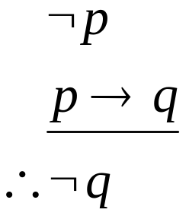
Modus Badus
Fallacy of denying the
hypothesis
Consider the following:
Is this true?
p | q | p→q | ¬p∧(p→q)) | (¬p∧(p→q)) → ¬q
T | T | T | F | T
T | F | F | F | T
F | T | T | T | F
F | F | T | T | T
Not a
valid
rule!

Slide 18
Modus Badus example
Assume you are given the following two statements:
  “you are not in this class”
  “if you are in this class, you will get a grade”
Let p = “you are in this class”
Let q = “you will get a grade”
You CANNOT conclude that you will not get a grade
  You could be getting a grade for another class

Slide 19
What we have shown
Rules of inference for propositions
Next up: rules of inference for quantified statements

Slide 20
Rules of inference for the universal quantifier
Assume that we know that ∀x P(x) is true
  Then we can conclude that P(c) is true
    Here c stands for some specific constant
  This is called “universal instantiation”
Assume that we know that P(c) is true for any value of c
  Then we can conclude that ∀x P(x) is true
  This is called “universal generalization”

Slide 21
Rules of inference for the existential quantifier
Assume that we know that ∃x P(x) is true
  Then we can conclude that P(c) is true for some value of c
  This is called “existential instantiation”
Assume that we know that P(c) is true for some value of c
  Then we can conclude that ∃x P(x) is true
  This is called “existential generalization”

Slide 22
Example of proof
Rosen, section 1.5, question 10a
Given the hypotheses:
  “Linda, a student in this class, owns a red convertible.”
  “Everybody who owns a red convertible has gotten at least one speeding ticket”
Can you conclude: “Somebody in this class has gotten a speeding ticket”?
C(Linda)
R(Linda)
∀x (R(x)→T(x))
∃x (C(x)∧T(x))

Slide 23
Example of proof
∀x (R(x)→T(x)) 3rd hypothesis
R(Linda) → T(Linda) Universal instantiation using step 1
R(Linda) 2nd hypothesis
T(Linda) Modes ponens using steps 2 & 3
C(Linda) 1st hypothesis
C(Linda) ∧ T(Linda) Conjunction using steps 4 & 5
∃x (C(x)∧T(x)) Existential generalization using
step 6
Thus, we have shown that “Somebody in this class has gotten a speeding ticket”

Slide 24
Example of proof
Rosen, section 1.5, question 10d
Given the hypotheses:
  “There is someone in this class who has been to France”
  “Everyone who goes to France visits the Louvre”
Can you conclude: “Someone in this class has visited the Louvre”?
∃x (C(x)∧F(x))
∀x (F(x)→L(x))
∃x (C(x)∧L(x))

Slide 25
Example of proof
∃x (C(x)∧F(x)) 1st hypothesis
C(y) ∧ F(y) Existential instantiation using step 1
F(y) Simplification using step 2
C(y) Simplification using step 2
∀x (F(x)→L(x)) 2nd hypothesis
F(y) → L(y) Universal instantiation using step 5
L(y) Modus ponens using steps 3 & 6
C(y) ∧ L(y) Conjunction using steps 4 & 7
∃x (C(x)∧L(x)) Existential generalization using
step 8
Thus, we have shown that “Someone in this class has visited the Louvre”

Slide 26
How do you know which one to use?
Experience!
In general, use quantifiers with statements like “for all” or “there exists”
  Although the vacuous proof example on slide 40 is a contradiction

Slide 27
Proof methods
We will discuss ten proof methods:
  Direct proofs
  Indirect proofs
  Vacuous proofs
  Trivial proofs
  Proof by contradiction
  Proof by cases
  Proofs of equivalence
  Existence proofs
  Uniqueness proofs
  Counterexamples

Slide 28
Direct proofs
Consider an implication: p→q
  If p is false, then the implication is always true
  Thus, show that if p is true, then q is true
To perform a direct proof, assume that p is true, and show that q must therefore be true

Slide 29
Direct proof example
Rosen, section 1.5, question 20
  Show that the square of an even number is an even number
  Rephrased: if n is even, then n² is even
Assume n is even
  Thus, n = 2k, for some k (definition of even numbers)
  n² = (2k)² = 4k² = 2(2k²)
  As n² is 2 times an integer, n² is thus even

Slide 30
Indirect proofs
Consider an implication: p→q
  It’s contrapositive is ¬q→¬p
    Is logically equivalent to the original implication!
  If the antecedent (¬q) is false, then the contrapositive is always true
  Thus, show that if ¬q is true, then ¬p is true
To perform an indirect proof, do a direct proof on the contrapositive

Slide 31
Indirect proof example
If n² is an odd integer then n is an odd integer
Prove the contrapositive: If n is an even integer, then n² is an even integer
Proof: n=2k for some integer k (definition of even numbers)
n² = (2k)² = 4k² = 2(2k²)
Since n² is 2 times an integer, it is even

Slide 32
Which to use
When do you use a direct proof versus an indirect proof?
If it’s not clear from the problem, try direct first, then indirect second
  If indirect fails, try the other proofs

Slide 33

Example of which to use
Rosen, section 1.5, question 21
  Prove that if n is an integer and n³+5 is odd, then n is even
Via direct proof
  n³+5 = 2k+1 for some integer k (definition of odd numbers)
  n³ = 2k+6
  Umm…
So direct proof didn’t work out. Next up: indirect proof

Slide 34
Example of which to use
Rosen, section 1.5, question 21 (a)
  Prove that if n is an integer and n³+5 is odd, then n is even
Via indirect proof
  Contrapositive: If n is odd, then n³+5 is even
  Assume n is odd, and show that n³+5 is even
  n=2k+1 for some integer k (definition of odd numbers)
  n³+5 = (2k+1)³+5 = 8k³+12k²+6k+6 = 2(4k³+6k²+3k+3)
  As 2(4k³+6k²+3k+3) is 2 times an integer, it is even

Slide 35
Proof by contradiction
Given a statement p, assume it is false
  Assume ¬p
Prove that ¬p cannot occur
  A contradiction exists
Given a statement of the form p→q
  To assume it’s false, you only have to consider the case where p is true and q is false

Slide 36
Proof by contradiction example 1
Theorem (by Euclid): There are infinitely many prime numbers.
Proof. Assume there are a finite number of primes
List them as follows: p₁, p₂ …, p_{n}.
Consider the number q = p₁p₂ … p_{n} + 1
  This number is not divisible by any of the listed primes
    If we divided p_{i} into q, there would result a remainder of 1
  We must conclude that q is a prime number, not among the primes listed above
    This contradicts our assumption that all primes are in the list
    p₁, p₂ …, p_{n}.

Slide 37
Proof by contradiction example 2
Rosen, section 1.5, question 21 (b)
  Prove that if n is an integer and n³+5 is odd, then n is even
  Rephrased: If n³+5 is odd, then n is even
Assume p is true and q is false
  Assume that n³+5 is odd, and n is odd
n=2k+1 for some integer k (definition of odd numbers)
n³+5 = (2k+1)³+5 = 8k³+12k²+6k+6 = 2(4k³+6k²+3k+3)
As 2(4k³+6k²+3k+3) is 2 times an integer, it must be even
Contradiction!

Slide 38
A note on that problem…
Rosen, section 1.5, question 21
  Prove that if n is an integer and n³+5 is odd, then n is even
  Here, our implication is: If n³+5 is odd, then n is even
The indirect proof proved the contrapositive: ¬q → ¬p
  I.e., If n is odd, then n³+5 is even
The proof by contradiction assumed that the implication was false, and showed a contradiction
  If we assume p and ¬q, we can show that implies q
  The contradiction is q and ¬q
Note that both used similar steps, but are different means of proving the implication

Slide 39
A note on proofs by contradiction
You can DISPROVE something by using a proof by contradiction
  You are finding an example to show that something is not true
You cannot PROVE something by example
Example: prove or disprove that all numbers are even
  Proof by contradiction: 1 is not even
  (Invalid) proof by example: 2 is even

Slide 40
Vacuous proofs
Consider an implication: p→q
If it can be shown that p is false, then the implication is always true
  By definition of an implication
Note that you are showing that the antecedent is false

Slide 41
Vacuous proof example
Consider the statement:
  All criminology majors in CS 202 are female
  Rephrased: If you are a criminology major and you are in CS 202, then you are female
    Could also use quantifiers!
Since there are no criminology majors in this class, the antecedent is false, and the implication is true

Slide 42
Trivial proofs
Consider an implication: p→q
If it can be shown that q is true, then the implication is always true
  By definition of an implication
Note that you are showing that the conclusion is true

Slide 43
Trivial proof example
Consider the statement:
  If you are tall and are in CS 202 then you are a student
Since all people in CS 202 are students, the implication is true regardless

Slide 44

Proof by cases
Show a statement is true by showing all possible cases are true
Thus, you are showing a statement of the form:
is true by showing that:

Slide 45
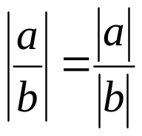
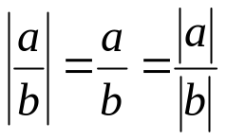
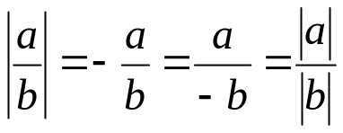
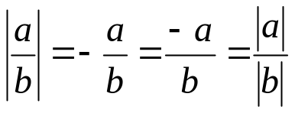
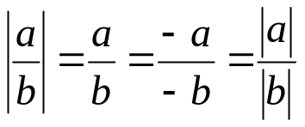
Proof by cases example
Prove that
  Note that b ≠ 0
Cases:
  Case 1: a ≥ 0 and b > 0
    Then |a| = a, |b| = b, and
  Case 2: a ≥ 0 and b < 0
    Then |a| = a, |b| = -b, and
  Case 3: a < 0 and b > 0
    Then |a| = -a, |b| = b, and
  Case 4: a < 0 and b < 0
    Then |a| = -a, |b| = -b, and

Slide 46
The think about proof by cases
Make sure you get ALL the cases
  The biggest mistake is to leave out some of the cases

Slide 47
Proofs of equivalences
This is showing the definition of a bi-conditional
Given a statement of the form “p if and only if q”
  Show it is true by showing (p→q)∧(q→p) is true

Slide 48
Proofs of equivalence example
Rosen, section 1.5, question 40
  Show that m²=n² if and only if m=n or m=-n
  Rephrased: (m²=n²) ↔ [(m=n)∨(m=-n)]
Need to prove two parts:
  [(m=n)∨(m=-n)] → (m²=n²)
    Proof by cases!
    Case 1: (m=n) → (m²=n²)
      (m)² = m², and (n)² = n², so this case is proven
    Case 2: (m=-n) → (m²=n²)
      (m)² = m², and (-n)² = n², so this case is proven
  (m²=n²) → [(m=n)∨(m=-n)]
    Subtract n² from both sides to get m²-n²=0
    Factor to get (m+n)(m-n) = 0
    Since that equals zero, one of the factors must be zero
    Thus, either m+n=0 (which means m=n)
    Or m-n=0 (which means m=-n)

Slide 49
Existence proofs
Given a statement: ∃x P(x)
We only have to show that a P(c) exists for some value of c
Two types:
  Constructive: Find a specific value of c for which P(c) exists
  Nonconstructive: Show that such a c exists, but don’t actually find it
    Assume it does not exist, and show a contradiction

Slide 50
Constructive existence proof example
Show that a square exists that is the sum of two other squares
  Proof: 3² + 4² = 5²
Show that a cube exists that is the sum of three other cubes
  Proof: 3³ + 4³ + 5³ = 6³

Slide 51
Non-constructive existence proof example
Rosen, section 1.5, question 50
Prove that either 2*10⁵⁰⁰+15 or 2*10⁵⁰⁰+16 is not a perfect square
  A perfect square is a square of an integer
  Rephrased: Show that a non-perfect square exists in the set {2*10⁵⁰⁰+15, 2*10⁵⁰⁰+16}
Proof: The only two perfect squares that differ by 1 are 0 and 1
  Thus, any other numbers that differ by 1 cannot both be perfect squares
  Thus, a non-perfect square must exist in any set that contains two numbers that differ by 1
  Note that we didn’t specify which one it was!

Slide 52
Uniqueness proofs
A theorem may state that only one such value exists
To prove this, you need to show:
  Existence: that such a value does indeed exist
    Either via a constructive or non-constructive existence proof
  Uniqueness: that there is only one such value

Slide 53
Uniqueness proof example
If the real number equation 5x+3=a has a solution then it is unique
Existence
  We can manipulate 5x+3=a to yield x=(a-3)/5
  Is this constructive or non-constructive?
Uniqueness
  If there are two such numbers, then they would fulfill the following: a = 5x+3 = 5y+3
  We can manipulate this to yield that x = y
    Thus, the one solution is unique!

Slide 54
Counterexamples
Given a universally quantified statement, find a single example which it is not true
Note that this is DISPROVING a UNIVERSAL statement by a counterexample
∀x ¬R(x), where R(x) means “x has red hair”
  Find one person (in the domain) who has red hair
Every positive integer is the square of another integer
  The square root of 5 is 2.236, which is not an integer

Slide 55
Mistakes in proofs
Modus Badus
  Fallacy of denying the hypothesis
  Fallacy of affirming the conclusion
Proving a universal by example
  You can only prove an existential by example!

