Slide 1
RHEOLOGY (2024)
بسم الله الرحمن الرحيم

Slide 2
INTRODUCTION
Rheology: is the science that study the flow properties of fluids and semi solids,
Or is the science that study the viscosity of fluids and semi solids.
Viscosity: is the resistance of a fluid to flow or movement.
The higher the viscosity, the greater the resistance.
Or: it is the science of deformation and flow of matter under the influence of stress.

Slide 3
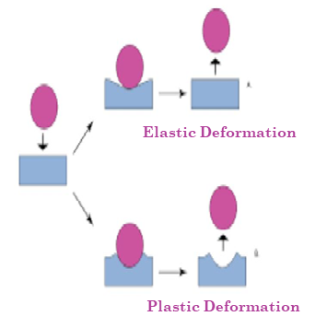
Deformation: describes the change of matter in terms of shape and/or volume.
If the changes due to deformation are at least partly nonreversible, then matter flows.
The deformation that results from the application of a stress may be of two types:
Elastic Deformation:
It is a spontaneous and reversible deformation, exhibited by elastic bodies
Plastic Deformation:
It is a permanent and irreversible deformation, exhibited by viscous bodies.

Slide 4
Importance of Rheology in pharmacy:
Characterization & classification of fluids & semi solids,
Adjustment of the dissolution rate by the viscosity & hence control bioavailability,
involved in the mixing and flow of materials,
physical stability of pharmaceutical products (suspension and emulsion),
The packaging of products into the suitable containers ,
Removal of products from containers prior to use and extrusion from a tube (extrudability)
Passage of product through a syringe needle (syrengability),
patient acceptability,

Slide 5
Classification of materials according to the types of flow and deformation:
Materials can be classified according to the types of flow and deformation based on Newton’s law into two categories:
Newtonian systems
non-Newtonian systems.

Slide 6
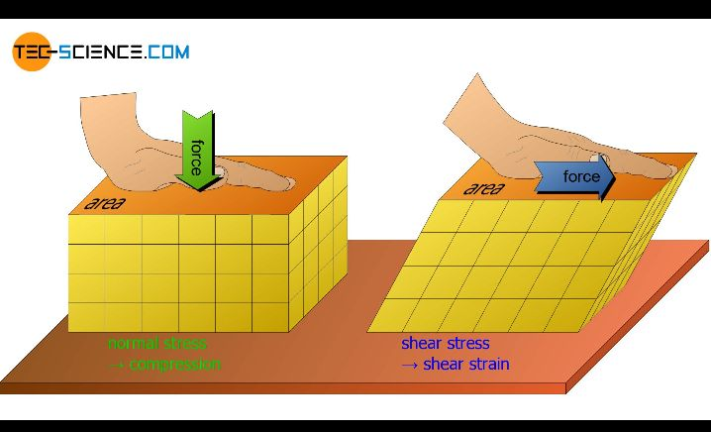
Newton’s law
Let us consider a block of liquid consisting of parallel plates of molecules as shown in this figure.
The bottom layer is considered to be fixed in place.
If the top plane of liquid is moved at constant velocity, each lower layer will move with a velocity directly proportional to its distance from the stationary bottom layer.

Slide 7
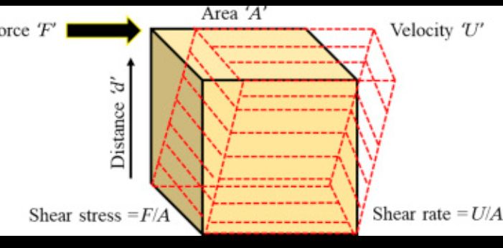



Rate of Shear or velocity gradient D:
It is the velocity difference (d_{v}) between two planes of liquid separated by an infinite distance, dr.
The Shearing Stress t:
It is the force per unit area required to cause flow,

Slide 8
Newton’s low states that:
The rate of flow (D) is directly proportional to the applied sheer (t):
η: is a coefficient of dynamic viscosity,
η = t/D
= Nm-2 / s-1 = Nm-2.s
Nm-2.s = Pascal (Pa) “Si units”
=dyn cm-2.s = Poice (P) “c.g.s. units”

Slide 9
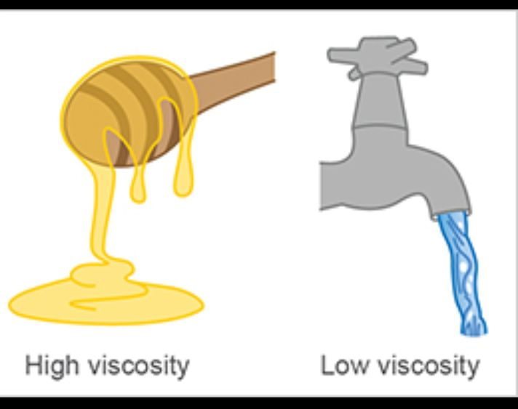
1- Newtonian (simple) flow:
represents an ideal situation in which the flow of a fluid obeys Newton's basic equation,
i.e. The higher the viscosity of a liquid, the greater the force per unit area (shearing stress) required to produce a certain rate of shear.
E.g. water, simple organic liquids, true solutions and dilute colloidal, suspensions and emulsions

Slide 10

These systems have constant viscosity where
When (D) is plotted against (t) a rheogram of a straight line passing through the origin is obtained:

Slide 11
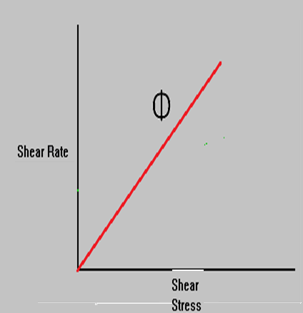

Rheogram of a Newtonian liquid
The passage through the origin indicates that even a mild force can induce flow in these systems.
The linear nature of the curve shows that the viscosity (η) of a newtonian liquid is a constant unaffected by the value of the rate of shear
the slope is the reciprocal of viscosity (fluidity Φ)

Slide 12
2- Non-Newtonian (complex) flow:
Are flow characteristics that show deviation from the Newton law,
Non-Newtonian materials exhibit several distinct types of non ideal behavior which are :
plastic flow,
pseudo plastic flow, and
dilatant flow s

Slide 13

1. Plastic Flow (Bingham bodies):
Bingham body are systems having strong van der Waals forces between adjacent particles,
so that they don’t flow until subjected to shearing stress sufficient to break down this force.
This force is Bingham yield value,

Slide 14
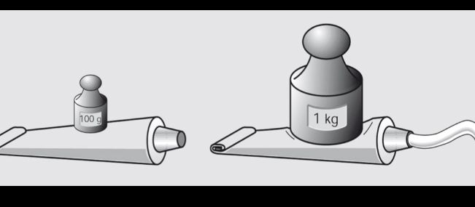
i.e plastic system can't flow until subjected to sear stress equals to or greater than yield value.
Plastic flow is usually shown in flocculated particles in a concentrated suspensions.
Bingham bodies are classified according to into their yield values into:
Solids: substances exhibit a high yield value,
Liquids: substances exhibit a small yield value.

Slide 15
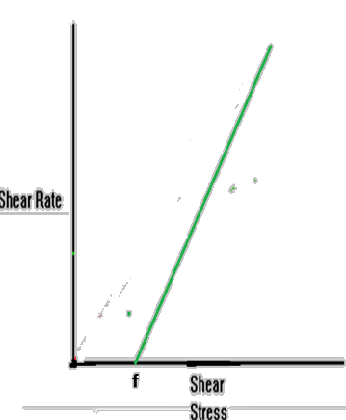
Rheogram of Plastic system:
The curve is linear over most of its length corresponding to that of a newtonian fluid.
However, the curve does not pass through the origin because it does not yield any flow until yield value is reached,
Bingham yield value is the intersect of theline with the shearing stress axis at a particular point (f).

Slide 16
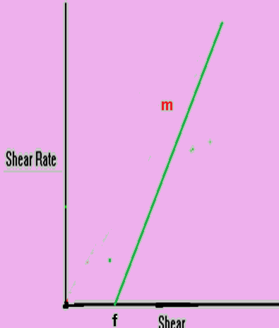

Plastic systems resembles Newtonian systems at shear stresses above the yield value
The slope of the rheogram is termed mobility (m), analogous to fluidity in Newtonian systems and its reciprocal is the Plastic viscosity, U:

Slide 17
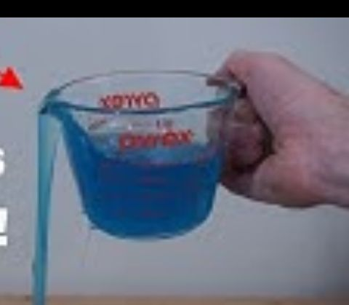
2-Pseudoplastic (Shear Thinning )Flow:
The viscosity of a pseudo plastic substance decreases with increasing rate of shear (shear-thinning systems).
pseudo plastic flow is exhibited bya large number of pharmaceutical products,
including all formulations containing aqueous dispersion of natural and/or synthetic gums (polymers)

Slide 18
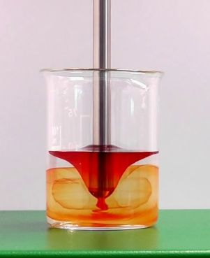
, e.g. acacia, tragacanth, sodium alginate, methyl cellulose, and Na CMC.
In the presence of shear particles arrange them selves in the direction of flow releasing the entrapped fluid& reducing viscosity.
When “D” is plotted against “t” for pseudo plastic system a down curve rheogram will obtained.

Slide 19
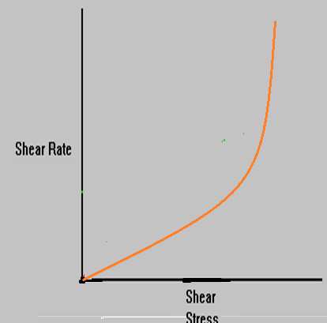
Rheogram of a pseudo plastic system
The rheogram is down curve begins at the origin.
Since no part of the curve is linear, the viscosity of a pseudo plastic material can not be expressed by a single value,
the viscosity at any point is known as apparent viscosity,

Slide 20
Pseudo plastic systems are expressed by the equation:
ὴ: viscosity coefficient
n: index of pseudo plasticity
for newtonian flow: n = 1,
for pseudo plastic flow: n < 1
The smaller the n the greater the pseudo plasticity

Slide 21
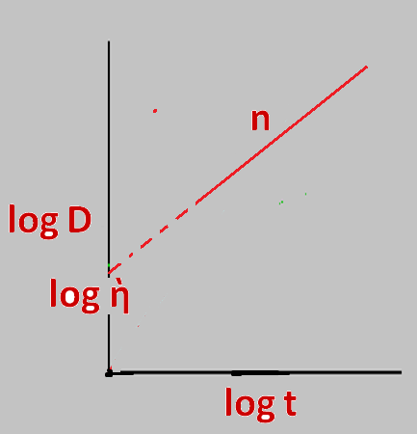
This equation is rearranged to a straight line equation:
when log t is plotted against log D, straight line is obtained,
The slope of the plot = n, & the intercept is log ὴ .

Slide 22

3- Dilatant Flow:
Dilatant systems is opposite to pseudo plastic one,
It exhibit an increase in viscosity with increasing rates of shear, “shear thickening systems”.
Such systems actually increase in volume when sheared and are hence termed dilatant.

Slide 23
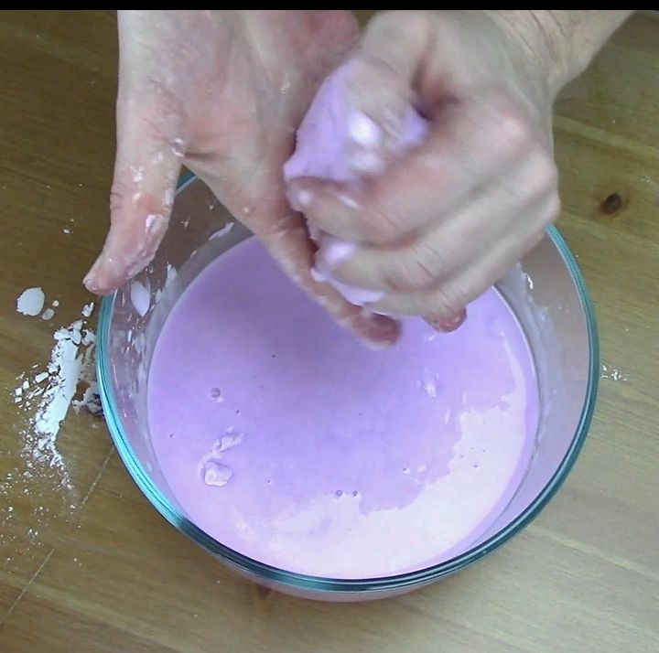
At rest, the particles are closely packed with the inter particle voids being at a minimum,
low sheer rates adequately lubricate the movement (easy movement),
As the shear stress is increased, the particles form clumps & increase the voids entrapping the surrounding fluid & resist the flow (solidified),

Slide 24
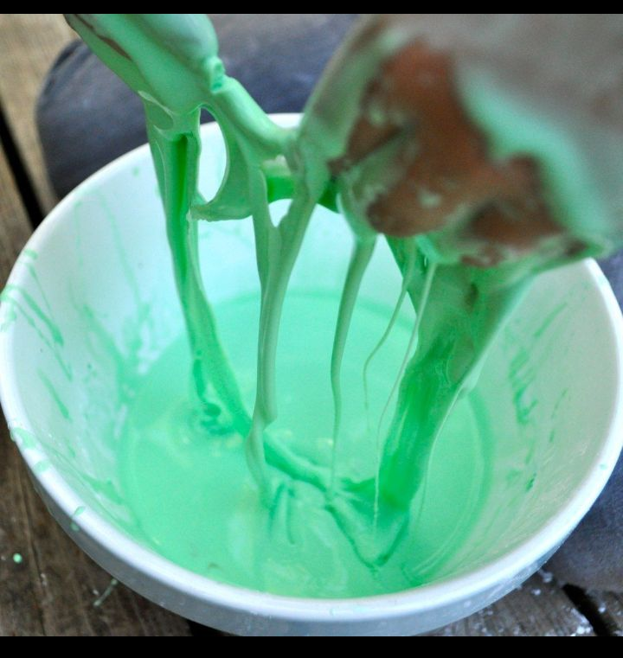
This solidification increase as the sheer rate increased until become paste-like
When the stress is removed, a dilatant system returns to its original state of fluidity.
This behavior is exhibited by dispersions of high solid content e.g. paste & of deflocculated particles.

Slide 25
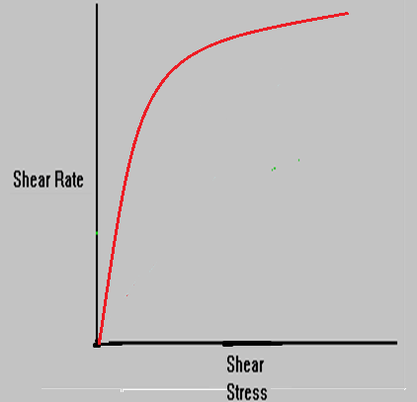
Rheogram of a dilatant system
Opposite to pseudo plastic the rheogram is up curve passing through the origin,
It is expressed by the equation:
n: is index of diletancy
for dilatant flow: n > 1,
The greater the n the greater the diletancy.
The values of n and η are calculated by plotting log D versace log t using the same straight line equation used for pseudo plastic system.

Slide 26
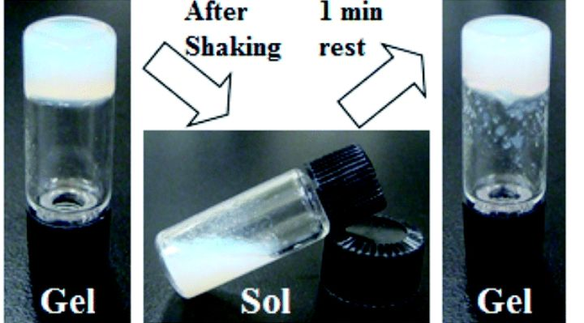
Thixotropy and Rheopexy
This is time dependant type of flow,
Thixotropy means to change by touch,
It is usually referred to as isothermal gel-sol-gel transformation,
Thixotropy occur usually in solutions of polymers having gel life net structure,

Slide 27
When thixotropic system is subjected to shear the viscosity reduced with time &
when the shear stress removed it may not return to its original structure instantly because its gel structure is broken down,
i.e. the particles or macro molecules don’t adapt immediately to shearing,

Slide 28
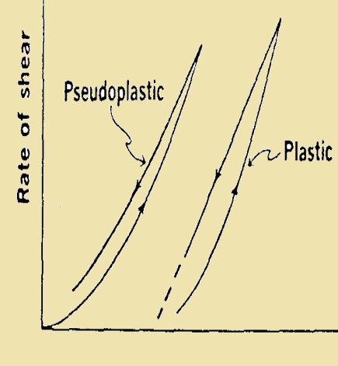
If these materials subjected to increasing shear rate followed immediately by it’s reduction to zero:
A down curve will be displaced with regard to up curve,
The resultant diagram will exhibit a hysteresis loop,

Slide 29
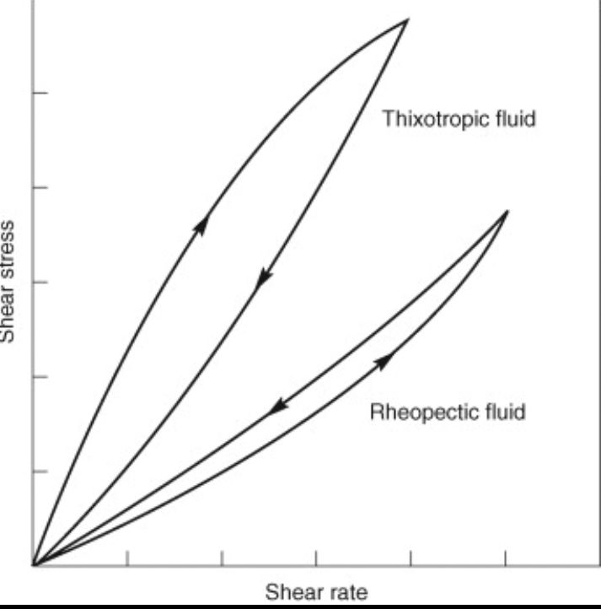
In thixotrobic systems (plastic & pseudo plastic) the down will be to the left of the upper curve,
the reverse is true for dilatant (negative thixortopy or rheopexy)

Slide 30
Factors Influence the Viscosity
Pressure: The viscosity of newtonian and non-newtonian materials increases exponentially with an increase in pressure, however, these changes are extremely small,
Temperature: An increase in temperature is accompanied by a decrease in viscosity, the temperature dependence increases with an increase in viscosity,
Concentration: Increasing the concentration of the system is accompined by increasing its viscosity,
Shear time: just thixotropic and rheopitic materials are affected by sheering time

Slide 31
Measurement of Viscosity

Slide 32
1. Measurement of newtonian systemss

Slide 33
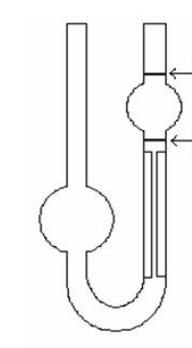
1. Capillary viscometer:
The viscosity of a newtonin liquid may be determined by measuring the time required for the liquid to pass between two marks as it flows by gravity,
a vertical capillary tube, known as a Ostwald U-tube viscometer is used in this method,
A range of apparatus of different pores are used, selected according to the viscosity of the tested liquid

Slide 34
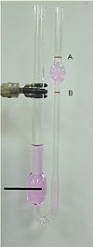
The viscosity is calculated by the equation:
η = ktp
k: constant of any tube
t: time of flow
P: pressure deference arcos the end of the tube
P: depends on density ‘ρ’ & gravitational force ‘g’, As g is constant p = ρ
η = kt ρ

Slide 35
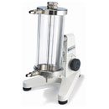
2. Falling sphere Viscometer:
It is a glass or steel ball is down in a vertical glass tube containing the test liquid,
The time needed for the ball to fall between two marks is accurately measured,

Slide 36

This viscometer is based on Stoke's law, which states that:
D: the diameter of the ball,
ρ₁ and ρ₂: the densities of the ball and the liquid respectively
V: the velocity
This low is used to determine sedimentation rate of the sustention.

Slide 37
2. Measurement of non newtonian systems:

Slide 38
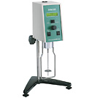
1. Rotational viscometer:
All of non newtonian fluid viscometers read viscosity directly
The sample is tested by rotation using spindles of different sizes

Slide 39
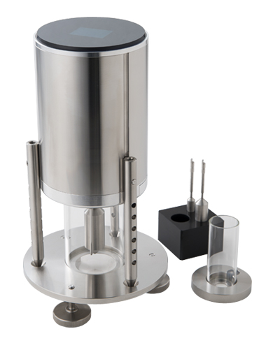
2. Cup and bob viscometer (Concentric cylinder viscometers):
the sample is sheared in the space between the outer wall of a bob and the inner wall of a Cup into which the bob fits .

Slide 40
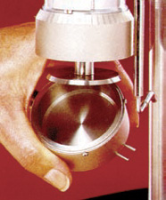
3. Cone and plate viscometer:
The cone is driven by a speed motor and the sample is sheared in the narrow gap between the stationary plate and the rotating cone

Slide 41
الحمد لله الذي علم بالقلم …. علم الانسان ما لم يعلم

