Slide 1
Monte-carlo method
11.03.2021
Ahmed Ismail

Slide 2
Agenda
Introduction
Advantages
Examples
codes
Notes:
Zusammenfassend möchte ich nun noch einmal meine Forschung präsentieren. Einsteigen werde ich mit einer kurzen Übersicht über die verschiedenen Reichweiten von Influencern und Publikumszeitschriften. Danach folgt eine kurze Einführung in den Forschungsgegenstand. Anschließend werde ich die daraus entwickelten Hypothesen erklären, meine Methodik erläutern und schlussendlich meine Ergebnisse vorstellen.

Slide 3
What is simulation
Simulation is the imitation of the operation of real world process or system over time.
To engage Modelling and simulation, first create amodel approximating and event.
The model is then followed by simulation,which allows for the repeated observation of the model.
After one or many simulations of the model, a third step takes place and that is analysis.
Analysis aids in the ability to draw conclusions,verify and validate the research, and make recommendations based on various iterations or simulations of the model.

Slide 4
What is Monte Carlo Simulation?
It is a statistical simulation technique that provides approximate solution to problems expressed mathematically.
It utilize the sequence of random number to perform the simulation.
❖ This techniques can be used in different domain
Complex Integral Computation
Economics Specially in Risk Management
extensively used in financial institutions
to evaluate sensitivities of portfolios to various parameters and to compute risk measurements

Slide 5
Why Monte Carlo Simulation
Simple implementation on computer
Applicable for complex problems that are otherwise intractable
Simulation does not produce an exact answer but in fact is a statistical estimate with error
1000 or more darts should yield a more accurate approximation of the integral than 100 or fewer
The Results can quickly become skewed and completely irrelevant if the games random numbers are not sufficiently random
Probabilistic Results:
Results show not only what could happen ,but how likely each outcome is.
Graphical Results.
it’s easy to create graphs of different outcomes and their chances of occurrence.
This is important for communicating findings to other stake holders.
Sensitivity Analysis.
◦With just afew cases,deterministic analysis makes it difficult to see which variables impact the outcome the most.
◦In Monte Carlo simulation,it’s easy to see which inputs had the biggest effect on bottom-line results.
Oi
+i+
The more passes are set, the longer the simulation takes and more tetrahedra are divided.
From 13 passes desired delta S is reached.

Slide 6
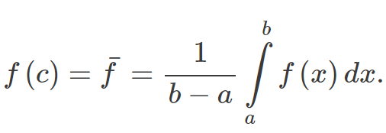
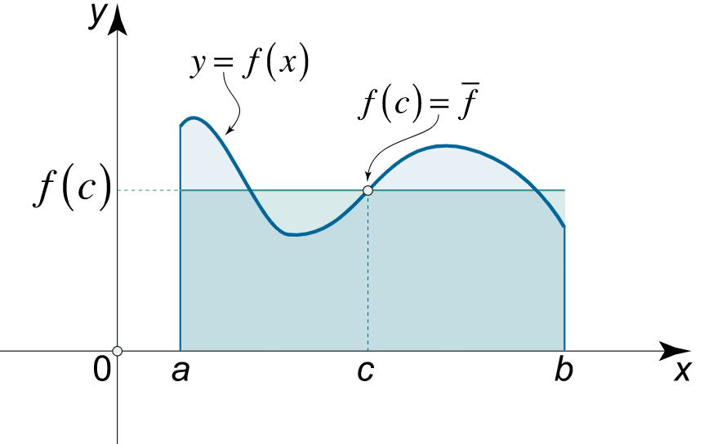
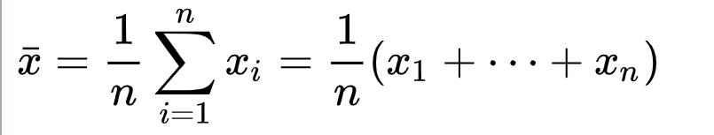
Examples of Monta carlo (Integral)
The integral problem can be expressed in the following equation
Then we can express the bounded equation as a function of mean value which can be taken randomly under definded period .

Slide 7
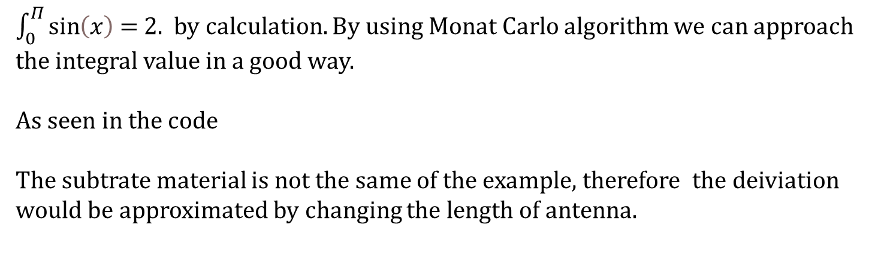
Integral caluclation by using Monta Carlo
$\int_{0}^{Π}{\sin\left(x\right)}$ = 2. by calculation. By using Monat Carlo algorithm we can approach the integral value in a good way.
As seen in the code
The subtrate material is not the same of the example, therefore the deiviation would be approximated by changing the length of antenna.

Slide 8

Patch antenna
The frequency of operation of the patch antenna is determined by the length L. The center frequency will be approximately given by:
The subtrate material is not the same of the example, therefore the deiviation would be approximated by changing the length of antenna.
$$f_{c}=\frac{C}{2L\sqrt{ε_{r}}}$$
Reference: http://www.antenna-theory.com/antennas/patches/antenna.php

Slide 9
Patch antenna
The frequency of operation of the patch antenna is determined by the length L. The center frequency will be approximately given by:
The subtrate material is not the same of the example, therefore the deiviation would be approximated by changing the length of antenna.
$$f_{c}=\frac{C}{2L\sqrt{ε_{r}}}$$
Reference: http://www.antenna-theory.com/antennas/patches/antenna.php

Slide 10
Patch antenna
The frequency of operation of the patch antenna is determined by the length L. The center frequency will be approximately given by:
The subtrate material is not the same of the example, therefore the deiviation would be approximated by changing the length of antenna.
$$f_{c}=\frac{C}{2L\sqrt{ε_{r}}}$$
Reference: http://www.antenna-theory.com/antennas/patches/antenna.php

Slide 11
Patch antenna
The frequency of operation of the patch antenna is determined by the length L. The center frequency will be approximately given by:
The subtrate material is not the same of the example, therefore the deiviation would be approximated by changing the length of antenna.
$$f_{c}=\frac{C}{2L\sqrt{ε_{r}}}$$
Reference: http://www.antenna-theory.com/antennas/patches/antenna.php

Slide 12
Patch antenna
The frequency of operation of the patch antenna is determined by the length L. The center frequency will be approximately given by:
The subtrate material is not the same of the example, therefore the deiviation would be approximated by changing the length of antenna.
$$f_{c}=\frac{C}{2L\sqrt{ε_{r}}}$$
Reference: http://www.antenna-theory.com/antennas/patches/antenna.php

Slide 13
Patch antenna
The frequency of operation of the patch antenna is determined by the length L. The center frequency will be approximately given by:
The subtrate material is not the same of the example, therefore the deiviation would be approximated by changing the length of antenna.
$$f_{c}=\frac{C}{2L\sqrt{ε_{r}}}$$
Reference: http://www.antenna-theory.com/antennas/patches/antenna.php

Slide 14
Patch antenna
The frequency of operation of the patch antenna is determined by the length L. The center frequency will be approximately given by:
The subtrate material is not the same of the example, therefore the deiviation would be approximated by changing the length of antenna.
$$f_{c}=\frac{C}{2L\sqrt{ε_{r}}}$$
Reference: http://www.antenna-theory.com/antennas/patches/antenna.php

