Slide 1

Face Detection, Deblurring
& Frontalization
A Quality-Aware Generative Pipeline for CCTV Surveillance
Ahmed Adnan (230089) | Ayush Yadav (230273) | Shreyansh Singh (230989)
Snehasish Haldar (231013) | Suyash Kumar (231067)
EE655 Group Project

Slide 2



Problem Statement
INPUT
OUTPUT
Raw CCTV surveillance video
Faces in non-frontal poses (side-view, angled)
Motion blur from camera shake or subject movement
Occlusions: glasses, masks, hair
Poor illumination & low resolution crops
High-quality frontal face image
Sharp, well-lit face crop selected from video
Geometrically aligned — face looking forward
Suitable for downstream tasks: recognition, verification
Constraints: Real-time inference limits, no multi-frame identity tracking, API latency for generative model

Slide 3

Literature Review
Geometric Frontalization
BASELINE
GAN-Based Frontalization
PRIOR GAN
Dougsouza (2015)
Opetrova et al. (HuggingFace)
Used facial landmark detection + geometric warp
Symmetric assumption — mirrored half onto other
Fails under heavy occlusion or large pose deviation
No quality awareness or frame selection
Generative model produces frontal face
Sensitive to blurry/low-quality inputs
No pre-filtering of input quality
YOLOv8 Detection
OUR TOOL
Qwen Image Edit
OUR TOOL
Ultralytics (2023)
Qwen Team (2024)
One-stage anchor-free detector
State-of-the-art speed/accuracy tradeoff
Adaptable to custom datasets
Used in both detection AND blur estimation
Instruction-guided diffusion model
Prompt-conditioned image editing
Preserves identity & style
API-accessible — no local GPU needed
Our Novelty: Quality-aware frame selection BEFORE generative frontalization — existing methods skip this critical step

Slide 4




Proposed Method: Pipeline Overview
1
2
3
4
5
CCTV
Video
Face
Detection
Quality
Scoring
Best Frame
Selection
Qwen
Frontalization
Raw input
video stream
YOLOv8n per
frame
Sharpness +
Brightness + Size
Highest scored
face crop
Prompt-guided
image edit
Key Insight
Generative models are highly sensitive to input quality. By inserting a quality-aware frame selection stage before frontalization, our pipeline produces significantly more consistent and realistic outputs compared to naive direct application.

Slide 5
Proposed Method: Step-by-Step Details
Step 1 & 2: Frame Extraction + Face Detection
Why YOLOv8n?
Each frame of the video is processed individually. YOLOv8n (nano) is chosen for its speed-accuracy tradeoff — lightweight enough for real-time inference on video while maintaining reliable detection. For each frame, bounding boxes of all detected faces are extracted. The largest face (by area) is selected to prioritize near-camera subjects.
Step 3: Quality Scoring
Why a composite score?
Three metrics are combined: (1) Sharpness — a trained YOLOv8 blur-detection model outputs a blur probability; sharpness = 1 − blur. (2) Brightness — mean V-channel in HSV, normalized to [0,1]. (3) Size — bounding box area ÷ total frame area. Weights: 0.6 × sharpness + 0.15 × brightness + 0.25 × size. Sharpness is weighted highest as blurry inputs cause generative artifacts.
Step 4 & 5: Selection + Frontalization
Why Qwen via API?
The frame with the maximum composite score is selected. Local deployment of a large diffusion model is computationally prohibitive; API inference via Hugging Face is practical. Prompt: "Frontalize this face, make it directly face forward, don't change the style of image, don't hallucinate" — explicit instruction prevents hallucination and style drift.

Slide 6

Experiments: Datasets & Implementation
Datasets Used
Implementation Details
Face Detection Dataset
Platform
Kaggle Notebooks with GPU acceleration
Source: Kaggle (fareselmenshawii)
Training YOLOv8n face detector. Large-scale annotated face bounding boxes.
GPU
2 × NVIDIA T4 (16 GB RAM)
Framework
PyTorch + Ultralytics YOLOv8
Blur-Deblur Dataset
Source: Custom (Suyash Kumar / Kaggle)
Face Model
YOLOv8n, fine-tuned on face dataset
Synthetically generated by applying motion blur to sharp face images. Enables supervised blur classification.
Blur Model
YOLOv8 classification, custom synthetic dataset
CCTV Video
Frontalization
Qwen Image Edit via Hugging Face API
Source: Project-recorded
Weights
Sharpness 0.6 / Brightness 0.15 / Size 0.25
Real-world surveillance video (MP4, 20241004_120449) serving as the primary pipeline input.

Slide 7
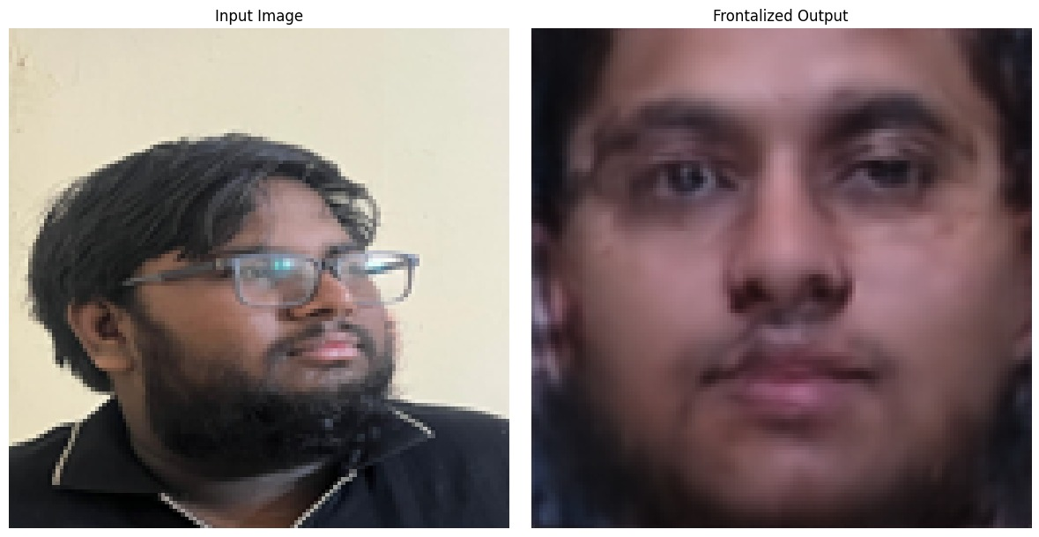
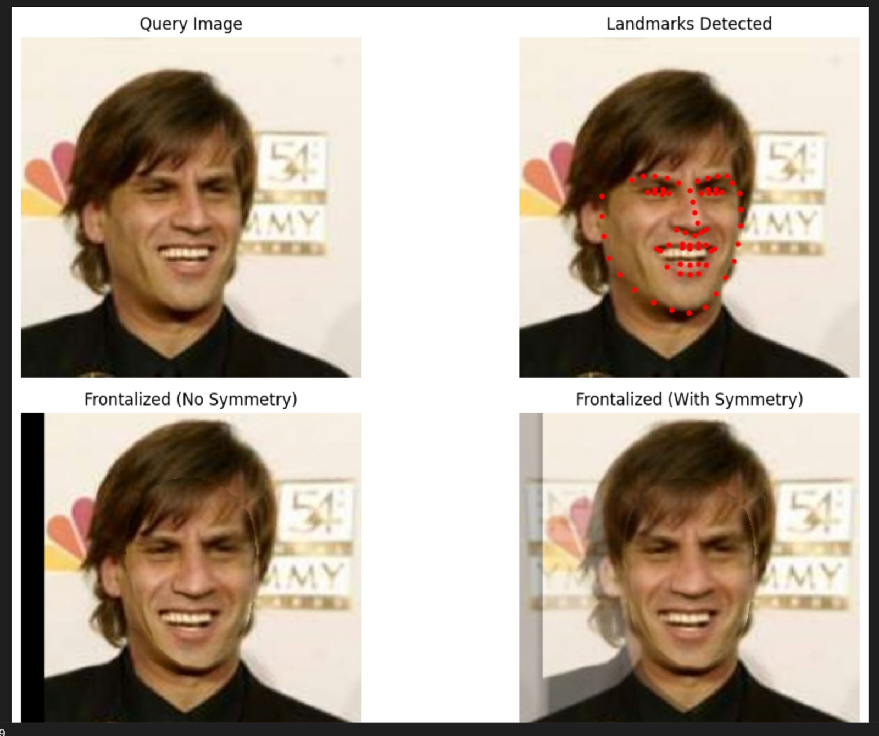
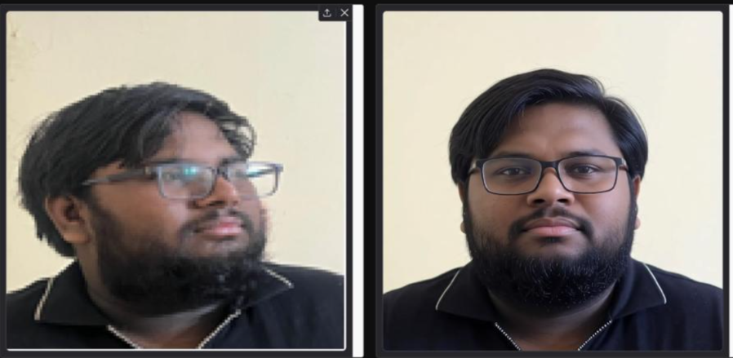
Experiments: Results & Comparison
Qualitative Comparison
Method | Robustness | Visual Quality | Input Quality Awareness
Geometric Baseline | Low | Low | None
GAN Model | Low | Low | None
Proposed (Ours) | High | High | Quality-Aware
[ INSERT RESULT IMAGE ]
GAN-based Model Output
(Figure 2a from paper)
[ INSERT RESULT IMAGE ]
Baseline Model Output
(Figure 2b from paper)
[ INSERT RESULT IMAGE ]
Proposed Model Output
(Figure 2c from paper)
GAN Model
Geometric Baseline
Proposed (Ours)

Slide 8
Observations & Limitations
Key Observations
Limitations
Multi-stage pipeline significantly improves robustness over single-stage models
Quality-based frame selection plays a critical role in enhancing final output
Proposed model performs well under moderate distortions (blur, pose variation)
Larger & clearer face regions yield better reconstruction performance
Generative models heavily dependent on input quality — pre-filtering is essential
Identity Drift
Generative model may deviate from true identity under extreme pose or poor input
Texture Smoothing
Reconstructed regions may lack fine details (skin texture) — slight over-smoothing
Occlusion Handling
Glasses, masks, hair introduce artifacts or inconsistencies in generated output
API Latency
Real-time deployment constrained by API call overhead for the generative model
Failure Cases
Extreme occlusion and severely degraded low-resolution inputs cause failure

Slide 9


Conclusion & Future Work
Conclusion
We presented an end-to-end pipeline integrating face detection (YOLOv8n), quality-aware frame selection, and generative frontalization (Qwen Image Edit). A key finding is that input quality critically determines generative model output quality — pre-filtering frames via a composite sharpness/brightness/size score significantly improves perceptual realism and structural consistency over baseline approaches.
Future Work
Temporal Tracking
Multi-Frame Fusion
Model Distillation
CCTV-Specific Training
Identity-consistent selection across frames; robust multi-person scenarios
Combine multiple good frames to improve reconstruction quality
Compress generative model for local deployment & real-time edge inference
Detection models fine-tuned on low-res, motion-blurred surveillance data

