Slide 1
NIROB / TOPIC A · VERSION 3.3
Your goal. Your final approval.
Nirob
An earned-autonomy wallet
and financial advisor
Conversational planning with a user-approved demo ledger
Five full-time MIST students · Bangladesh
Team and registration details are user-reported.
Synthetic accounts · Local AI · Your final approval
01
Notes:
35 seconds. Version 3.3, updated 20 October 2026. Introduce local model inference, synthetic accounts and final user approval. MIST is the team institution, not a fixed user workspace label. Formal team name/roster and documents remain to be supplied. Proposed Topic A mapping is ours, not organizer approval. Source: https://www.its.ac.id/international/wp-content/uploads/sites/66/2026/10/PBCSF-Appendix-2-Problem-Description-and-Competition-Rules-for-International-Track.pdf

Slide 2
NIROB / TOPIC A · VERSION 3.3
A goal, a checked draft, a recorded result
Understand & prepare
Chat about spending or income ideas; permitted tools prepare payment drafts.
Review & authorize
Inspect the exact transaction and verify a fresh passkey for every payment.
Record & review
The demo ledger records spending; reviewed drafts can earn preparation autonomy.
Synthetic accounts · Local AI · Your final approval
02
Notes:
40 seconds. Explain that chat gives contextual advice; the payment route validates explicit intent before tool use. The model does not receive an execution tool. Errors stop the bounded agent; autonomous replanning is not implemented. Source: agent.mjs, chat.mjs, server.mjs.

Slide 3
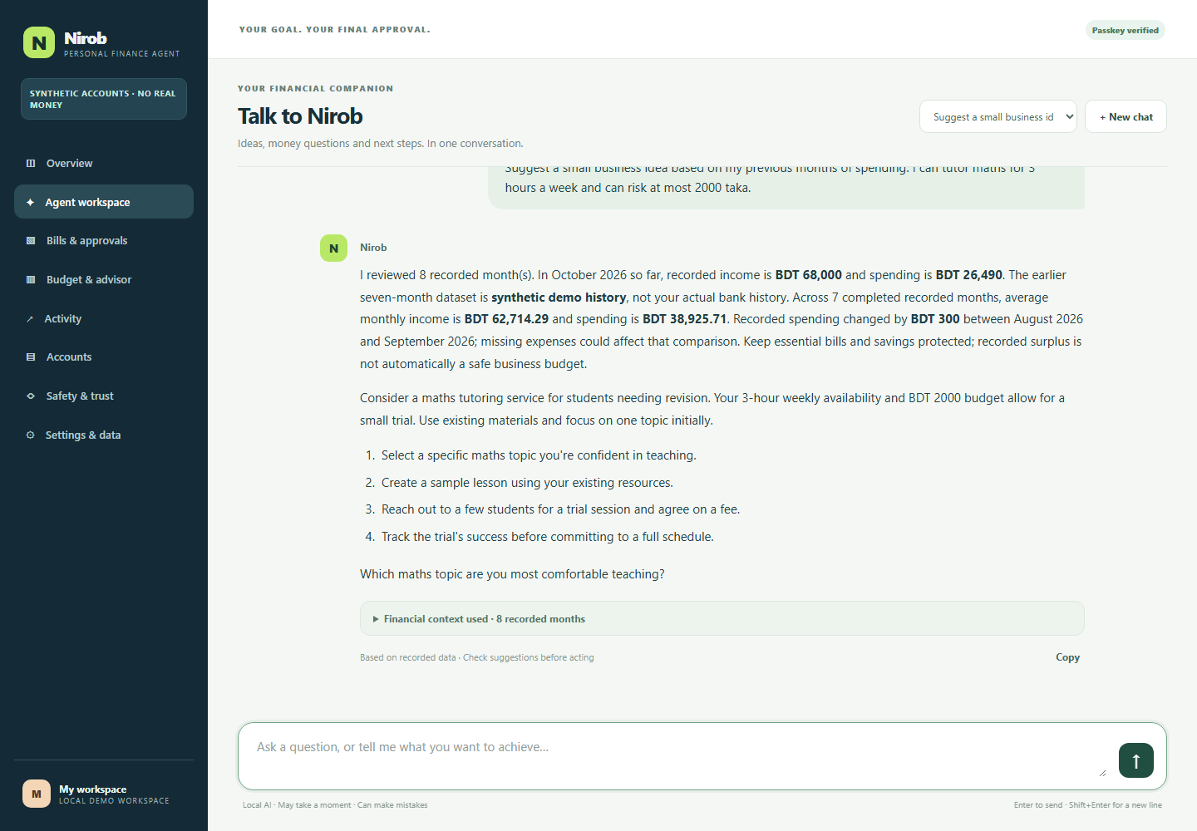
NIROB / TOPIC A · VERSION 3.3
A conversational financial workspace
Local Qwen3-4B
Ask a question, then follow up.
No cloud model API key.
Recorded context
Seven completed demo months
plus the current month so far.
Visible assumptions
Expand the financial context.
Check the suggested next steps.
Synthetic accounts · Local AI · Your final approval
03
Notes:
55 seconds. Show actual v3.3 chat screenshot captured for this update. Discuss conditional maths-tutoring idea, 3-hour weekly limit and BDT 2,000 ceiling. The model can make mistakes; recommendations have not been validated by finance experts or representative users. Coaching uses eight in-context examples; weights were not fine-tuned. Source: chat.mjs, coaching.mjs, chat-model-manifest.json, work/media-v33/chat-evidence.json.

Slide 4
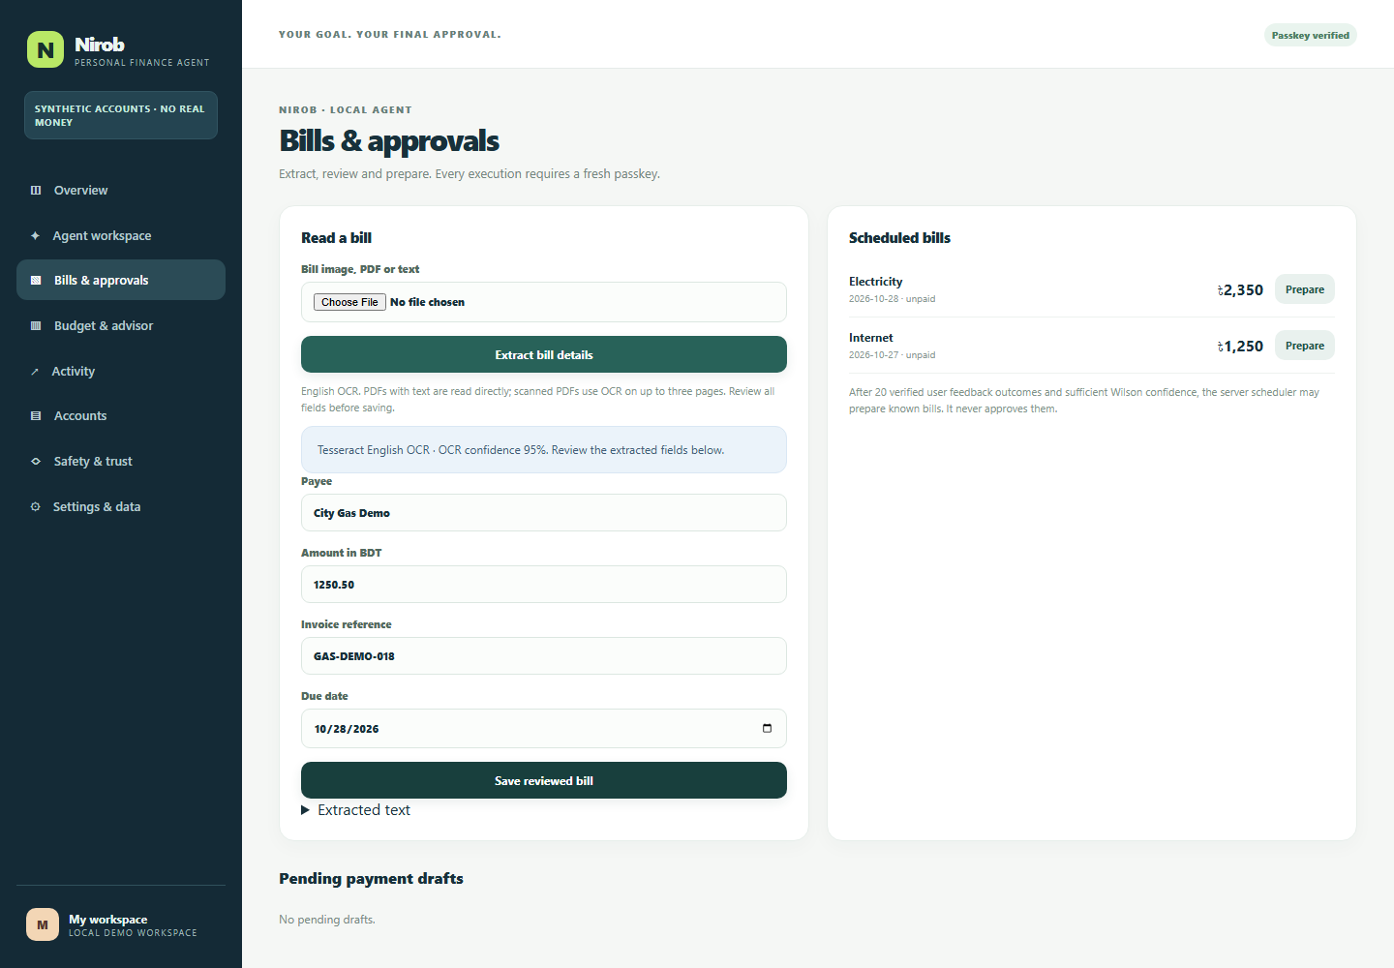
NIROB / TOPIC A · VERSION 3.3
Budget suggestions and reviewed bill extraction
Plan recorded cash flow
Income, expenses, unpaid
bills and a savings goal.
Check the shortfall
Missing commitments or cash
purchases change the result.
Read and review a bill
English image/PDF extraction;
check every field before saving.
Synthetic accounts · Local AI · Your final approval
04
Notes:
45 seconds. Current UI uses a clean included synthetic bill. OCR supports image/PDF paths; this recording uses an image. Handwritten/Bengali/noisy-bill performance is unvalidated. Budget arithmetic is deterministic and advice is conditional. Source: domain.mjs, ocr.mjs, evidence/ocr-evaluation.json.

Slide 5
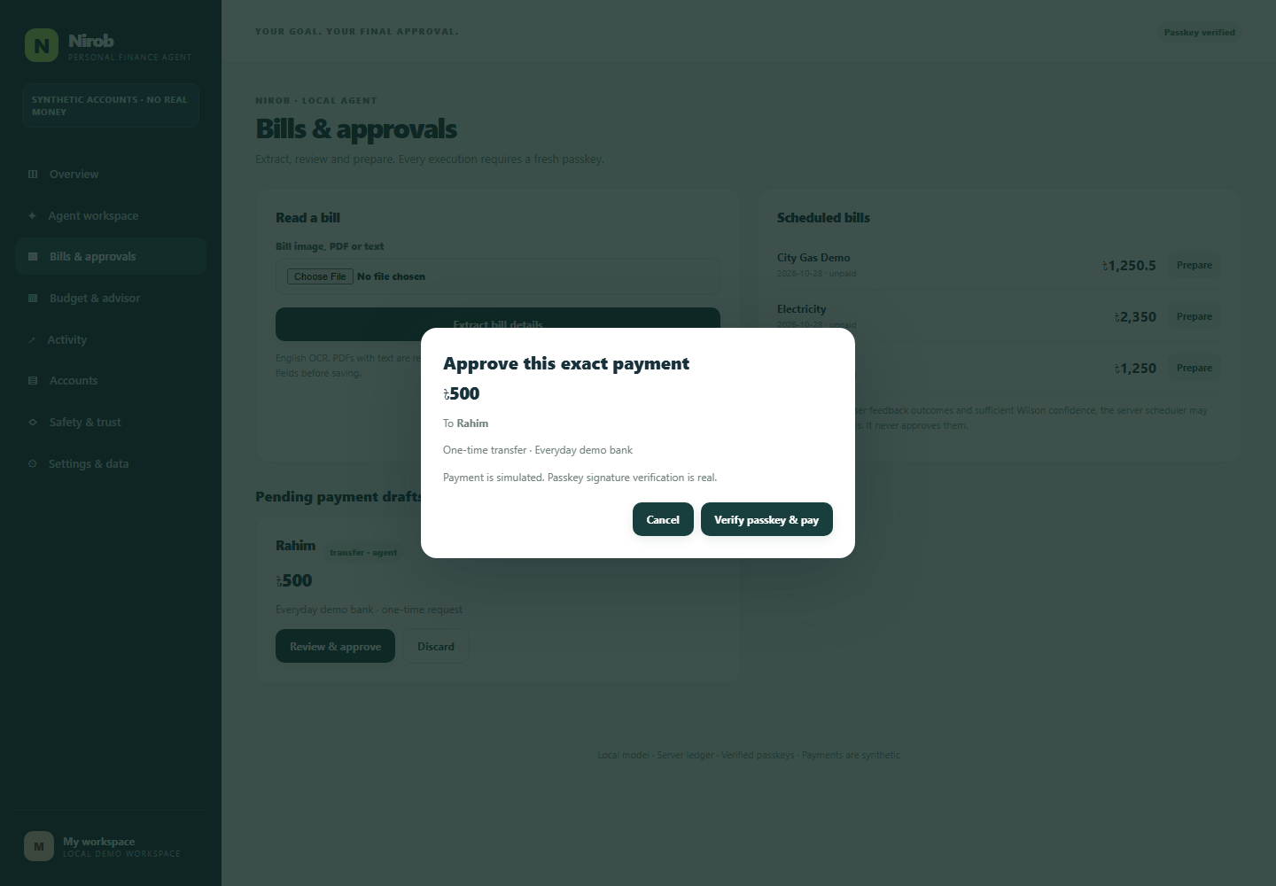
NIROB / TOPIC A · VERSION 3.3
The user approves every final payment
Fresh passkey approval
Signature, origin and user
verification checked by server.
Exact transaction binding
Single-use challenge, expiry,
transaction digest and Guardian.
Demonstrated boundary
Virtual passkey in the video.
No live bank or biometric storage.
Synthetic accounts · Local AI · Your final approval
05
Notes:
55 seconds. The video executes a synthetic BDT 500 transfer after signed approval in an isolated workspace. Windows may use fingerprint, face or device PIN. No fingerprint-only claim. Flagged approvals require two distinct credentials, not proof of separate physical devices. HMAC audit can detect changes but the machine owner can replace database and key. Source: server.mjs, SECURITY.md. Physical fingerprint hardware was not tested.

Slide 6
NIROB / TOPIC A · VERSION 3.3
Trust expands preparation and scheduling
Review actual drafts
Correct, incorrect and unsafe feedback are separate from payment approval.
Scope-specific thresholds
Bills and transfers: 20 / 40 / 80 reviews plus 80% / 90% / 95% Wilson bounds.
Keep the approval boundary
Bill tier 1 enables eligible draft scheduling. Every payment still needs a passkey.
Synthetic accounts · Local AI · Your final approval
06
Notes:
55 seconds. Both count and bound must pass. Bill and transfer trust are separate. Unsafe feedback locks the scope at level zero. Tiers two and three currently add evidence but no additional execution power. Synthetic benchmark cases never impersonate user feedback. Source: TRAINING_AND_TRUST.md, trust-progress.mjs, domain.mjs.

Slide 7
NIROB / TOPIC A · VERSION 3.3
Measured results and disclosed limits
76 / 76
Automated unit, domain, storage and HTTP tests
8 / 8
Signed reset/import integration checks
100 / 100
Development scenarios after fixes; initial run 90/100
96.30%
Aggregate Wilson lower bound; benchmark requires 95%
80 + 20
Model-invoked cases + pre-inference checks
Related development cases, not independent production-reliability evidence.
Synthetic accounts · Local AI · Your final approval
07
Notes:
65 seconds. Initial run had five bill wording failures and five invented-recipient failures. Fixes were tested on the same 100-case development set. Eighty cases invoked the real local model; ten ambiguity and ten policy checks stopped before inference. Smaller groups have lower bounds: transfers91.24%, bills83.89%, analysis83.89%, ambiguity72.25%, policy72.25%. Aggregate95% does not establish each scope95%. Personal trust unchanged. Sources: evidence/automated-review-100*.json, workspace-tests.txt, workspace-data-http.json.

Slide 8
NIROB / TOPIC A · VERSION 3.3
Each installation can have its own workspace
Choose a name
Settings & data replaces the fixed university label with a user-selected name.
Use your own demo records
Add dated entries manually, or preview a JSON dataset before replacement.
Clear records or reset everything
Typed confirmation and fresh passkey; personal trust resets with the records.
Synthetic accounts · Local AI · Your final approval
08
Notes:
50 seconds. Clear keeps profile and enrollment; full reset removes both. Import keeps profile/passkeys but replaces financial/chat/trust/audit records. Approval is bound to the previewed dataset. External exports/backups and authenticator-held credentials remain. No forensic wipe claim. Source: PERSONAL_WORKSPACE.md and workspace-data.mjs.

Slide 9
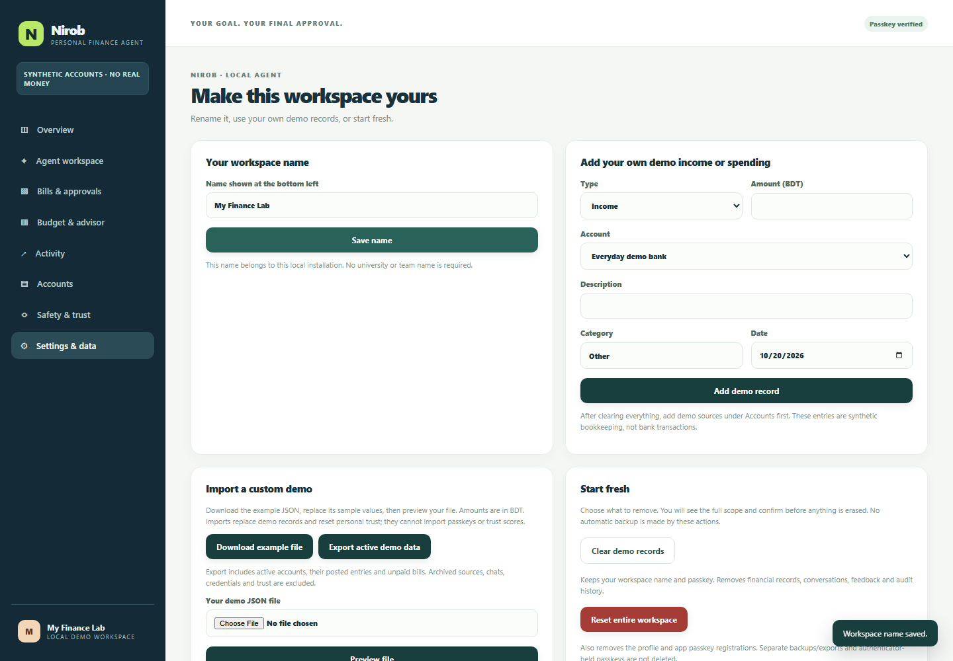
NIROB / TOPIC A · VERSION 3.3
Renaming and replacing data in the app
A personal label
My workspace → your own name
Saved on this installation
An explicit replacement
Preview counts and totals.
Confirm the file, then approve.
Unlock after replacement.
Synthetic accounts · Local AI · Your final approval
09
Notes:
35 seconds. Actual v3.3 Settings screen. The walkthrough demonstrates a custom import and both reset modes in an isolated recording database, without changing the user workspace. Synthetic-data labels remain. Source: work/media-v33/capture.json.

Slide 10
NIROB / TOPIC A · VERSION 3.3
Local architecture and authorization
Conversation and permitted tools
Browser chat → local model and bounded planner → deterministic financial tools
Approval and ledger
Draft → Guardian → transaction-bound passkey verification → SQLite posting
Evidence and data controls
HMAC audit, separate personal trust, measured benchmark, bound import/reset approval
Synthetic accounts · Local AI · Your final approval
10
Notes:
45 seconds. Node server on localhost4177, local model on8088 in normal use. Recording uses isolated4193/8089. Execution stays server-side. Audit is not externally immutable. Production requires identity/recovery, authorized provider integrations and independent security review. Sources: ARCHITECTURE.md, SECURITY.md.

Slide 11
NIROB / TOPIC A · VERSION 3.3
Known limits and the next evaluation
No live banking connection
Account numbers do not connect a bank or intercept a Visa payment.
Advice still needs human judgment
No expert usefulness study, market-demand validation or income guarantee.
Next checks
Physical-device trials, diverse bills, held-out tasks and representative user feedback.
Synthetic accounts · Local AI · Your final approval
11
Notes:
40 seconds. No new model weight training. Longer chats use bounded context. This is a local single-user prototype, not a production bank app. Live PSP or bank access would require provider authorization and an approved integration. Hardware matrix, recovery, concurrency at production scale and noisy OCR remain unvalidated.

Slide 12
NIROB / TOPIC A · VERSION 3.3
Topic A package and submission checks
Proposed fit: personal finance assistant
Budgeting, bill analysis, spending insights and advice based on recorded finances.
Evidence package
Updated deck, execution demo, walkthrough, source and disclosed test records.
Team actions still needed
Repository URL, formal roster/proofs, physical-device review and official upload.
Synthetic accounts · Local AI · Your final approval
12
Notes:
45 seconds. Rules rechecked20October2026: presentation≤10min, optional demo≤5min; non-on-chain evidence accepts simulated/sandbox operation logs and video. Proposed Topic A mapping, not organizer confirmation. Topic F real on-chain hash requirement is not met; Topic C needs genuine cross-border/student-finance focus. User reports five full-time MIST students in Bangladesh, all non-Chinese, registration complete; documents not inspected and formal team name missing. Published deadline20October2026 23:59Beijing=21:59Dhaka; check organizer updates. Source: https://www.its.ac.id/international/wp-content/uploads/sites/66/2026/10/PBCSF-Appendix-2-Problem-Description-and-Competition-Rules-for-International-Track.pdf

