Slide 1


Slide 2

Meeting Chairperson

Slide 3

Black Box

Slide 4
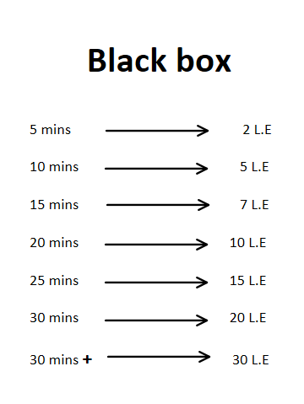

Slide 5


