Slide 1
Vertical Axis Wind Turbine
Darrieus Type

Slide 2
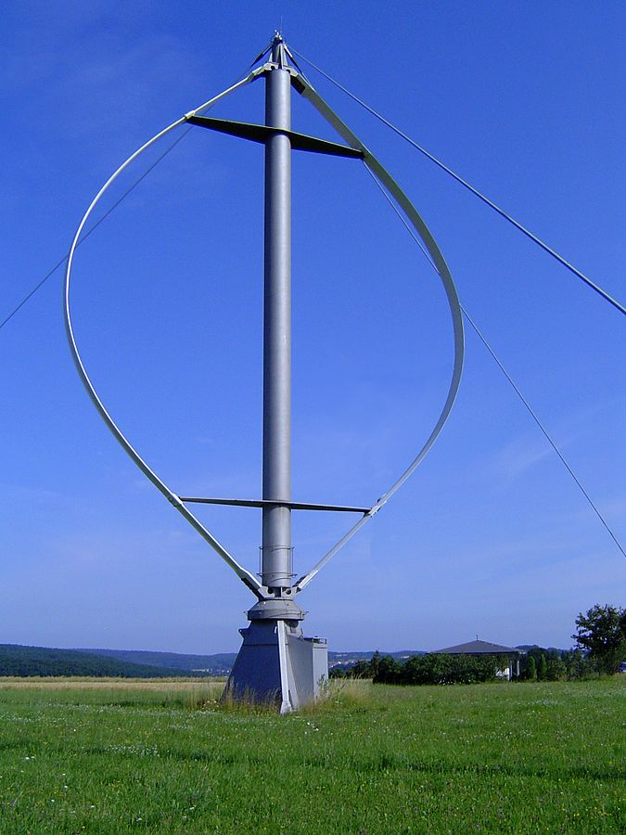
Introduction
The Darrieus wind turbine is a type of vertical axis wind turbine.
(VAWT) used to generate electricity from the energy carried in the wind.
The turbine consists of a number of curved aerofoil blades , mounted on a vertical rotating shaft or framework.
This design of wind turbine was patented by Georges Jean Marie Darrieus.

Slide 3
Advantage of VAWT
VAWT is Omni-Directionality which allow VAWT to operate using wind incident from any direction and therefore does require yaw control system.
VAWT gearbox and generator can be placed at ground level making maintenance easier.
VAWT can be placed close together in a wind farm.
VAWT operates in urban areas where the wind in urban area is very turbulent and unstable with fast change in direction and velocity.

Slide 4
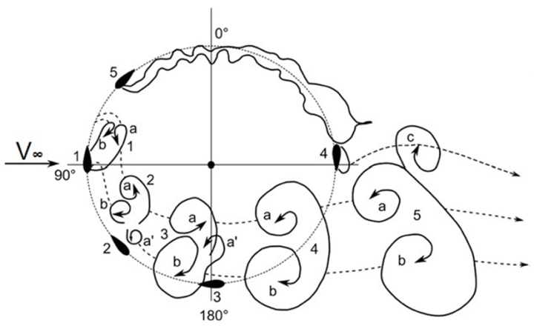
Disadvantage of VAWT
VAWT have poor efficiency, especially compared to HAWT’s.
VAWT is difficult to self start.
VAWT generates eddies and wake region.
VAWT need to be improved to be used
in large scale.
VAWT is more complex blade design.

Slide 5
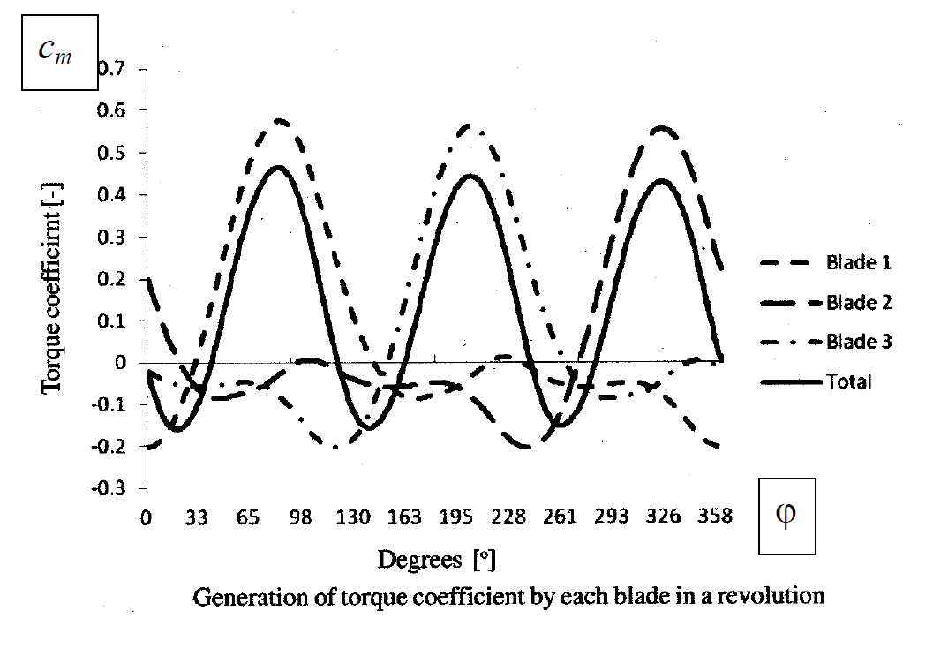
The main problem with the design of Darrius Type is that the angle of attack changes as the turbine spin. So the magnitude of the torque generated will varies which leads to flactuating

Slide 6
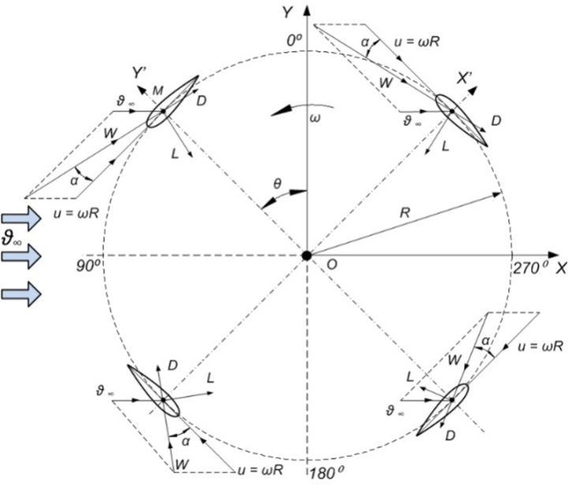

Slide 7
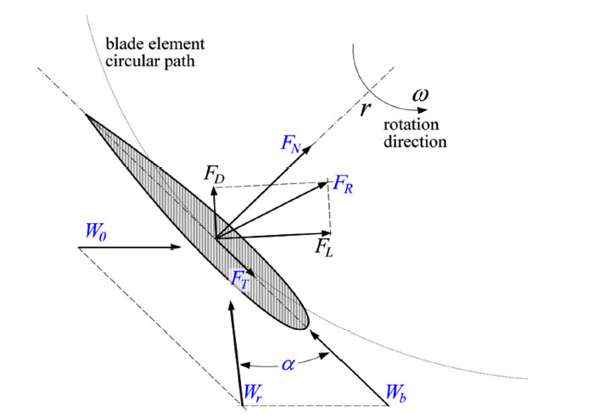

Slide 8
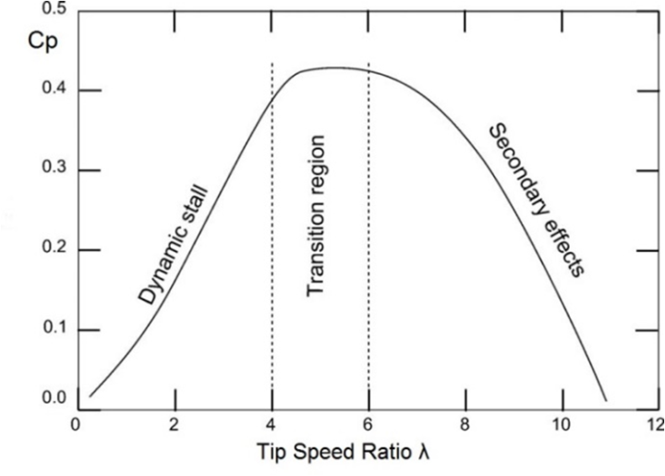

Slide 9
Darrieus Type Features
Darrieus operates because of lift forces.
Darrieus reaches important rotational speed at clearly less torque.
The low torque is actually not bad because it allows less wear and tear on the components of the turbine.
Darrieus cannot start on its own.
Most authors specify values of 0.4 to 0.42 for the maximum Cp.

Slide 10
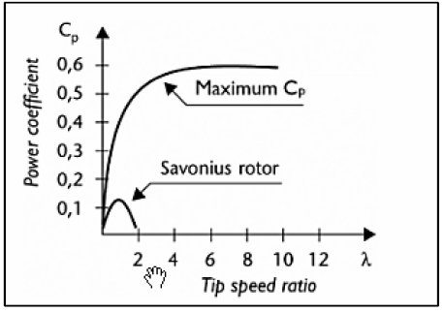
Savonius Type Features
Savonius works under drag forces.
Savonius produces an important torque and low speed.
Savonius is able to self-start if it has three or more blades.

Slide 11
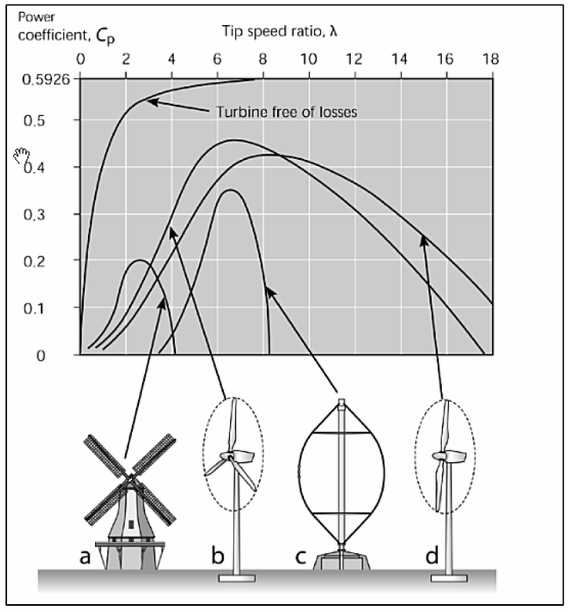

Slide 12
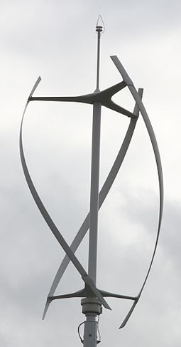
Gorlov Helical Type
The blades of a Darrieus turbine can be canted into a helix, three blades and a helical twist of 60 degrees.
Since the wind pulls each blade around on both the windward and leeward sides of the turbine, this feature spreads the torque evenly over the entire revolution, thus preventing destructive pulsations.

