Slide 1
Wind turbine
Selection of Generators

Slide 2
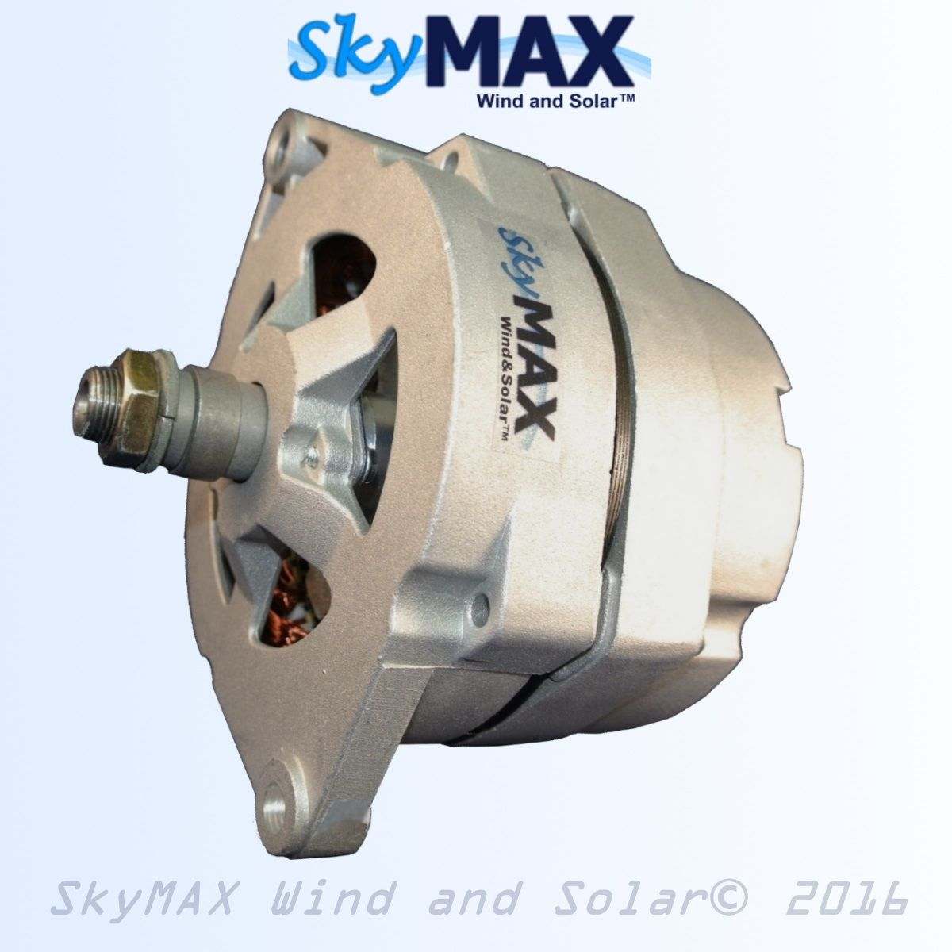
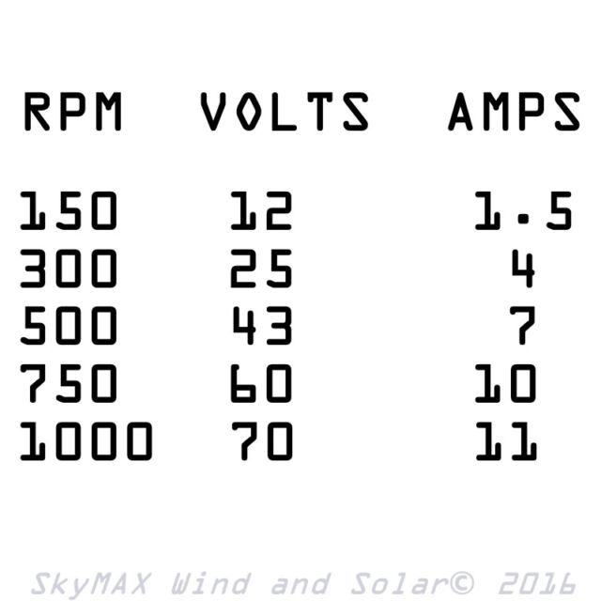
Small Scale Generators
1) Basic Permanent Magnet Alternator (US $119.58)
Features:
Uses Rare Earth Neodymium Magnets.
Hand Wound Stator Coils.
Ideal for low wind start-up.
Reaches over 12V BELOW 150RPM.

Slide 3
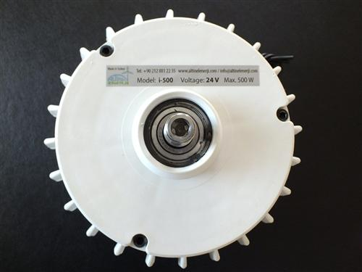
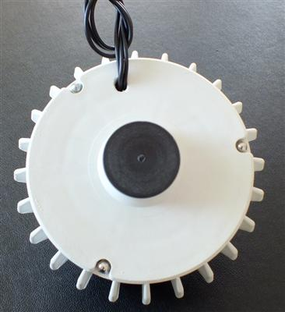
2) ISTA BREEZE Wind Generator (US $225.14)
Features:
Uses Rare Earth Neodymium Magnets.
Uses overspeed control “Electromagnetic brake with controller“.
Rated Voltage 24V.
Rated Power 400W.
Weight 2kg.
Made in Germany.

Slide 4
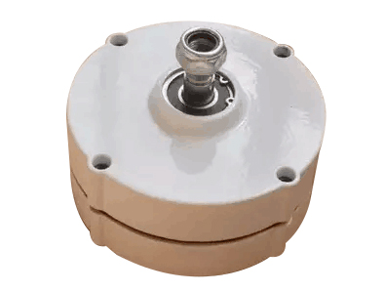
3) NdFeB Permanent Magnet Generator/Aluminum shell (US $234.59)
Features:
Uses Rare Earth Neodymium Magnets.
Rated Voltage 12V
Rated Power 100W
2.0m/s Low Speed Start
Made in China

Slide 5
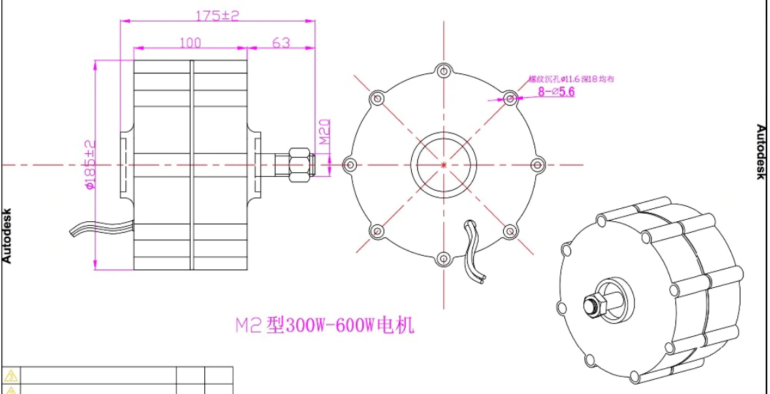

Slide 6
