Slide 1
Wind Turbine Gearbox

Slide 2
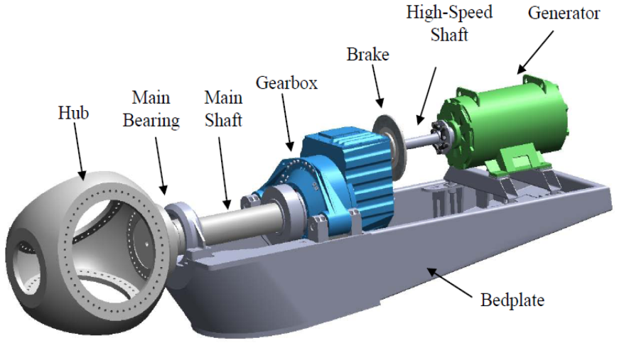
Gearbox
Gearboxes in wind power transform slow speed, high torque wind turbine rotation to higher speed required by the generator, which converts the mechanical power to electricity.

Slide 3
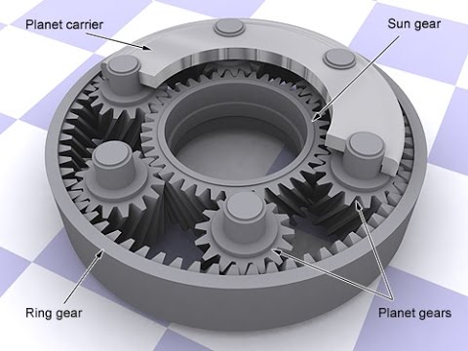
Gearbox Components
Gearbox used in a wind turbine is a planetary type, which has 3 main components:
The sun gear (central gear)
The planet gears and the planet gears' carrier
The ring gear

Slide 4
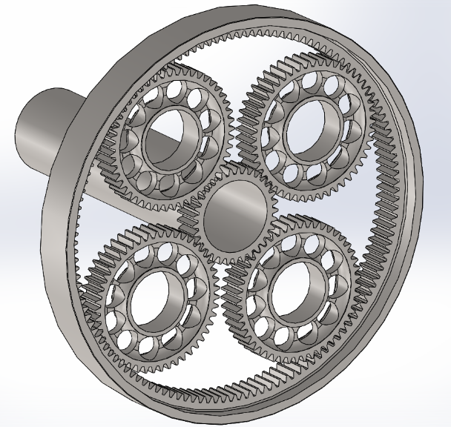
Gear Ratio Calculations
R: Number of teeth in ring gear
S: Number of teeth in sun (middle) gear
P: Number of teeth in planet gears
Constraints:
All teeth have the same pitch or tooth spacing (to ensure the teeth would mesh)
R = 2 × P + S

Slide 5
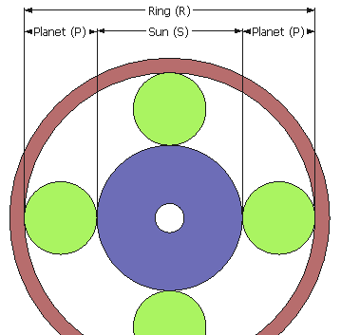
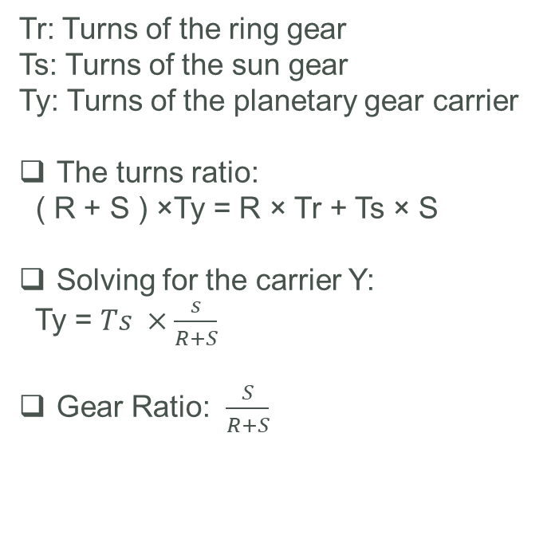
Gear Ratio Calculations
Tr: Turns of the ring gear
Ts: Turns of the sun gear
Ty: Turns of the planetary gear carrier
The turns ratio:
( R + S ) ×Ty = R × Tr + Ts × S
Solving for the carrier Y:
Ty = $Ts ×\frac{s}{R+S}$
Gear Ratio: $\frac{S}{R+S}$

Slide 6
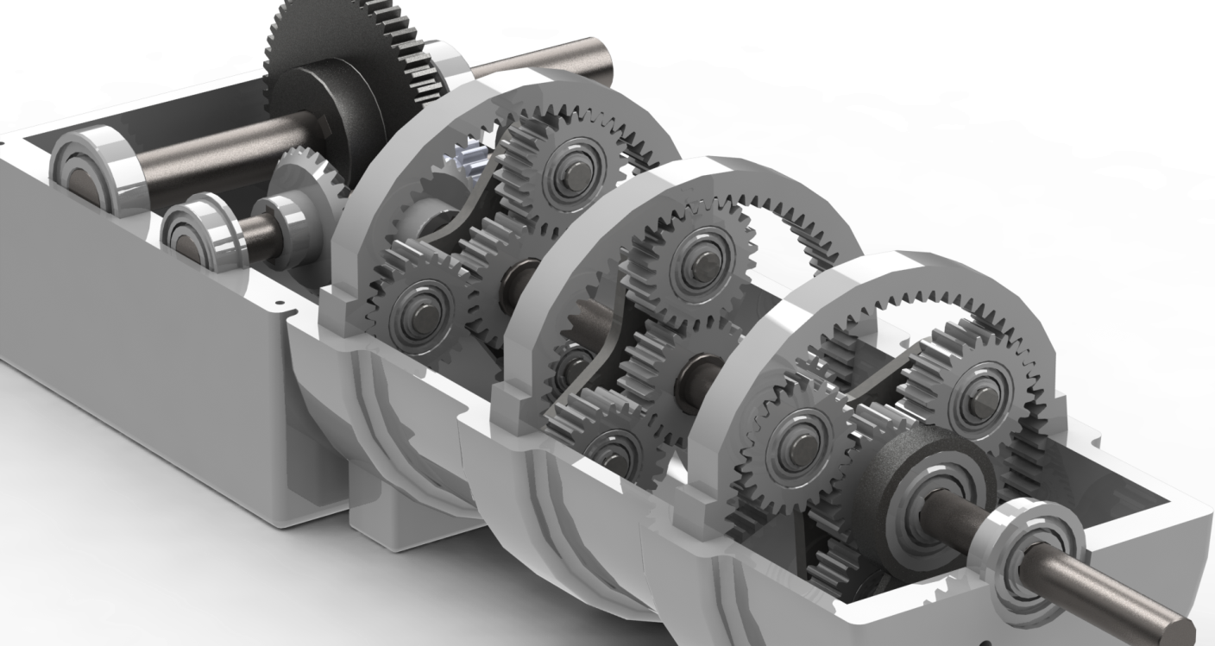
Planetary Gear Suppliers
The two major gearbox suppliers are German Winergy, which has about 50% of the world market, and Hansen of Belgium, with approximately 30% of the market.

