Slide 1
Giromill

Slide 2
Advantages :
The H-rotor can be placed on a higher tower and is normally not as close to the ground like a Darrieus turbine.
The H-rotor has better aerodynamic performance than the Darrieus rotor
the H-rotor has a simpler construction due to the straight blades, which makes it cheaper and easier to manufacture.

Slide 3
Disadvantages :
Large bending moments on the blades .

Slide 4
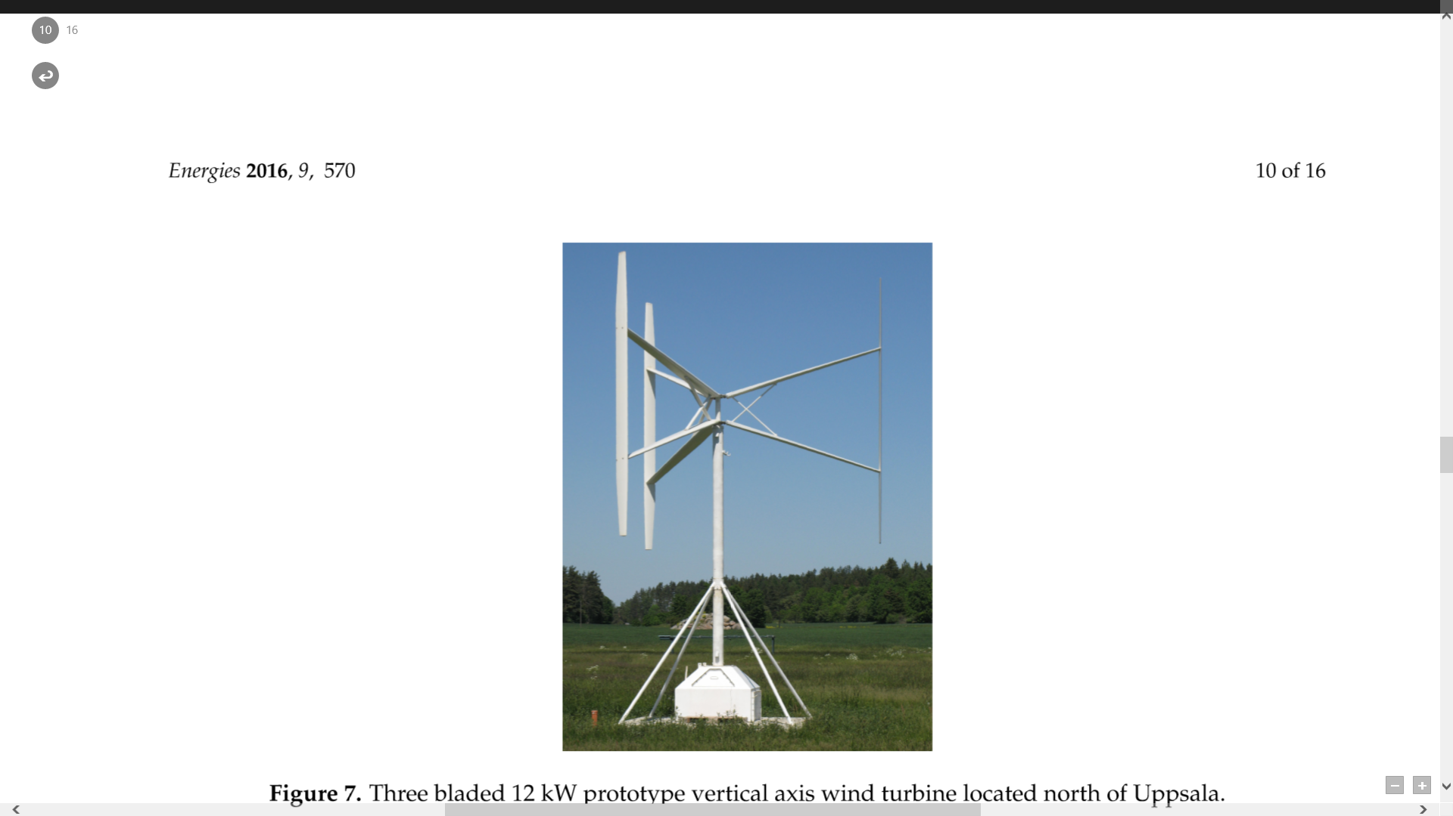
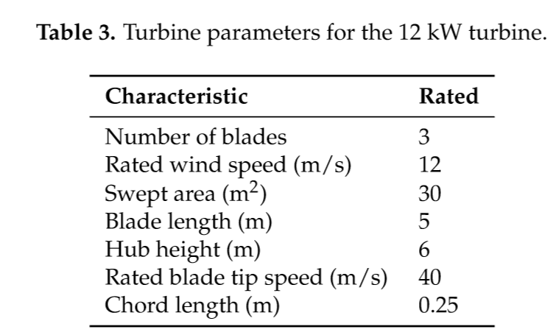
Scaling up:

Slide 5
