Slide 1
Wind Turbine Equations

Slide 2
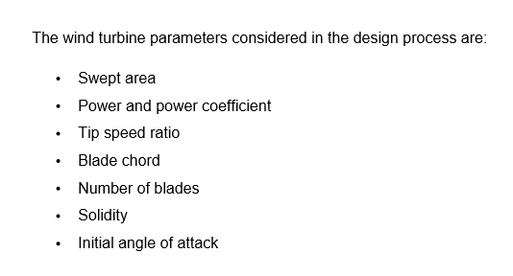

Slide 3
Aerodynamic equations
Structural equations

Slide 4

What we need ?

Slide 5
Aerodynamic Models Of VAWT
Single Stream Tube (SST)
Double Multiple Stream Tube (DMST)
Actuator Cylinder
Vortex Models
CFD Models

Slide 6
DMST
Memoria page22 to 27
Memoria page 60 to 65

Slide 7
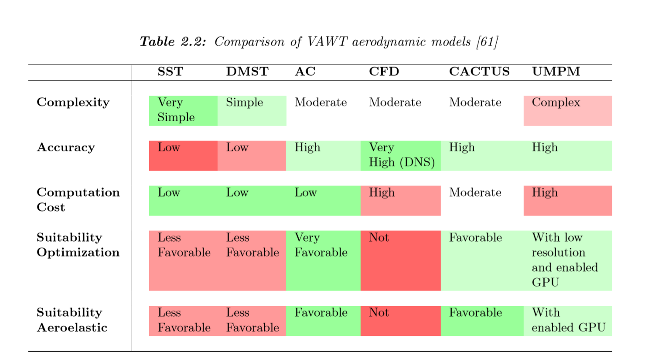

Slide 8
Structural Modeling
Computational Structural Dynamics (FEA)
Multi-Body Systems (MBS)
Modal Analysis
Beam Method

Slide 9
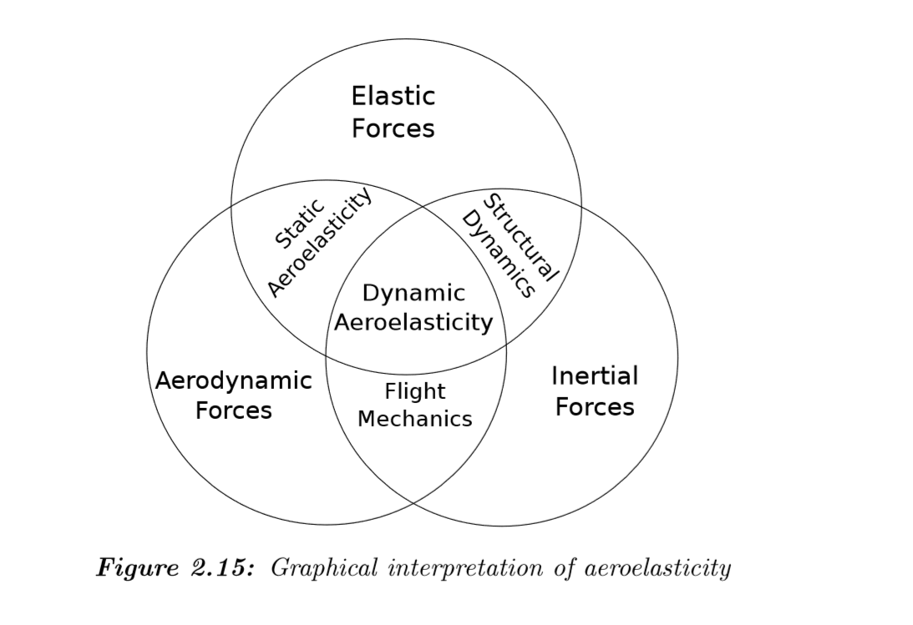
Numerical Aeroelastic Analysis(FSI)

Slide 10
Optmization

Slide 11
Design variables
Objective function
constrains

Slide 12
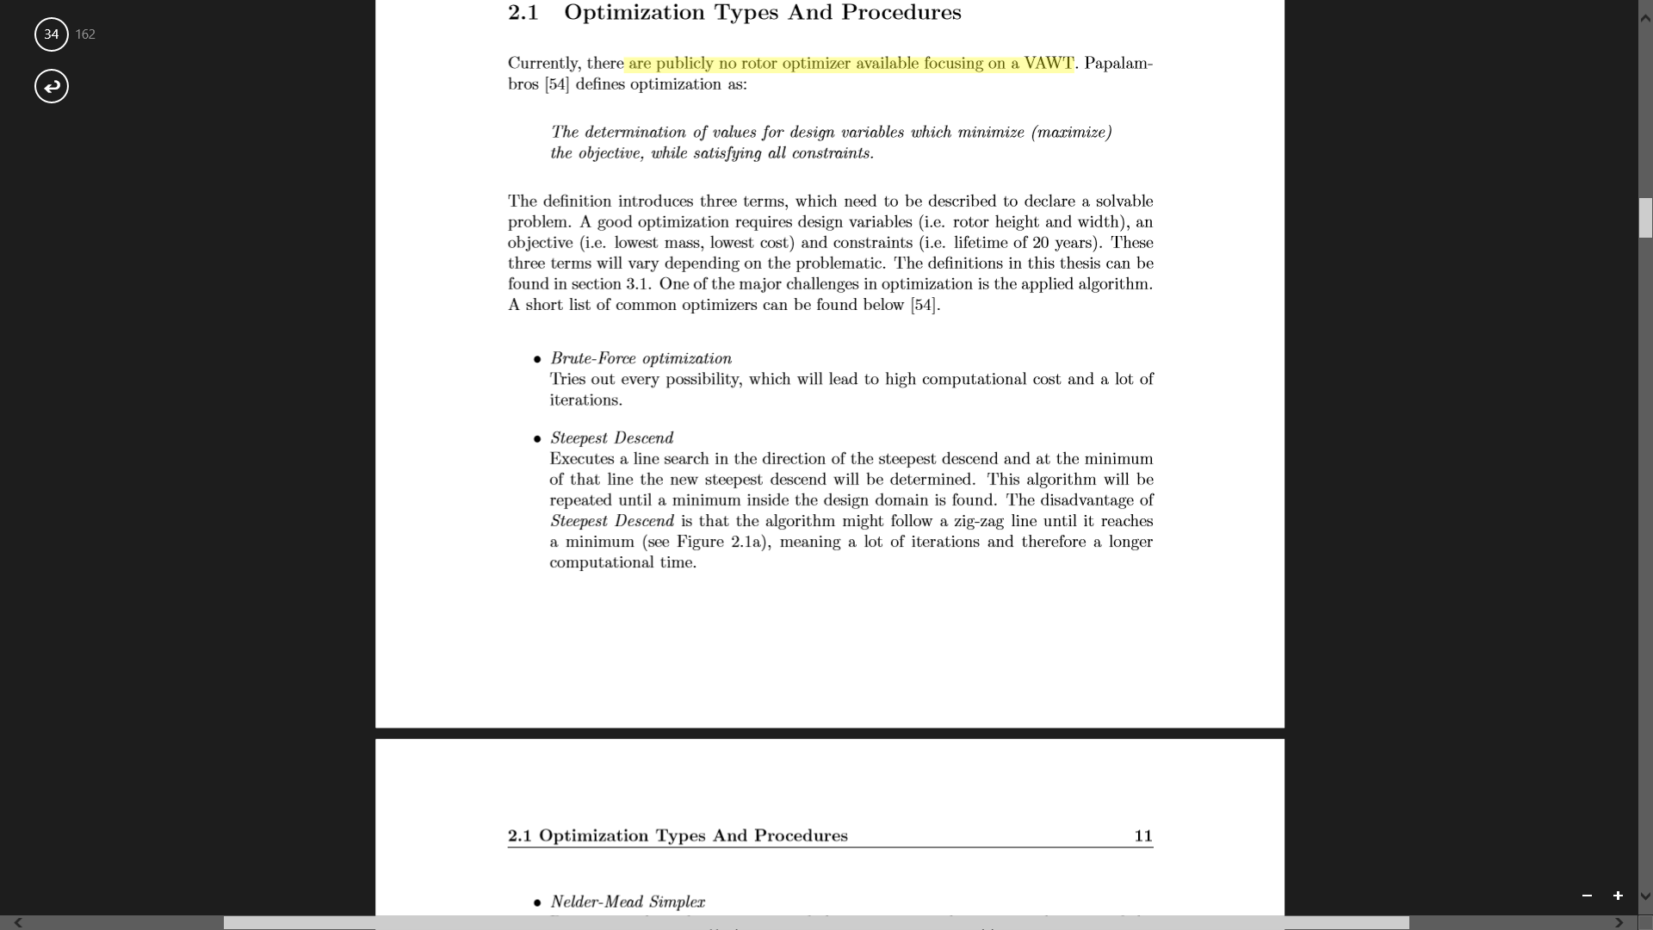
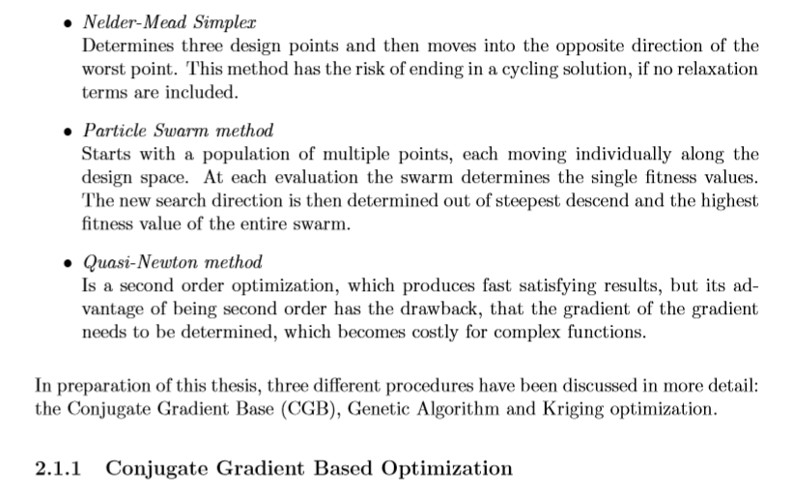

Slide 13


Slide 14

How to start ?

Slide 15
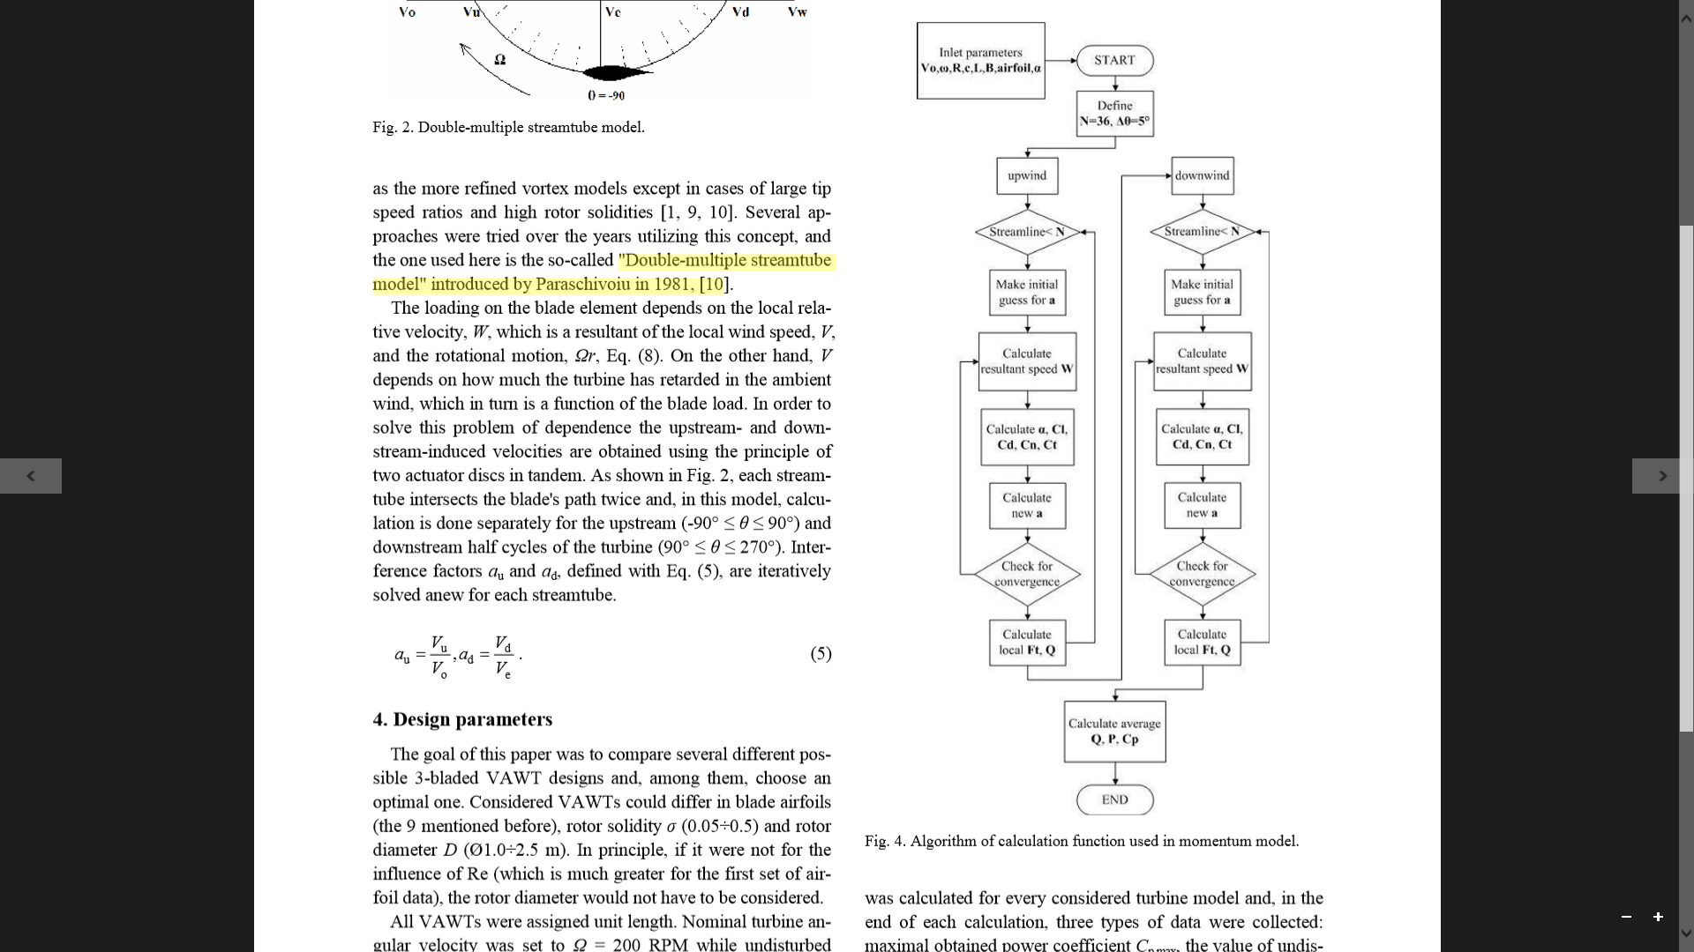

Slide 16
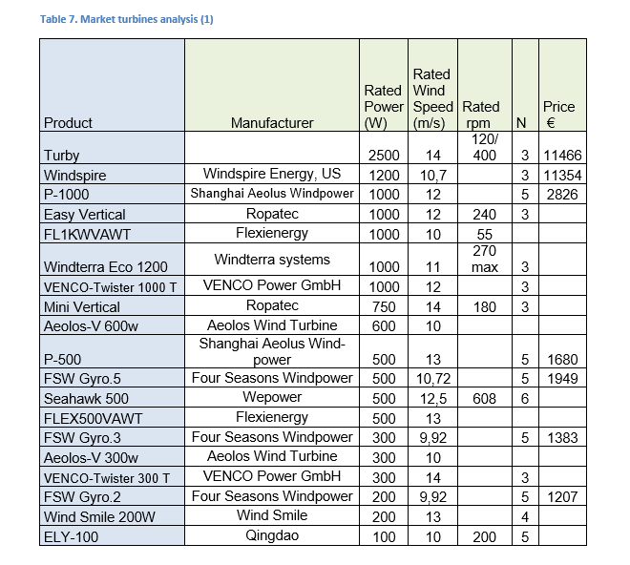

Slide 17
