Slide 1

Healthcare: Patient Health &
Insurance Cost Analysis
A Data Analysis Project
G2
Alyaa Mohamed Elkordy
Afnan Mohamed Abdelfattah
Ebtihal Hassan Osman
Ahmed Ayman Fathy Mahrous

Slide 2

Why Do Some Customers Cost Us More?
Analyzing Medical Insurance Costs for 1,337 Customers

Slide 3



The Business Problem
The Challenge
As a health insurance provider, some customers cost far more than others in claims
Key Question
What actually drives higher medical costs?
Why It Matters
Understanding this lets us price policies more fairly and manage risk better

Slide 4

Getting the Data Ready
01
Remove Duplicates
Removed 1 duplicate customer record found in the raw data
02
Verify Values
Verified all values are realistic (ages, weights, costs — no impossible entries)
03
Identify Outliers
Found several customers with unusually high charges
04
Decision: Keep Them
Decision: kept them — not data errors, but exactly the customers we need to understand

Slide 5
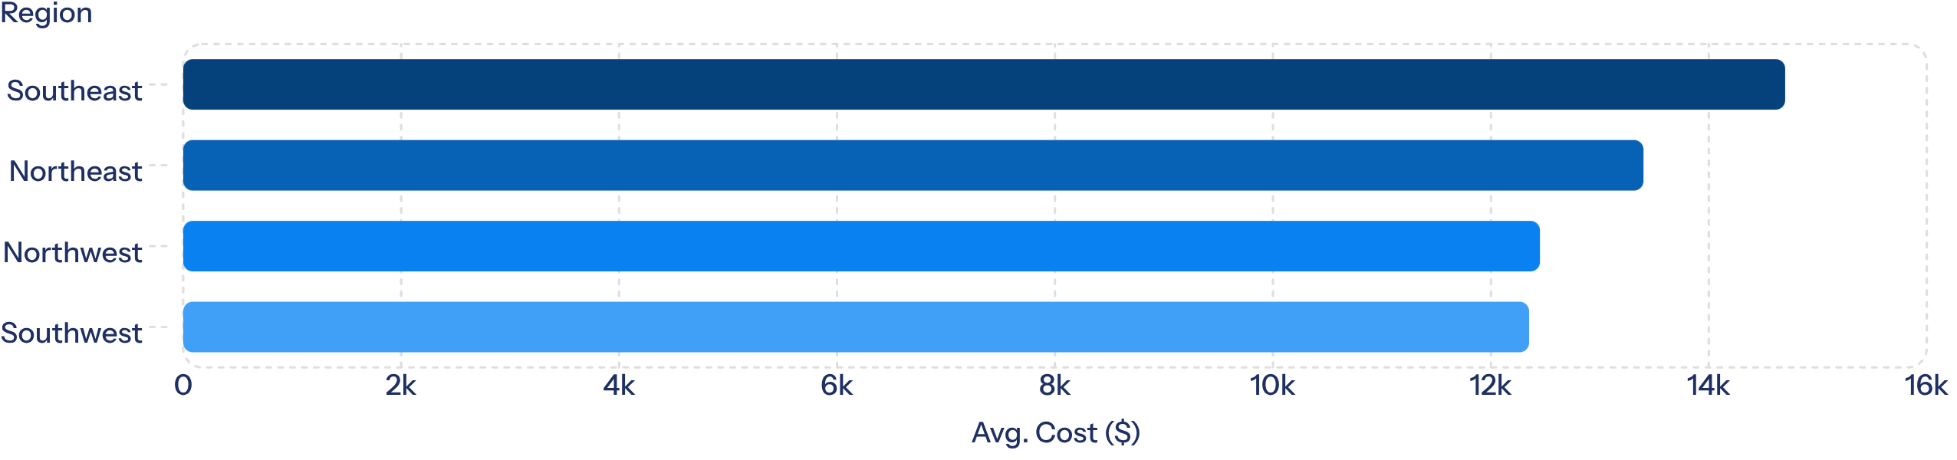
Question 1: Where Is the Problem Geographically?
Grouped customers by region, compared average cost per region
Region | Avg. Cost
Southeast | ~$14,700
Northeast | ~$13,400
Northwest | ~$12,450
Southwest | ~$12,350
Southeast stands out clearly — group sizes are similar, so the gap is real

Slide 6

But Is Region the Real Cause?
The Question
Is region itself driving cost, or is something else at play?
Next Step
Need to look at who exactly the highest-cost customers are

Slide 7
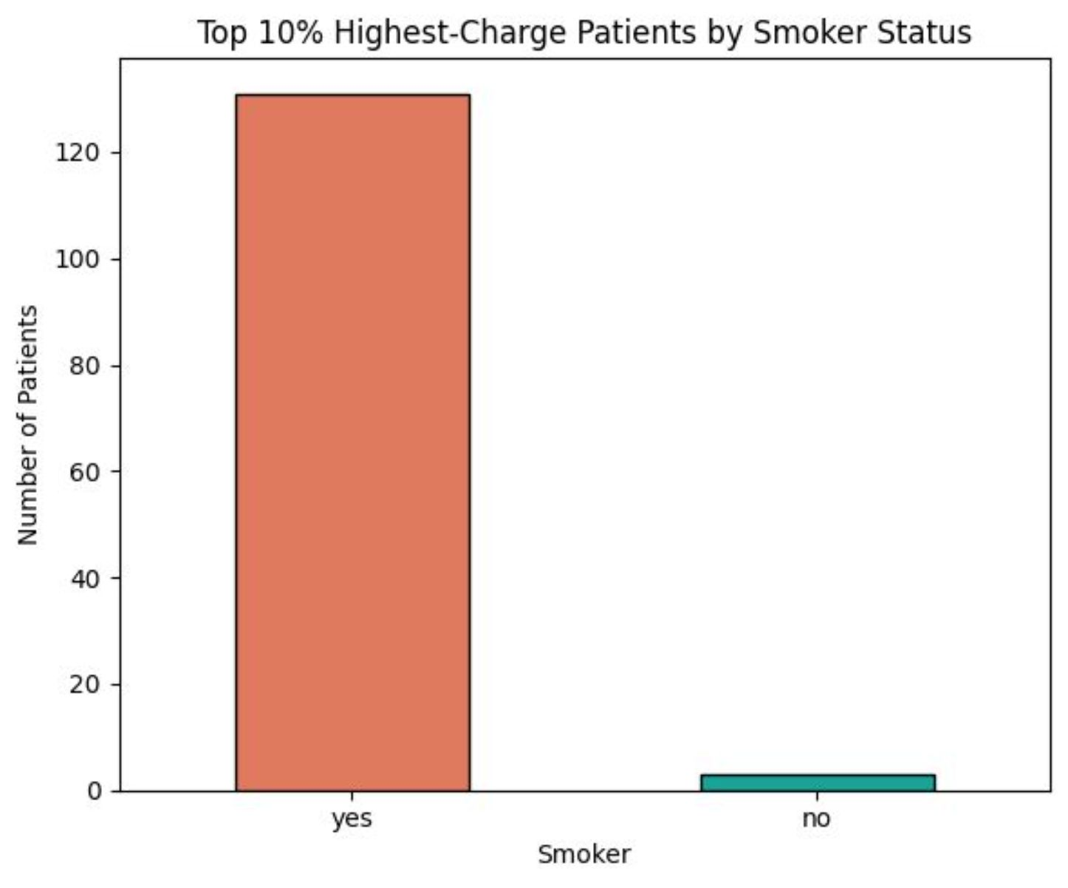
Question 2: Who Are the Top 10% Costliest Customers?
Isolated the top 10% by charges (134 of 1,337 customers)
Asked: what do they have in common?
The finding:
98%
of the highest-cost customers are smokers
Smokers are only 20% of the overall customer base

Slide 8
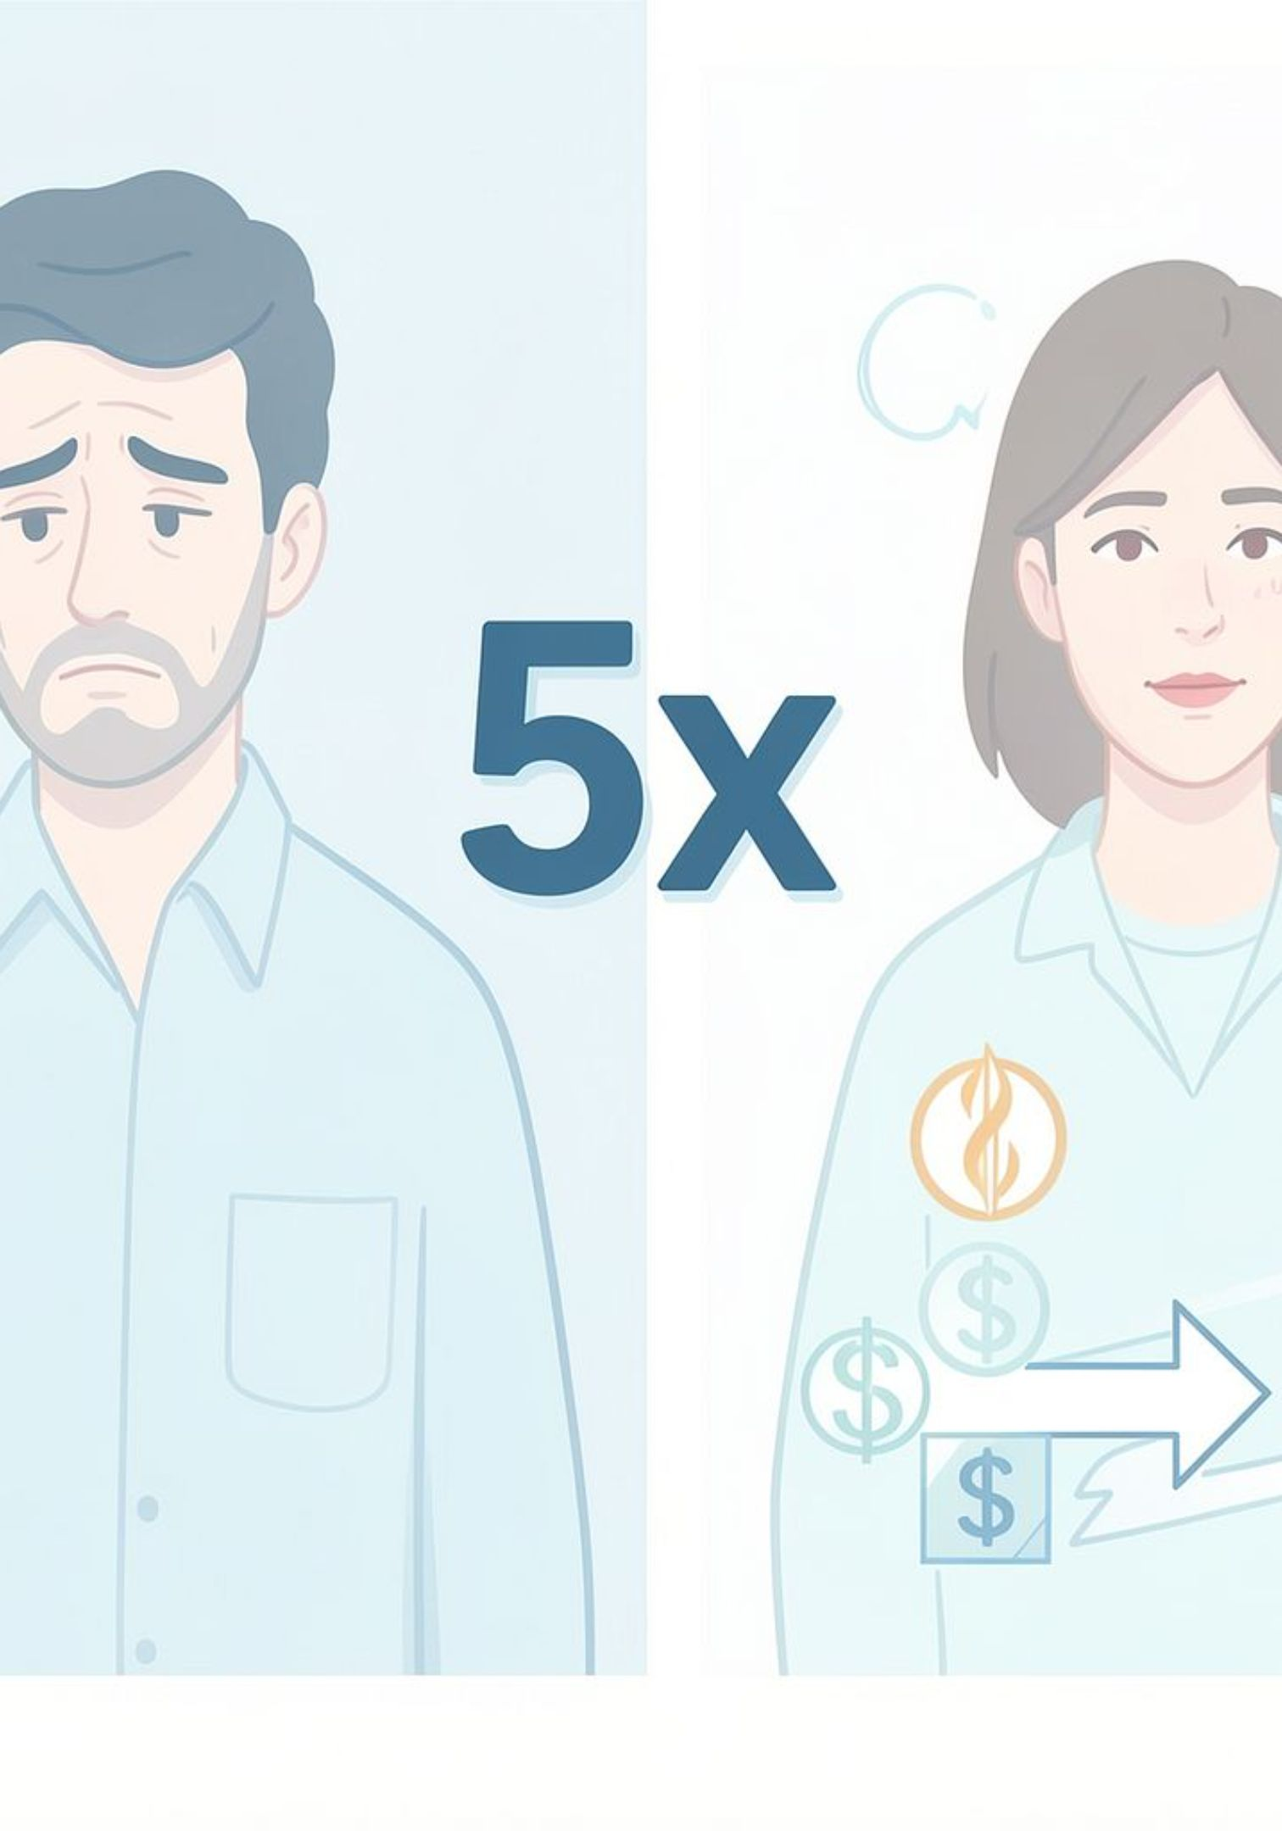

What This Number Means
5x
More Likely
A smoker is roughly 5x more likely to fall into the top 10% cost group than a non-smoker
This is the single strongest factor found across the entire analysis

Slide 9
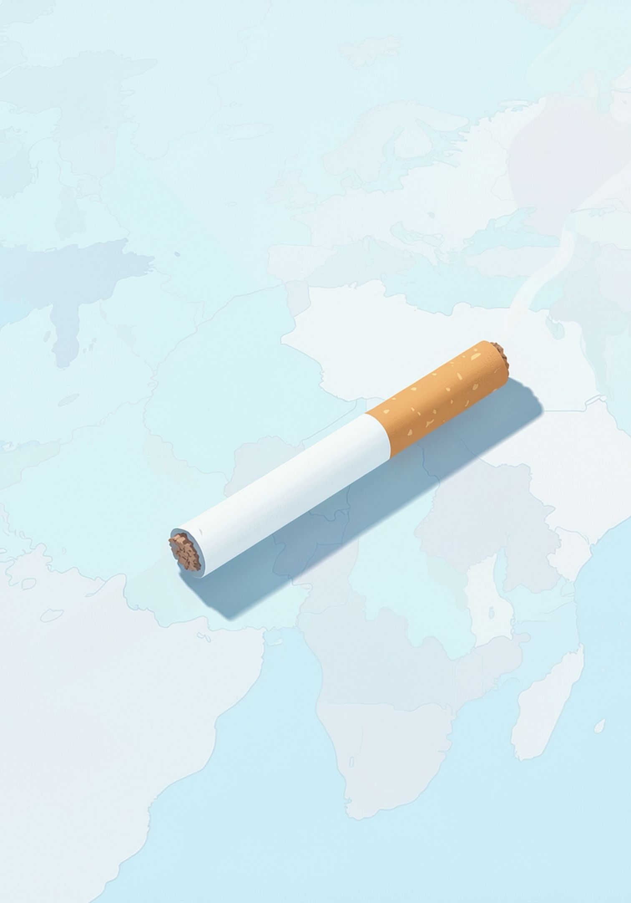
The Missing Link
Observation
Southeast also has the highest smoker rate among all regions
Conclusion
Region isn't the real cause — it's a reflection of higher smoking rates
Root Cause
Smoking is the root cause; region was just a shadow of it

Slide 10


So, What Should We Do?
01
Price Smoking Risk Accurately
Set a clear, data-driven premium gap between smokers and non-smokers
02
Launch a Quit-Smoking Incentive
Offer discounts to customers who quit — real savings for both sides over time
03
Build a Predictive Model
Predict a new customer's cost upfront from their basic profile

Slide 11
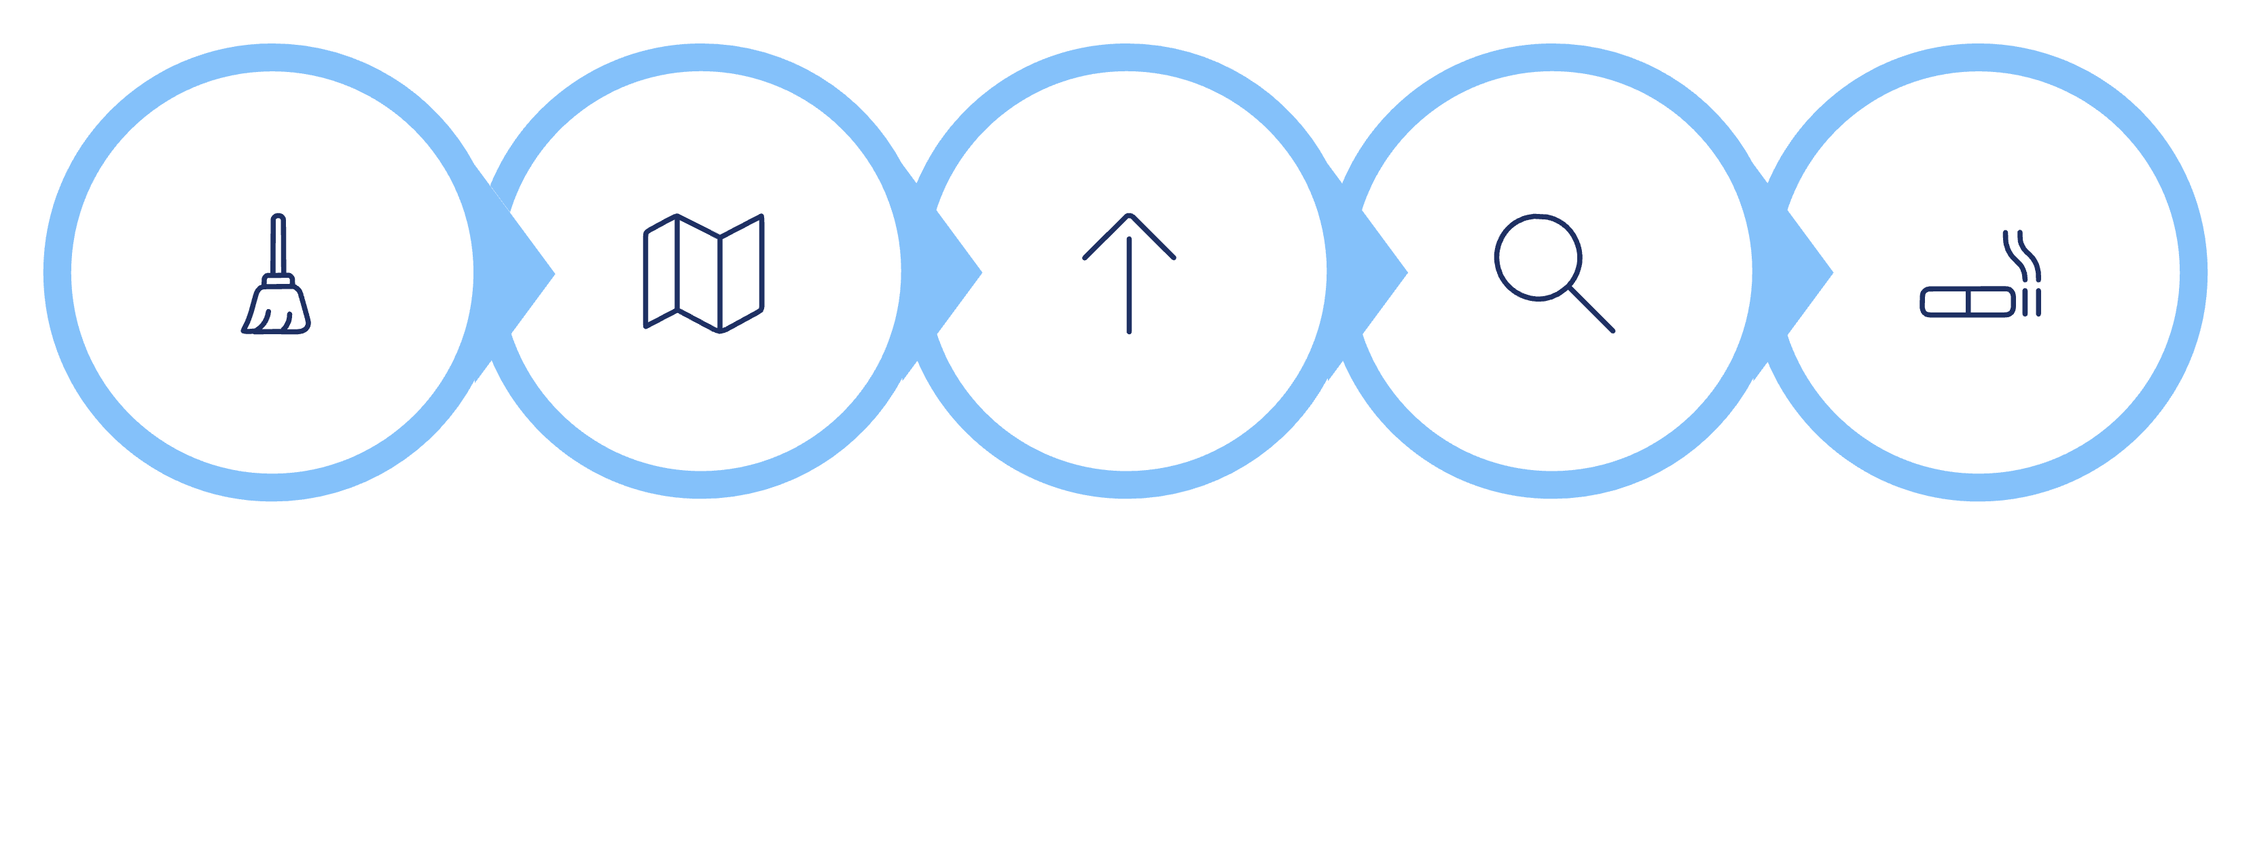
Summary of the Journey
Compare Regions
Southeast Highest
Dive into Why
Found Smoking
Cleaned Data
Smoking isn't just one factor among many — it's the strongest, clearest driver of medical cost

Slide 12

BMI, Smoking & Regional Risk
Why is the Southeast the expensive region?
1

Slide 13



THE STARTING POINT
HIGHEST-COST REGION
The Southeast has the highest
average medical charges.
Southeast
$14,735
average charges per patient
“Why is this region specifically the most expensive?”
Three questions this section answers:
Does BMI itself affect cost?
Is smoking behind the regional gap?
Is Southeast a double-risk region?
2

Slide 14
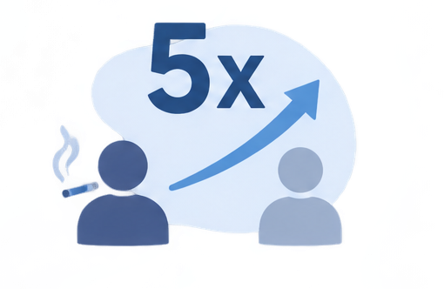
QUESTION 3 · DOES BMI ITSELF AFFECT COST?
Weight alone isn't the problem.
Weight + smoking is.
OBESE + SMOKER
4.7x
higher charges than obese non-smokers
Across every BMI category, being a smoker roughly doubles or triples the cost — but for obese patients, the gap explodes. The two risk factors compound, they don't just add up.
3

Slide 15

QUESTION 4 · IS SMOKING BEHIND THE REGIONAL GAP?
The Southeast also has the
highest share of smokers.
SOUTHEAST SMOKER RATE
25%
vs. 17.8%–20.7% elsewhere
The bars and the line move together: the region with the highest cost is also the region with the highest smoker rate. That's not a coincidence.
4

Slide 16
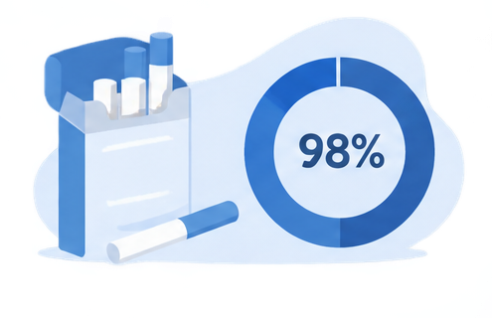
QUESTION 5 · IS SOUTHEAST A DOUBLE-RISK REGION?
It's not just smoking — weight
follows the same pattern.
SOUTHEAST AVG. BMI
33.36
highest of all four regions
Southeast leads on BMI too — about 3 points above the next-highest region. This isn't one risk factor; it's two, stacked in the same place.
5

Slide 17

THE BIGGER PICTURE
Southeast is a double-risk region.
SMOKER RATE
AVERAGE BMI
AVG. CHARGES
25%
33.36
$14,735
highest of all regions
highest of all regions
highest of all regions
Three separate questions — BMI, smoking, and geography — all point back to the same conclusion: costs don't rise because of a single factor, they rise when risk factors stack together in the same place.
6

Slide 18

TAKEAWAY
Don't target the region.
Target the risk factors.
01
Cost is driven by combinations, not single traits
Smoking and obesity compound each other — obese smokers cost 4.7x more than obese non-smokers.
02
Geography is a symptom, not the cause
Southeast is expensive because of who lives there — higher smoking rate and higher average BMI — not because of the region itself.
03
Prevention programs should follow the risk factors
Smoking-cessation and weight-management support will lower costs anywhere they're applied — not just in Southeast.
7

Slide 19
What Drives Medical Charges?
An analysis of healthcare insurance costs across smoking status, region, age, and gender — identifying the dominant factors behind charge variation.

Slide 20
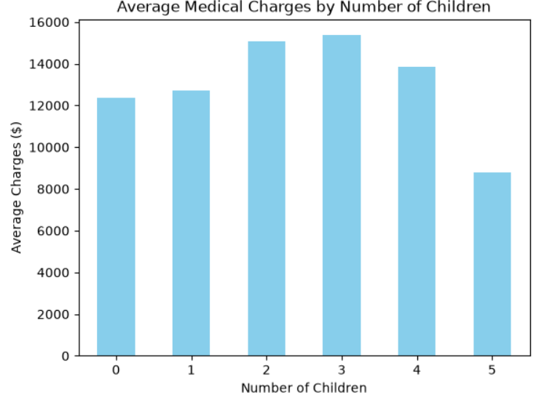

Average Charges by Number of Children
Family size shows the weakest relationship with medical charges of the three factors examined. Charges rise mildly through 2–3 children, then dip at 4–5 — suggesting no strong, consistent linear pattern.
Children/family size is an unreliable cost predictor. Do not over-index on this variable in cost modeling.

Slide 21
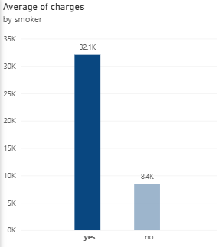
Smoking Status: The Clearest Cost Driver
$8,441
$32,050
3.8x
Non-Smoker Average
Smoker Average
Cost Multiplier
Average charges for non-smoking patients
Average charges for smoking patients
Smokers pay roughly 3.8× more than non-smokers

Slide 22
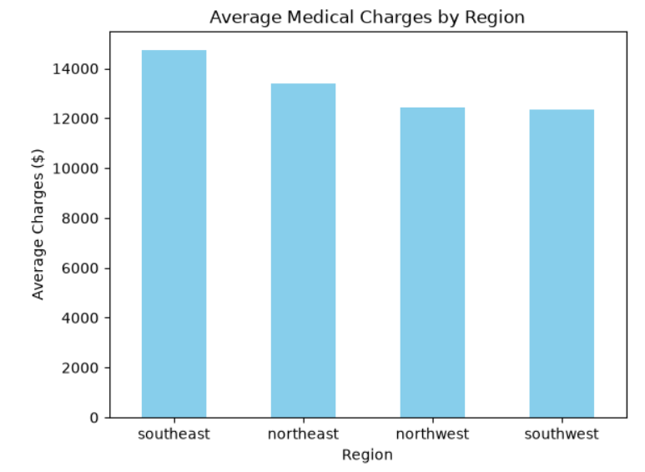
Average Charges by Region
The Southeast leads at $14,735 — nearly $2,400 more than the lowest-cost region (Southwest at $12,347). Regional variation is meaningful, and largely tied to differences in smoking prevalence across geographies.

Slide 23
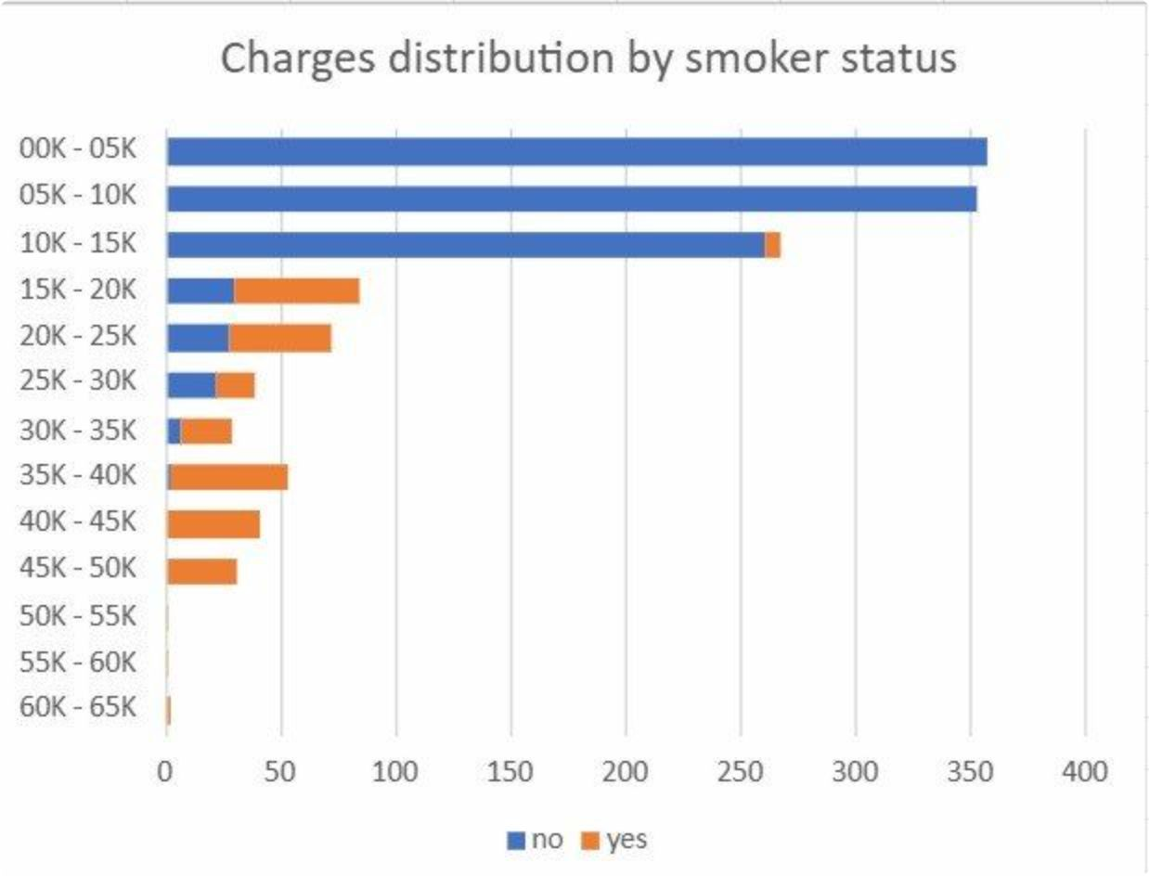
Charges Distribution by Smoker Status
Two Barely Overlapping Worlds
Non-smokers: 91% fall under $15,000 — that's 972 of 1,063 patients concentrated in the lowest charge band.
Smokers: 97% (267 of 274) exceed $15,000, spreading up to $65,000 — only a small remainder (7 patients) still fall between $10,000–$15,000.
The two distributions barely overlap. This is not a subtle statistical difference — it is a structural separation in cost profiles driven entirely by smoking status.

Slide 24
Age vs. Charges, by Smoker Status
When plotted across age, two visibly separate bands emerge — smokers consistently occupy a higher cost band than non-smokers at every age group.
Charges Increase with Age
Smokers Always Higher
Two Separate Bands
Both groups show rising costs as patients get older — a gradual, steady climb rather than a sudden jump.
Regardless of age, smokers are consistently placed in a higher charge band — the gap does not close at any point in the age spectrum.
The visual separation between smoker and non-smoker charge distributions is clear and persistent — confirming smoking as the dominant structural driver.

Slide 25
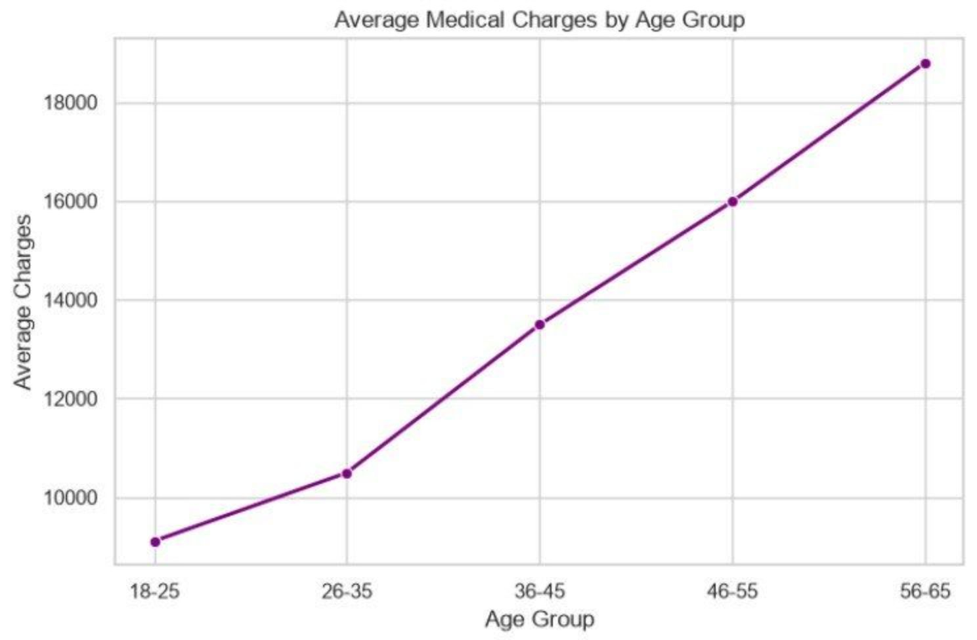
Average Charges by Age Group
Steady Growth, No Sudden Cliff
From age 18–25 ($9,111) to age 56–65 ($18,796), charges more than double — but the increase is gradual and consistent, not driven by any single age threshold.
Each decade adds roughly $2,000–$3,500 in average charges. Age is a real cost driver, but a secondary one compared to smoking status.
Growth is steady, not a sudden jump — cost rises gradually with age.

Slide 26
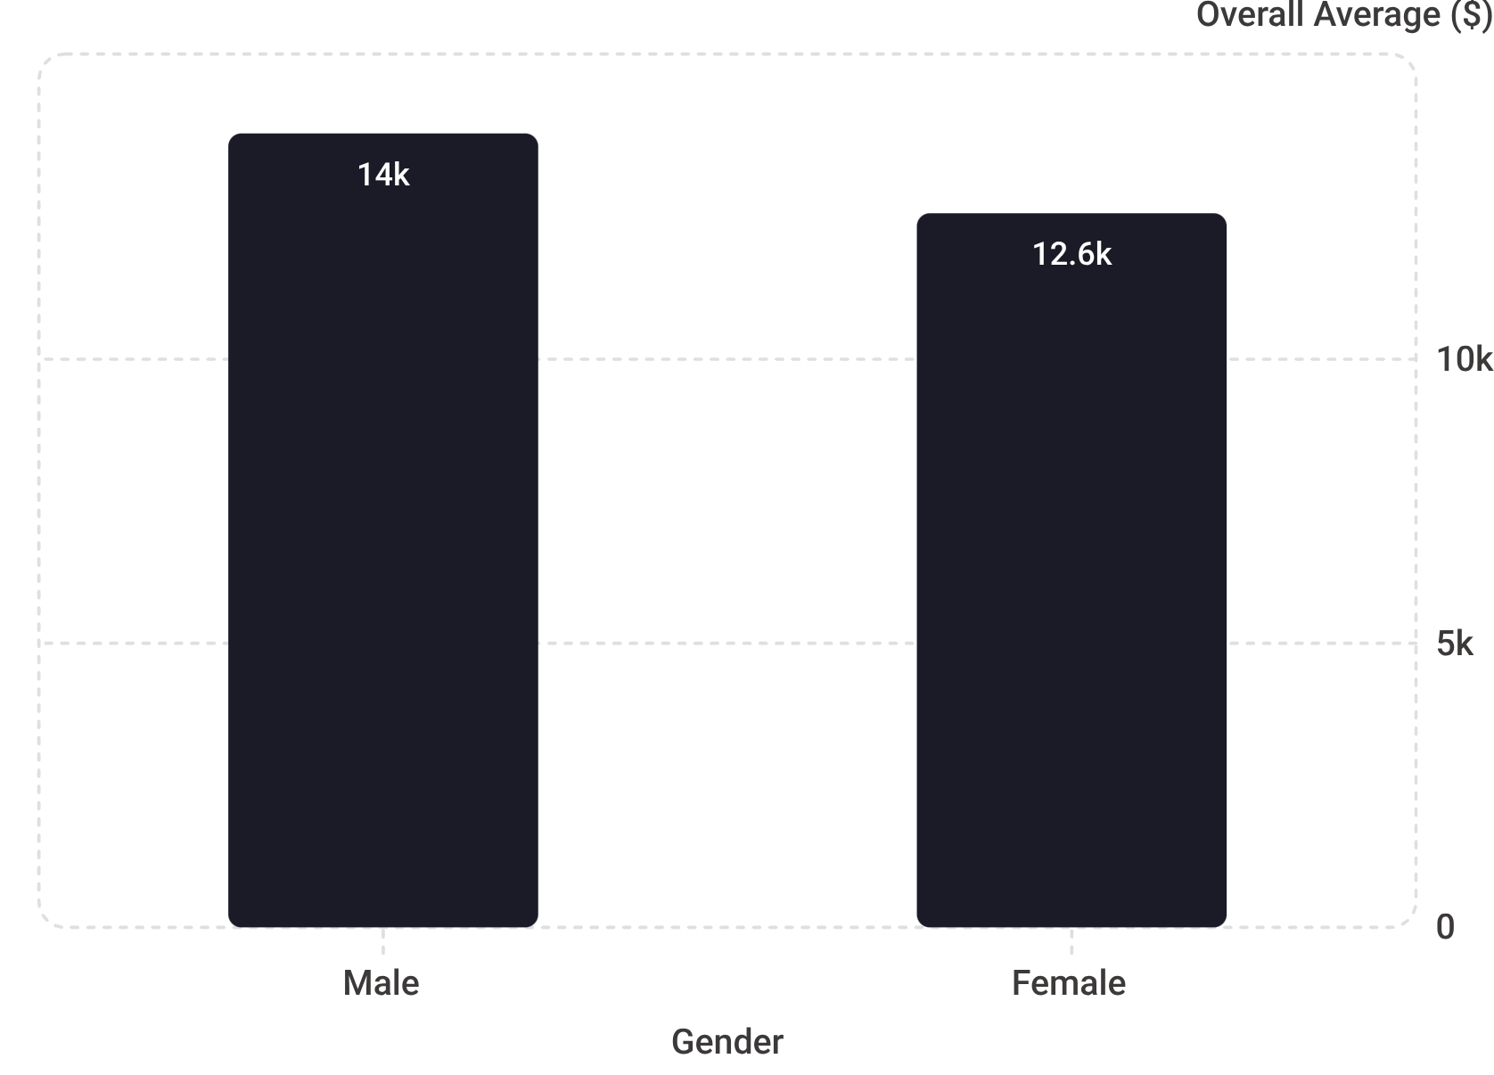
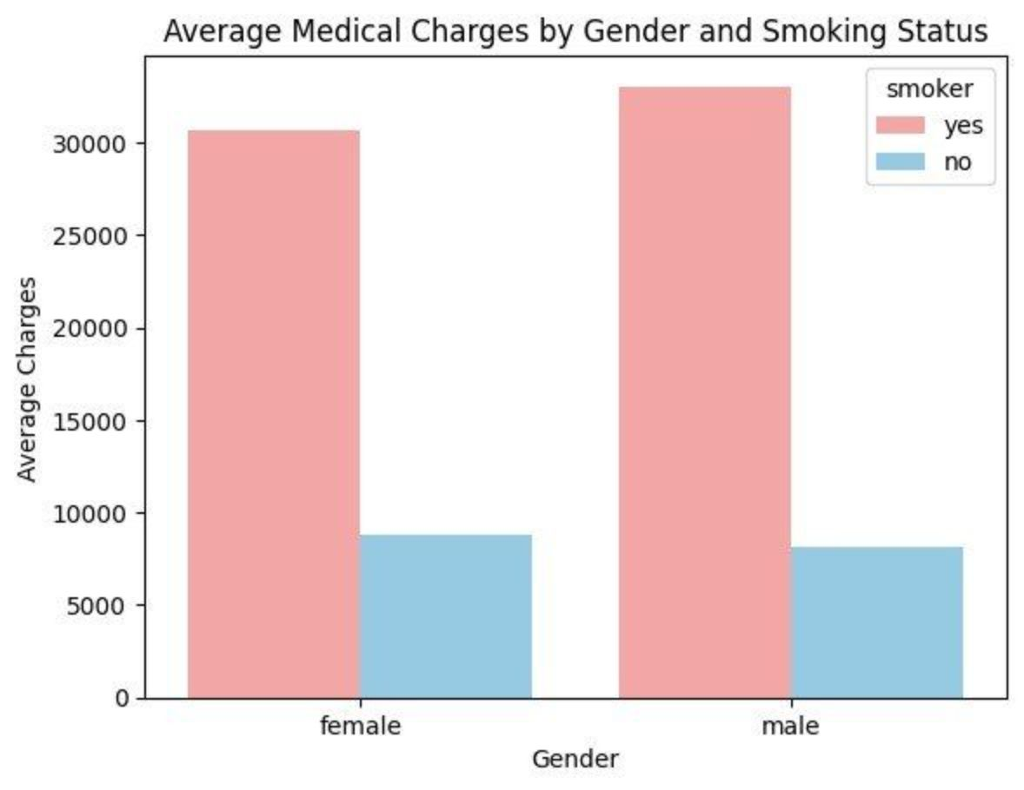
Gender Analysis
Raw Numbers Look Like a Gap…
…But Smoking Status Explains It All
Once split by smoking status, the gender gap nearly disappears. Gender itself is not a meaningful cost driver — smoking status is.

Slide 27
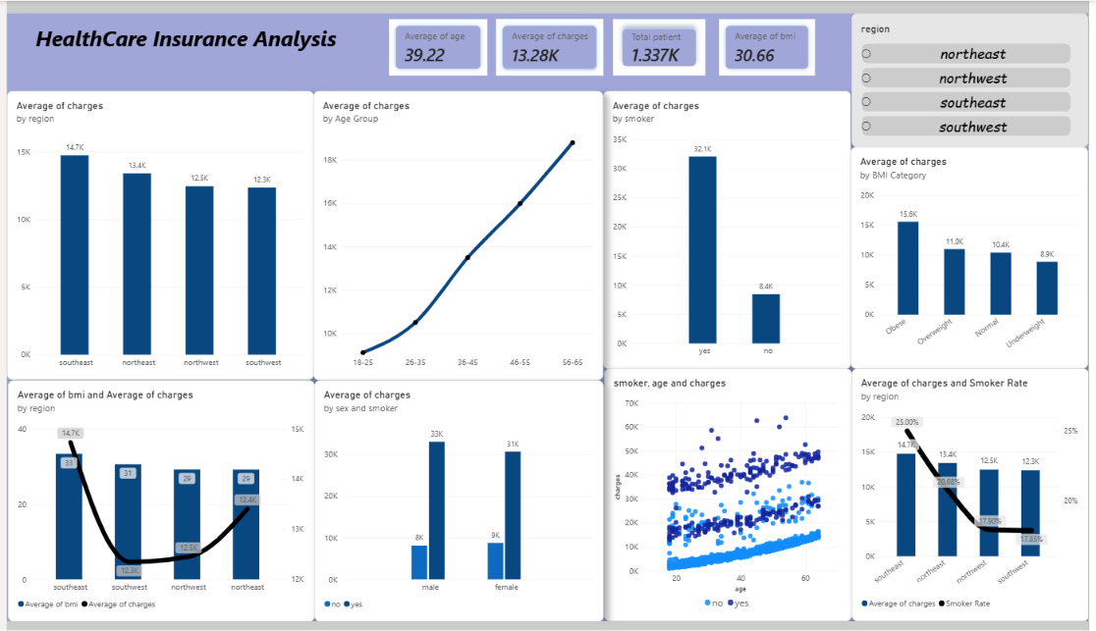

Slide 28
Conclusion
What Drives Medical Charges?
01
Smoking
The clearest and strongest cost driver.
02
Risk Factors
Smoking and obesity compound each other.
03
Geography
The Southeast is a symptom of higher risk, not the root cause.
Target the risk factors — not the region.

