Slide 1
CapitalMarket
Web Application

Slide 2

Capital Market Problems:-
The middleman issue
* User had to call a broker to buy or sell or edit stocks by himself
* User wasn’t able to view an order which is created previously by himself
* User wasn’t able to know the stocks price by himself

Slide 3

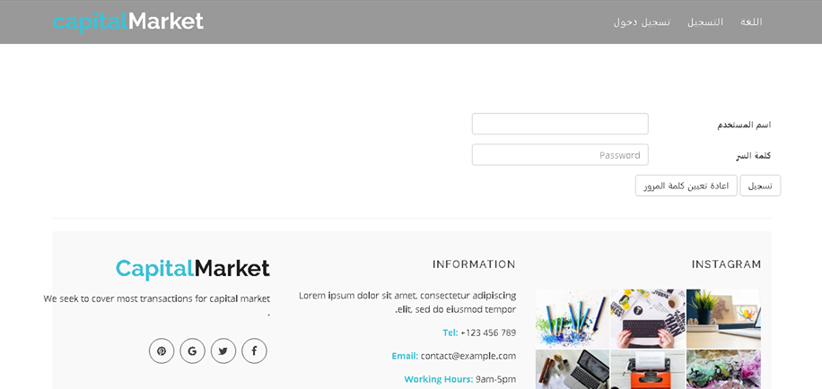
Solution:-
No Middleman
* in our system user can act directly with the Capital Market without any
middle man
* user can buy or sell or update his orders after registration and login
* user can view all his orders

Slide 4
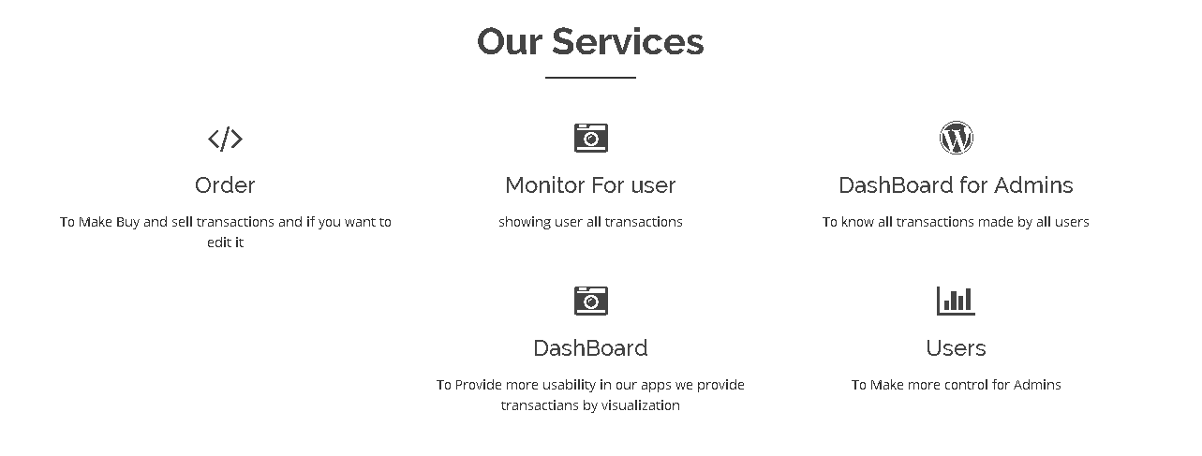
Our Services :

Slide 5
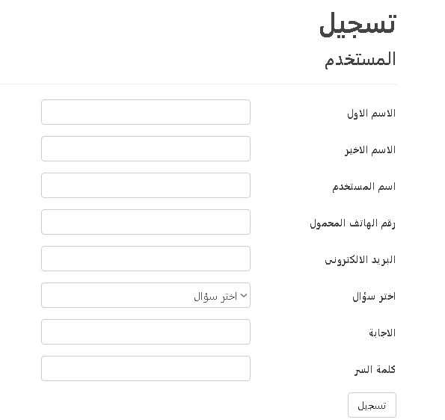
Application Functionalities:-
Registration

Slide 6
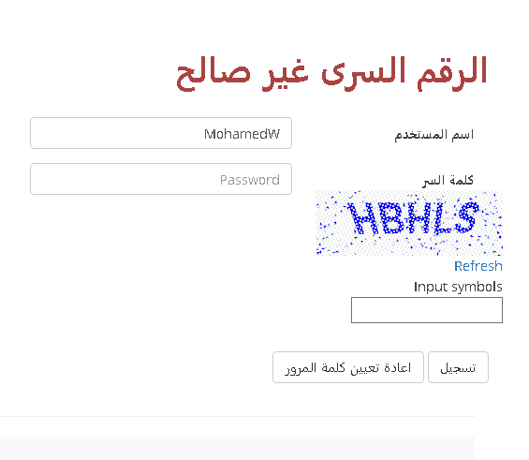
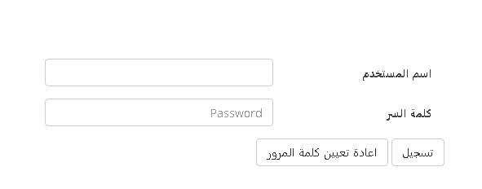
Application Functionalities:-
Login Page

Slide 7
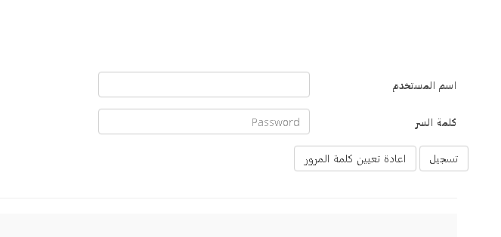
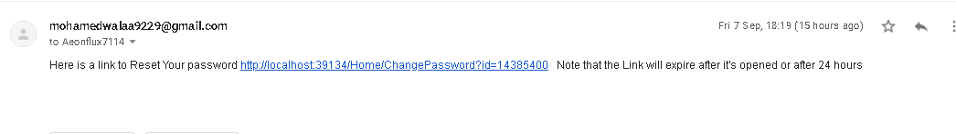
Application Functionalities:-
Forget Password

Slide 8
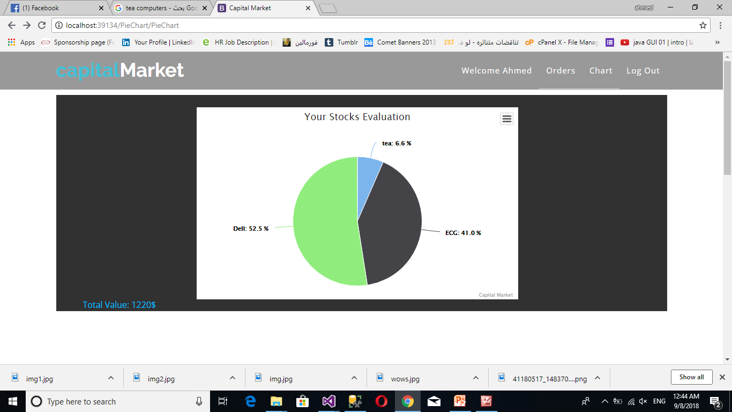
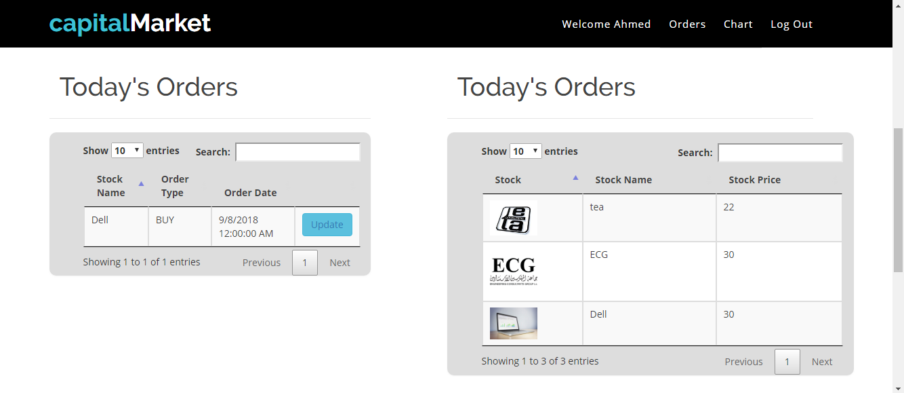
Application Functionalities:-
DashBoard Page
* Stocks Evaluation chart
* Stocks Price table
* Todays Orders

Slide 9
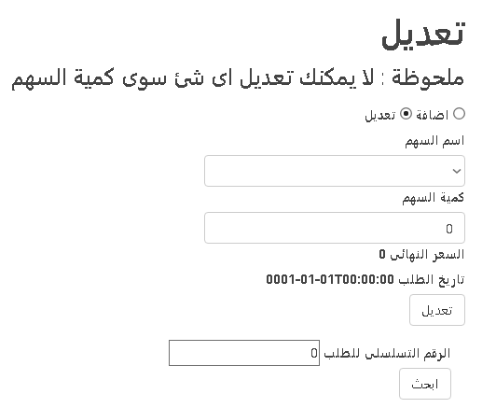
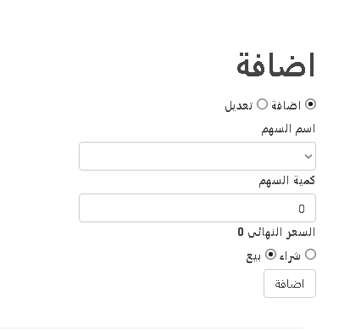
Application Functionalities:-
Order Page
*Order Sell/buy
*Order Search
*Update Order Quantity

Slide 10
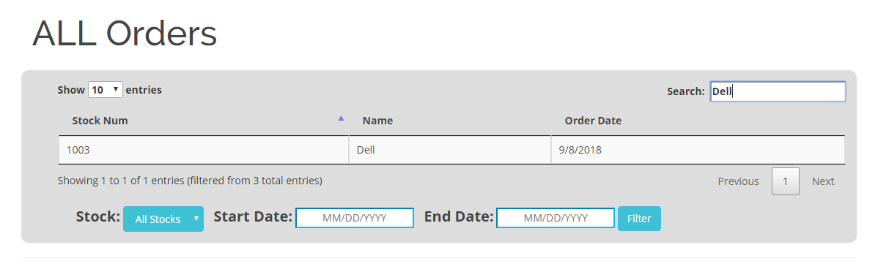
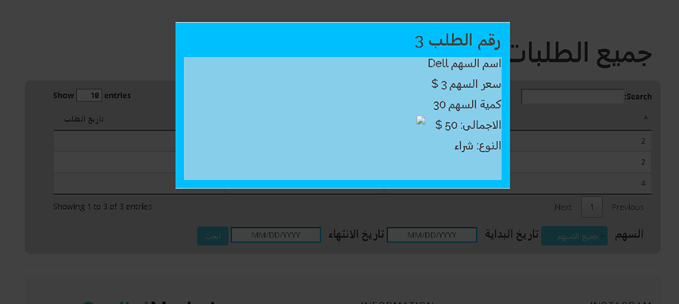
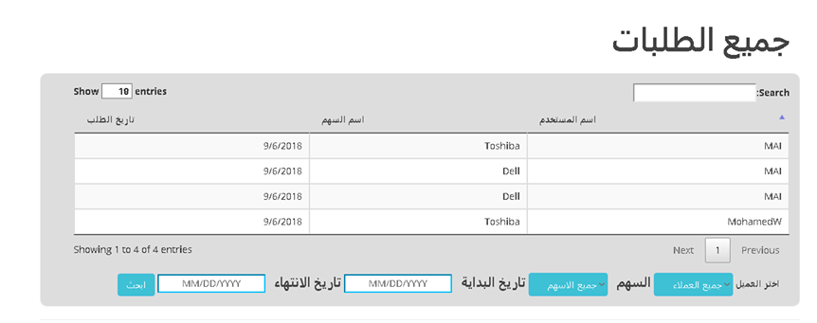
Application Functionalities:-
Monitor Page
* Search Order
* Order Bill

Slide 11
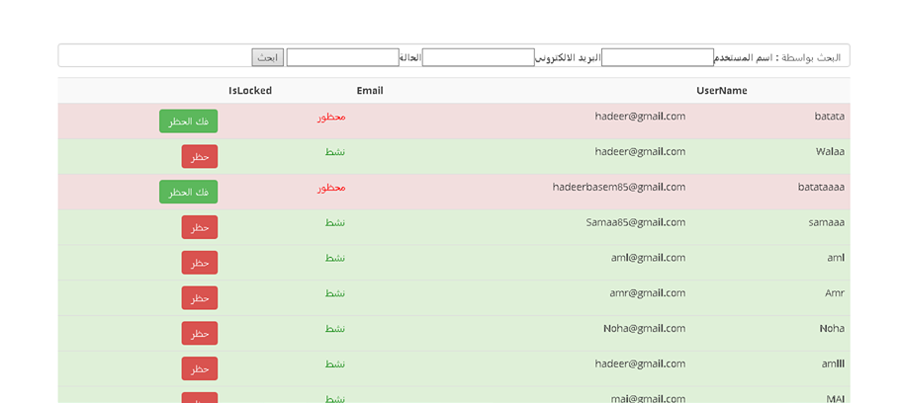
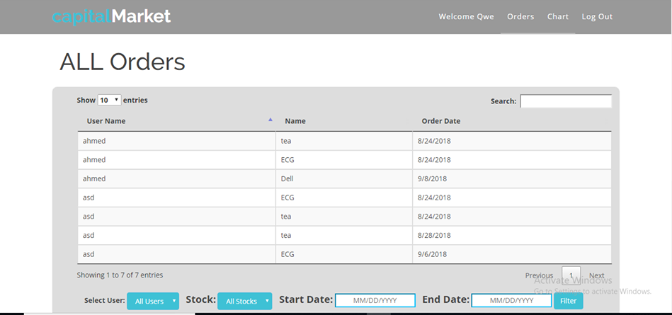
Application Functionalities:-
Users Page
*Users Table
*Admin Monitor

Slide 12

THANK You..

