Slide 1

Occupational Disease

Slide 2
Definition
Occupational diseases
are diseases caused by work or work environment

Slide 3
Major categories of occupational illness by organ system
Musculoskeletal disorders
Respiratory disorders
Neurologic and psychiatric disorders
Skin disorders
Reproductive and development disorders
Cardiovascular disorders
Hematologic disorders
Hepatic disorders
Renal and urinary disorders

Slide 4
occupational disease (continue)
Workplace health hazards can cause three kinds of reactions in the body:
Immediate or acute reactions, like shortness of breath or nausea, can be caused by a one-time event, (e.g., a chemical spill). These reactions are not usually permanent.
Gradual reactions, like asthma or dermatitis (skin rashes), can get worse and persist when you are exposed over days, weeks or months. These reactions tend to last for a longer time.
Notes:
chemical spill تسرب مواد كيماوية

Slide 5
Delayed reactions or diseases that take a long time to develop, like lung cancer or loss of hearing, can be caused by long-term exposure to a substance or work activity. These reactions can be noticed long after the job is over.

Slide 6
OCCUPATIONAL HEALTH HAZARDS
        TYPES OF OCCUPATIONAL HEALTH HAZARDS
        A. Physical
        B. Chemical
        C. Biological
        D. Mechanical
        E. Psychosocial hazards

Slide 7

PHYSICAL HAZARDS
  Temperature - Heat / Cold
     Illumination
     Noise
     Vibration
     Radiation
     Atmospheric pressure

Slide 8
DUSTS (Pneumoconiosis)
        Inorganic Dust
        - Coal Dust -Anthracosis
        ♦ Silica -Silicosis
        ♦ Asbestos -Asbestosis
        Organic Dusts
        ♦ Cane Fiber -Bagassosis (Bronchi gets affected)
        - Cotton dust -Byssinosis (In Textile industries)
        ♦ Tobacco - Tobaccosis, Lung Cancer
        ♦ Grain Dust -Farmer’s Lungs
Notes:
Pneumoconiosis تغبر الرئة

Slide 9
Pneumoconiosis
(Parenchymal lung disease)
If the lung disease is due to inhaled particles,
International Labor Organization (ILO) as the accumulation of dust in the lungs and the tissue reactions
E.g.
    vapors, or gases
    Smoke
    Mist
    Particles like dust and fibers (silica and asbestos dust)
Notes:
Mist

Slide 10
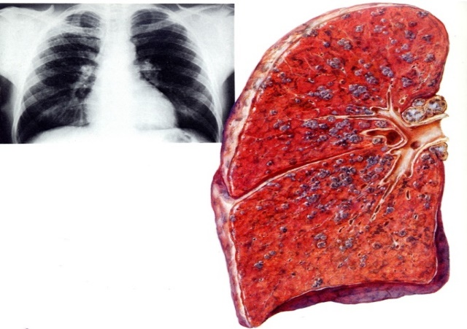
Pneumoconiosis
    Caused as :
    secondary to inhalation of inorganic dust leading to change in the lung architecture
    excluding chronic bronchitis, emphysema, and cancer
silica and asbestos produce progressive fibrosis in the lung
Notes:
Emphysema

Slide 11
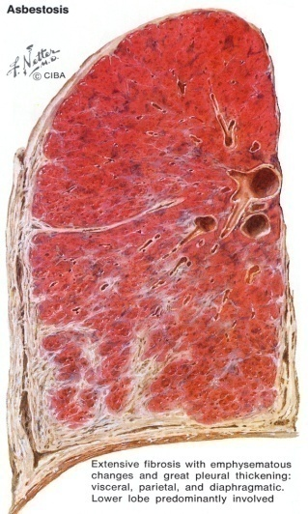
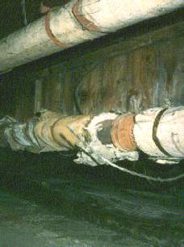
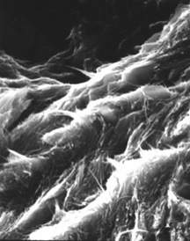
Asbestosis

Slide 12
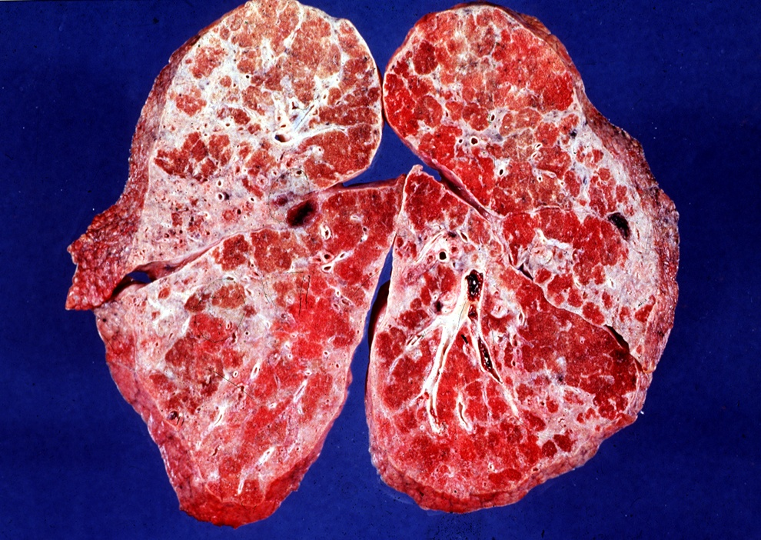
ASBESTOSIS
Asbestosis is widespread scarring of lung tissue caused by breathing asbestos dust.
Asbestos is composed of fibrous mineral silicates of different chemical compositions.
When inhaled, asbestos fibers settle deep in the lungs, causing diffuse fibrosis.

Slide 13
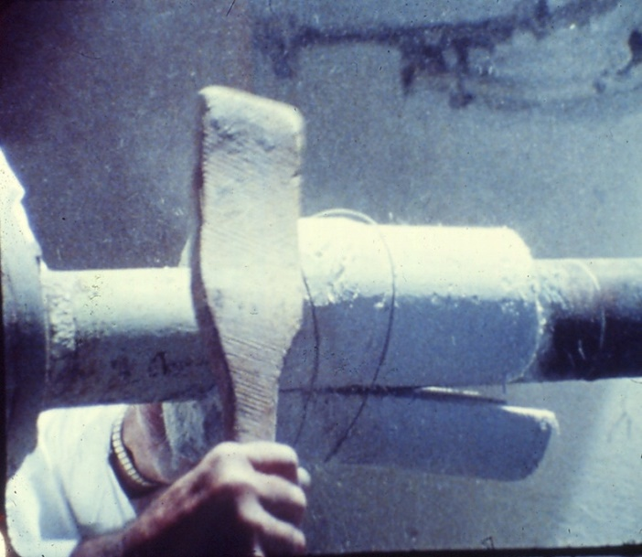
Occupational exposure
Workers who demolish buildings that have insulation containing asbestos are at increased risk.
The more a person is exposed to asbestos fibers, the greater the risk of developing an asbestos-related disease.
Notes:
demolish buildings هدم المباني

Slide 14
Asbestos related diseases
Diseases are:
  Interstitial pulmonary fibrosis (asbestosis)
  Bronchogenic carcinoma
  Pleural Effusions
  Fibrous plaques
  Pleural fibrosis
  Mesotheliomas (malignant tumor of pleura and peritoneum)
  Laryngeal neoplasms
Notes:
Laryngeal neoplasms الأورام الحنجرة

Slide 15
Symptoms
Symptoms of asbestosis appear gradually only after large areas of the lung become scarred.
The scarring causes the lungs to lose their elasticity.
The first symptoms are a mild shortness of breath and a decreased ability to exercise.

Slide 16
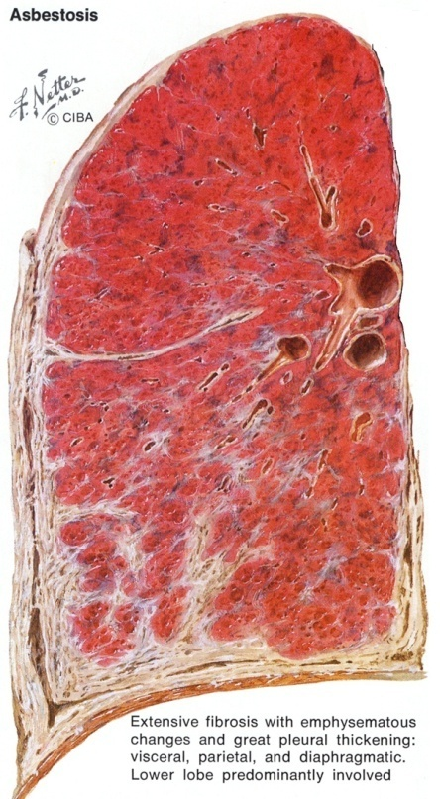
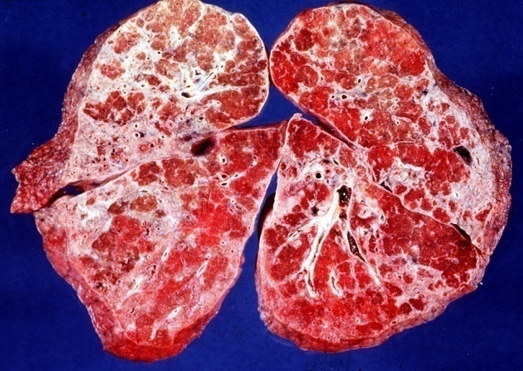
Pathology of Asbestos Related Diseases
Diffuse interstitial fibrosis starting
at the base of the lung
Thickening of the pleura

Slide 17
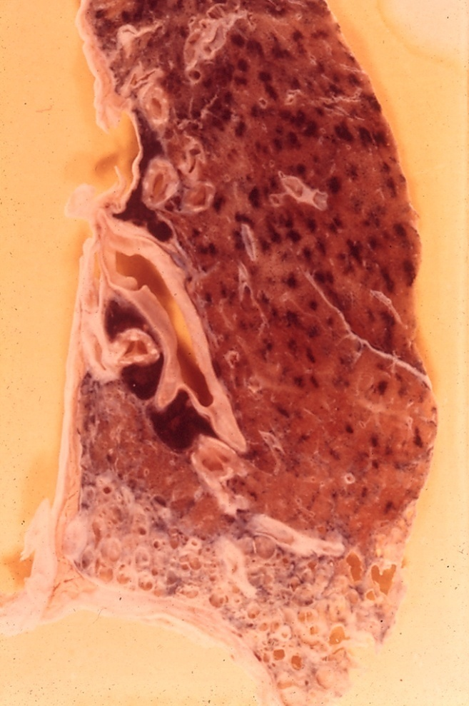
Pathology of Asbestos Related Diseases
Diffuse fibrosis
starting at the base of the lung
“Honey comb appearance”
On morphology bases

Slide 18
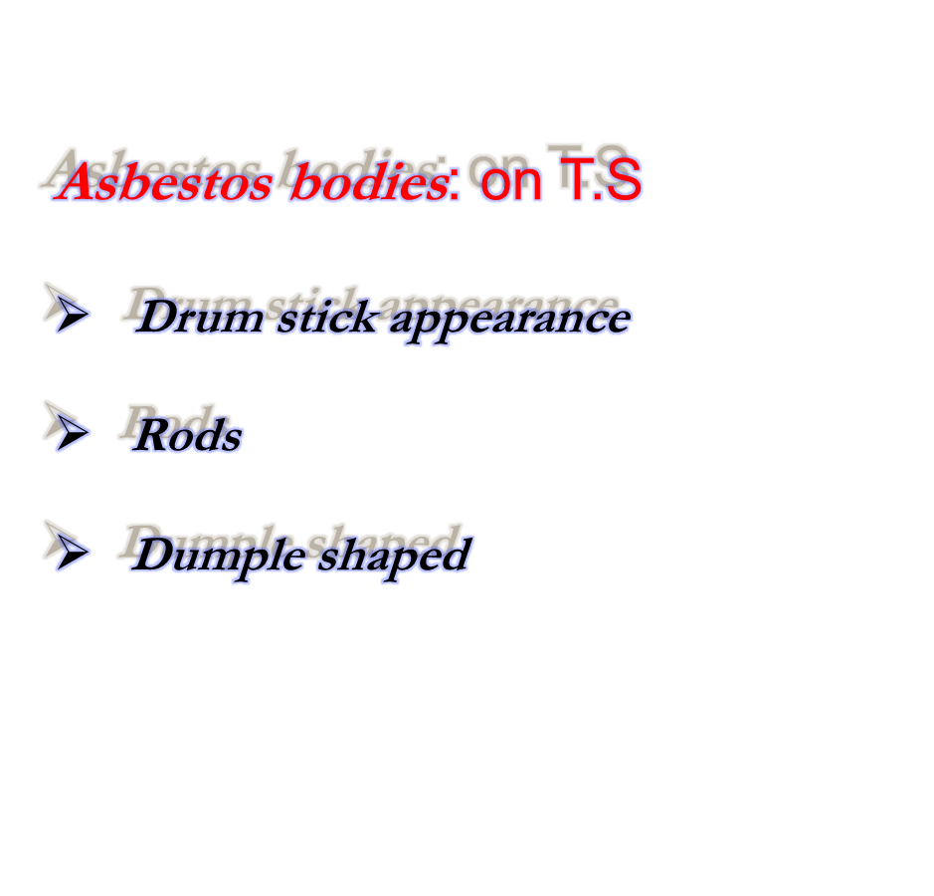
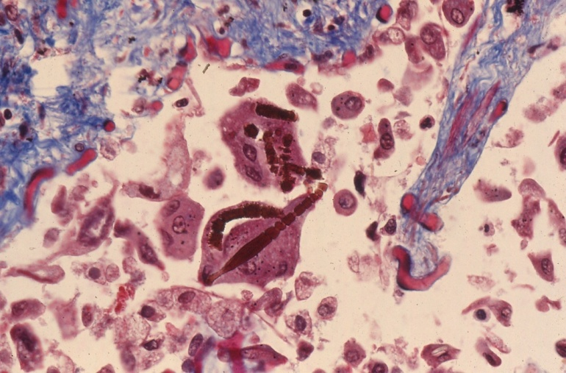
Pathology of Asbestos Related Diseases

Slide 19
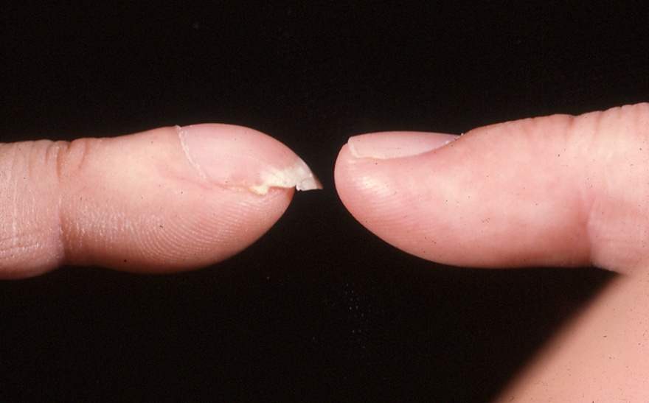
Pathology of Asbestos Related Diseases
Clupping of the Fingers which reflects chronic
hypoxic lung disease

Slide 20
Diagnosis of asbestosis
Positive occupational history of exposure to asbestos dust
Shortness of breath
Cyanosis
Clupping of the fingers
End inspiratory fine crepitation
Notes:
End inspiratory fine crepitation
نهاء طقطقة غرامة الشهيق

Slide 21
Prevention and treatment
Diseases caused by asbestos inhalation can be prevented by minimizing asbestos dust and fibers in the workplace.
Because industries that use asbestos have improved dust control, fewer people develop asbestosis today,
Smokers who have been in contact with asbestos can reduce their risk of lung cancer by:
    giving up smoking and
    should probably have a chest x-ray annually.

Slide 22

Silicosis is permanent scarring of the lungs caused by inhaling silica (quartz) dust.
Silica is the main constituent of sand, so exposure is common among:
  metal miners,
  sandstone and granite cutters,
  foundry workers, and potters.
Tuberculosis is a common complication of silicosis.
Notes:
foundry workers, and potters.
عمال المسبك، والخزافين.

Slide 23
Pathogenesis of silicosis
When inhaled, silica dust passes into the lungs, and scavenger cells such as macrophages engulf it.
Enzymes released by the scavenger cells cause the lung tissue to scar.
At first, the scarred areas are tiny round lumps (simple nodular silicosis), but eventually they may combine into larger masses (complicated silicosis).
These scarred areas cannot transfer oxygen into the blood normally.
The lungs become less flexible, and breathing takes more effort.

Slide 24
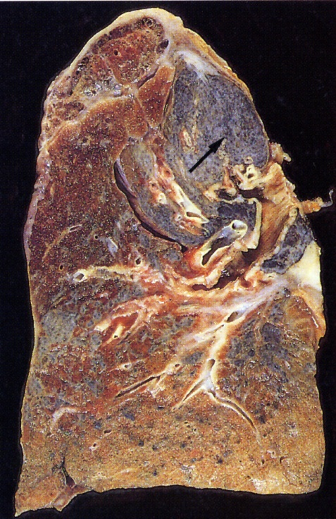
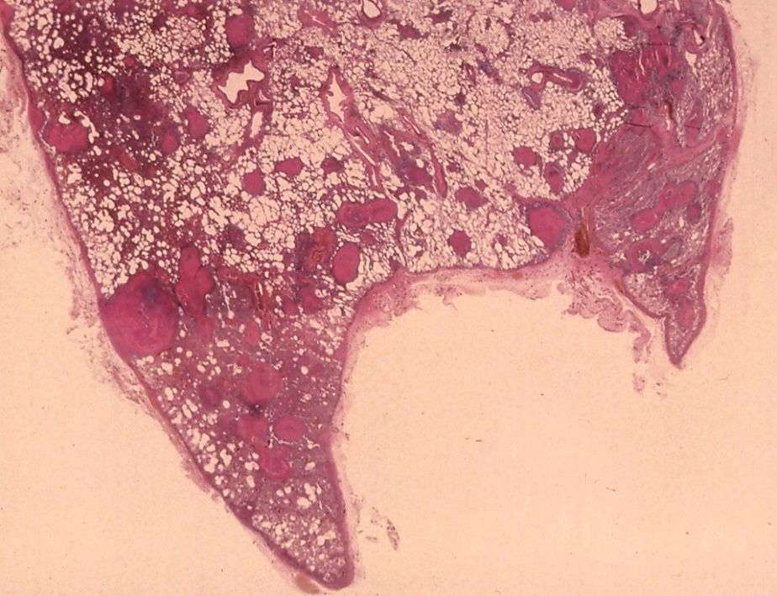
Pathology of Silicosis
Thickened pleura
Lung fibrosis
Silicotic nodules

Slide 25
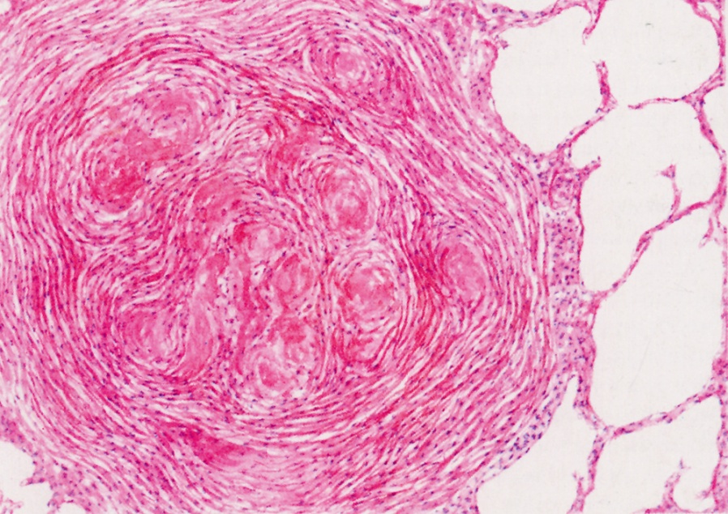
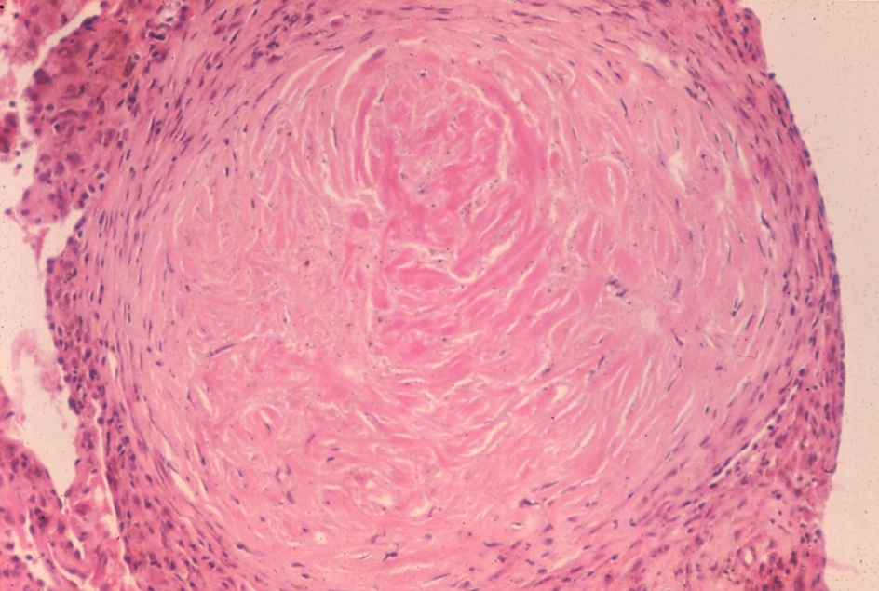
Pathology of silicosis
Silicotic nodule
(Onion shape appearance)
Early lesions are nodules
More fibrous tissue , less cells
It is composed of lamellae of collagen
It contains dust particles, carbon

Slide 26

Pathology of silicosis
Initial lesions start first in the middle and upper parts of the lung as small tiny nodules,
then spread to the rest of the lung

Slide 27
Diagnosis of Silicosis
Positive History of exposure to free silica dust
Early dry irritant cough
Later, shortness of breath

Slide 28
Prevention and Control
Workers exposed to silica dust should have regular chest x-rays —every 6 months for sandblasters and every 2 to 5 years for other workers—so that problems can be detected early.
If the x-rays show silicosis, a doctor will probably advise the worker to avoid continued exposure to silica

Slide 29
Treatment
Silicosis cannot be cured, but its progression can be slowed if exposure to silica is avoided, especially at an early stage of the disease.
A person who has difficulty breathing may benefit from the treatments used for chronic obstructive pulmonary disease (COPD), such as drug therapy to keep the airways open and free of mucus.
Because people with silicosis have a high risk of developing tuberculosis, they should have regular checkups that include a tuberculosis skin test

Slide 30
CHEMICAL HAZARDS
Solvents, acids, pesticides, heavy metals.

Slide 31
I. Inflammation (Irritation) of Respiratory System
This effect can be produced by substances that are:
  Soluble in water and can produce inflammatory effect
The site of the effect depends on the degree of solubility
  Highly soluble Upper respiratory tract irritation
  Moderately soluble Middle respiratory tract irritation
  Sparingly soluble lower respiratory tract irritation

Slide 32
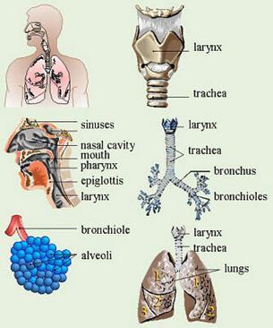
Classification of irritants
Upper respiratory tract irritants
    E.g. Ammonia
    Inflammation of mucosa of Eyes, Nose and Oro-pharynx
Mid-respiratory tract irritants
    E.g. Chlorine
    Asthma-like attack
Lower Respiratory tract irritant
    E.g. Nitrogen dioxide
    Pulmonary edema

Slide 33
Start of the disease
First day of working week
Exposure to dust
Mast cell
After release of histamine
Shrunken mast cell
Histamine
Bronchospasm
Obstructed airway
Bronchi

Slide 34
Investigations
Positive occupational History (several years e.g. 10 years or more)
Lung function
  Obstructive pattern of lung function impairment
Symptoms and signs:
  Acute symptoms
  Chest tightness
  Cough
  Wheeze
After few hours of
exposure

Slide 35
OCCUPATIONAL HEALTH HAZARDS
        TYPES OF OCCUPATIONAL HEALTH HAZARDS
        A. Physical
        B. Chemical
        C. Biological
        D. Mechanical
        E. Psychosocial hazards

Slide 36
Biological Hazards
  Bacteria- Tetanus, Tuberculosis, Anthrax, Brucellosis (Milkmen).
  Virus - Hepatitis, AIDS
  Protozoa & Parasitic -Malaria, Hydatid (Dog handlers), Hookworms (Anckylestoma), tapeworms (Agri-workers), etc.
  Fungi-(Agri-workers)-Tinea-infections, Coccidiomycosis (yeast skin infection), etc.
Notes:
Milkmen حلاب
Dog handlers مدربي الكلاب

Slide 37
OCCUPATIONAL HEALTH HAZARDS
        TYPES OF OCCUPATIONAL HEALTH HAZARDS
        A. Physical
        B. Chemical
        C. Biological
        D. Mechanical
        E. Psychosocial hazards

Slide 38
        Mechanical hazards
        ???????????????

Slide 39
PSYCHOSOCIAL HAZARDS
❖ Lack of job satisfaction, insecurity, poor interpersonal relations, work pressure, etc.
❖ Psychological & behavioral changes – hostility, aggressiveness, anxiety, depression, alcoholism, drug addiction, sickness absenteeism.
❖ Psychosomatic disorders- Hypertension, headache, body-ache, peptic ulcers, asthma, diabetes, heart disorders, etc.
Notes:
Hostility عداء
sickness absenteeism المرض الغياب

Slide 40
ENGINEERING CONTROLS
A Designing-building, Work station.
B Good Housekeeping.
C Ventilation
D Mechanization
E Substitution.
F Enclosure
G Isolation
H Local Exhaust Ventilation.
I Personal Protective Devices.
J Work Environment Monitoring
K Statistical Monitoring.

Slide 41
Occupational Diseases Factors
Physical | Heat, noise, radiation
Chemical | Solvents, pesticides, heavy metals.
Biological | Tuberculosis, Hep. B, HIV
Ergonomic | Repetitive motion, improper designed tools or work areas
Psychosocial stressor | Lack of control over work, inadequate personal support
Mechanical | Mainly cause accident and injuries
Notes:
Ergonomic مريح

Slide 42
Recognizing Occupational Disease
The identification of work-related medical problems depend most importantly on the occupational history questions asked by physicians.
How????

Slide 43
The Occupational History
Description of all jobs held
Work exposures
Timing symptoms
Epidemiology of symptoms or illness among other workers
Non-work exposures and other factors

Slide 44
Screening for Occupational Disease
Screening Approach :
History : questionnaire
Physical Examination
Tests :
  Chest x-ray
  Pulmonary Function Test
  Biologic monitoring

Slide 45
Preventing Occupational Disease
Measures Applied to the Process or Workplace
  Substitution of a hazardous Substance for Non Hazardous One
  Installation of Engineering Controls and Devices
  Job Redesign, Work Organization Changes and Work Practice Alternatives
Measures Primarily Directed Toward Worker
  Education and Advice
  Personal Protective Equipment
  Organizational Measures

Slide 46
Household Exposures non-occupational disease
Risks of Household Exposures
in Lung Disease Among Women
Arising out of the routine activities (cooking, cleaning)

Slide 47
Source Exposure Potential adverse Rx
Biomass fuels Particulates Airway obstruction
Gas fuels NO2 Asthma exacerbation
Food prep Allergenic food stuffs
Cleaning Hypochlorite/ Irritant lung injury
Laundry chlorine gas
Other irritants Irritant bronchitis,
Detergent asthma
Notes:
Exacerbation مفاقمة
food stuffsمواد غذائية

Slide 48
Thankyou

