Slide 1
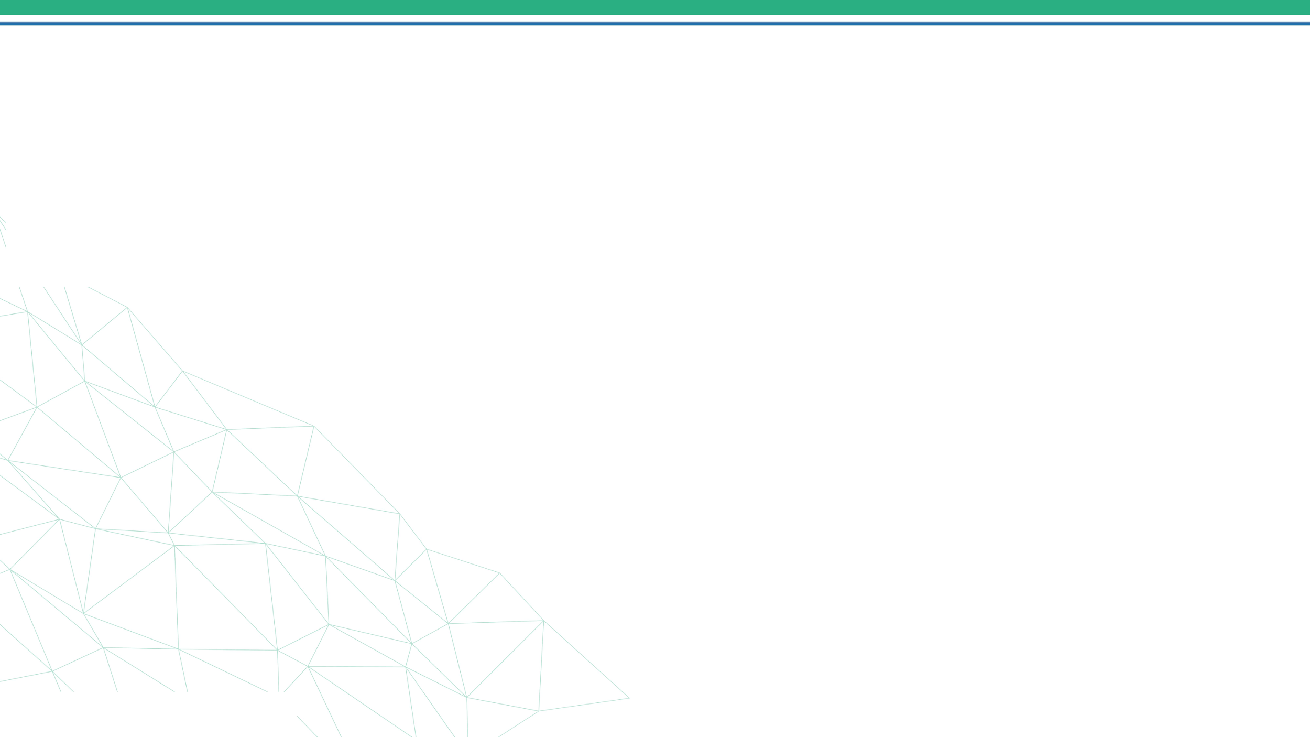


Real-Time Sign Language
Recognition
ASL fingerspelling from a webcam · MediaPipe landmarks · static-pose MLP
Ahmed Abd El-Ghafar Slama · Ahmed Hassan Mohamed · Yara Ahmed Mohamed Abdelall · Salwa Wael Mohammed Elkordy
DEPI · Microsoft Machine Learning Program — Graduation Project 2026

Slide 2
Project Idea
The problem, our solution, and what makes it stand out
!
+
★
The Problem
Deaf & hard-of-hearing people face a daily communication barrier. Human interpreters are scarce, costly, and can't be booked for every moment — a pharmacy, a bank, a clinic reception.
The Solution
A camera-only, real-time system that reads ASL fingerspelling from hand movement and turns it into on-screen text. No gloves, no sensors — just a webcam and a browser.
Unique Value
Works on hand LANDMARKS, not pixels: tiny, fast on CPU, robust to lighting & skin tone. A confidence gate + temporal smoothing keep predictions stable and flicker-free.
2

Slide 3
How It Works — Architecture
One landmark front-end, one static-pose classifier
Webcam
frame
MediaPipe
21 landmarks
Normalize
63-D vector
Static MLP
24 classes
Letter
The model
63-D landmark vector → StandardScaler → Dense 256→128→64 (BatchNorm + ReLU + Dropout) → Softmax over the 24 static letters A–I, K–Y.
Stability
A confidence gate ignores uncertain frames; a majority vote over the last 10 predictions removes flicker; the word builder commits held letters.
landmarks → normalize → static MLP → confidence gate + smoothing → Word Builder → text
3

Slide 4
Wireframe & User Journey
A single-screen web client — usability first
User journey
TEXT
CAB
1
Open the app & allow camera access
webcam + landmark overlay
2
Sign a letter — the skeleton overlay tracks your hand
Start
3
Hold ~1s → the letter commits to the word
Space
Back
4
Release your hand before repeating the same letter
A
Clear
5
Use Space / Backspace / Clear to edit text
4

Slide 5
End Users & Key Features
Who it serves and what it does
End users
Key features
•
Deaf & hard-of-hearing
Spell names, words & addresses without an interpreter.
Real-time recognition on CPU (landmark-based)
Recognizes the 24 static ASL letters (A–I, K–Y)
•
Service counters & retail
Pharmacies, banks, clinics, telecom & government desks.
Confidence gate + majority-vote smoothing (no flicker)
•
Education
Interactive ASL-alphabet tutor with instant feedback.
Word builder with commit-on-stability logic
Live hand-skeleton overlay & confidence meters
•
Developers
A drop-in REST/WebSocket API for kiosks and apps.
REST + WebSocket API, session-isolated state
5

Slide 6
Data Structure
From raw images to a compact landmark dataset
Dataset — ASL Alphabet (Kaggle)
Feature engineering & techniques
▸ ~87,000 images · 200×200 px · originally 29 classes
▸ Modelled: 24 static letters (A–I, K–Y)
▸ Dropped: J, Z (motion) and space / delete / nothing
▸ Roughly balanced — ~3,000 images per class
▸ Format: image folders per class (not a CSV)
▸ MediaPipe HandLandmarker → 21 × (x, y, z) = 63 features
▸ Normalize: wrist-relative + scale-invariant (pose only)
▸ StandardScaler on features; stratified 80 / 20 split
▸ MLP: Dense 256→128→64 → Softmax (24 classes)
▸ Confidence gate + majority-vote smoothing at inference
▸ Cached to .npy for fast, reproducible re-runs
6

Slide 7
Languages, Frameworks & Tools
The full technology stack
1
2
3
4
5
Languages
Machine Learning
Backend
Frontend
Tools & Ops
Python
JavaScript
HTML / CSS
TensorFlow / Keras
MediaPipe (Tasks)
scikit-learn
NumPy · OpenCV
FastAPI
Uvicorn
WebSockets
Pydantic
Vanilla JS
Canvas overlay
WebSocket client
Google Colab
Docker
Git / GitHub
joblib
7

Slide 8
Live Application & Testing
Working end-to-end, and how we validated it
Current state
Testing & QA
What we learned
▸ Notebook → trained models
▸ FastAPI backend (REST + WS)
▸ Live web client (webcam)
▸ Runs in real time on CPU
▸ Dockerised & deployable
▸ Static model self-test on held-out data
▸ Evaluation: accuracy, precision, recall, F1
▸ Confusion matrix + training curves
▸ Manual real-time webcam testing
▸ API tested via Swagger /docs & curl
▸ Removed dynamic model → fixed wrong letters
▸ Confidence gate → no wrong flashes
▸ UI-driven space / backspace
24
static letter classes (A–I, K–Y)
63-D landmark features per frame
8

Slide 9
Business Impact & Practical Use
Accessible communication, at software scale
$50–150
per hour saved vs.
on-demand interpreting
430M+
people with disabling
hearing loss (WHO)
24 / 7
instant, on-demand,
zero marginal cost
Practical use cases
Accessibility kiosks
Turn any service counter into an accessible one.
Education apps
Gamified ASL-alphabet learning with live feedback.
Healthcare intake
Faster, safer when no interpreter is on hand.
Call captioning
Overlay fingerspelled letters during video calls.
9

Slide 10
Deliverables
Everything produced for this project
✓
Trained model bundle
2 models + scaler + encoders + config.json
✓
Colab training notebook
End-to-end, reproducible, top-to-bottom
✓
FastAPI backend
REST + WebSocket, session-isolated
✓
Web frontend
Live webcam client with overlay
✓
API documentation
Full endpoint reference + examples
✓
Business impact doc
Market, users, ROI, roadmap
✓
GitHub repository
README, structure, run instructions
✓
This presentation
DEPI defense deck
10

Slide 11
Project Team & Roles
Four members · GitHub + Colab · agile collaboration
AS
Ahmed Abd El-Ghafar Slama
ML & Model Design
Static-model design, training notebook, landmark normalization.
AM
Ahmed Hassan Mohamed
Backend & API
FastAPI service, REST/WebSocket, session engine, Docker.
YA
Yara Ahmed Mohamed Abdelall
Frontend & UX
Web client, webcam capture, landmark overlay, controls.
SE
Salwa Wael Mohammed Elkordy
Data & Evaluation
Dataset prep, metrics & confusion matrix, documentation.
11

Slide 12
Thank You
Questions & feedback are welcome
Real-Time Sign Language Recognition
Ahmed Slama · Ahmed Hassan · Yara Abdelall · Salwa Elkordy
DEPI · Microsoft Machine Learning Program

