Slide 1
Opinion poll Application idea
CMP6213 Mobile and Wearable Application Development
Idea/Design Presentation
Ahmed Mohamed – S18124225

Slide 2
Introduction
The aim is to design and create a localised opinion poll application for Android platforms.
Users can contribute towards opinion polls every day/week by answering How much they agree or disagree with questions but only in their postcode.
A user can view the general opinions of people living in their postcode.
User progress on completing poll questions will be saved so they can complete them later.
The application will use location privileges to verify postcodes.
Notes:
Allow people to connect locally

Slide 3
Mobile Feature/Frameworks
Framework
The Bootstrap framework might be used to allow the application to be responsive on different devices.
Web Services
Users will be able to view the voting results and all questions for polls
Data persistence
Users will be able to save poll results into their favourites page, which is stored in a database.
User will be able to view previous votes on polls
social media
Users will be able to tweet poll results and favourites questions

Slide 4
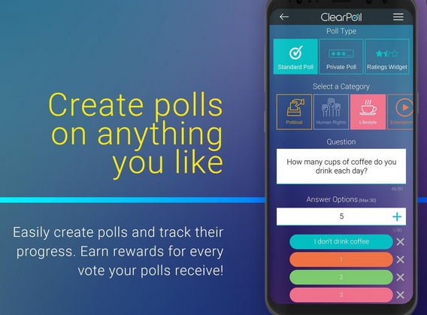
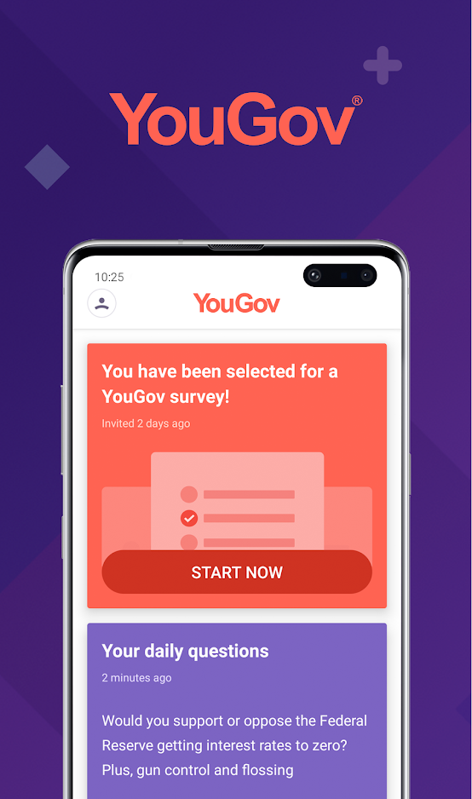
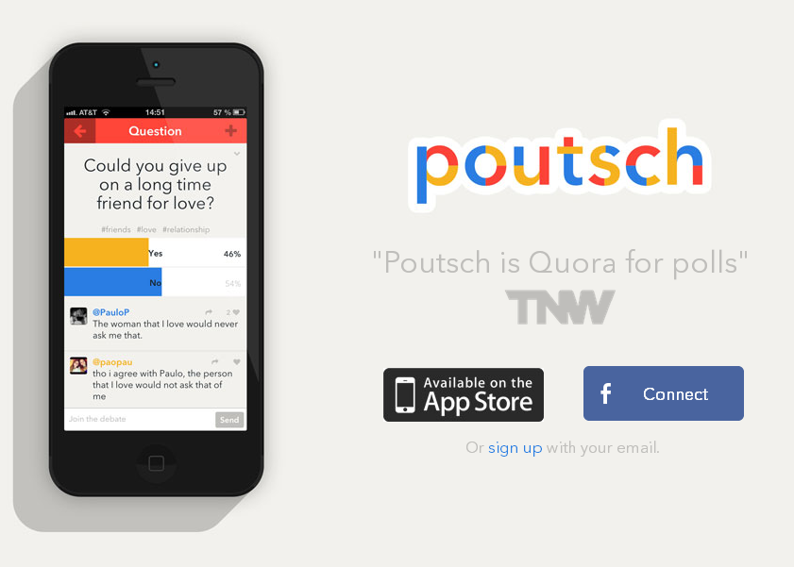
Similar Applications
Top features
Attitudes on different topics tab
Vote on articles
Earn points
Live Daily questions
User comments
Rewards
User created polls

Slide 5

UML Use case Diagram
Search topics
<<extend>>
Suggests topics for user
<<include>>
List of live polls
<<include>>
Select question
<<include>>
vote
<<include>>
<<extend>>
Complete introduction questions
Filter list by date
<<extend>>
Create account / log on
Add question to favourites
<<include>>
View users live questions
List questions
<<include>>
<<extend>>
Share question
<<include>>
View favourites
<<include>>
<<extend>>
Log into twitter through API
View voting history and results
View profile
<<extend>>

Slide 6
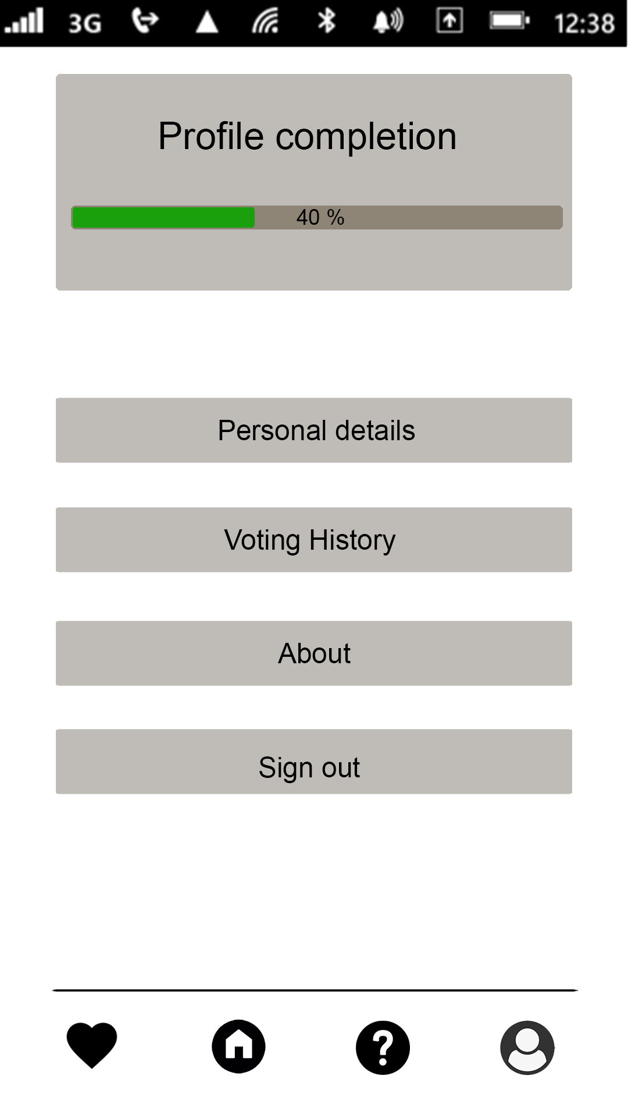
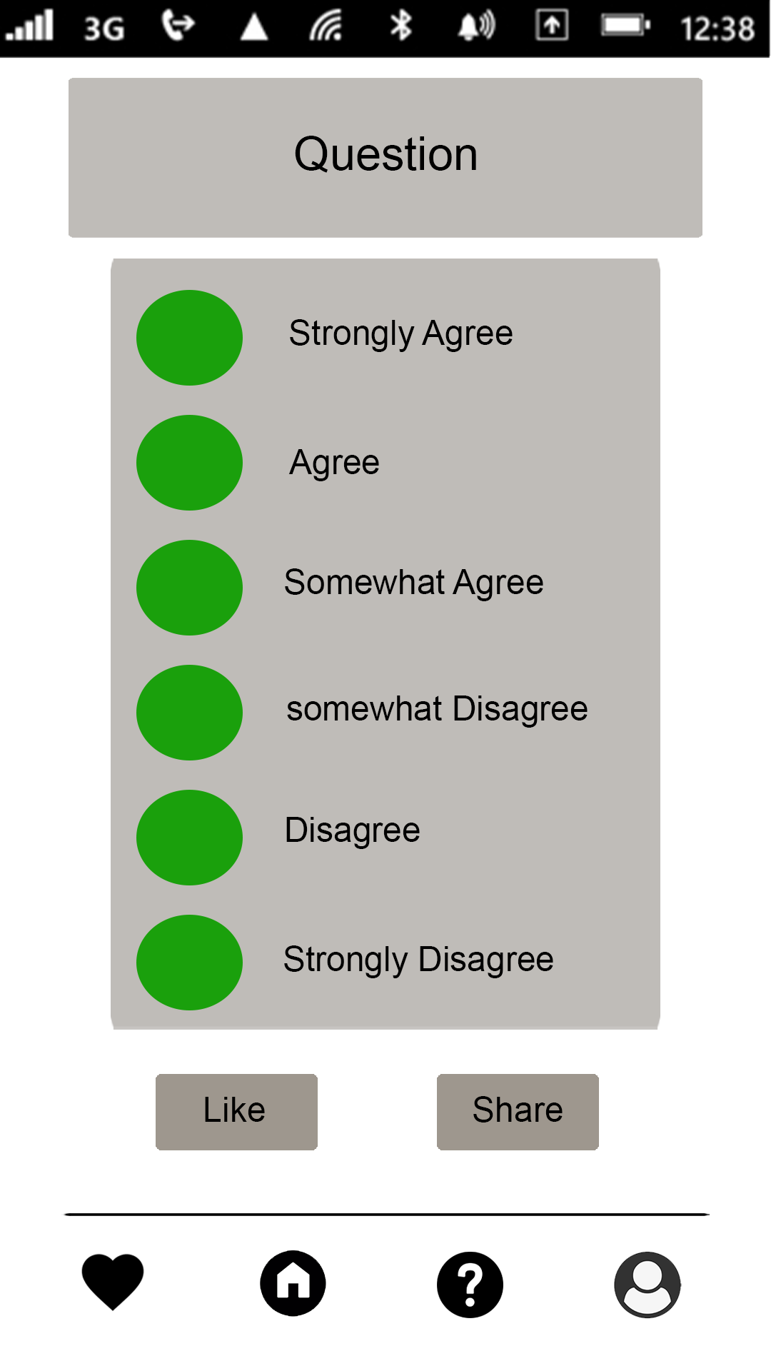
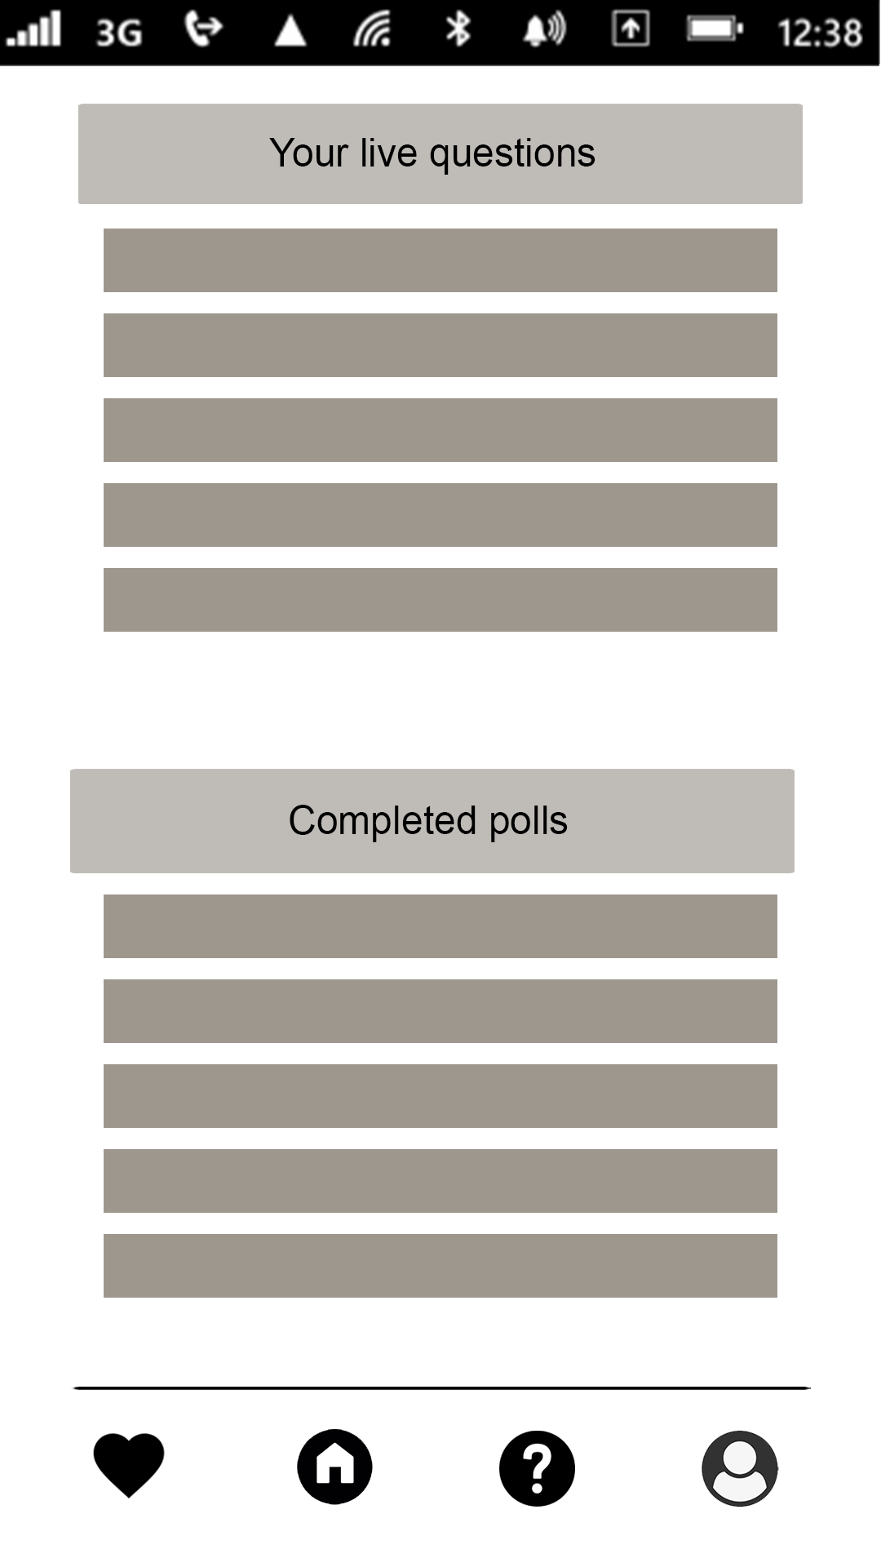
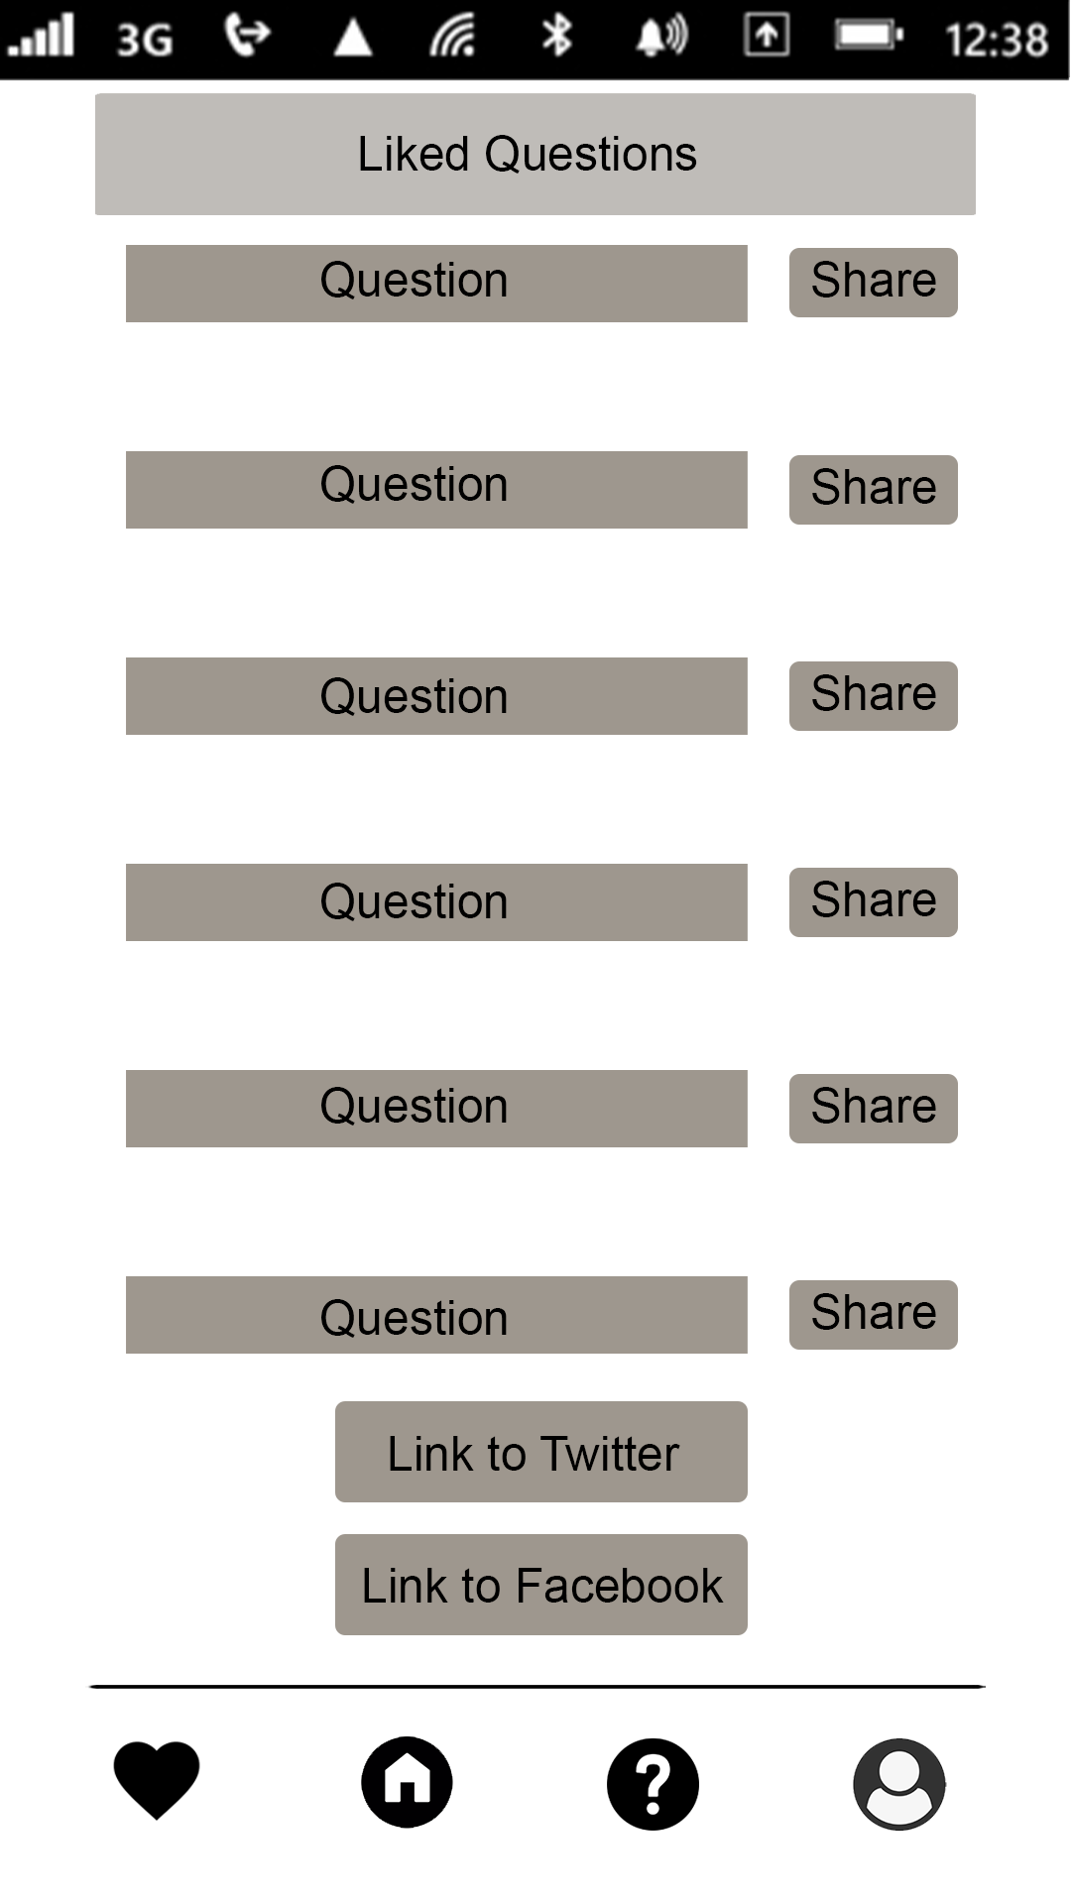
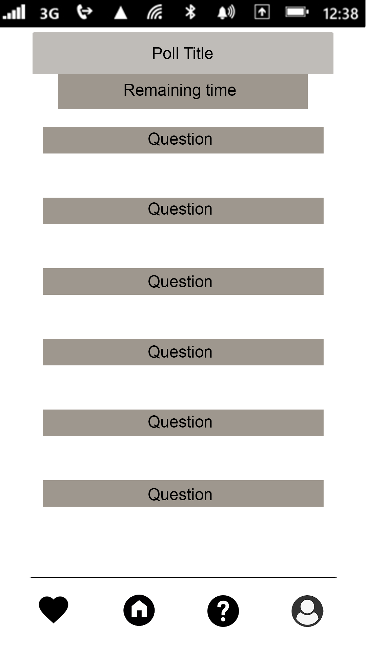
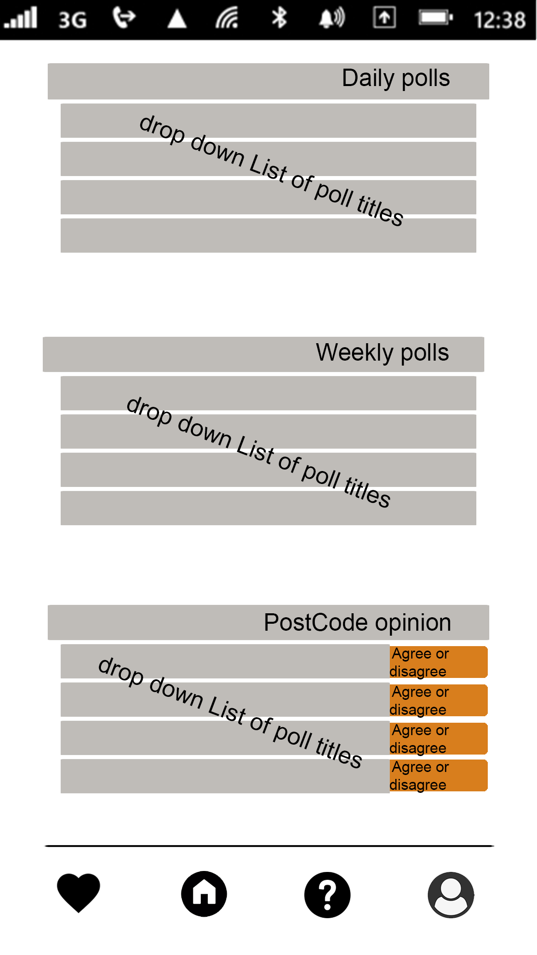
User Interface Designs
Profile page
Single Question
View
Questions page
Favourites page
Poll page
Home page
The question mark button will take the user to this page. Which displays completed polls and current polls that the user is engaged in
When a user clicks a question, the single question page will appear.
When user clicks on a poll title they will be directed to the poll page. Which shows a list of questions for the poll
The home button will direct the user to the home page. Which shows a list of the daily/weekly polls and results from previous poll in the users postcode
Profile button will take user to this page
The favourites button will take the user to this page. Which displays liked polls.

Slide 7
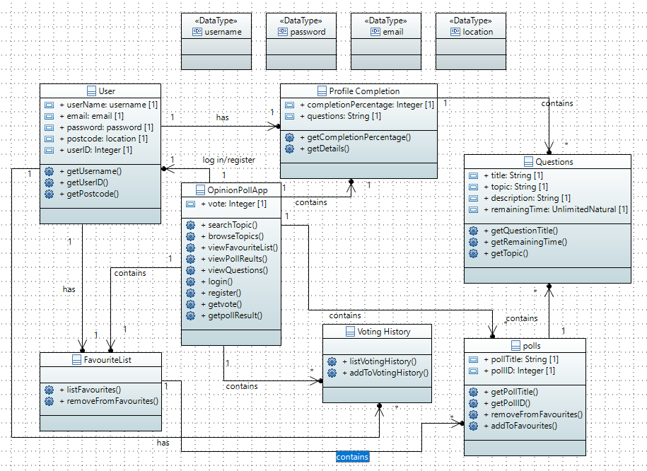
UML Class Diagram
The opinion poll app contains many polls which each have many questions
Questions have the following attributes:
Title
Topic
Description
Remaining time
Profile completion contains many questions which are used to determine details such as age, ethnic background and political leaning.
The opinion poll app contains many previous user votes
Opinion poll app contains one Favourites list contains many polls
User has many pervious votes
Data types used are:
Username
Password
Email
Integer
String
Unlimited Natural (remaining time)

Slide 8
Data Persistence
Room Persistence Library
The room library will be used to store and move the following data flutily between the app and the database using SQL
ER Diagram
OpinonPollApp
Voting History
pollTitle(String)
pollId (Int)
Questions (String)
Vote (Int)
A user has one favourites list
Containing the title of liked polls
User
Username
Email
password
VotingResults
Polls
Title (String)
Id (Int)
Questions (String)
A user has many previous votes which contain the vote, questions and poll title
Favourites List
FavouritePolls

Slide 9


Services
Facebook and Twitter APIs will be used to allow users to share polls on social media

Slide 10
Conclusion and Perceived Challenges
Finding a library of questions could save time as it will be time consuming populating different topics with unique polls and questions.
If time allows adding a feature that gives users the ability to summit questions would add a new layer to the application.
Finding a way to add video/audio questions could improve accessibility for a broader target group.

