Slide 1
Application Title
Implementation Walkthrough
A Anonymous 10111011
A.Anonymous@mail.bcu.ac.uk

Slide 2
Overview
Write an overview about your App.

Slide 3
Design Decisions and changes
Discuss design decisions and changes (if any) to original proposed design.

Slide 4
Concepts/Technologies Covered
Showing your understanding of the core concepts covered in the module.
Emphasise the technologies that you have used in your Application (with evidence).

Slide 5
Application Wide Notes
Indicate if your application is a Working Application Developed in Android Studio or Non compiling application.
Screenshots / explanation of what it does / how it works.

Slide 6
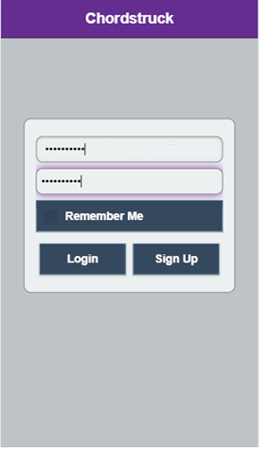
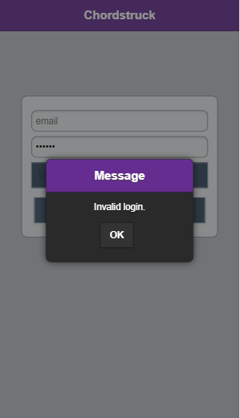
Login Screen Operation Overview
Upon entering a username and password, clicking “login”
Will start an AJAX query to the server, verifying credentials
Against the MySQL database and returning the result.
On successful login, the active page transitions to the “posts”
Page, effectively animating a display transition between two
Elements.
The screenshot on the left shows the login page, with the right
Showing invalid data being entered.
Note: Before and After Screenshots

Slide 7
Login Screen – Code
Copy & paste in the main parts of the code you developed in your .java files
Add some comments on what the Code Should Do
public class MainActivity extends ActionBarActivity {
@Override
protected void onCreate(Bundle savedInstanceState) {
super.onCreate(savedInstanceState);
setContentView(R.layout.activity_main);
Button buttonClick = (Button) findViewById(R.id.loginBtn);
buttonClick.setOnClickListener(new View.OnClickListener() {
@Override
public void onClick(View view) {
onButtonClick((Button) view);
}
});
}
public void onButtonClick(Button view) {
TextView textHello = (TextView) findViewById(R.id.textView);
textHello.setText(“Login Successful !!!");
}

Slide 8
Registration Screen
Add a number of slides of how you would established a Connection to a Firebase Database
Note: This can be setup via a Web Browser – so you should be able to screen shot this / highlight steps necessary
Likely to need several slides
Add code that would be necessary to connect to database.
Add code to write data to db….

Slide 9
How Many Slides
Continue in same manner as the past few slides
As Many as necessary to give a full overview of ALL App Features

Slide 10
Conclusions – Key Features / Functionality Achieved
PHP REST API handling all server side processing.
MySQL Database for persistent storage.
JWT – JSON Web Token used for storing session variables/data locally.
Mobile centred UI design
Status posting/commenting between users.
Friends functionality.
Private messaging between users.
Login/Signup with hashed credentials.
jQuery & jQuery Mobile
Highlight any specific API’s used

Slide 11
Conclusions – Problems Encountered
Highlight any Problems / Solutions you encountered
Could include links to Stackoverflow OR other sources that proved useful / info on how you got it working / provided hints on how to develop .java code
Could include Screenshots of interesting Errors

Slide 12
Conclusions – Improvements / Future Work
Complete profile details/images (e.g. bands/instruments).
Search based on band affiliation and instruments.
Location based filtering of search results (i.e. based on proximity to user) – link to API Documentation
Spotify API integration to display possible music tracks that users were a part of, such as band portfolios. – link to API Documentation

