Slide 1
Digital Transformation Strategy of *Entreprise***
Bureau Conseil : *IDEA Lab Conseil*
Name 1:
Name 2:
Name 3:

Slide 2
Table of Content
Digital Transformation Strategy of **
Minimum Viable Product: Fiche de Projet

Slide 3
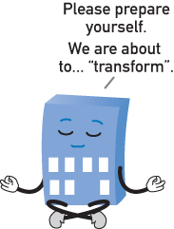
Chapter 1: What is Digital Transformation for “Entreprise”?
A digital transformation can introduce:
A digital transformation will impact an organization’s:
Business, Technology, Data and People
Digital Transformation and Technology
Digital Transformation and Data
Digital Transformation and People
Digital Transformation and Organizations and Solutions

Slide 4
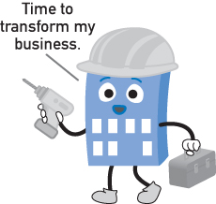
Chapter 2: What Led to Digital Transformation?)
Losing Touch with Customer Communities
Inability to Grow in Stale Marketplaces
Inability to Adapt to Rapidly Changing Marketplaces
Cold Customer Relationships
Inefficient Operations
Inefficient Decision-Making

Slide 5
Chapter 3: Common Technology Drivers
(What Enables Digital Transformation?)
Enhanced and Diverse Data Collection
Contemporary Data Science
Sophisticated Automation Technology
Autonomous Decision-Making
Centralized, Scalable, Resilient IT Resources
Immutable Data Storage
Ubiquitous Multiexperience Access

Slide 6
Chapter 4. Common Benefits and Goals (Why Undergo a Digital Transformation?)
Enhanced Business Alignment
Enhanced Automation and Productivity
Enhanced Data Intelligence and Decision-Making
Improved Customer Experience and Customer Confidence
Improved Organizational Agility
Improved Ability to Attain Market Growth

Slide 7
Chapter 5. Common Risks and Challenges (What Are the Pitfalls?)
Poor Data Quality and Data Bias
Increased Quantity of Vulnerable Digital Data
Resistance to Digital Culture
Risk of Over-Automation
Difficult to Govern

Slide 8
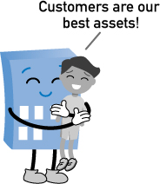
Chapter 6. Realizing Customer-Centricity
What Is a Product?
What Is a Customer?
Product-Centric vs. Customer-Centric Relationships
Transaction-Value vs. Relationship-Value Actions
Customer-Facing vs. Customer-Oriented Actions
Relationship Value and Warmth
Single vs. Multi vs. Omni-Channel Customer Interactions
Customer Journeys
Customer Data Intelligence

Slide 9
Chapter 7. Data Intelligence Basics
What Is a Product?
What Is a Customer?
Product-Centric vs. Customer-Centric Relationships
Transaction-Value vs. Relationship-Value Actions
Customer-Facing vs. Customer-Oriented Actions
Relationship Value and Warmth
Single vs. Multi vs. Omni-Channel Customer Interactions
Customer Journeys
Customer Data Intelligence

Slide 10
Chapter 8. Intelligent Decision-Making
Manual Decision-Making
Conditional Automated Decision-Making
Intelligent Manual Decision-Making
Intelligent Automated Decision-Making
Intelligent Manual vs. Intelligent Automated Decision-Making

Slide 11
Part II: Digital Transformation in Practice
Chapter 9 Understanding Digital Transformation Solutions
Chapter 10 An Introduction to Digital Transformation Automation Technologies
Chapter 11 An Introduction to Digital Transformation Data Science Technologies
Chapter 12 Inside a Customer-Centric Solution

Slide 12
Chapter 9. Understanding Digital Transformation Solutions
Distributed Solution Design Basics
Data Ingress Basics
Common Digital Transformation Technologies

Slide 13
Chapter 10. An Introduction to Digital Transformation Automation Technologies
Cloud Computing
Blockchain
Internet of Things (IoT)
Robotic Process Automation (RPA)

Slide 14
Chapter 11: An Introduction to Digital Transformation Data Science Technologies
Big Data Analysis and Analytics
Machine Learning
Artificial Intelligence (AI)

Slide 15
Chapter 12. Inside a Customer-Centric Solution
The purpose of this chapter is to:
demonstrate the practices of customer-centricity
indicate how and where digital transformation technology can be utilized to improve a customer journey
highlight how the utilization of customer-centricity practices and digital transformation technology can realize strategic business objectives

