Slide 1

Faculty of Engineering and Information Technology
ENCS3330, DIGITAL INTEGRATED CIRCUITS
"Efficient Power-Optimized 4x4 Pipeline Multiplier for Enhanced Digital Arithmetic in DSP and Microcontroller Applications"
Prepared by : Ahmad Zubaidia 1200105
Hamza Awashra 1201619
Jana Herzallah 1201139
Supervised by : Professor Khader Mohammad

Slide 2
Contents :
Abstract with results:
Design history / comparison of literatures
Proposed design block diagram
Design circuit , simulations and sizing
Design layout , simulations
Optimization technique used
Conclusion with summary of area , delay and power

Slide 3
Abstract with results:
This paper introduces a 4x4 pipeline multiplier designed for signal processing and arithmetic tasks. This specialized circuit divides the multiplication process into stages, allowing for concurrent operations, enhancing speed in digital systems. The study emphasizes its significance in various applications like microcontrollers and GPUs due to its efficient arithmetic capabilities. The proposed design minimizes power consumption and reduces area usage by optimizing transistor count using pass gates, with the goal of achieving high power efficiency while preserving computational accuracy, promising potential advancements in digital arithmetic circuits.

Slide 4
The proposed 4x4 pipeline multiplier is expected to outperform traditional multiplication techniques such as the Wallace tree, Boolean algorithm, and the classical array multiplier in terms of delay, area, and power efficiency. By incorporating pipeline registers and leveraging advanced design strategies like Modified Gate Diffusion Input (MGDI) gates, the pipeline multiplier aims to significantly reduce delay, optimize area utilization, and minimize power consumption compared to these conventional methods. This innovative approach holds the potential to deliver superior performance across various digital arithmetic applications.

Slide 5
Design history / comparison of literatures
Multipliers within microchips serve as the mathematical wizards, enabling rapid and accurate multiplication operations. These multipliers are indispensable across various applications, from basic calculators to sophisticated AI systems, and in functions such as signal processing, device control, mobile devices, and automotive systems.
This paper delves into these challenges, exploring strategies to enhance microchips by making them more energy-efficient, compact, and proficient in multiplication tasks. The study highlights that different hardware techniques can be employed to design and engineer multiplier circuits, impacting crucial aspects such as delay, power consumption, and area utilization.
Traditionally, the 4-bit binary multiplier involves two fundamental steps. The first step entails computing partial products, a relatively straightforward process achieved through bitwise AND gate operations between the binary bits. This step is considered the simpler part of the overall multiplication process.

Slide 6
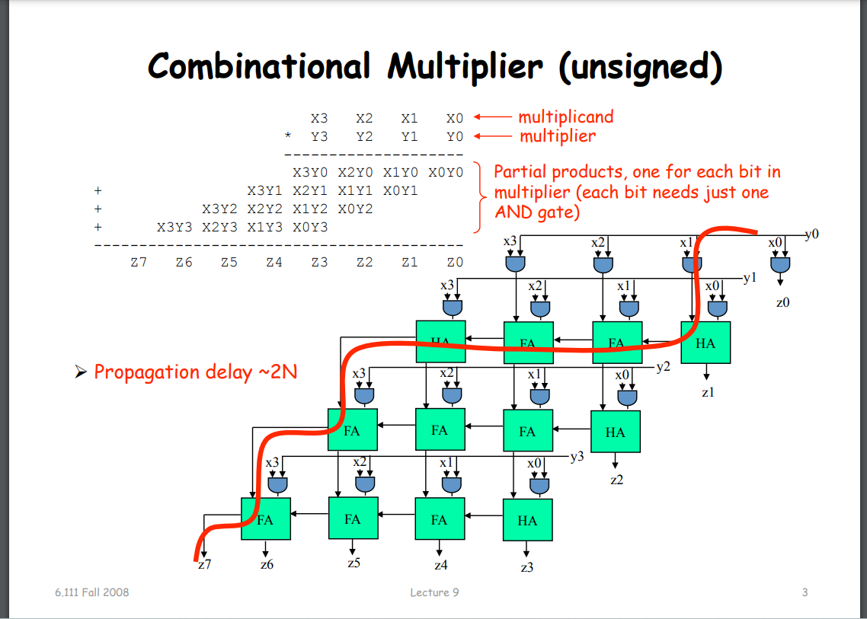
Figure 1 : classic 4*4 multiplier
The conventional method of multiplication involves using AND gates to calculate partial products and subsequently performing addition using full adders. However, this approach encounters significant challenges related to propagation delay. Each 4-bit adder must wait for the previous one to receive its input, resulting in increased power consumption during the waiting period. The propagation delay in a binary multiplier is approximated by multiplying the number of bit pairs (equal to the number of bits in each operand) by the gate delay, which varies based on technology and manufacturing processes.

Slide 7
Furthermore, there is a crucial consideration known as "input-to-output delay" or "input delay," representing the time required for a gate's input signals to stabilize and meet timing requirements before generating a valid output. Managing input delays is vital in ensuring correct and reliable operation of digital circuits.
Given the challenges associated with the classical design, there is a pressing need for improvements. Enhanced designs, such as the Booth algorithm and the Wallace tree compressor, have been developed to address these issues, offering potential solutions for optimizing multiplication processes. These enhanced designs will be further explored and discussed in the following sections.

Slide 8
Booth algorithm:
Increased Input Latency: In the context of Booth multiplication, which is utilized for improving multiplication operations, this method relies on a combination of shifting and addition procedures. These actions can result in heightened input latencies when compared to simpler multiplication techniques, potentially affecting the overall timing of the system.
Complex Control Logic: The Booth algorithm necessitates intricate control logic to manage the shifting and addition processes effectively. This added complexity can lead to an augmentation of input latencies and also contribute to greater power consumption due to the incorporation of extra logic gates and transitions.
Dynamic Power Dissipation: The Booth algorithm often entails dynamic power dissipation since it performs numerous bit-level operations within a single clock cycle. The transitions and operations involving bits and operands can give rise to dynamic power consumption, a concern of particular significance in applications with stringent power constraints.[5]

Slide 9
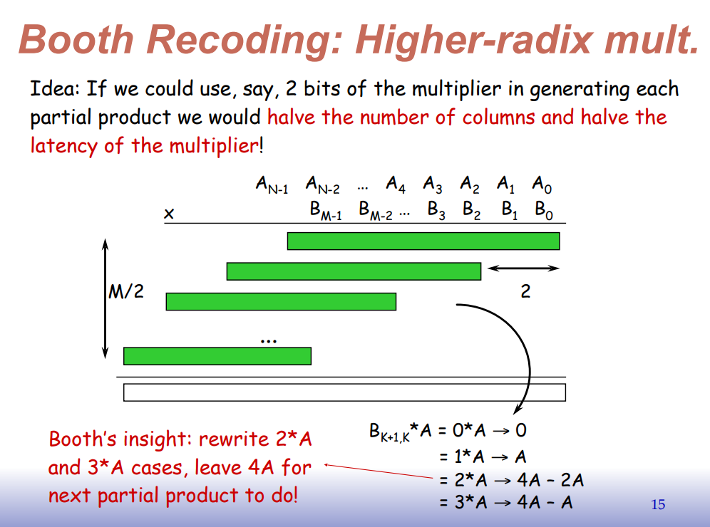

Slide 10
Concerning the Wallace Tree Compressor:
Input Latency and Critical Path: The Wallace tree compressor, employed in parallel adder and multiplier designs to reduce the number of partial products, can introduce notable input delays, particularly within critical paths. These delays can impose limitations on the overall system performance.
Increased Power Consumption: The usage of the Wallace tree compressor may also lead to elevated power consumption due to the parallel processing of partial products. The involvement of multiple gate levels in the compression process may contribute to an escalation in dynamic power dissipation.
Expanded Circuit Size: In efforts to mitigate input latencies and enhance performance, designers frequently opt for more intricate Wallace tree compressors. This choice can result in larger circuit layouts, potentially presenting challenges in situations where chip area is constrained.
Signal Integrity: Given the handling of multiple inputs and outputs by the Wallace tree compressor, maintaining signal integrity, particularly in extensive designs, can be a complex task. Signal degradation or interference from noise sources may emerge as concerns, impacting the overall reliability of the system.

Slide 11
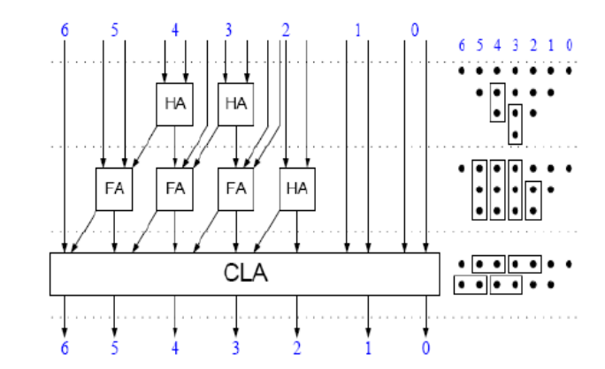
Wallace tree algorithm:
Figure 3 :Wallace tree

Slide 12
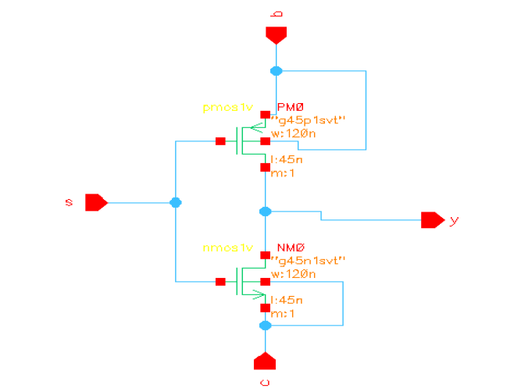
One another powerful way of improving the classical design that we considered in our design is to use the concept of :
Implementation of Multiplexer (MUX) Using Modified GDI Technique
In this section, we explore the application of the Modified Gate Diffusion Input (MGDI) technique in designing a Multiplexer (MUX). The MGDI technique leverages a specialized XOR gate configuration to achieve enhanced power efficiency and performance while maintaining the desired logical functionality.
Figure 4 : mux implemented by MGDI technique

Slide 13
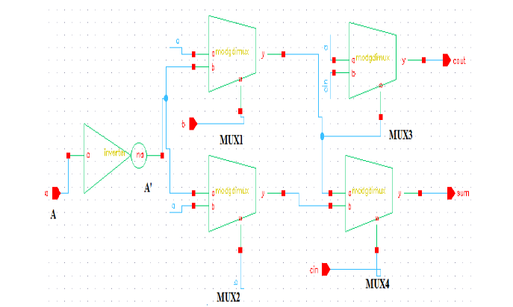
Modified GDI Full Adder Design
A Full Adder circuit is a fundamental component in digital logic, often used in arithmetic operations. Implementing a Full Adder using MGDI entails creating XOR gates for sum (S) bits and additional logic for the carry-out (Cout) bit. The steps we followed for MGDI Full Adder design included:
Employed MGDI XOR gates for each sum bit (S0, S1) by connecting the input bits (A, B, and Cin) to these XOR gates.
Utilized a combination of MGDI XOR and NAND gates to compute the carry-out (Cout) bit. Connect the input bits (A, B, Cin) and the inverted outputs of the XOR gates to the NAND gates. The output of the NAND gates yields the Cout signal.
Figure 5 : full adder using 2*2 multiplexers

Slide 14
Why didn’t we continue the whole design with MGDI technique?
The MGDI technique aims to optimize power efficiency and enhance performance while maintaining the necessary logical functions in these circuits. However, it's essential to emphasize that MGDI gates require meticulous design considerations, including transistor sizing and configurations, to meet specific objectives, such as power consumption reduction and improved operational speed.
This implementation showcases the versatility of the MGDI technique, allowing for the construction of complex logic circuits like a MUX and Full Adder with potential advantages in power savings and performance enhancement. However, we faced a huge challenge with the design complexity regarding the layout phase and because of the lack of resources for building the layout of this phase we had to think of another way of enhancing the design

Slide 15
Proposed design block diagram
Our proposed design will have the pipelining as the basic enhancement step done on the classical design which will enhance the speed, decrease the area and the mitigate the dissipated power by adding dividing the whole circuit into pipelining stages which the registers will separate between these stages acting as buffers that will hold the values which are getting passed between stages, that will increase the throughput by ½ the classical throughput, also tpd which is the propagation delay from input to output will be decreased to the half value at least. And it also have the gates built from an enhanced ways rather than the traditional ones, we have used the pass gates in building the xor , mux and flip flops so that saved us the half number of transistors in each element which caused the rreduction in power , delay and area as will be shown in the upcoming sections.
In the upcoming figure the desired 4*4 pipeline multiplier that we designed in this project .

Slide 16
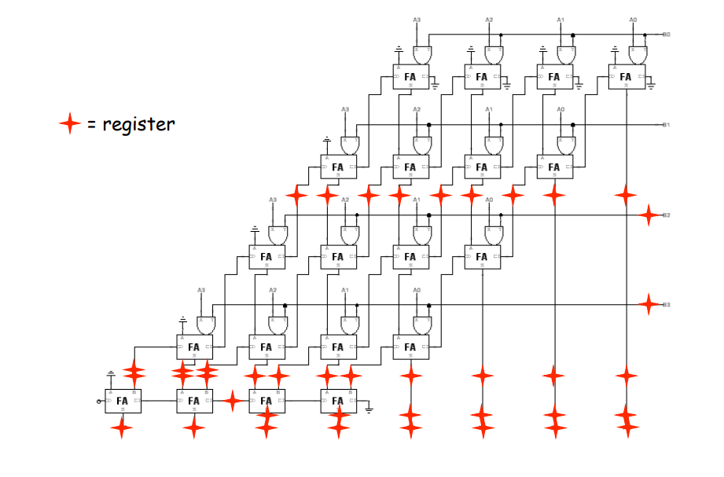
Proposed design
Figure 6 : propose pipeline multiplier

Slide 17
Its noticeable how there are multiple registers added to the circuit and how much they will affect the process of calculating the output of multiplying 2 4-bits binary numbers, the effect can be divided into some main ideas represented by:
Increasing throughput: Pipelining divides the multiplication operation into many phases, enabling the simultaneous processing of several inputs. The multiplier can now handle more multiplication operations per unit of time due to the increase in throughput.
Reduced Latency: By scheduling numerous processes to be completed simultaneously, pipelining minimizes the multiplier's latency. Once a stage's first multiplication is finished, the stage's second multiplication can begin. As a result, consecutive input values provide speedier results.
Effective Resource Utilization: The architecture effectively uses resources by employing registers to store interim results at each pipeline level. Registers are used to temporarily store data, which eliminates the need for complicated combinational logic and potentially reduced space requirements.

Slide 18
4. Scalability: Pipelined designs are often more scalable, making it easier to extend the multiplier to larger word lengths (e.g., 8x8, 16x16) without significant changes to the basic architecture.
5. Reduced Data Dependency Delays: Registers at each pipeline stage can help mitigate data dependency delays by storing and forwarding intermediate results. This can result in a more efficient utilization of computation resources.
Although there are so much benefits with this design, the real challenge will become with the complexity of designing the chip and its layout which will be discussed in the following sections:

Slide 19
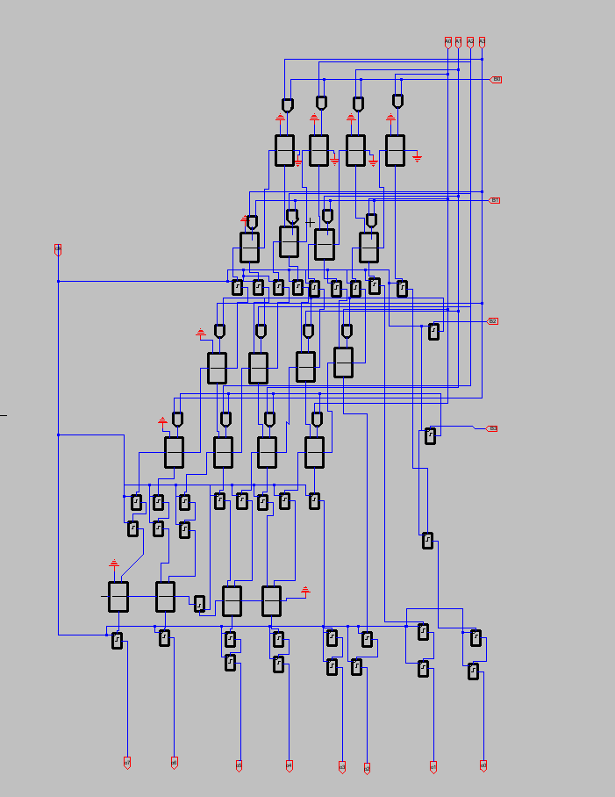
Design circuit , simulations and sizing

Slide 20
In order to explain how exactly this design works we need to divide it into little chuncks and understand how each small circuit works and how can we improve it in terms of the memory taken, number of transistors , area and power
Our system consists of:
And gates:
Nand cmos
Invertor cmos
Full adders:
Xor cmos
Mux
Flip flops:

Slide 21
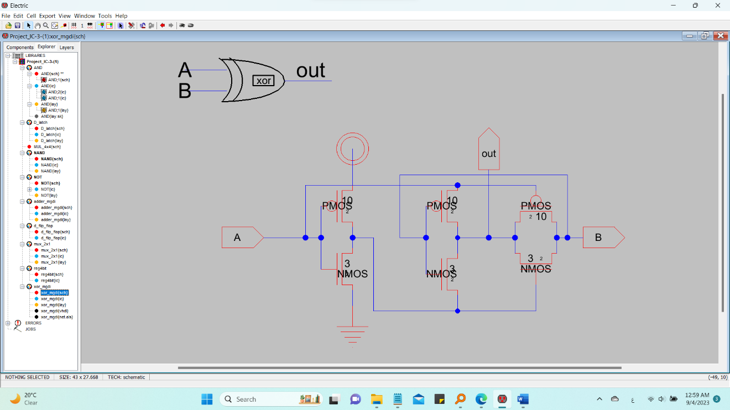
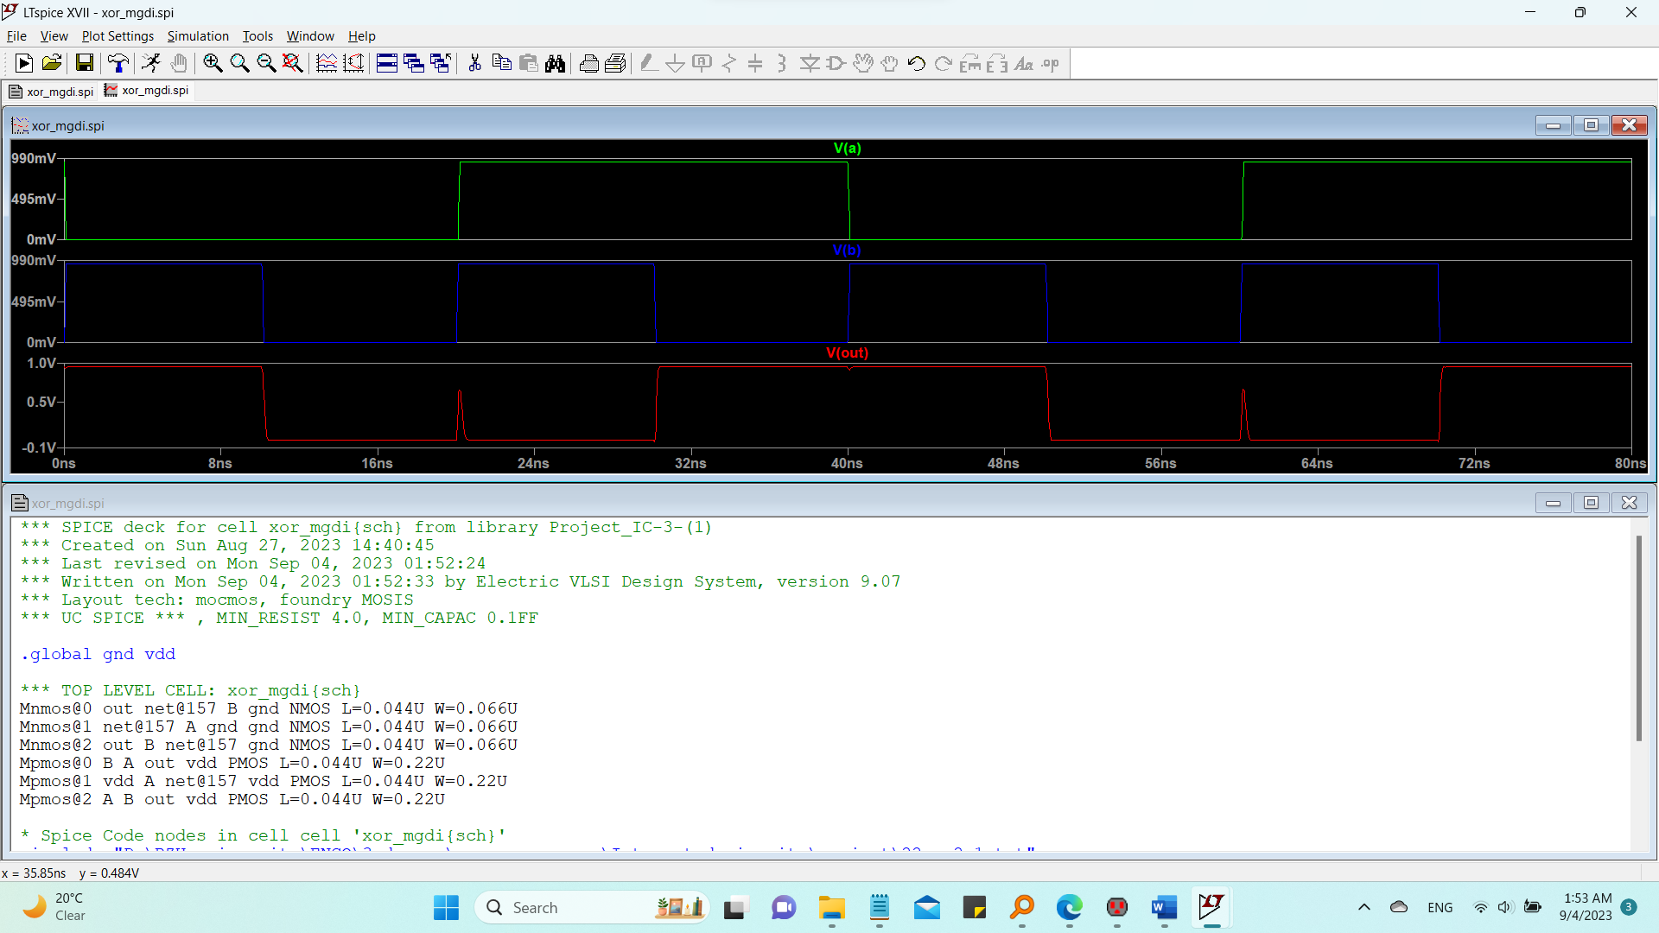
1. full adders:
Xor
Multiplixer
Figure 9 : xor gate built from cmos transistors / schematics
Figure 10 : simulation of the xor gate

Slide 22
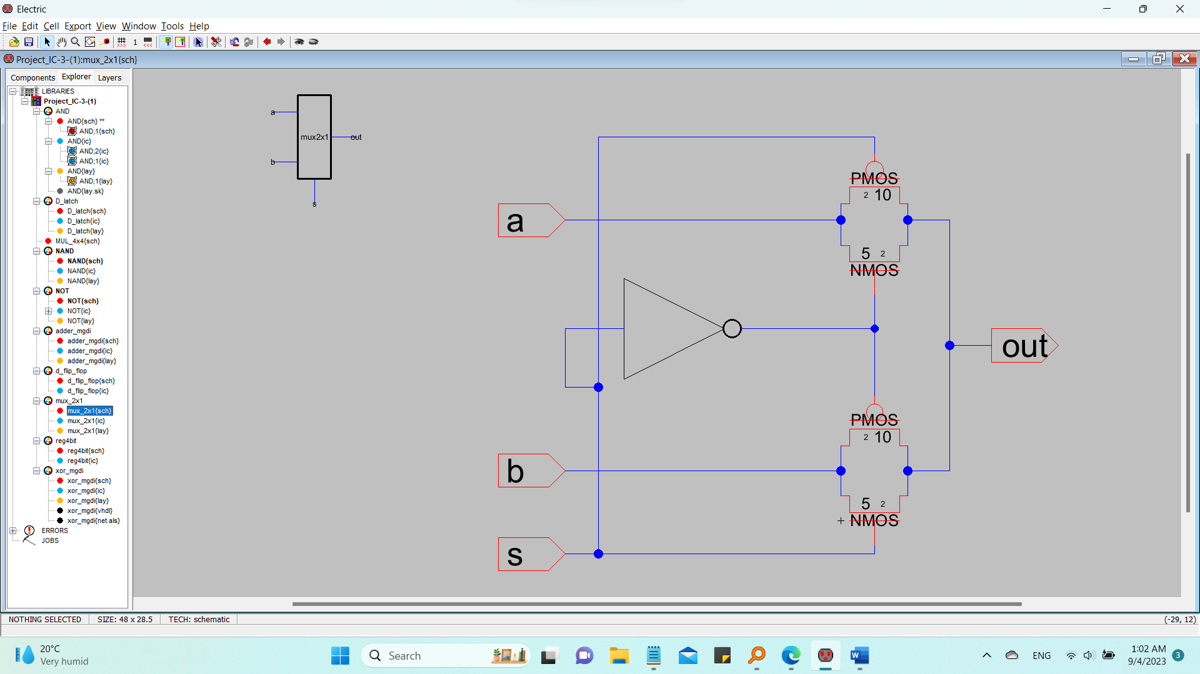
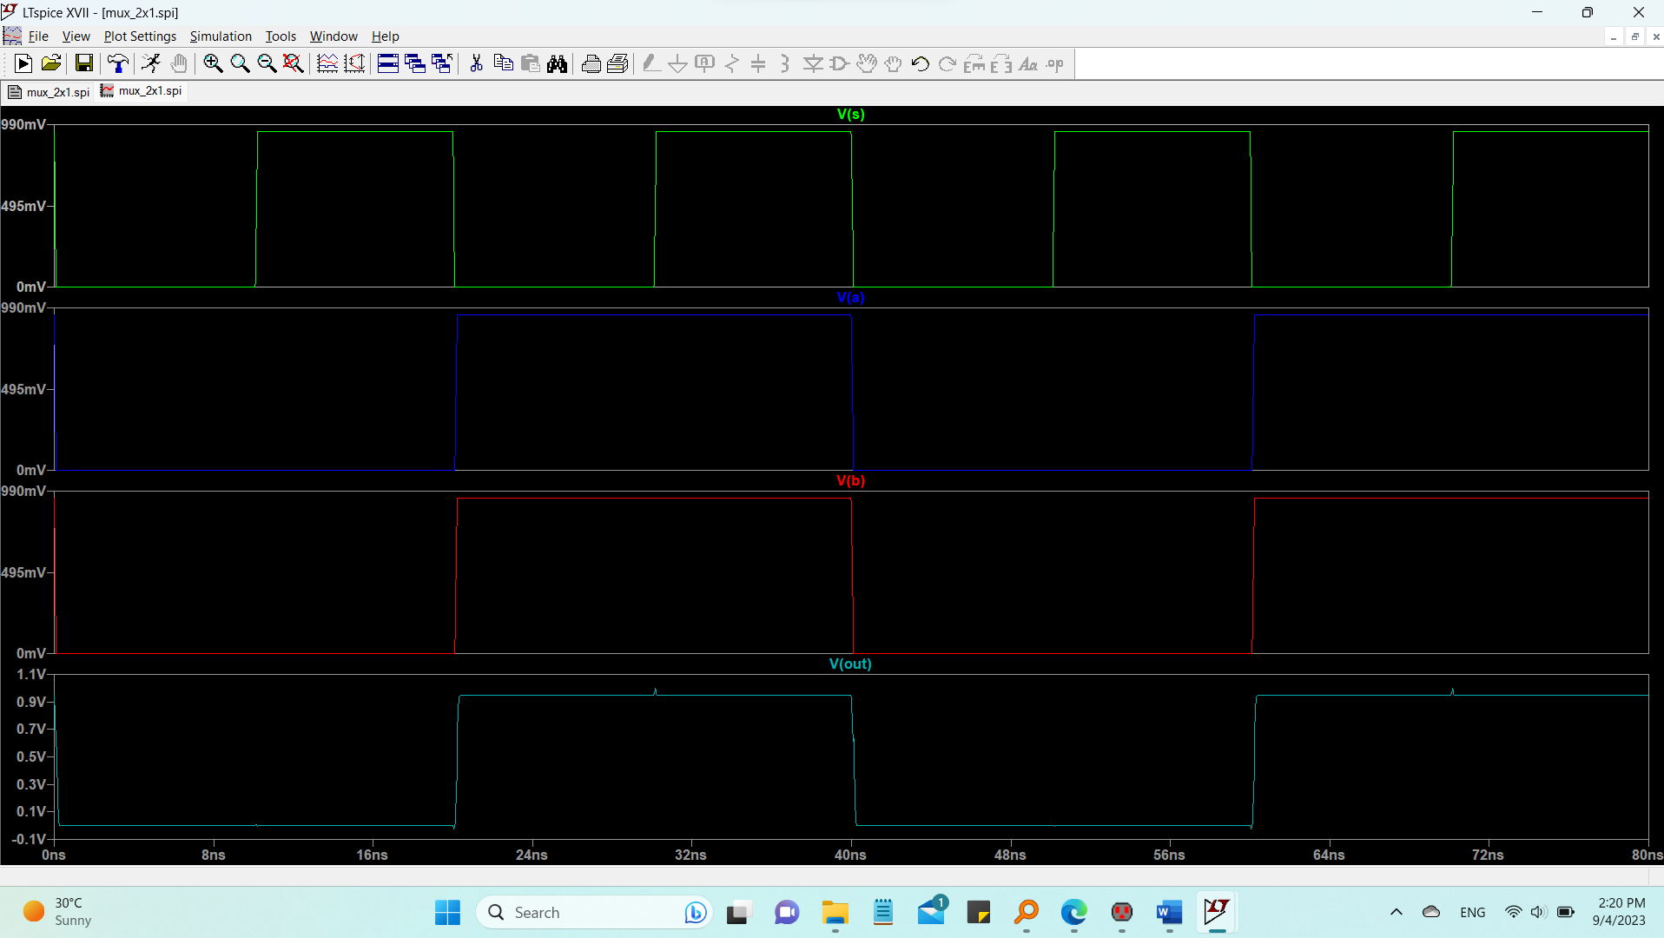
1. full adders:
Xor
Multiplixer
Figure 12 : multiplexer gate built form pass gates/ schematics
Figure 13: multiplexer gate simulation

Slide 23
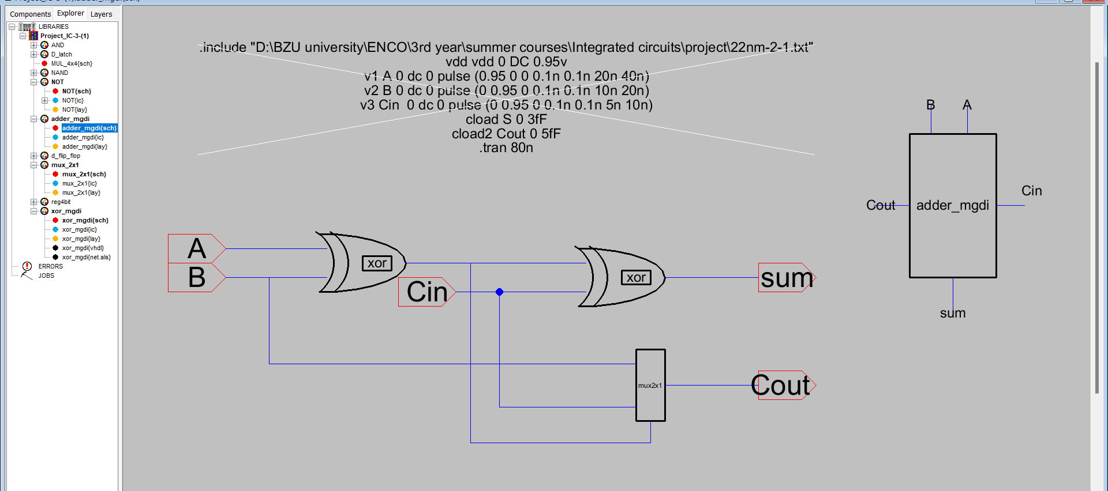
full adders:
Figure 14: schematics of full adder

Slide 24
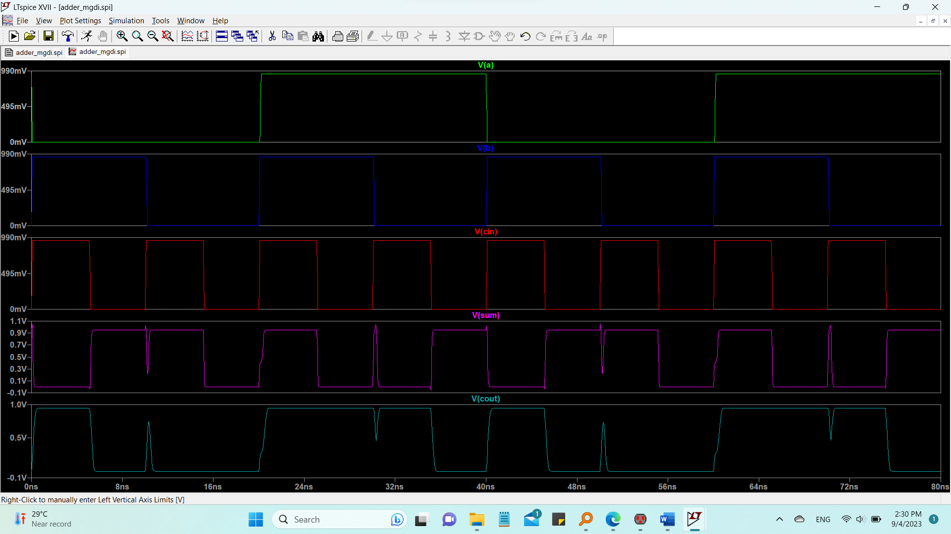
Figure 15 : simulation of the full adder

Slide 25
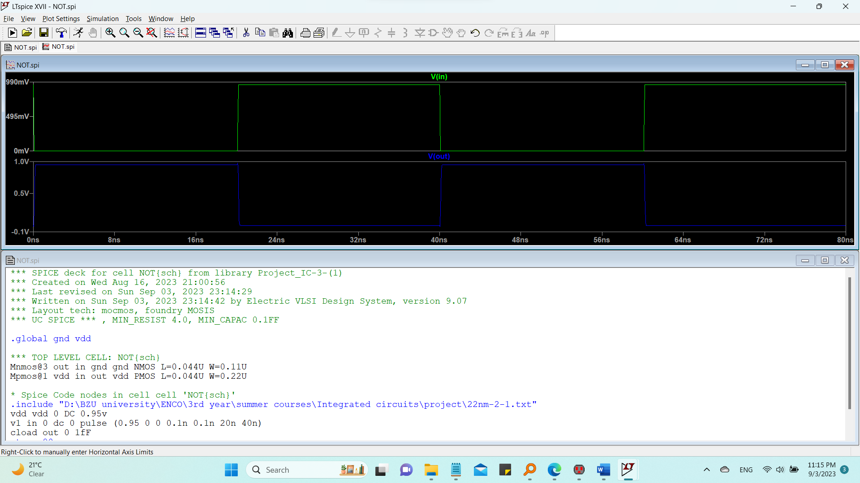
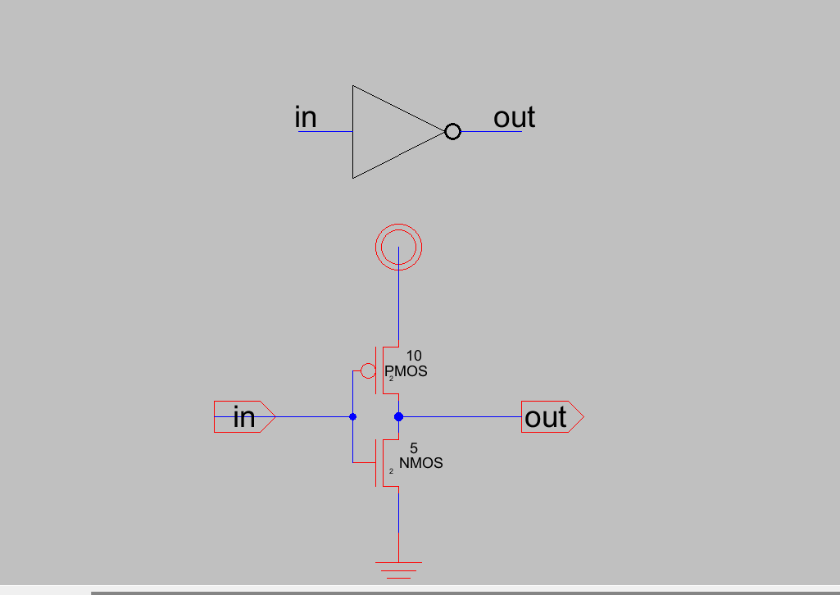
2. And gate :
Invertor
Nand gate
Figure 16: schematics of the invertor
Figure 17: simulation of the invertor

Slide 26
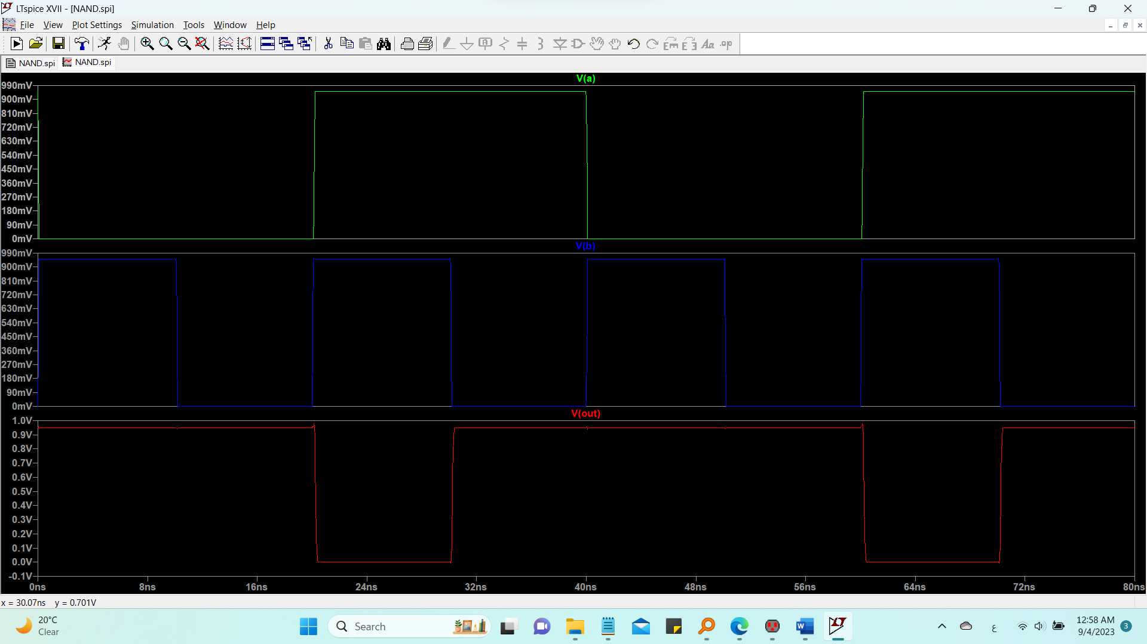
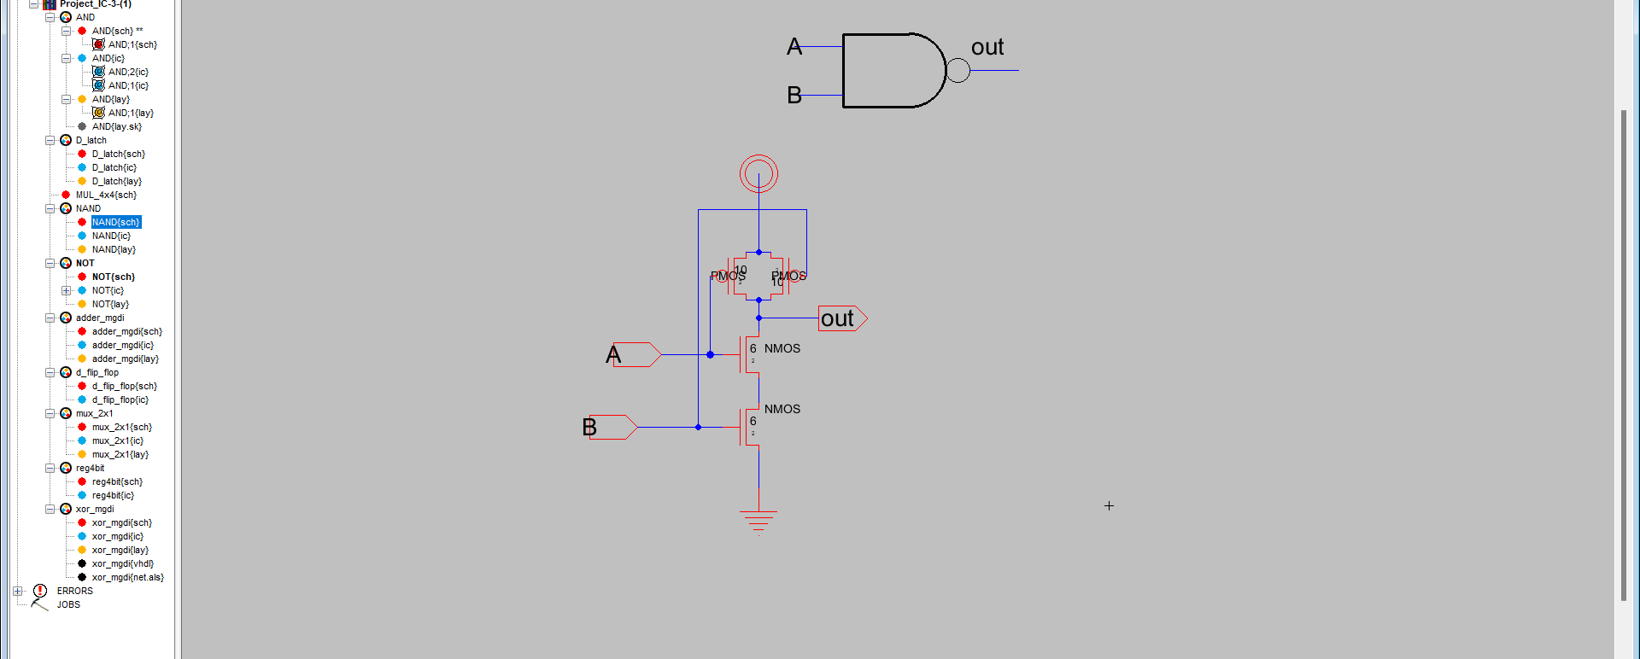
2. And gate :
Invertor
Nand gate
Figure 18: nand gate schematics
Figure 19: nand gate simulation

Slide 27
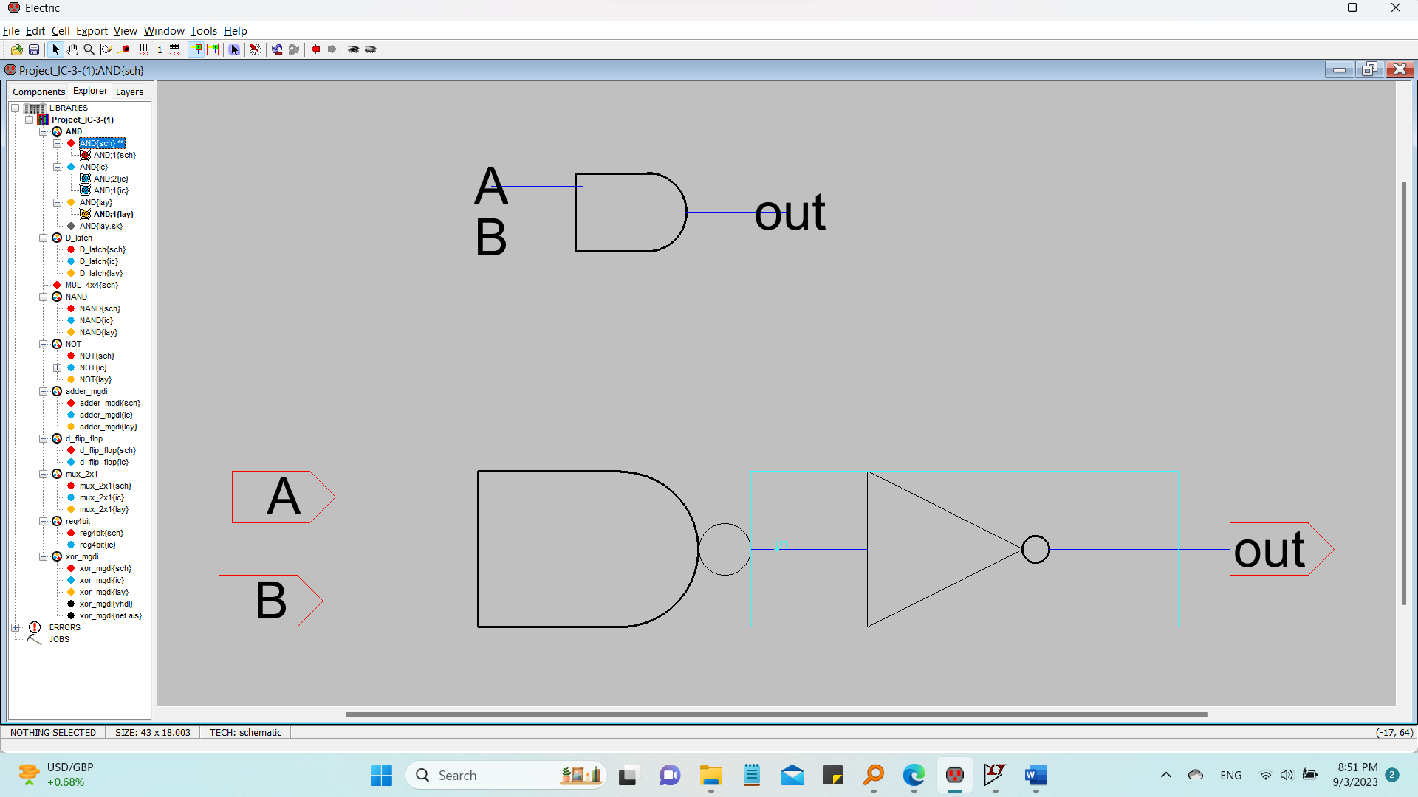
And gate :
Figure 20: and gate schematics

Slide 28
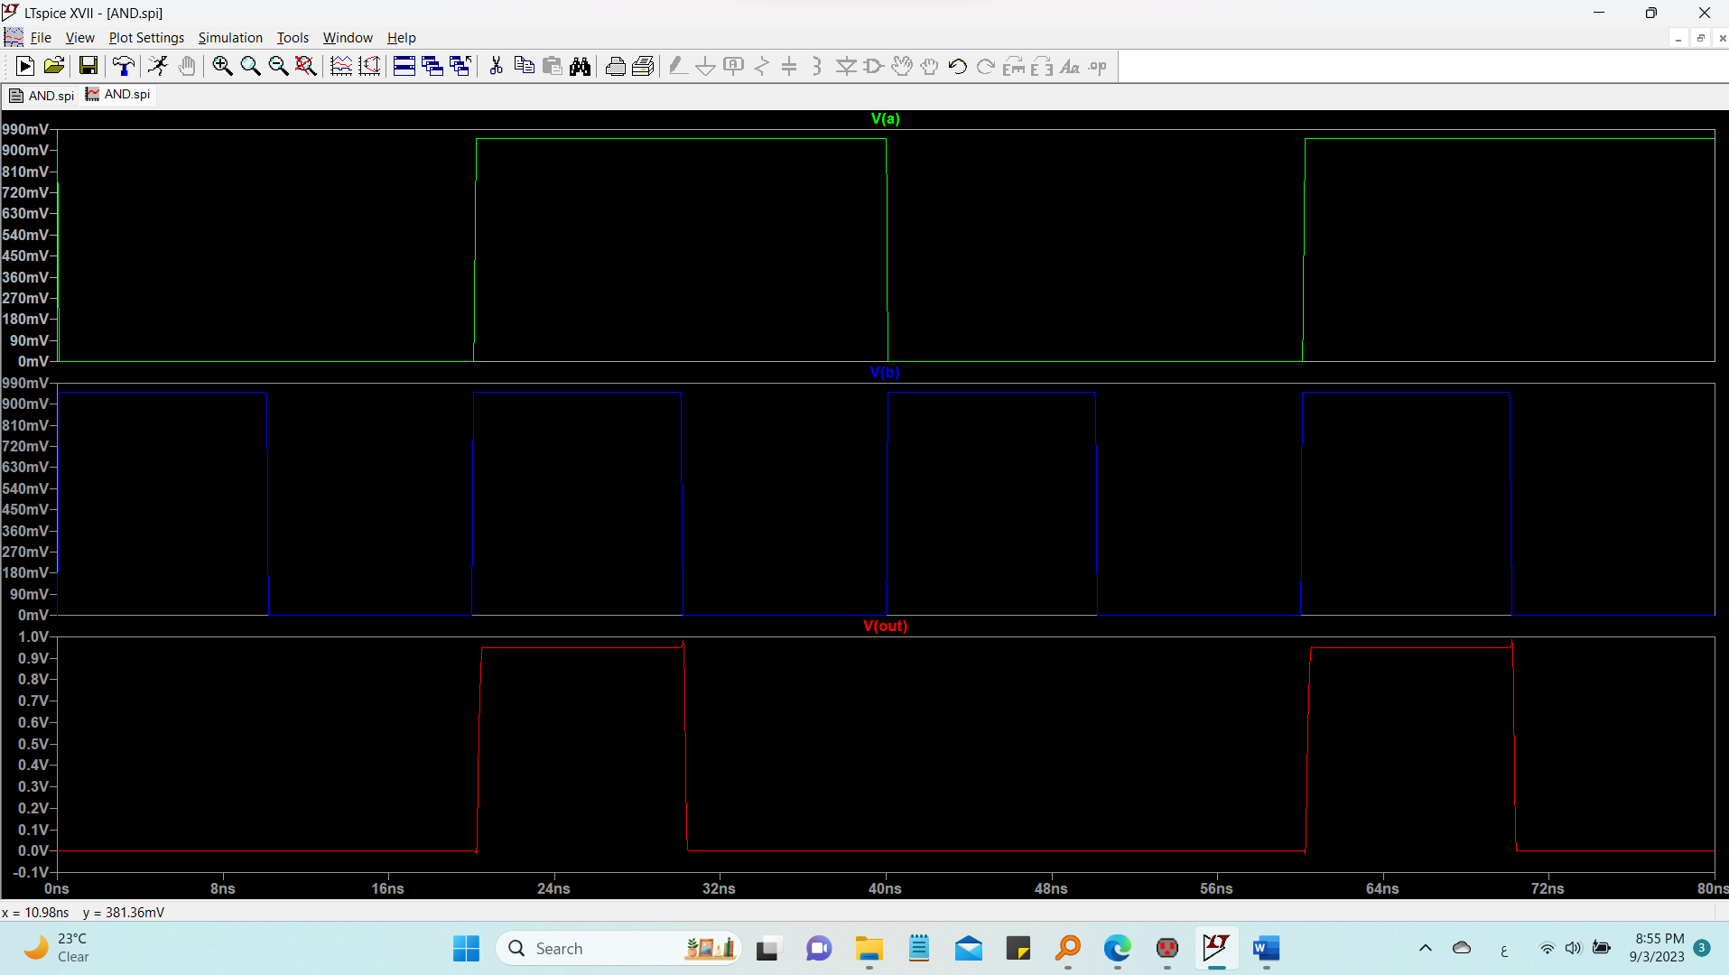
And gate :
Figure 21 : and gate simulation

Slide 29
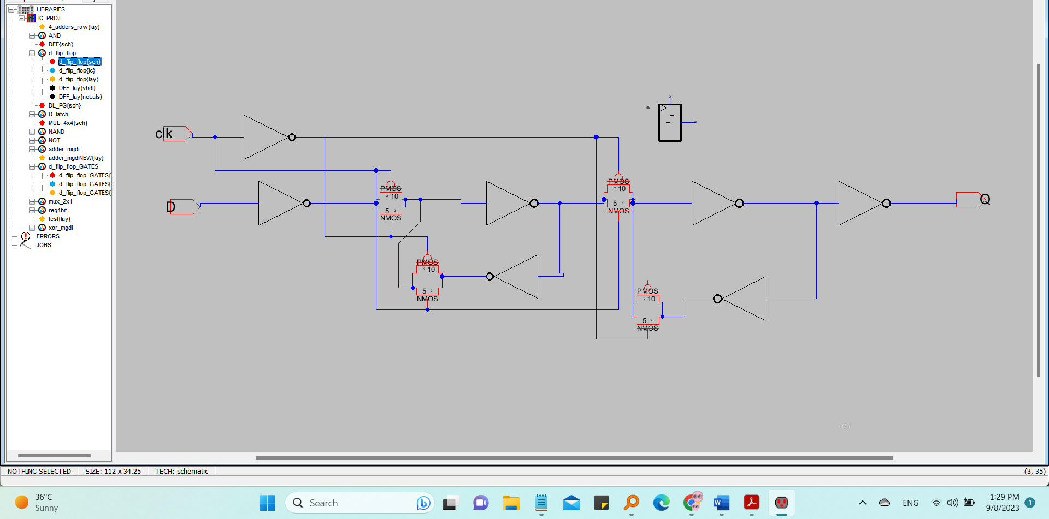
3. Flipflops

Slide 30
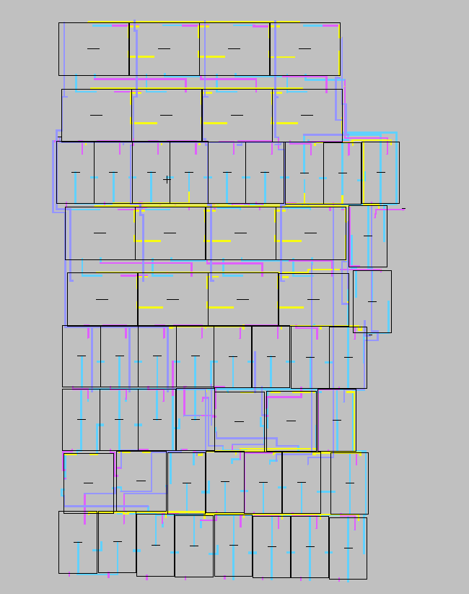
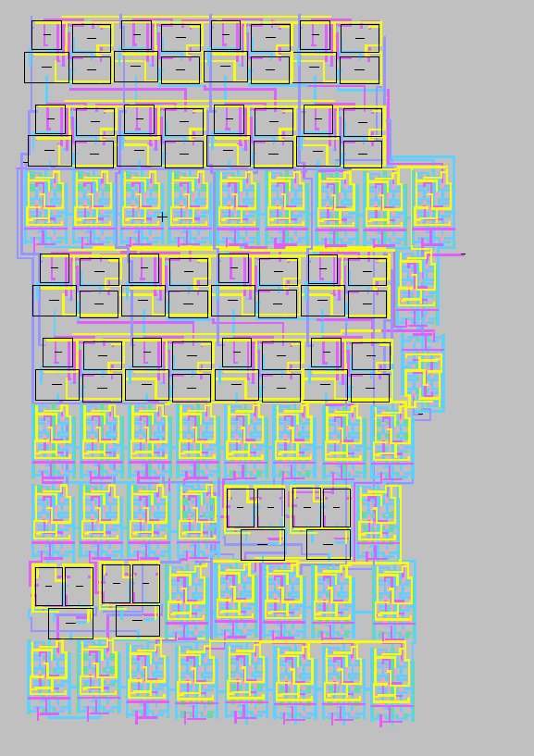
Design layout , simulations

Slide 31
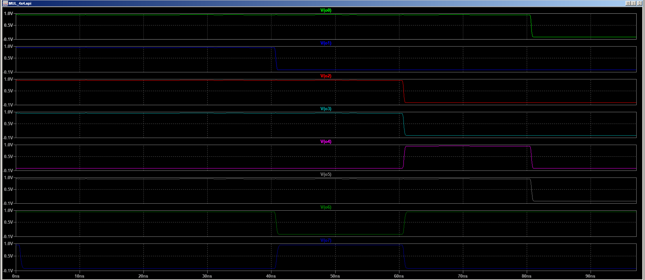
simulations
multiplier simulation example1
Here the Input is: 8 x 8
While the Output is 64 01000000

Slide 32
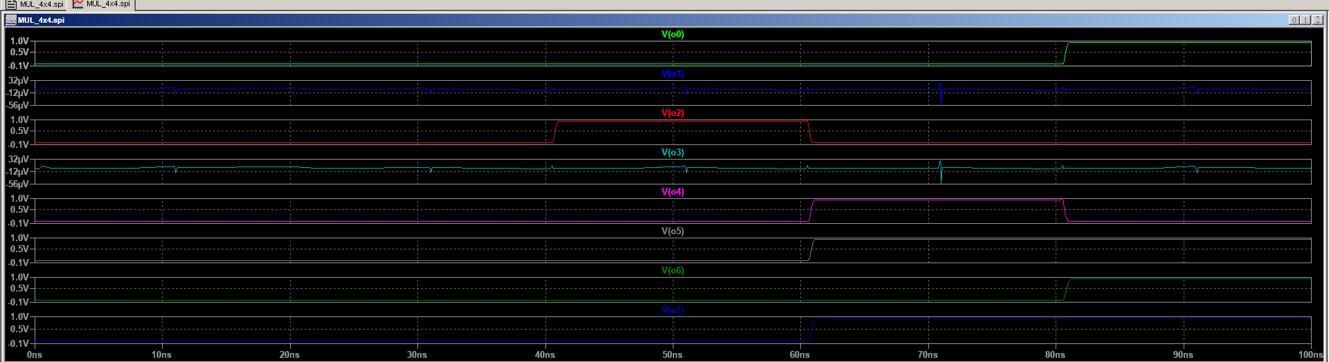


multiplier simulation example2
We can see how 15 * 15 = 255 = 11100001

Slide 33
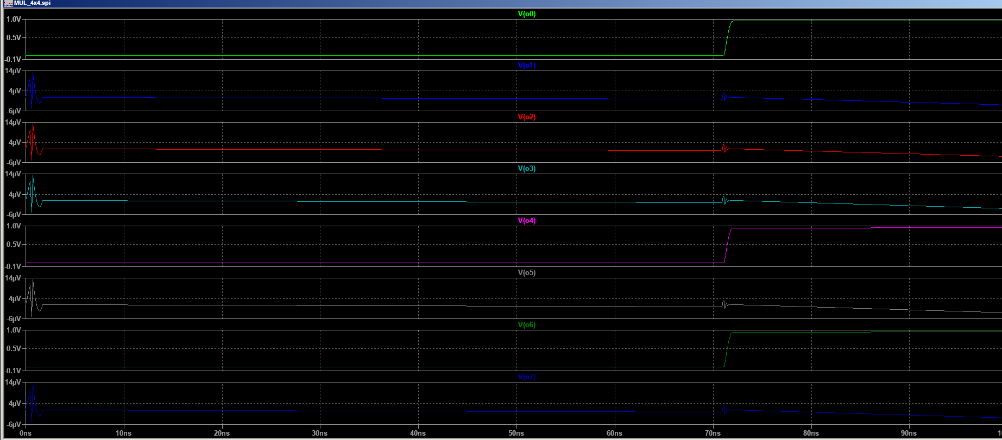

multiplier simulation example3

Slide 34
Area and sizing
Area Estimation of Multiplier Design in 22nm Technology
In the design process, it's essential to assess the silicon area footprint of the digital components to ensure efficient utilization of the chip space and optimize for performance and power. In this section, we provide a detailed calculation of the area occupied by our multiplier circuit implemented in the 22nm technology node.
1. Specifications:
Technology Node: 22nm (0.022µm)
Transistor Details:
NMOS Transistors:
Quantity: 650
Dimensions: 2L x 5W
PMOS Transistors:
Quantity: 650
Dimensions: 2L x 10W

Slide 35
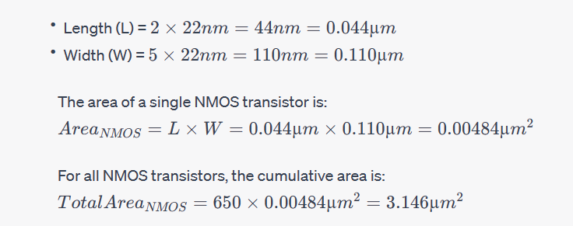
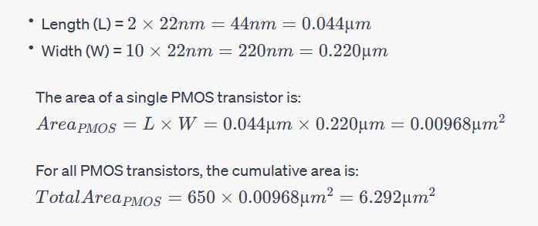
2. Area Calculation:
a. NMOS Transistors:
Given the 22nm technology:
b. PMOS Transistors:
Using the 22nm technology:

Slide 36

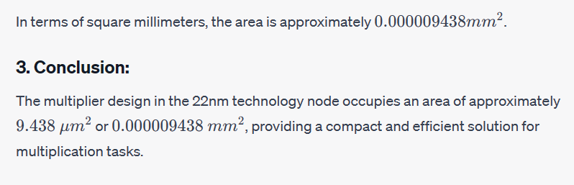
c. Total Area:
The total area for the design, combining both types of transistors, is:

Slide 37
Delay
1. Baseline Assumptions:
To gauge an approximate delay for our multiplier, we began by analyzing the intrinsic gate delays typically associated with the 22nm technology node:
Intrinsic NMOS Gate Delay: Approximately 15ps
Intrinsic PMOS Gate Delay: Approximately 20ps
2. Multiplier Delay Breakdown:
Our 4-bit multiplier's operation can be compartmentalized into distinct stages, each contributing to the overall delay.
a. Bit Product Generation: Each bit multiplication involves an AND operation. Assuming an average gate delay for this operation, the delay contribution is roughly 15ps.
b. Intermediate Summation: The multiplier produces intermediary products which are then accumulated. If we employ a simple carry-propagate adder mechanism or a similar scheme, we're considering a delay equivalent to approximately four times the intrinsic gate delay:

Slide 38


Delay
3. Total Delay Estimation:
Combining the delays from the above stages, we obtain a ballpark delay for the multiplier:
Thus, our 4-bit multiplier designed in the 22nm technology is estimated to have a delay of approximately 165ps which is significantly less than the delays provided in table 1

Slide 39
Power
Power dissipated in our circuit can be calculated by multiplying the voltage by each one of the current so power = vdd(i1+i2+i3+i4+i5+i6+i7+i8) as shown in the figure above: i1=0.9*10^-9
i2=1.7*10^-6
i3=0
i4=1.2*10^-6
i5=.001*10^-6
i6=1*10^-6
i7=0
i8=0 vdd=0.95 volts
power = 0.95(0.9*10^-9
+1.7*10^-6+1.2*10^-6+.001*10^-6+0+0) = 3.7069 milli watt regrading to vdd =0.95
Which in comparison with the power provided in the table is much less than the values provided above in table 1.

Slide 40
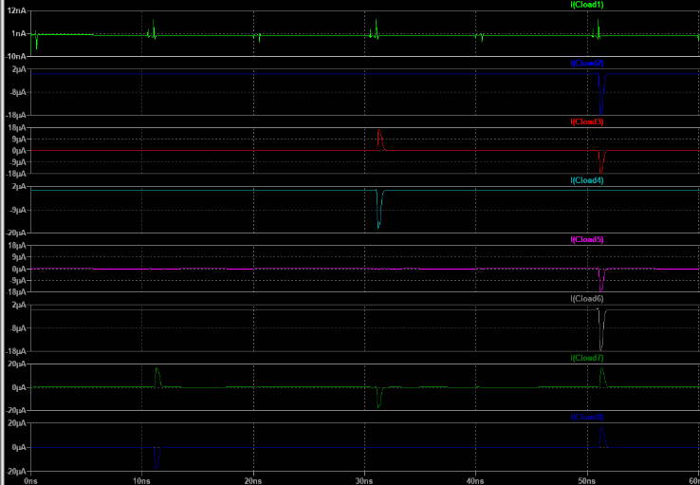
Currents used to calculate the power from the past slide:

Slide 41
Optimization technique used
Two main enhancement and optimization techniques were used:
Using registers built from pass gates
Building full adder of xor and multiplexer implemented by pass gates
We went with designing the flip flop using pass gates from cmos transistors because it saves half of the number of transistors when comparing the design built from latches [7]
For the full adder part, we went with building it from the enhanced xor and multiplexer circuits as shown in details above
we went with this design due to the less memory it will take rather than using the normal unmodified gates.
The simulation showed good results when we tested the circuit and half number of transistors were used in the design of each circuit when comparing with the classical multiplier without registers and from which was built from unimproved gates used in full adders and flipflops

Slide 42
Conclusion with summary of area , delay and power
This paper presented the 4*4 multiplier enhancement using the pipelining idea and also using pass gates in the multiplier components represented by the full adder, multiplexer and flip flops.
After discussing the various techniques in designing the multiplier as mentioned above, represented by the booth algorithm, the Wallace tree and the MGDI way of implementing the gates we have noticed how there is a tradeoff between reducing the power, area and delay and increasing the designs complexity in terms of addressing the schematics and the layout which was the biggest challenge we have encountered throughout this project. These challenges emphasized the importance of meticulous planning and simulation in VLSI design. After getting the results of the power =3.7069 milli watt which was it looked much less than the referred ones and the delay which equaled 165ps which is a lot less than the delay referred in table (1) and lastly the area which 9.438 um2 which also recorded the smallest value in the referred table too.

Slide 43
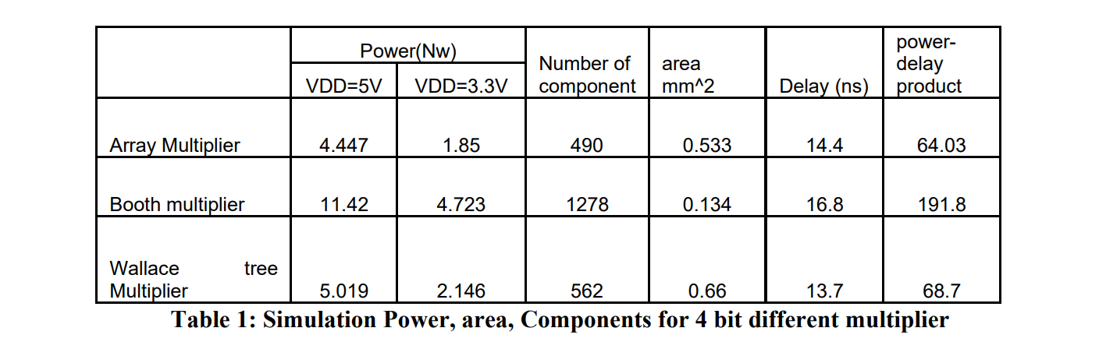
Referring to the DSP DESIGN AND IMPLEMINTAION OF FOLDED ENHANCED PIPELINE MULTEPLIER [9] we can see how the power, delay and area for the various design techniques provided in our project
In conclusion, this project was a remarkable journey into the world of VLSI, where we not only gained a deep understanding of various multiplication techniques but also came to calculate how much power and delay and area could be saved by designing the proposed design and we came to appreciate the delicate balance between power consumption, latency, and area utilization in digital circuit design.

