Slide 1
The Laplacian operator is a second-order derivative filter used in image processing to highlight regions of rapid intensity changes, such as edges and corners, in an image. It is often used for edge detection and image enhancement. The Laplacian operator is represented by the symbol ∇² (pronounced "del squared").
The Laplacian operator can be defined mathematically in 2D for grayscale images as follows:
∇²(f) = ∂²f/∂x² + ∂²f/∂y²
f(x, y) is the grayscale intensity of the image at coordinates (x, y).
∇²(f) is the Laplacian of the image at coordinates (x, y).
∂²f/∂x² is the second derivative of the image intensity with respect to the horizontal axis x.
∂²f/∂y² is the second derivative of the image intensity with respect to the vertical axis y.
In other words, the Laplacian operator computes the sum of the second derivatives in both the x and y directions at each pixel location in the image. When applied to an image, the Laplacian filter highlights regions with rapid changes in intensity, such as edges and corners, by producing positive or negative peaks in the filtered image.
The Laplacian operator is a simple and effective edge detector, but it is highly sensitive to noise. Therefore, it is often combined with a smoothing filter, such as a Gaussian filter, to reduce noise before applying the Laplacian operator. This combined approach is known as the Laplacian of Gaussian (LoG) operator.
In summary, the Laplacian operator is used to emphasize edges and regions of high frequency (rapid intensity changes) in an image, making it a valuable tool for edge detection and feature extraction in image processing tasks.

Slide 2
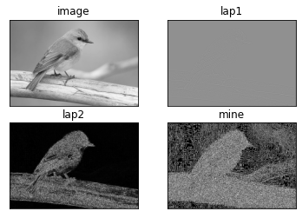
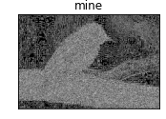

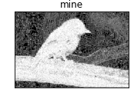
Kernel_size=3
Without converting the output back to uint8
lap2=np.uint8(np.absolute(lap1))
[[ 0 1 0]
[ 1 -4 1]
[ 0 1 0]]
Kernel_size=3
Without converting the output back to uint8
[[ 0 1 0]
[ 1 -4 1]
[ 0 1 0]]
Kernel_size=3
converting the output back to uint8
[[ 0 -1 0]
[ -1 4 -1]
[ 0 -1 0]]
Kernel_size=3
converting the output back to uint8
output=np.uint8(np.clip(output,0,255))
#convert the output back to uint8
output=np.uint8(np.clip(output,0,20))

Slide 3
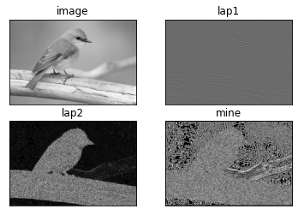
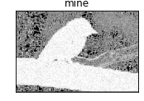
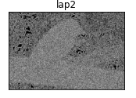
[[ 0 0 -1 0 0]
[ 0 -1 -2 -1 0]
[-1 -2 16 -2 -1]
[ 0 -1 -2 -1 0]
[ 0 0 -1 0 0]]
kernal_size= 5 Less accuracy than
kernal_size= 3
kernal_size= 5
Less accuracy than
kernal_size= 3
#convert the output back to uint8
output=np.uint8(np.clip(output,0,20))
kernal_size= 7
Less accuracy than
kernal_size= 5 and 3

