Slide 1
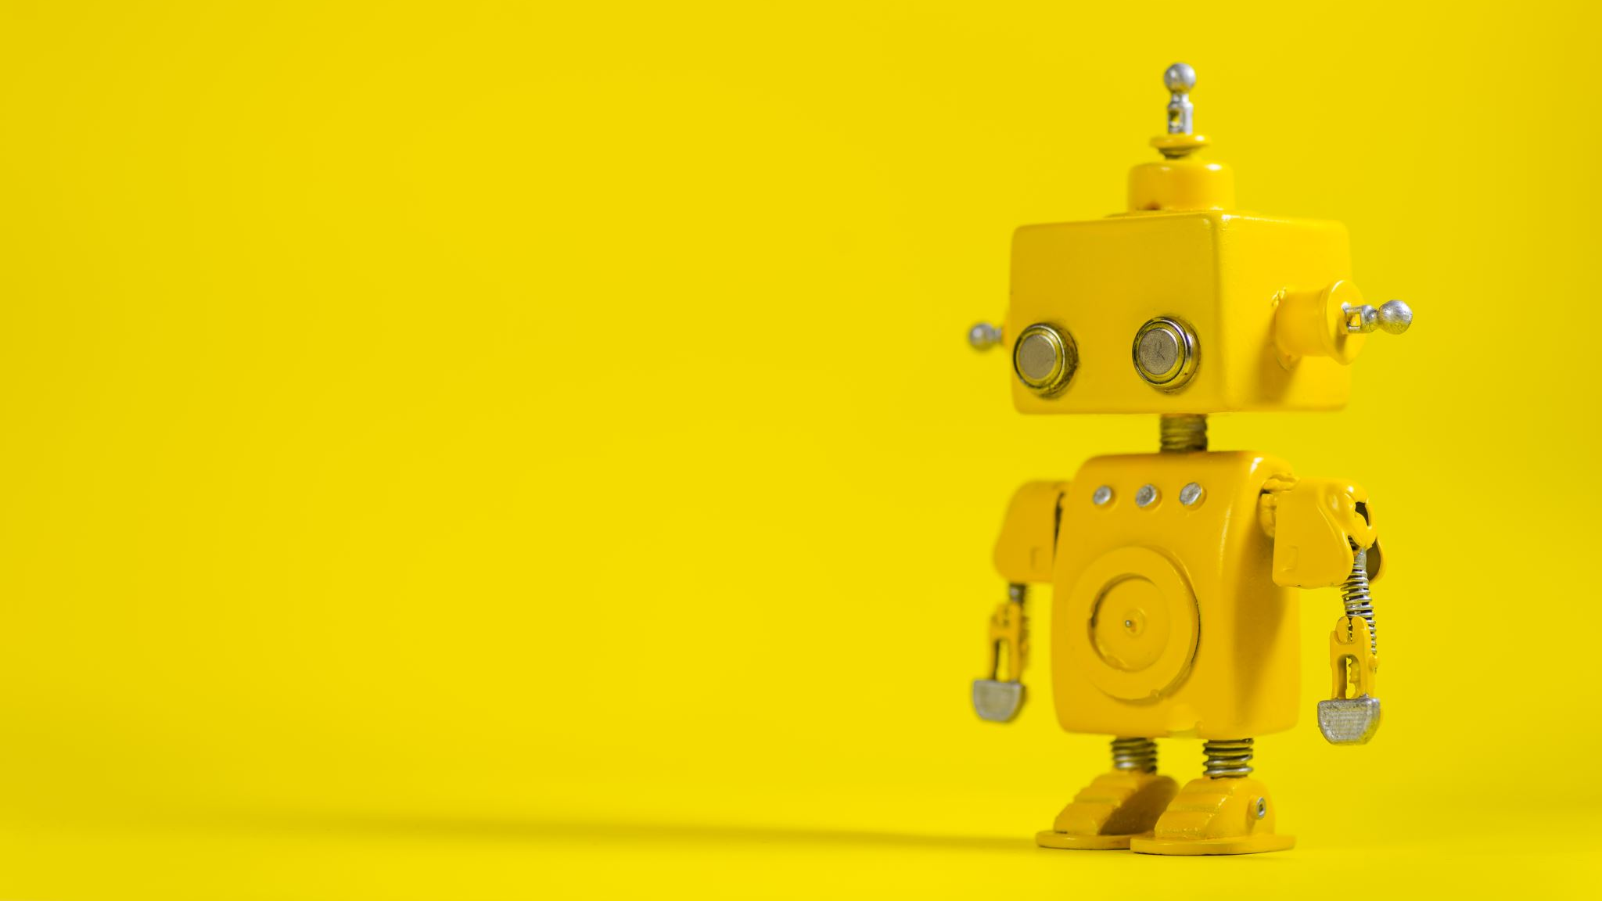
Flask SIS
Educational Bot

Slide 2
APPLICATION:
Setting up working environment.
App initialization.
Routes definitions.
Database.
Application logic.
Chatbot.
Other notes.

Slide 3
SETTING UP ENVIRONMENT:
Create virtual environment.
Install required packages.
Create the project.

Slide 4
APP INITIALIZATION:
Flask environment.
Define app.
Import others.
DEFINE ROUTES.

Slide 5
DATABASE:
Define database using SQLAlchemy.
Define tables using classes.
Instantiate database.
Generate random data for development test.
APPLICATION LOGIC.
CHATBOT:
Rivescript package.
Bot brain (chat scenario).

