Slide 1
CS ARCS (Computer Science Assistance Request and Credit System)
Team members
Leader : Ahmed Abdelbary 2221191298
Member 1: Lamiaa Abushara 2211150120
Member 2: Seba Alzaher 2201114862
CS390 Software Engineering – Fall 2024

Slide 2
Research :Project Objectives Overview
objectives
Facilitate Academic Support
Create a User-Friendly System
Ensure Faculty Supervision
Encourage Senior Mentorship

Slide 3
Planning Phase
Waterfall Approach
Research
Gathering requirements
System design
Development phase 2
Development phase 1
Testing phase

Slide 4
Research: Core Features
Request Assistance Portal
Mentorship Assignment
Mentorship Dashboard
Faculty Supervision Console
Progress Tracking and Reporting

Slide 5
System Requirements
a) Functional Requirements :
define the specific actions or tasks a system must perform to meet its intended purpose.
b) Non Functional Requirements :
define how a system performs rather than what it does. They focus on attributes like performance, usability, security, and reliability.

Slide 6
F-01: System should authenticate users and differentiate roles. (Log in/sign in)
F-02: Junior students can create and manage task requests. Senior students should be able to browse and accept tasks.
F-05: Faculty can review tasks and grant extra credits if standards are met.
Functional Requirements
Priority Weight equal to 5

Slide 7
Functional Requirements
Priority Weight equal to 4
F-03: System must verify senior students' tasks align with courses.
F-07: Implement task prioritization and fair distribution mechanism.

Slide 8
Functional Requirements
Priority Weight equal to 3
F-04: Track task status, documents exchanged, and scheduling details.
F-09: Allow faculty to manually override system decisions on credits.
F-12: Include a calendar system for scheduling and reminders.

Slide 9
Functional Requirements
Priority Weight equal to 2
F-06: Notify users about task postings, acceptances, and completions.
F-08: Enable feedback and rating system for tutoring sessions.
F-10: Enable document sharing and collaboration tools within tasks
.
F-11: Provide a search function for users to find specific tasks.

Slide 10
Non-Functional Requirements
Priority Weight equal to 5
NF-01 : (Ensure system availability 24/7 with minimal downtime.
NF-03 : System should be responsive on various devices including mobile.
NF-04 : Secure user data and prevent unauthorized access.

Slide 11
Non-Functional Requirements
Priority Weight equal to 4
NF-02 : Interface should be user-friendly and tailored to each user role.
NF-05 : Ensure data integrity and prevent loss or corruption.
NF-06 : Comply with accessibility standards to support all users.
NF-08 : Designed for easy maintenance and future updates.

Slide 12
Non-Functional Requirements
Priority Weight equal to 3
NF-09: System should maintain a log of all activities for auditing.
NF-10 : System updates should be deployable without downtime.
NF-11 : Provide multilingual support for diverse student bodies.

Slide 13
Non-Functional Requirements
Priority Weight equal to 2
NF-07 : Integrate smoothly with existing university systems.
NF-12 : Ensure system's user interface adheres to the latest UI trends.

Slide 14




Actors and Stakeholders
Junior Student: Requests tutoring help.
Faculty Member: Reviews sessions and assigns credits.
Senior Student: Provides tutoring and earns points.
Library Room Access System: Logs student attendance in controlled areas

Slide 15
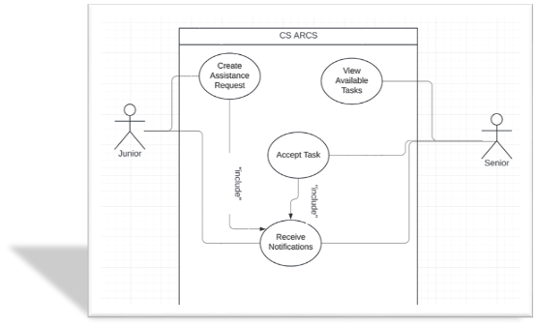
Design Diagrams
Use cases

Slide 16
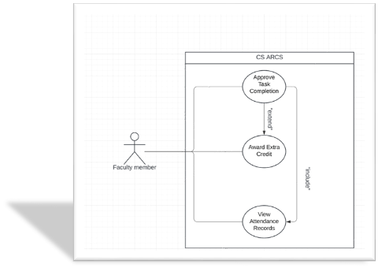
Design Diagrams
Use cases

Slide 17
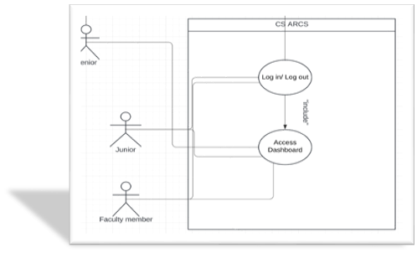
Design Diagrams
Use cases

Slide 18
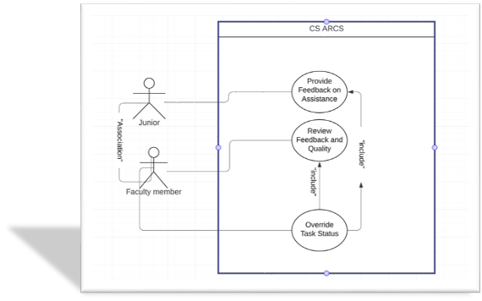
Design Diagrams
Use cases

Slide 19
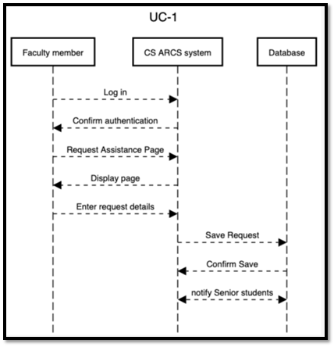
Design Diagrams
System Sequence

Slide 20
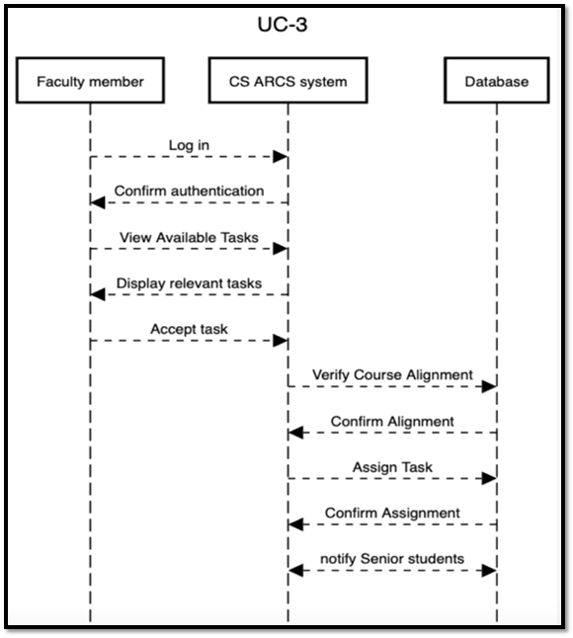
Design Diagrams
System Sequence

Slide 21
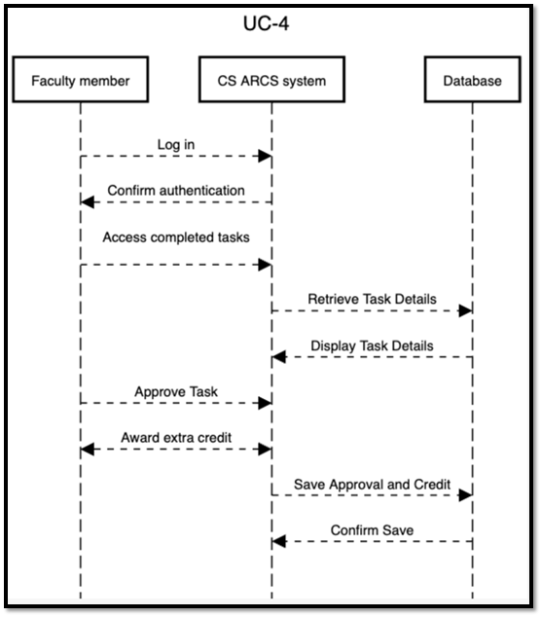
Design Diagrams
System Sequence

Slide 22
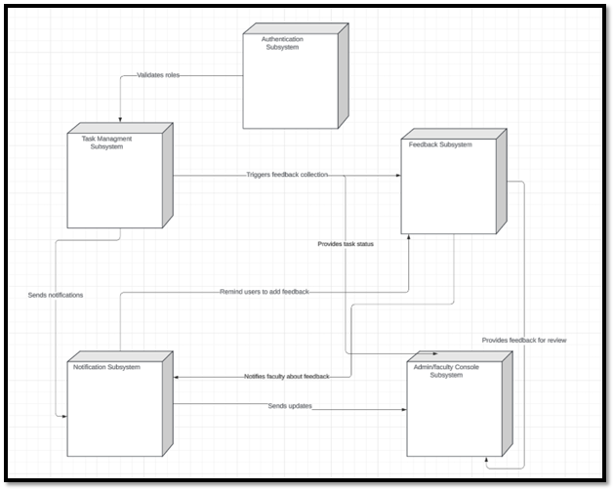
Design Diagrams
UML Diagram

Slide 23
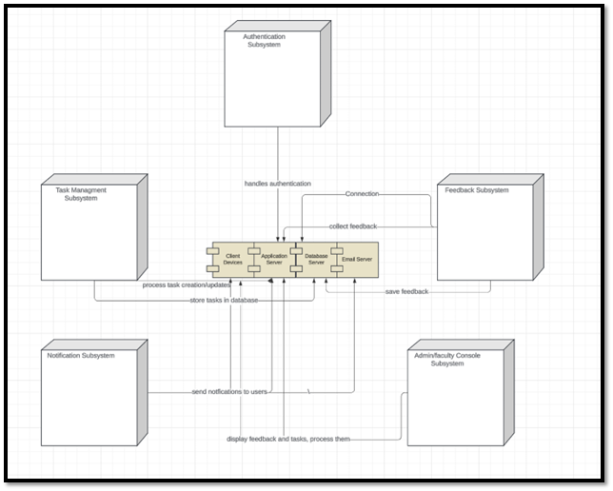
Design Diagrams
UML Diagram

Slide 24
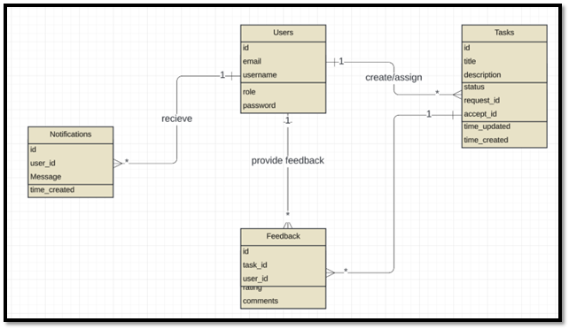
Design Diagrams
UML Diagram

Slide 25
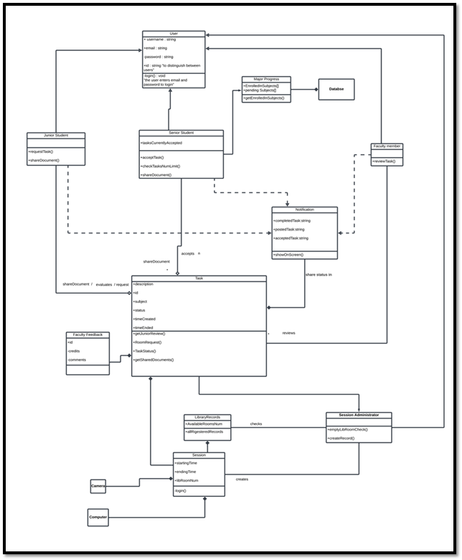
Design Diagrams
UML Diagram

Slide 26
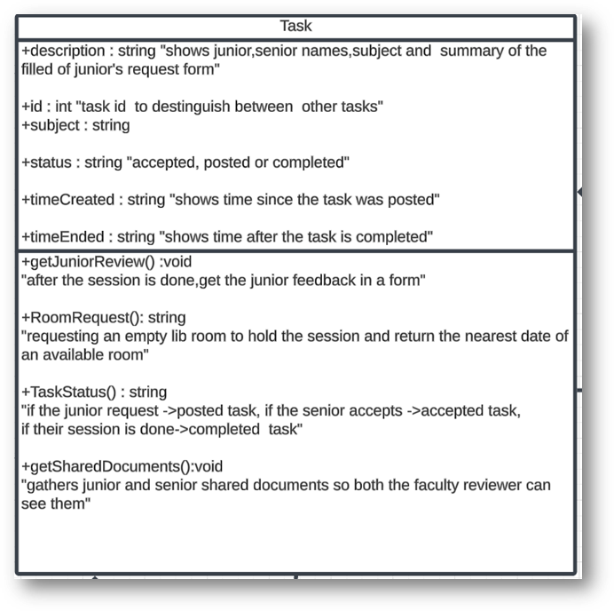
Design Diagrams
Task Class in UML Diagram

Slide 27
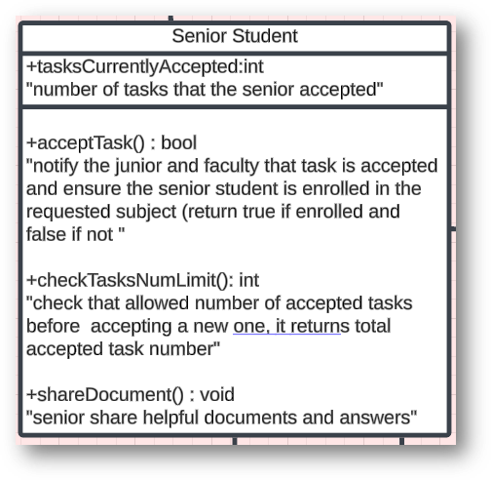
Design Diagrams
Senior Student Class in UML Diagram

Slide 28
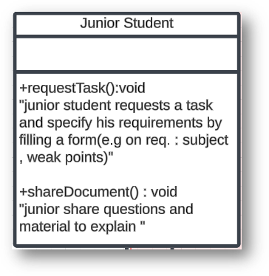
Design Diagrams
Junior Student Class in UML Diagram

Slide 29
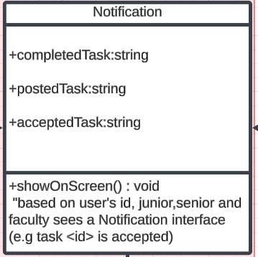
Design Diagrams
Notification Class in UML Diagram

Slide 30
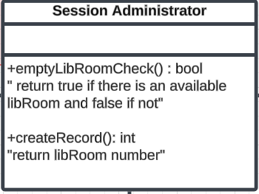
Design Diagrams
Session Admin Class in UML Diagram

Slide 31
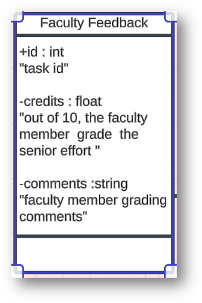
Design Diagrams
Faculty Member Class in UML Diagram

Slide 32
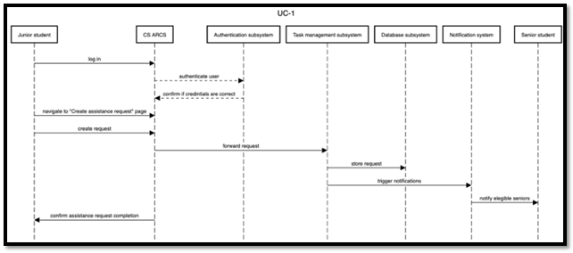
Design Diagrams
Interaction Diagrams

Slide 33
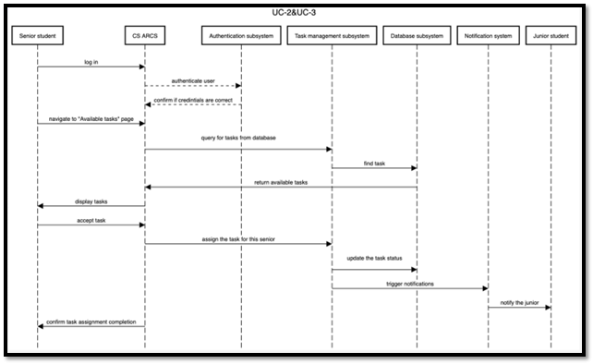
Design Diagrams
Interaction Diagrams

Slide 34
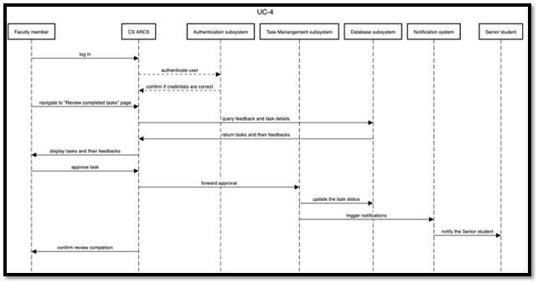
Design Diagrams
Interaction Diagrams

Slide 35
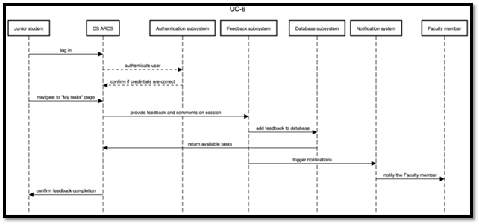
Design Diagrams
Interaction Diagrams

Slide 36
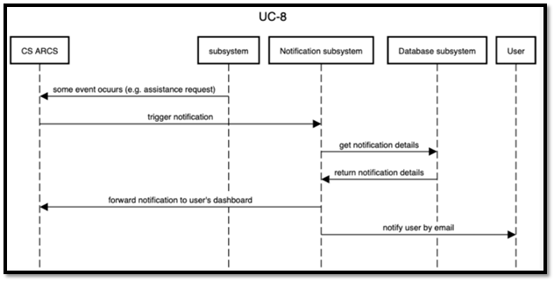
Design Diagrams
Interaction Diagrams

Slide 37
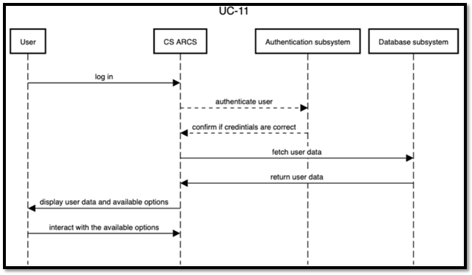
Design Diagrams
Interaction Diagrams

Slide 38
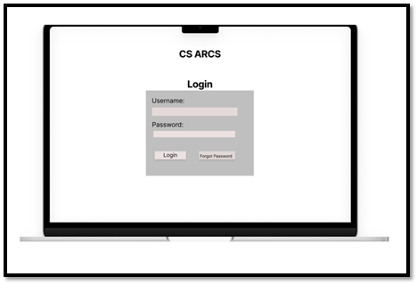
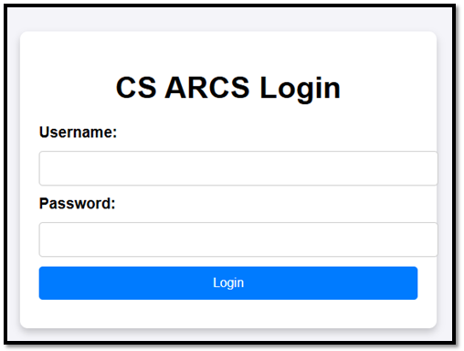
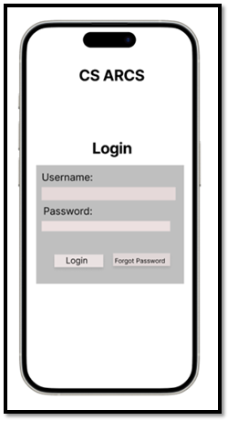
Design Phase 1 and 2
Login Main Page on a PC/Laptop and Mobile Phone (UC-9)

Slide 39
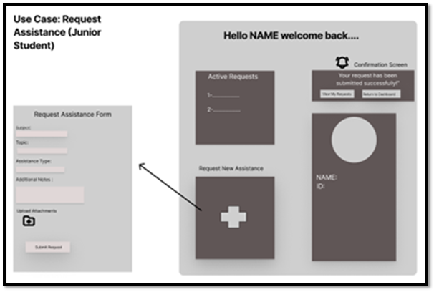
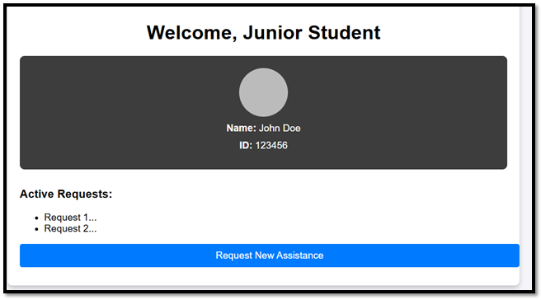
Design Phase 1 and 2
Junior Dashboard

Slide 40
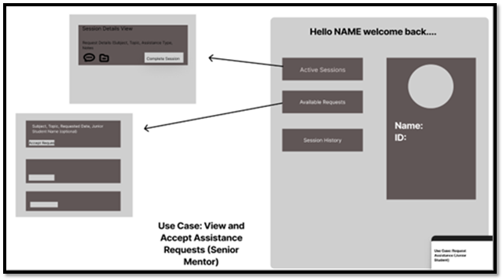
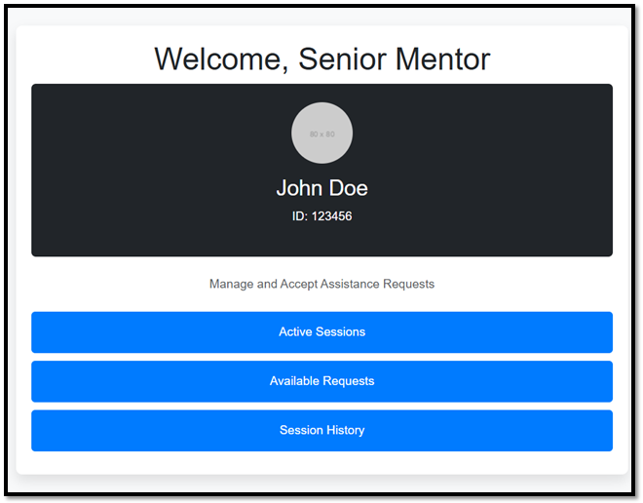
Design Phase 1 and 2
Senior Dashboard

Slide 41
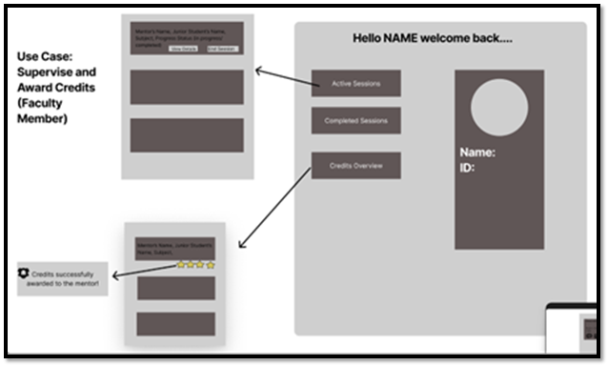
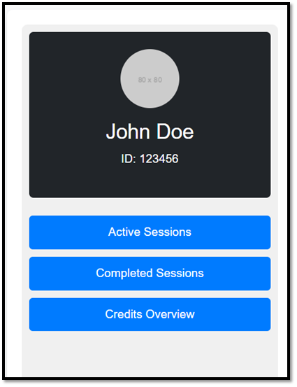
Design Phase 1 and 2
Faculty Member Dashboard

Slide 42
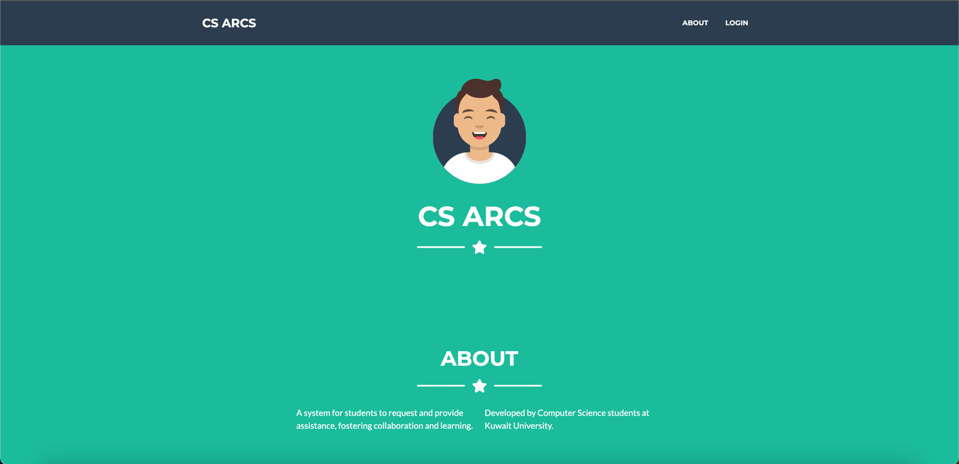
UI : Home Page

Slide 43
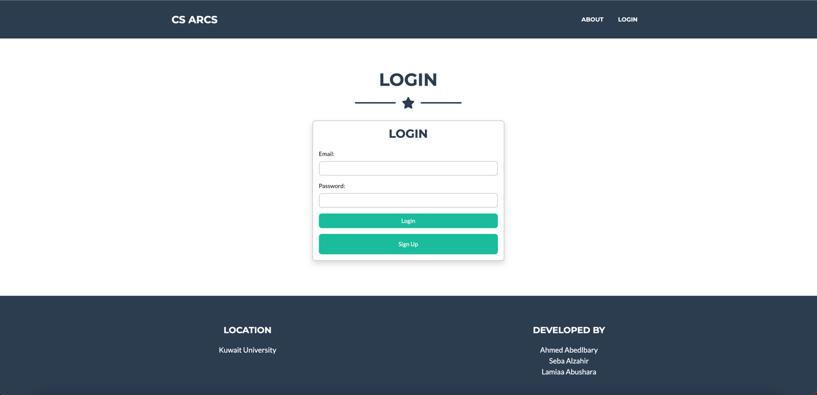
UI : Home Page After Scrolling Down

Slide 44
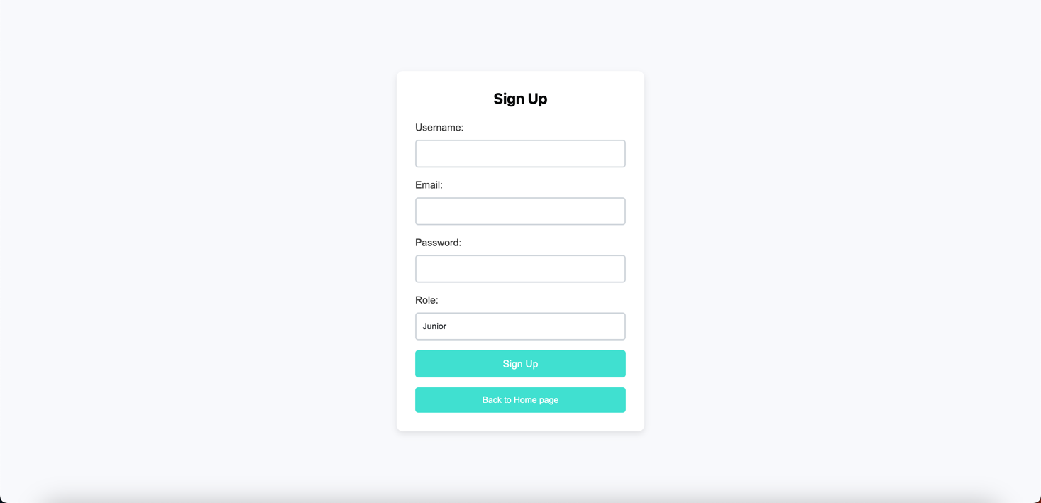
UI: Sign Up Page

Slide 45
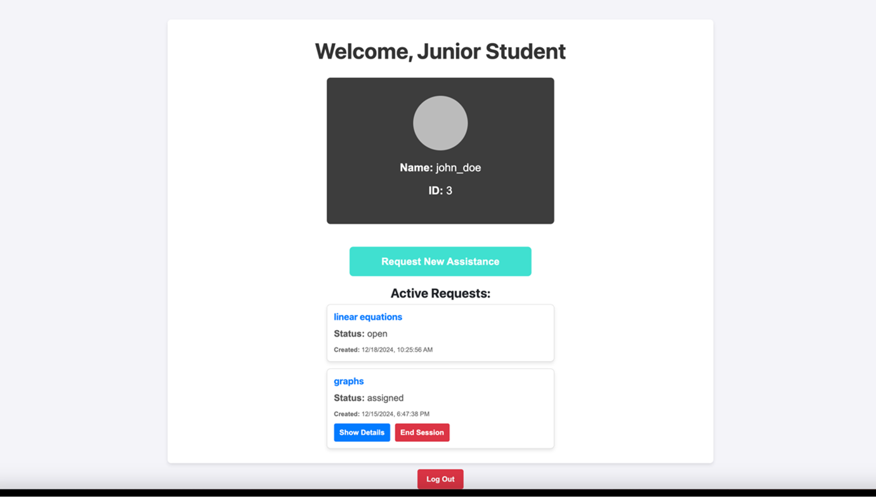
UI: Junior Student Dashboard

Slide 46
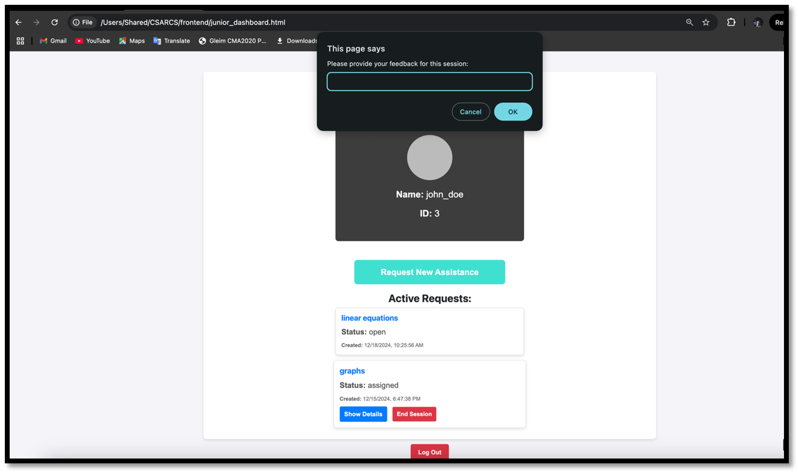
UI: Junior Student Dashboard

Slide 47
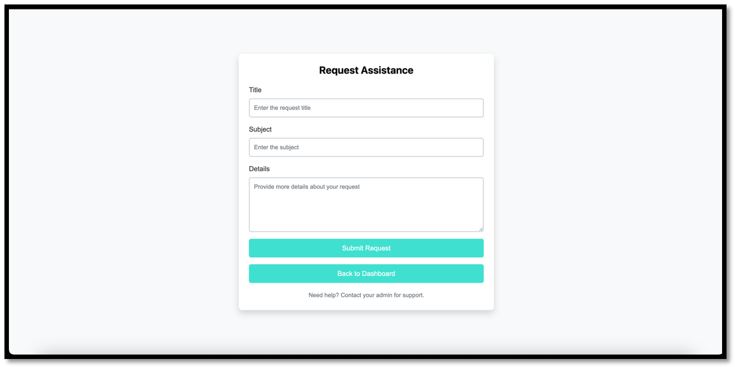
UI: Junior Student

Slide 48
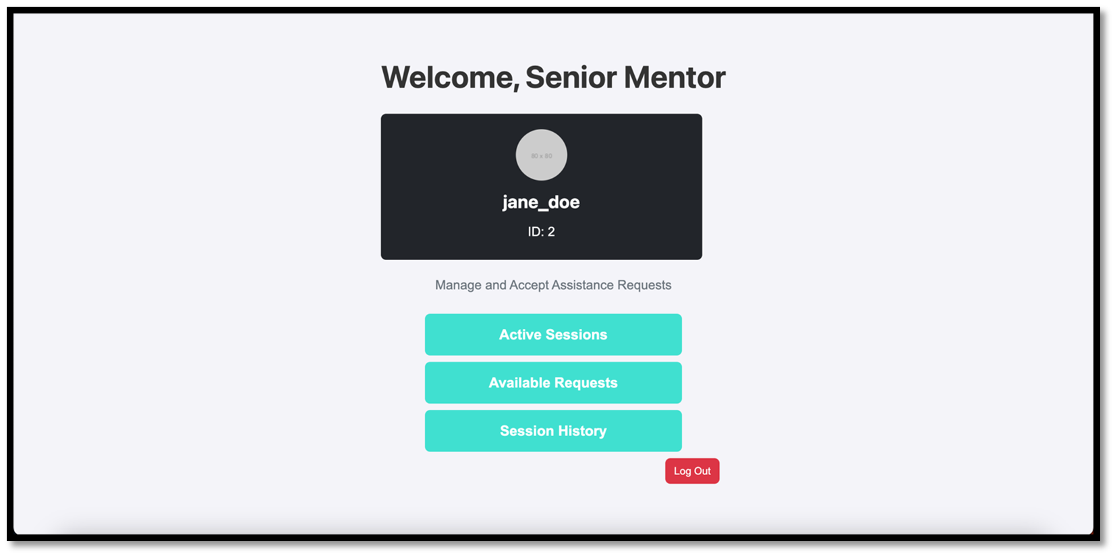
UI: Senior Student Dashboard

Slide 49
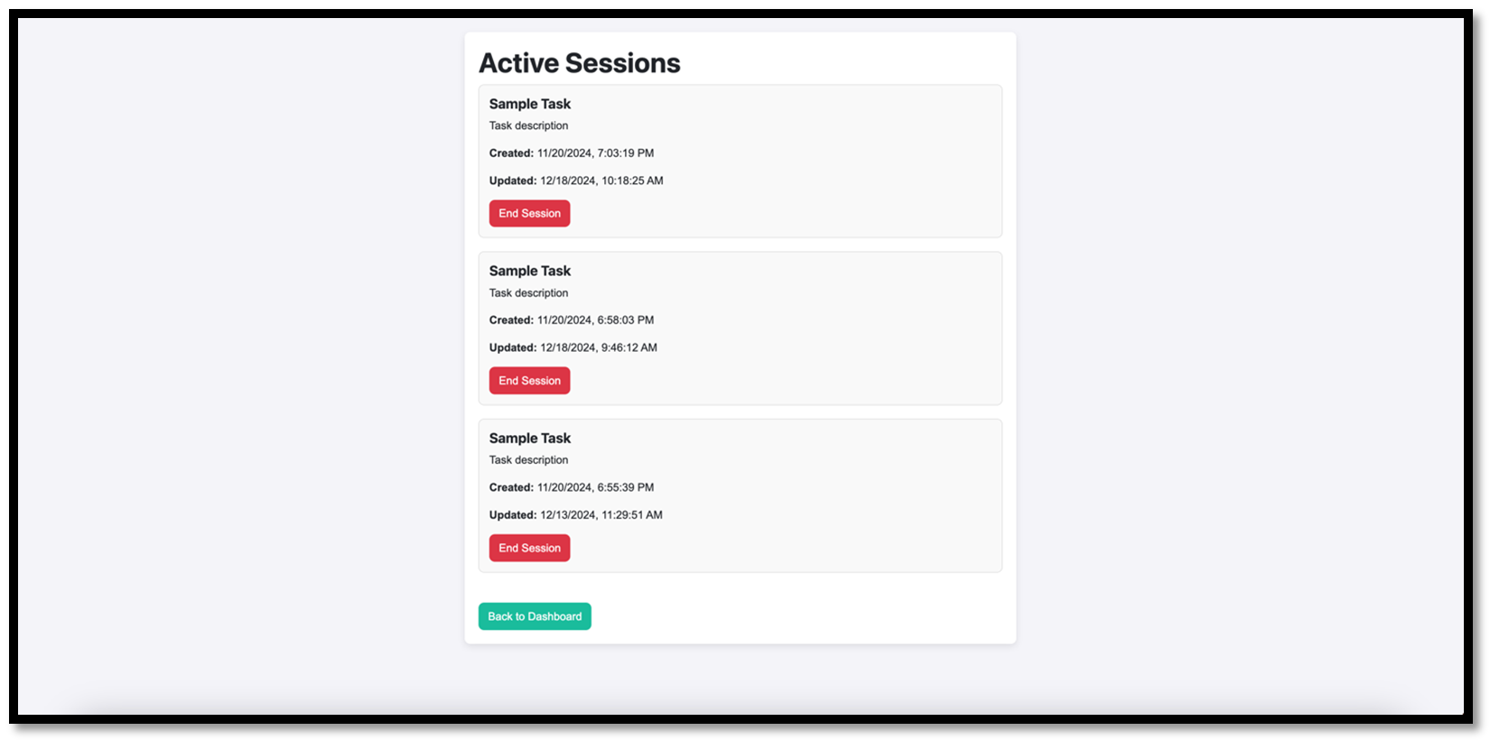
UI: Senior Student Dashboard

Slide 50
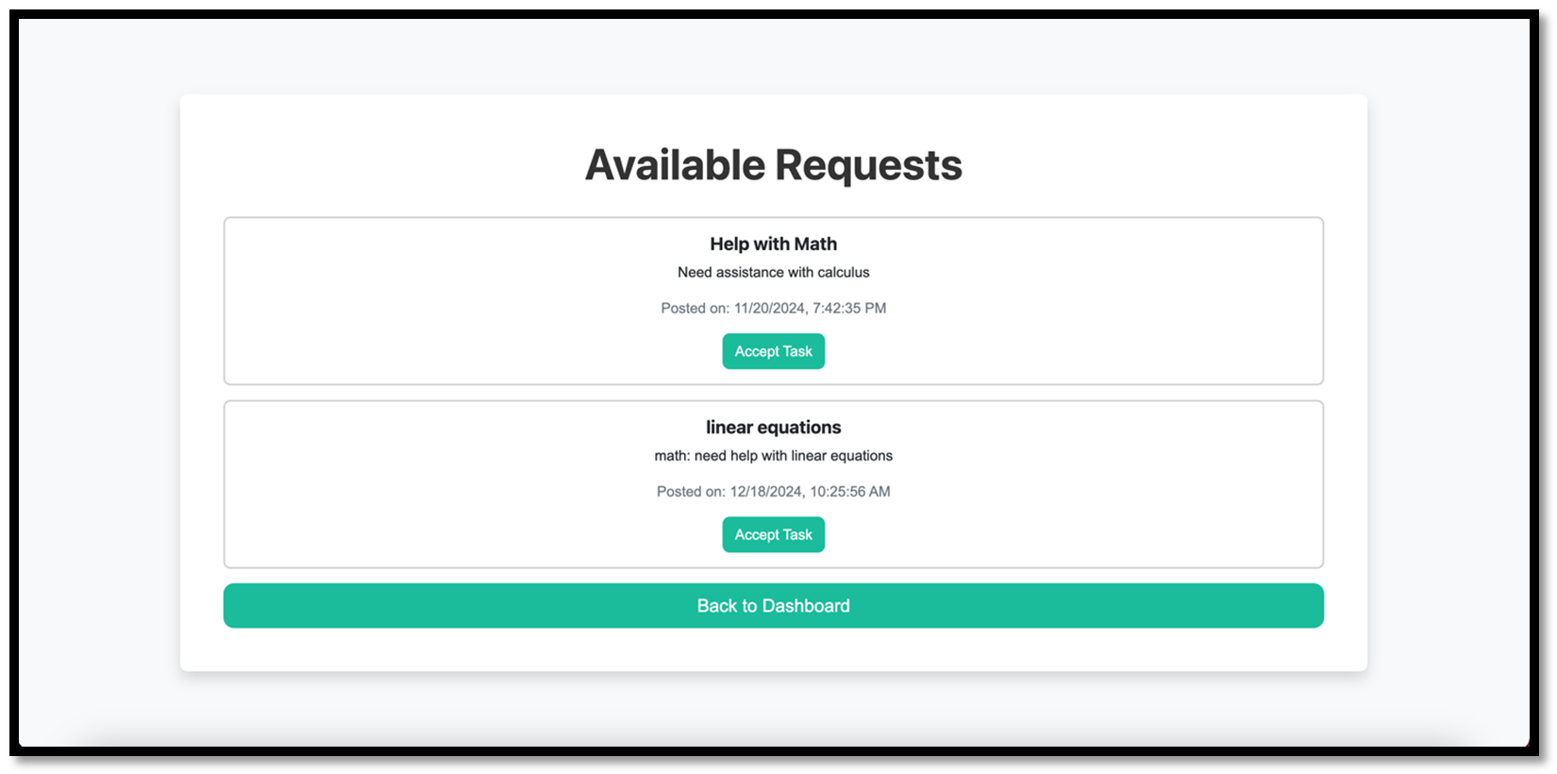
UI: Senior Student

Slide 51
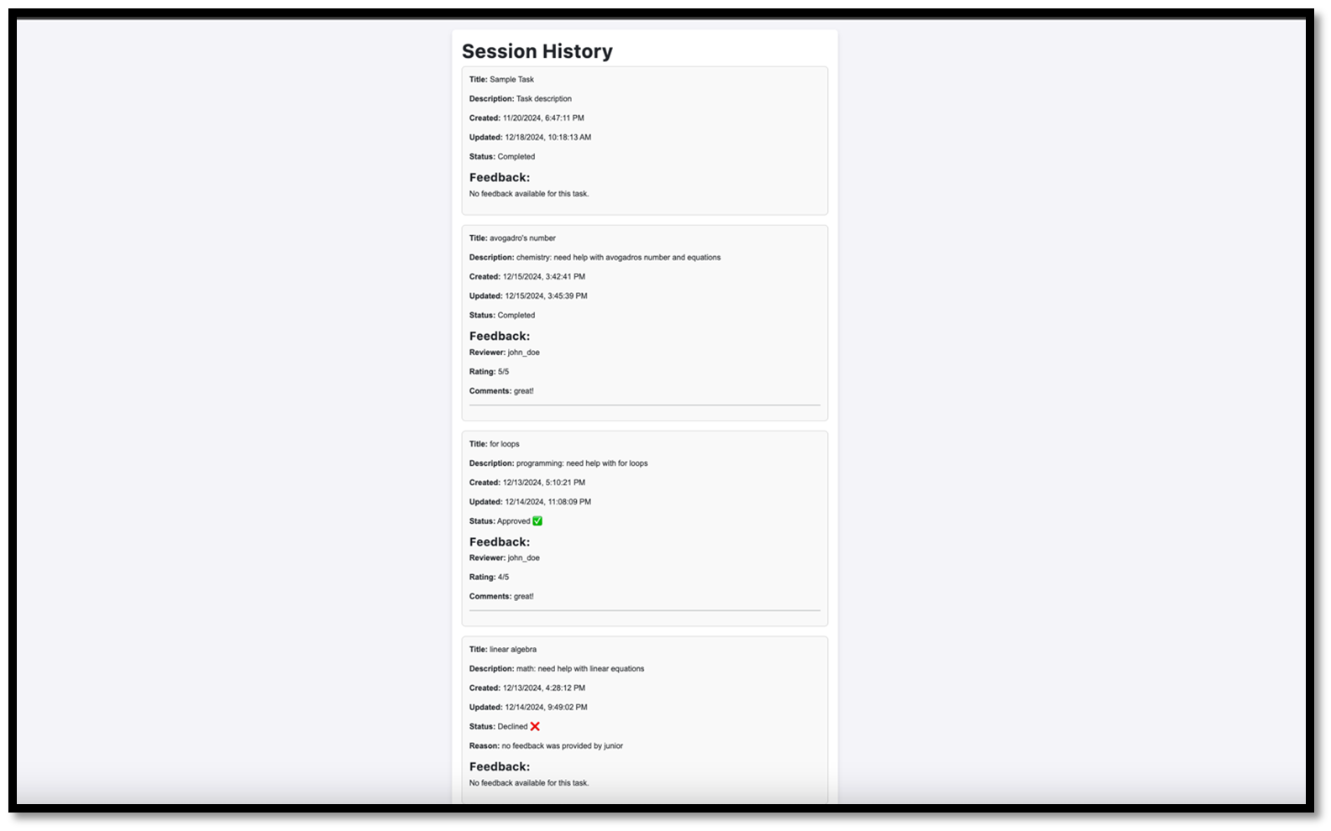
UI: Senior Student

Slide 52
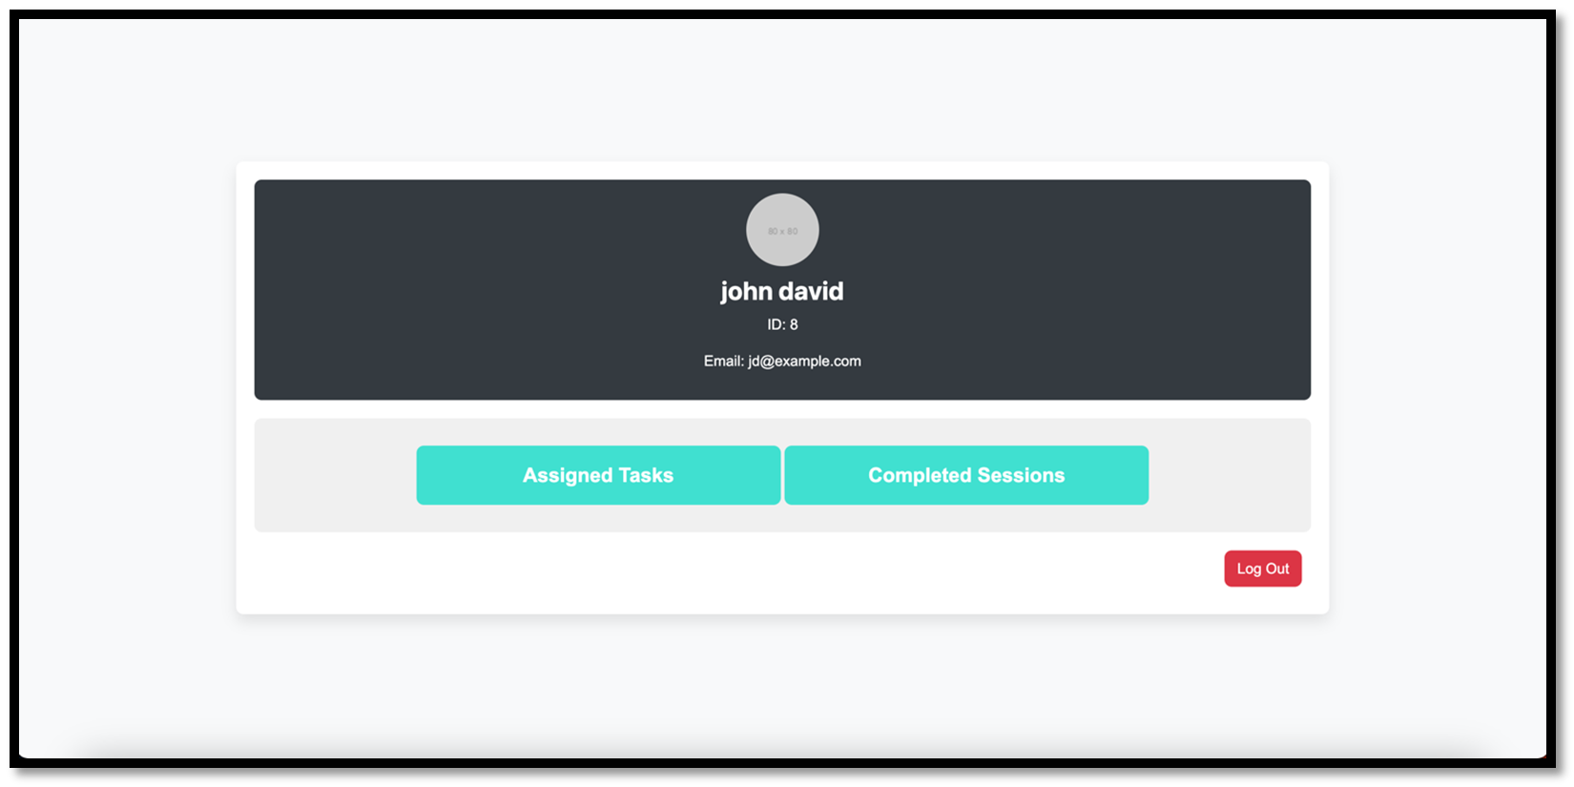
UI: Faculty Member Dashboard

Slide 53
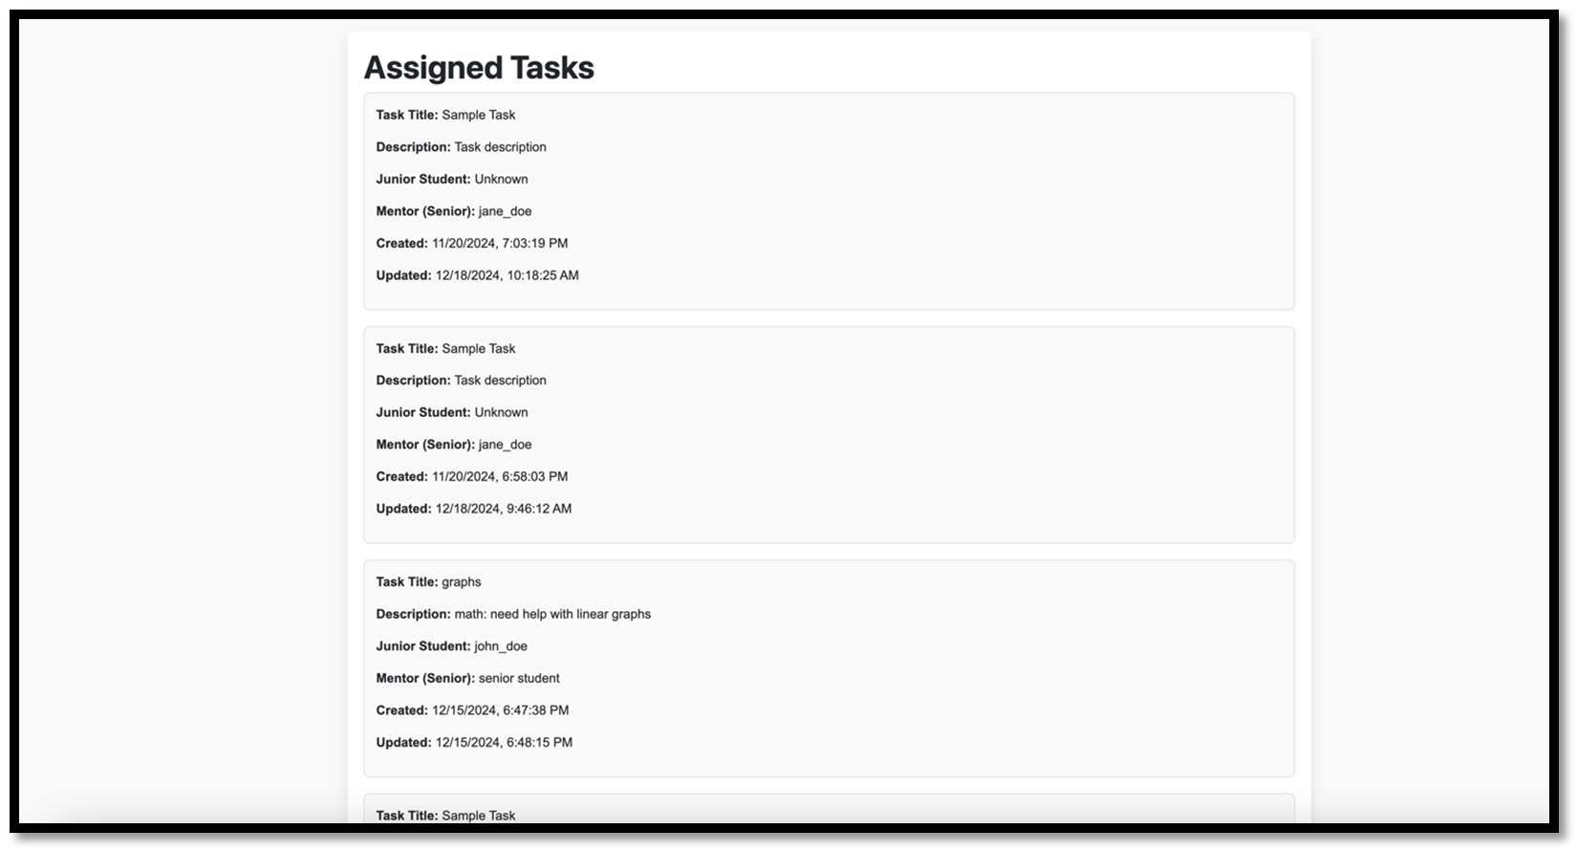
UI: Faculty Member

Slide 54
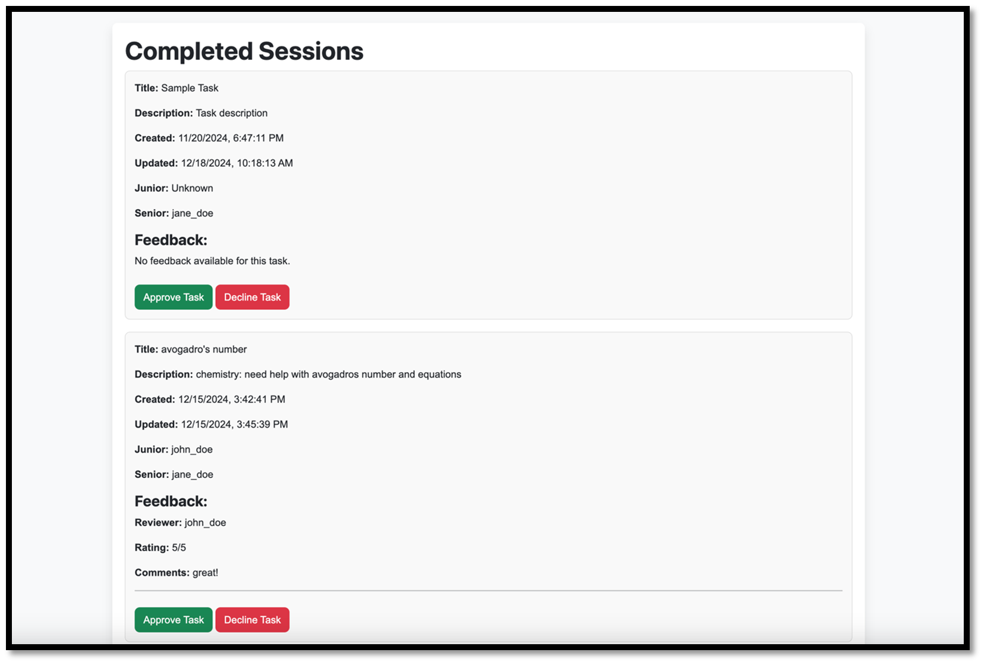
UI: Faculty Member

Slide 55
Risks and Challenges
Risk | Probability | Effects
Library rooms are temporary closed | 2 | The system’s restriction on library rooms as the only permitted spaces has resulted in no sessions taking place.
Library admin is not available | 2 | No one is assigning room for sessions
Cameras and computers in all library rooms are not working | 3 | There is no way to verify attendance in the session.
Sudden disagreement between team members | 2 | it can cause delays, confusion, and reduce progress
Challenge | Probability | Effect
dishonest feedback | 4 | System goal is unachieved due to manipulation/ faculty doubt its credibility/ unfair advantages for some students, while others may be undervalued.
library rooms number are small causing late session appointments | 3 | Late appointments may result in junior students turning to ask other students directly, bypassing the system.
Senior team members who provide incorrect guidance to juniors | 3 | leading juniors to receive lower-than-expected grades due to misdirection. As a result, juniors lose trust in the system.

Slide 56

How to run
Install Node.js , npm, and sqlite3
Run the following command:
Server now runs on http://localhost:3000
After running the server, open the index.html page which is located in the frontend directory using your browser

Slide 57
Conclusion
CSARCS successfully bridges the gap in mentorship by providing a streamlined platform for effective collaboration, task management, and communication. The system enhances user experiences and fosters meaningful connections between juniors and seniors.

