Slide 1
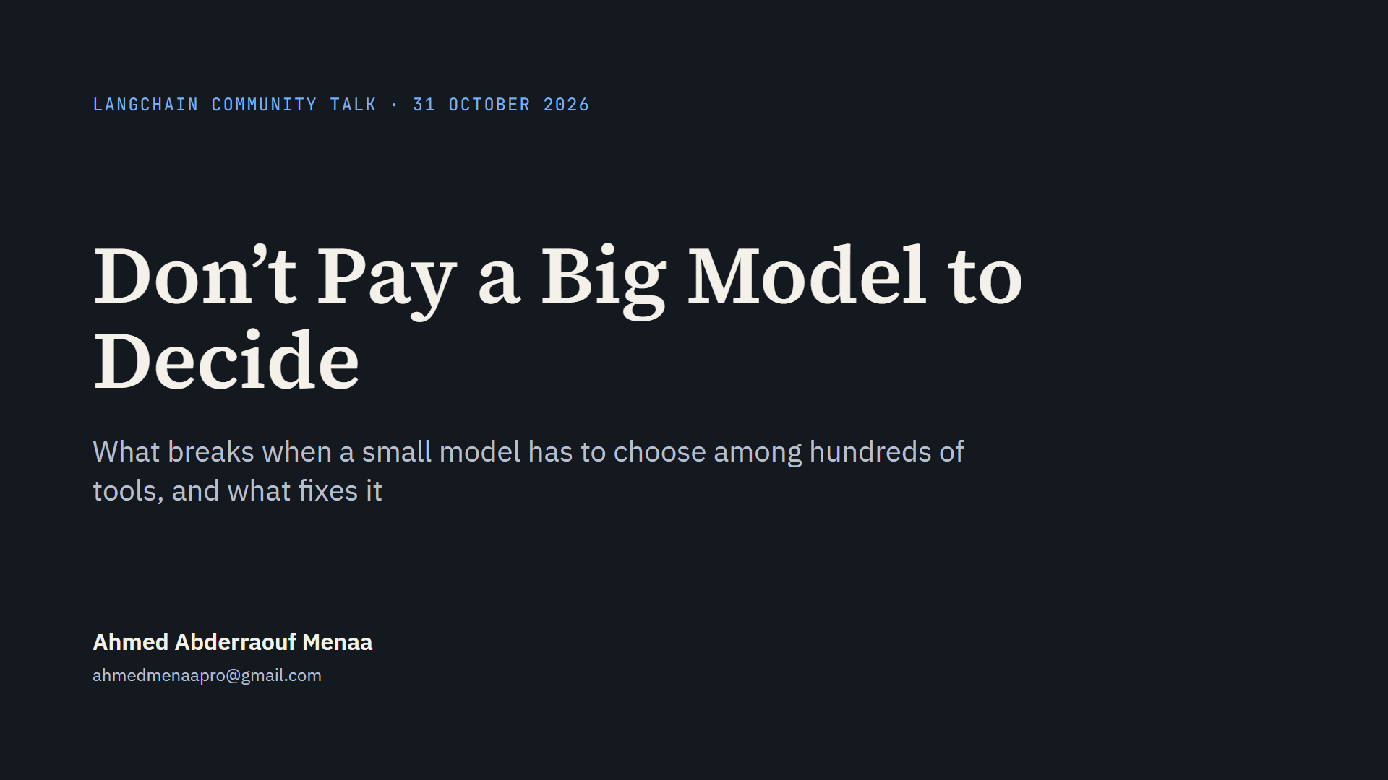
Notes:
Who I am. I will start with my MSc thesis, what it asked and what it found, because tonight’s project is built on it. Then the new question: can a 4-billion-parameter model run an agent that has hundreds of tools to choose from, when many of those tools look alike? Short answer: finding the tools is the easy part. Choosing between look-alikes is where it breaks.

Slide 2
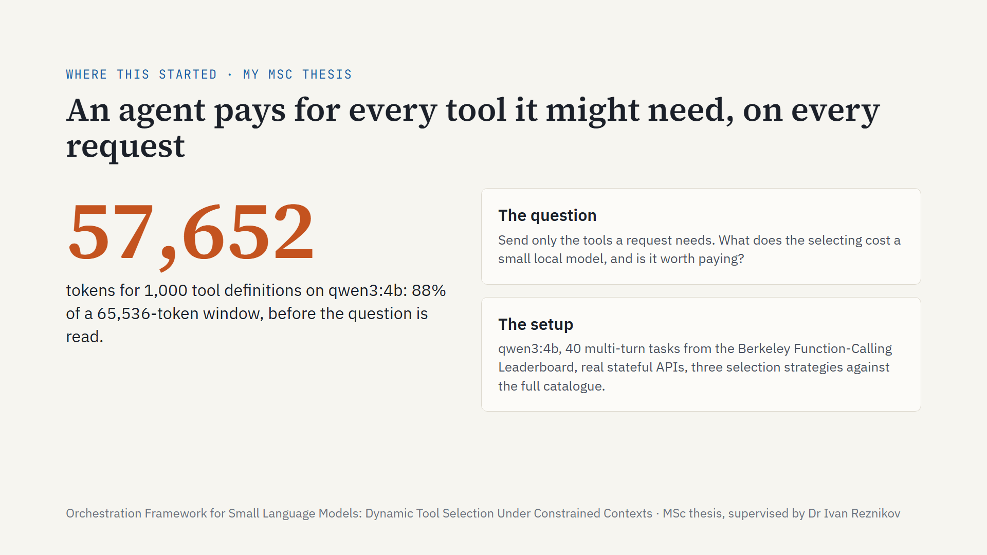
Notes:
Before tonight’s project, where it comes from. My MSc thesis, supervised by Ivan, asked a simple question. An agent can only call a tool whose description is already in its prompt, so every tool it might need costs tokens on every request, used or not. On qwen3:4b a thousand tools fill 57,652 tokens, 88% of a 65,536-token window, before the agent has read the question. Sending only the tools a request needs is the obvious fix, and it is not new. What was missing was a price: what does the selecting cost a small local model, and is it worth paying? I tested three selection strategies against the full catalogue, on 40 multi-turn tasks from the Berkeley Function-Calling Leaderboard, against real stateful APIs.

Slide 3
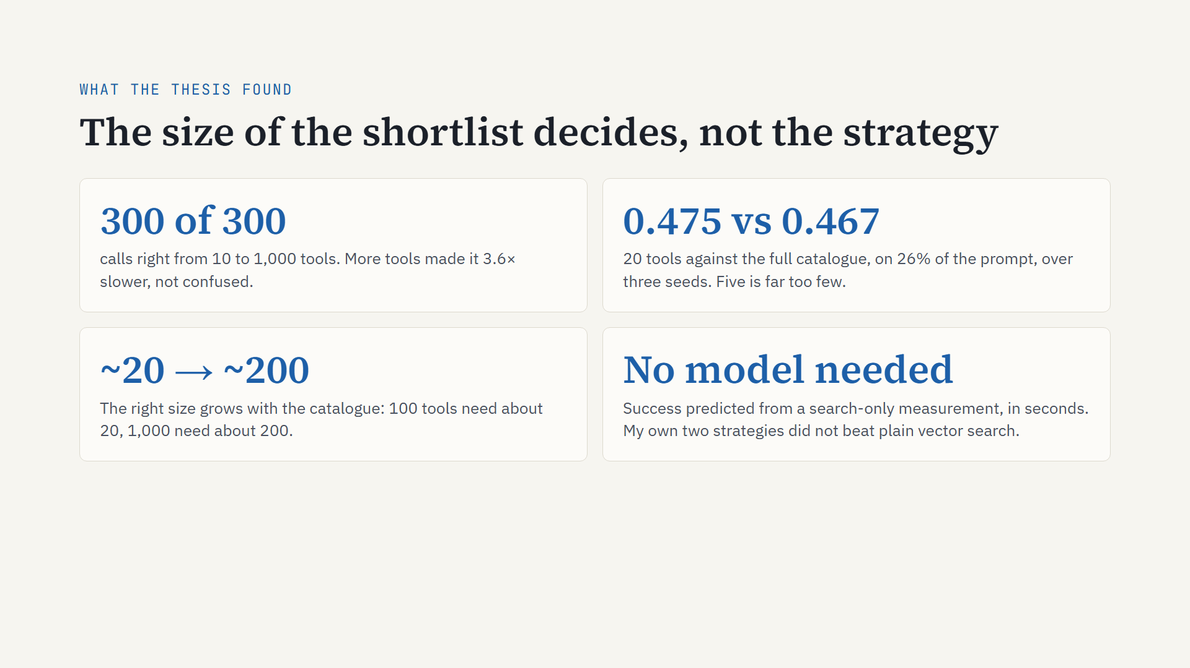
Notes:
Four findings. First, more tools did not confuse the model: 300 calls out of 300 were right at every catalogue size from ten tools to a thousand. What more tools did was make every request slower and more expensive, throughput down 3.6 times. Second, what decides task success is the size of the shortlist, not the selection strategy. The common default of five is far too few. Over three seeds, twenty tools reached 0.475 task success against the full catalogue’s 0.467, on a quarter of the prompt. Third, the right size grows with the catalogue: about twenty at a hundred tools, about two hundred at a thousand, where the full catalogue no longer fits the window at all. Fourth, a method: you can predict task success from a measurement of the search alone, with no model in the loop, in seconds. And honestly: neither of the two strategies I designed beat plain vector search.

Slide 4
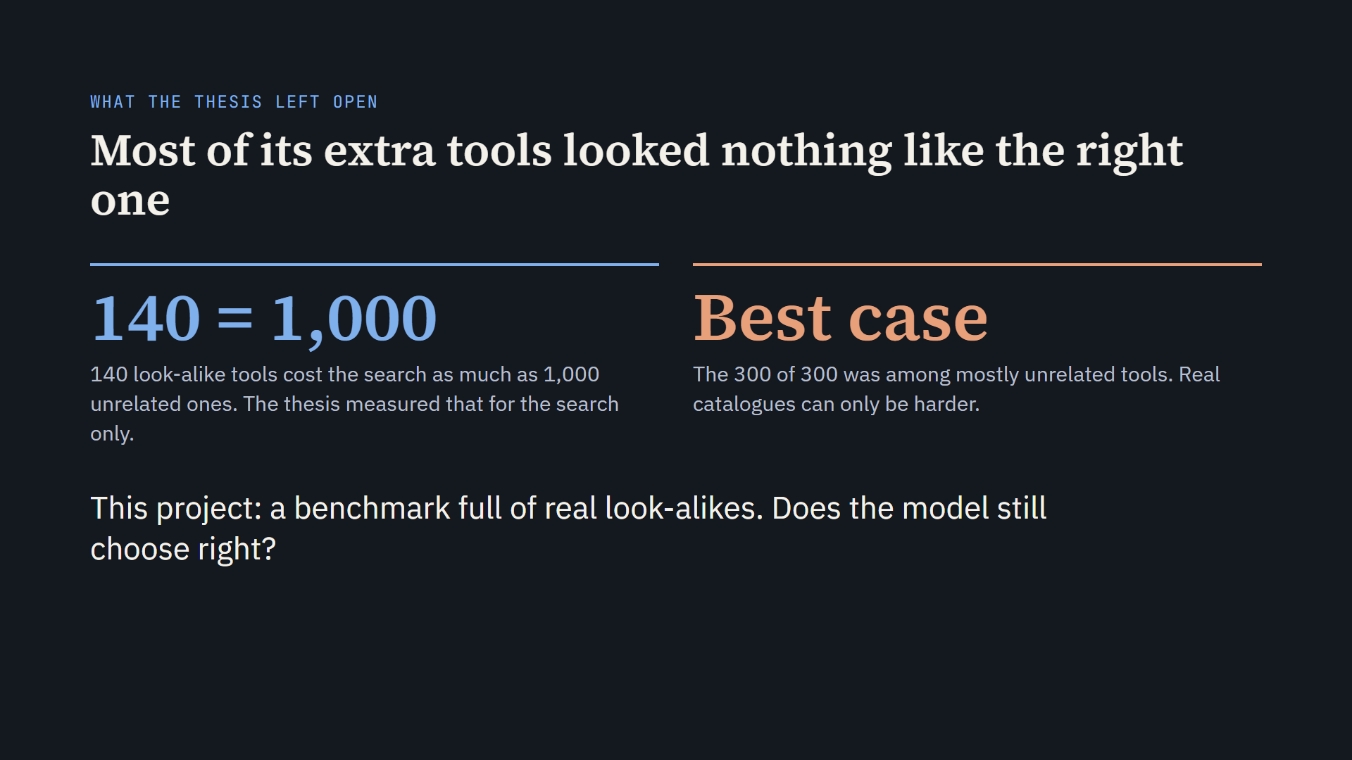
Notes:
The thesis left one door open, and it said so.
Its extra tools were mostly unrelated filler. That is how most benchmarks are built.
It did test look-alikes, but only for the search: 140 look-alikes hurt the search as much as 1,000 unrelated tools. About ten times worse.
So the 300 out of 300 is a best case. The thesis says the damage it measured is the least you should expect.
This project asks the next question: with real look-alikes, does the model itself still choose right?
Short answer: no. The rest of the talk is what breaks, why, and what fixes it.

Slide 5
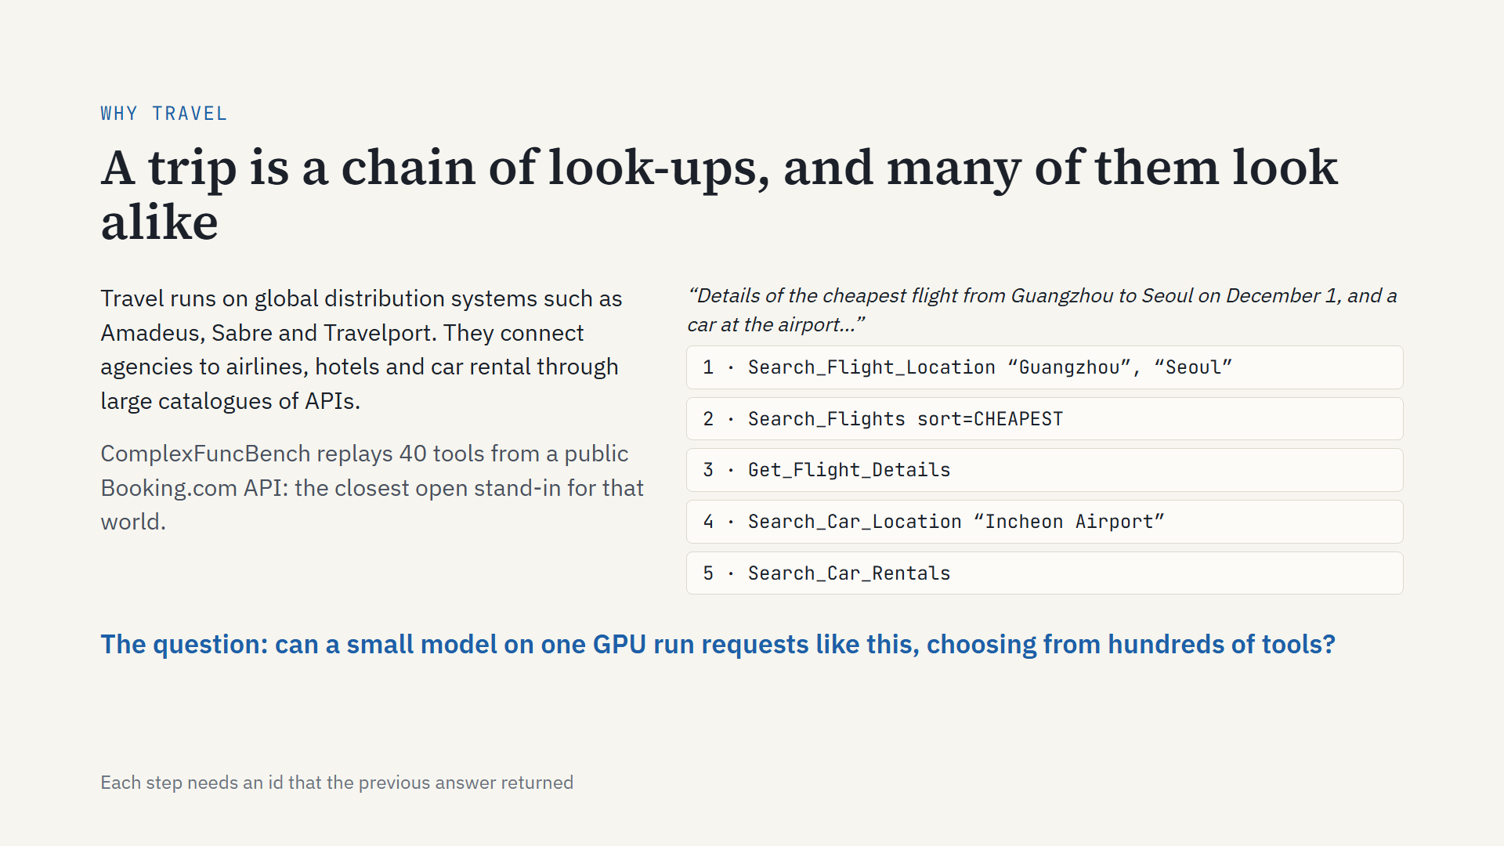
Notes:
Why travel, and why this benchmark.
Travel runs on global distribution systems: Amadeus, Sabre, Travelport. They connect agencies to airlines, hotels and car rental through large catalogues of APIs.
A real request is a chain. Here is one from the benchmark: the cheapest flight from Guangzhou to Seoul, and a car at the airport. Find both airports. Search flights, cheapest first. Get the flight’s details. Find the car-rental location. Search for cars. Each step needs an id the previous answer returned.
And many of those tools look alike. Keep two in mind: “search flights” versus “minimum price”, and the car-rental location search. Both come back later.
That opened the question for me: could a small model on one GPU run this, choosing from hundreds of tools?

Slide 6
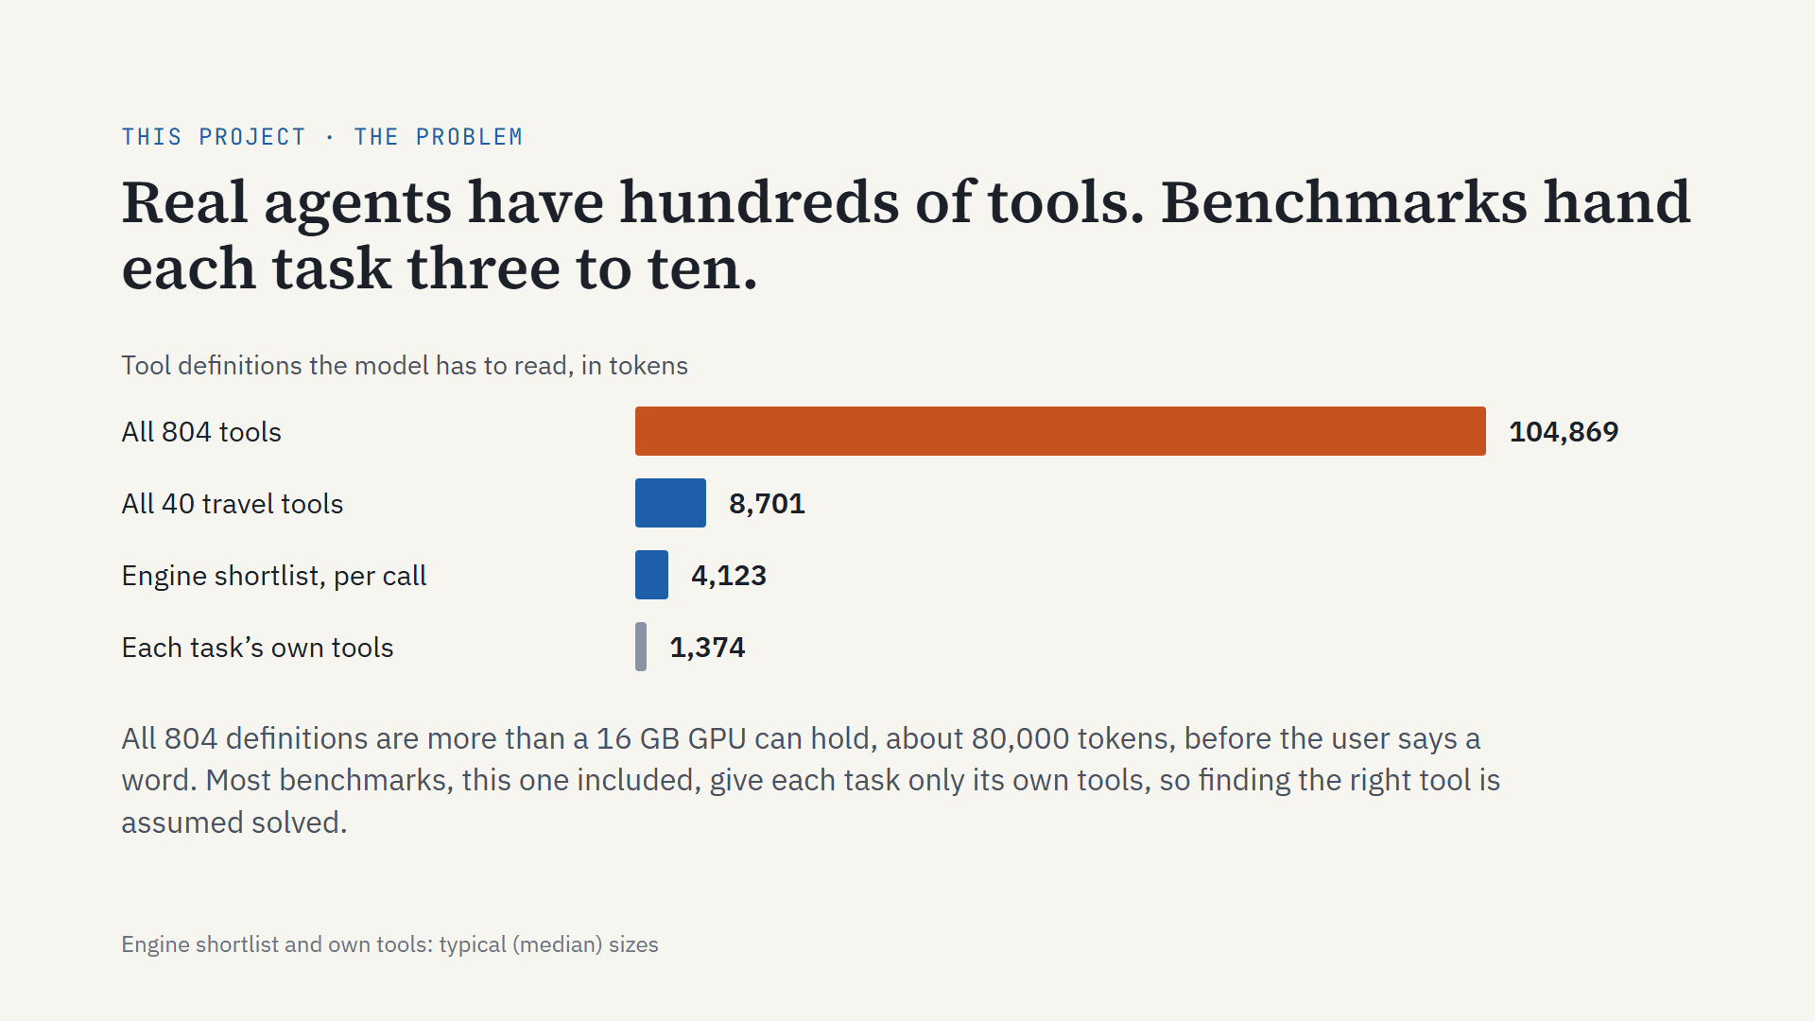
Notes:
Real agents carry hundreds of tools. All 804 definitions here are about 105,000 tokens; a 16 GB T4 GPU holds about 80,000 once the model is loaded, so they do not fit before the user even speaks. ComplexFuncBench, like most tool benchmarks, gives each task only the 3 to 10 tools it needs, so the leaderboard quietly assumes perfect tool retrieval. That assumption is what this talk removes.

Slide 7
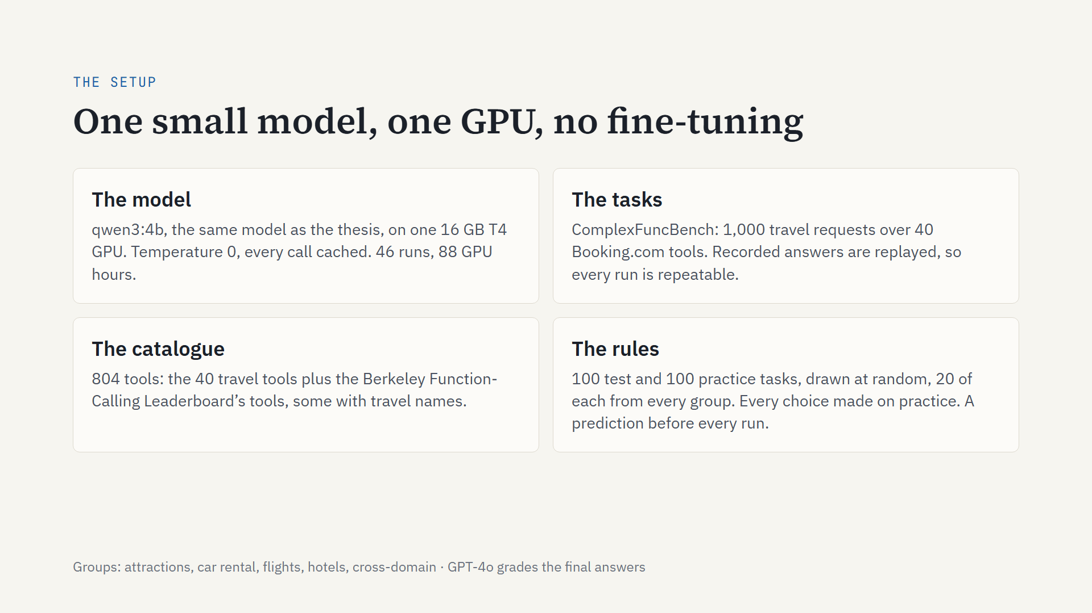
Notes:
Same model as the thesis: qwen3, 4 billion parameters. One 16 GB GPU per run. 46 runs, about 88 GPU-hours in all.
The benchmark is ComplexFuncBench: 1,000 travel requests over 40 Booking.com tools. Its answers are recorded and replayed, so every run is repeatable.
To make it hard, I added the Berkeley leaderboard’s tools: 804 in total, some with travel names.
The tasks come in 5 groups. From each group I drew 20 test and 20 practice tasks at random, with a fixed seed. The other 800 are a pool for examples and offline checks.
Every design choice was made on practice. Before every run I wrote down a prediction with a range, so a result could prove me wrong.
GPT-4o grades the final answers, as in the benchmark.

Slide 8
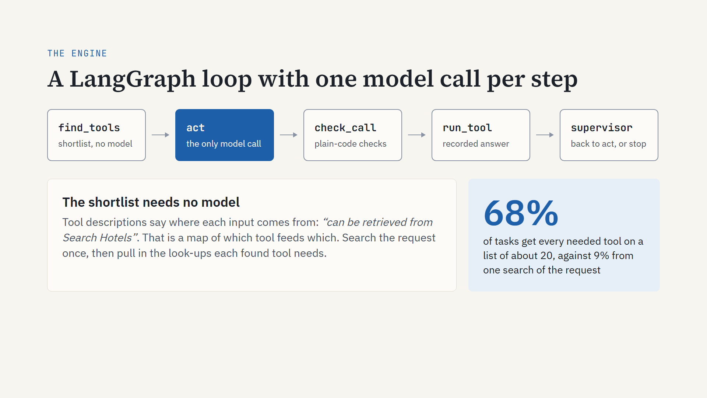
Notes:
The engine is a loop of five steps. Only one of them, act, calls a model. The rest is plain code.
The shortlist needs no model. Each tool’s description says where its inputs come from, for example “can be retrieved from Search Hotels”. That gives a map: this tool needs an id that comes from that tool.
Searching the request alone puts every needed tool on the list for only 9% of tasks.
Add the map, and it is 68%, on a list of about 20 tools.
The other 32% are tasks where some needed tool is still missing. Keep them in mind: fix 4 goes after exactly those.

Slide 9
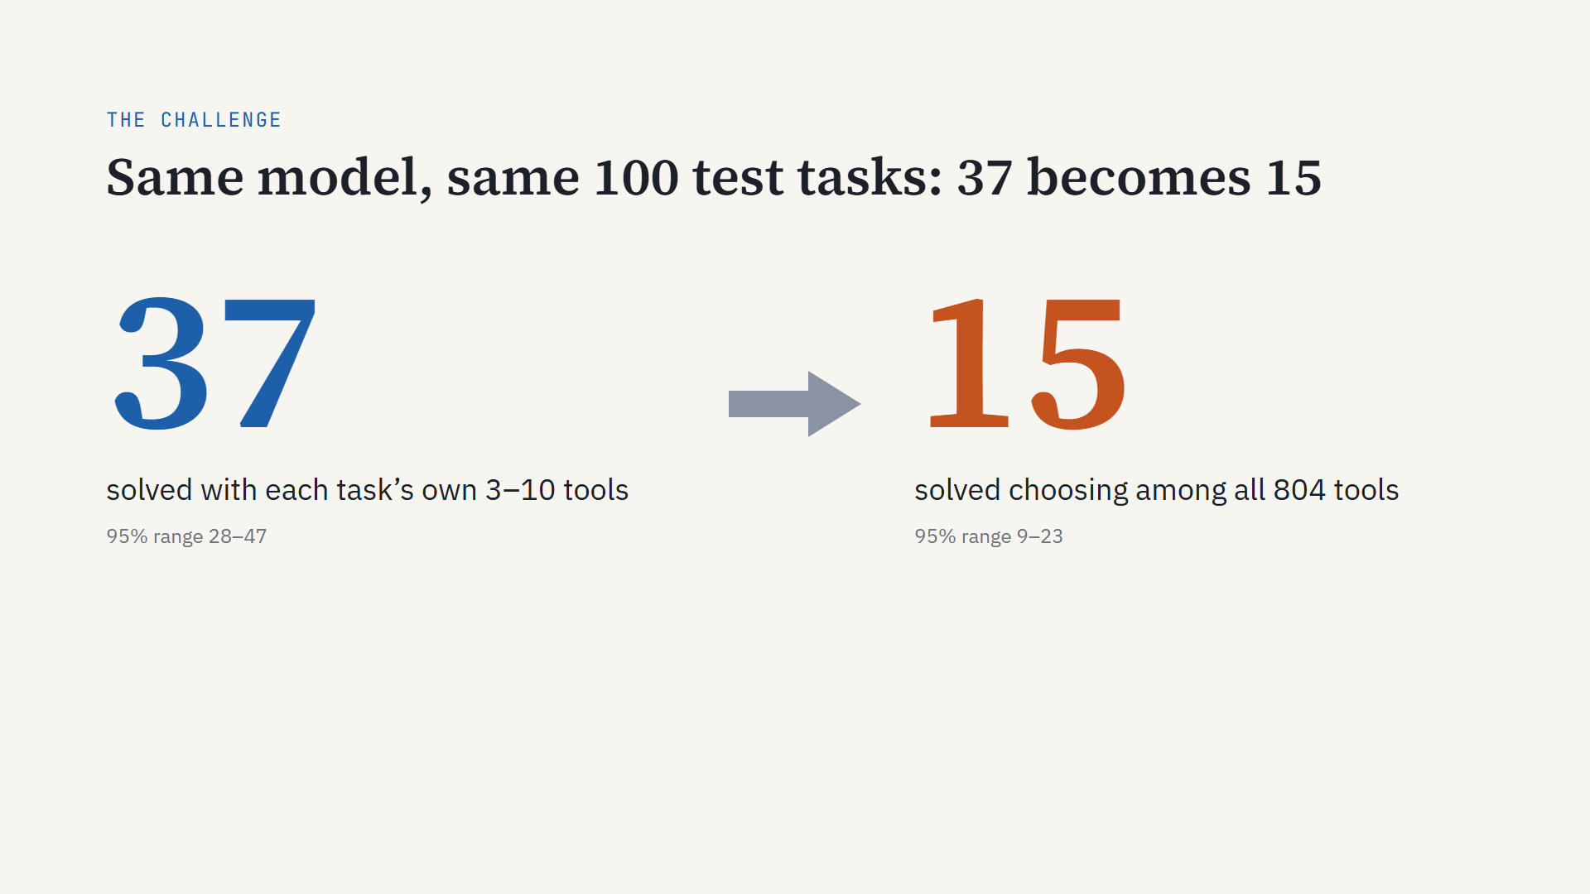
Notes:
Same model, same 100 test tasks. With its own tools it solves 37. Through the engine, with all 804 tools in reach, it solves 15. The ranges do not overlap, so this is not luck. Next slide: where those 22 tasks went.

Slide 10
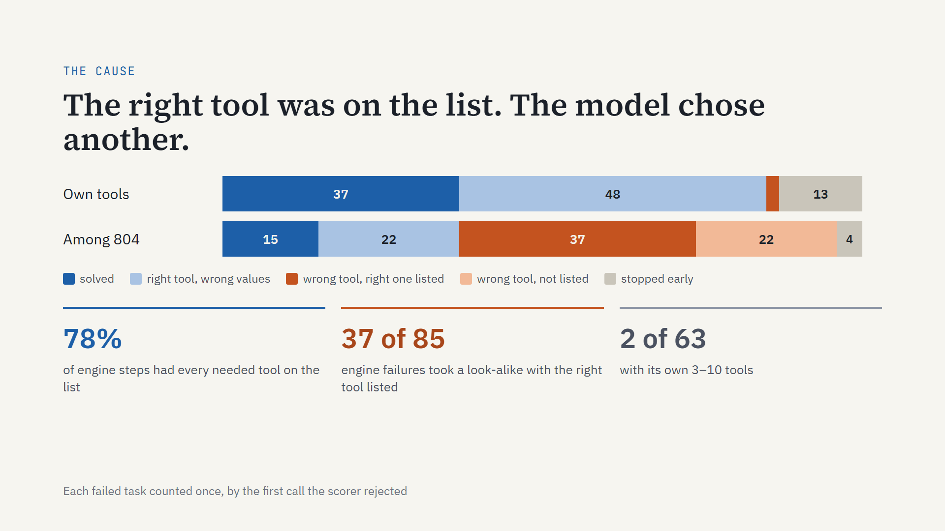
Notes:
The scorer ends a task at the first call it cannot accept, so each failure has one cause. With its own tools, the model almost always picks the right tool and gets a value wrong: a date, a filter, a sort order. Among 804, the biggest block is new: wrong tool, with the right one sitting on the list. The right tool was listed at 78% of steps (159 of 203). So finding worked well enough. Choosing is what broke.

Slide 11
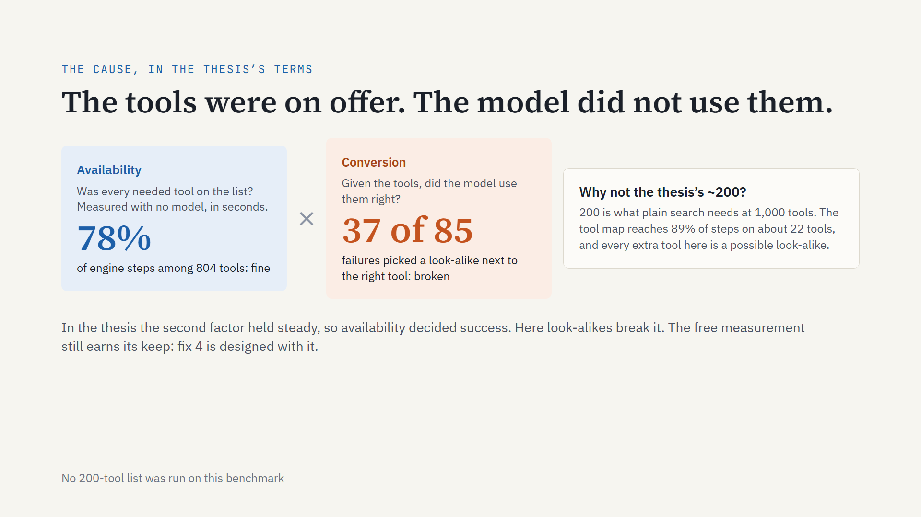
Notes:
Let me say the cause in the thesis’s terms.
The thesis split task success into two parts. Availability: was every needed tool on the list? That one you can measure with no model, in seconds. Conversion: given the tools, did the model use them right?
In the thesis, conversion held steady, so availability decided everything.
Here, availability was fine: 78% of steps had every needed tool listed. Conversion is what broke: 37 of 85 failures picked a look-alike sitting right next to the right tool.
Why not use the thesis’s rule of about 200 tools at 1,000? That 200 is what plain search needs. Our tool map gets 89% of steps on about 22 tools. And here every extra tool is another possible look-alike. To be honest, I never ran a 200-tool list on this benchmark.
The free measurement still earns its keep: fix 4 is designed with it, before any GPU time.

Slide 12
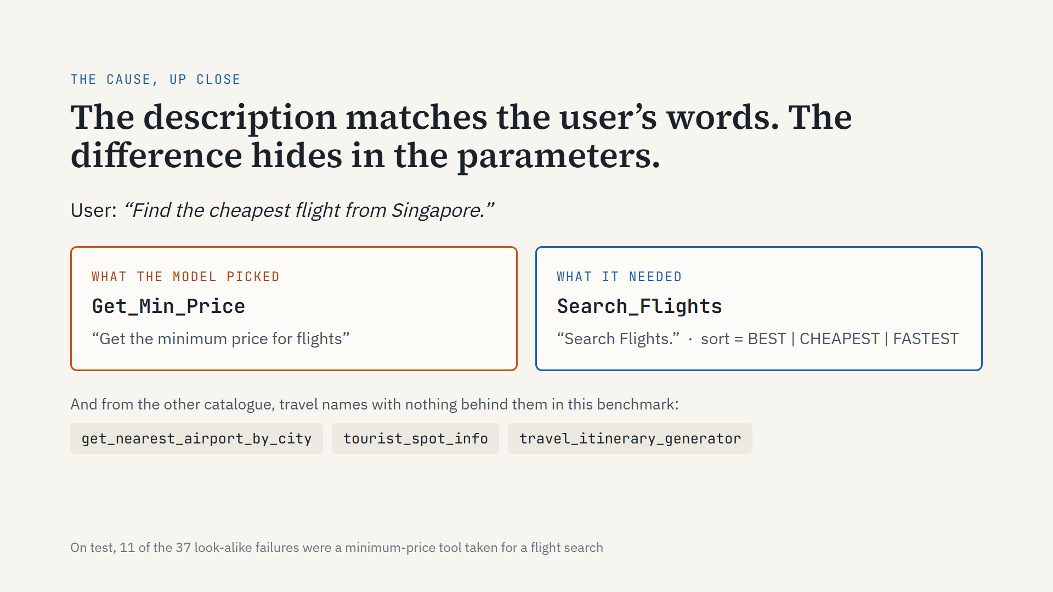
Notes:
Here is the most common look-alike. Search_Flights is described as just “Search Flights.” Get_Min_Price says “Get the minimum price for flights.” This user asks for the cheapest flight, so the model takes the tool that says “minimum price”. The benchmark expects Search_Flights with sort set to CHEAPEST: what separates the two is a parameter, not the description. On the test tasks, 11 of the 37 look-alike failures were this pair or its multi-stop twin. The 804 also include tools from another benchmark with travel names. They look plausible and lead nowhere.

Slide 13
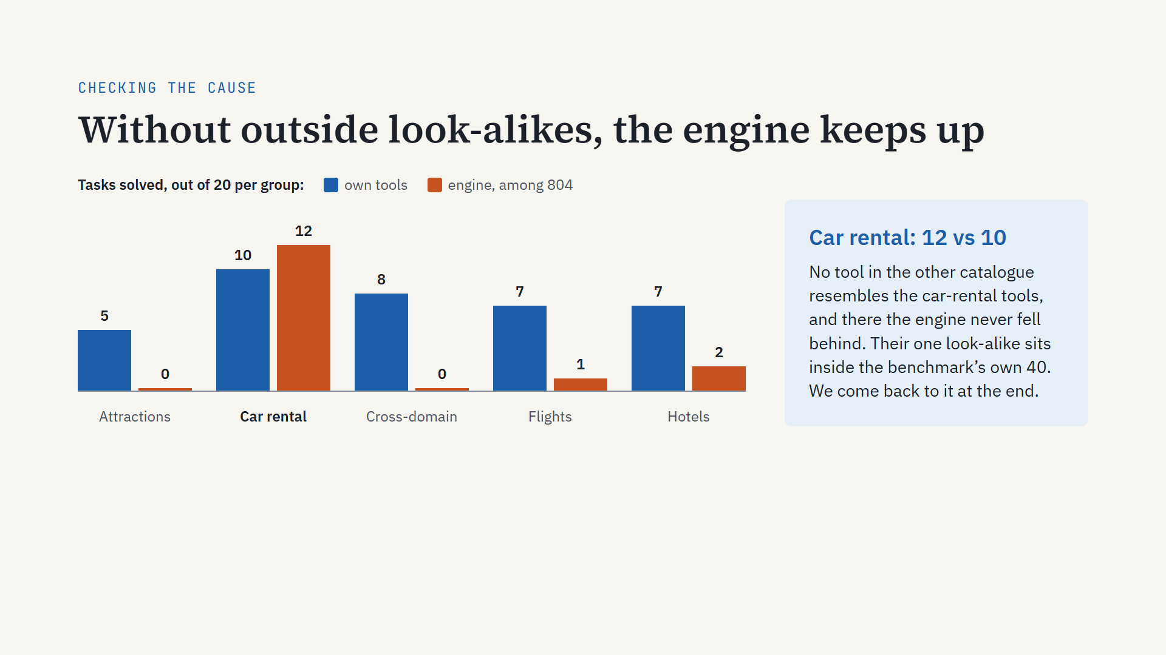
Notes:
How to read it: each pair of bars is one group of 20 test tasks. Blue is the model with its own tools. Orange is the engine choosing among all 804.
Attractions and cross-domain drop to zero. Flights and hotels collapse.
Car rentals hold, 12 against 10. That is the one group where no outside tool looks like the ones the task needs.
Car rentals do have one look-alike, inside the benchmark’s own 40 tools. Hold that thought: it comes back at the end.
So the cause holds: the engine works; look-alikes on the list break it. Now, four fixes, one at a time.

Slide 14
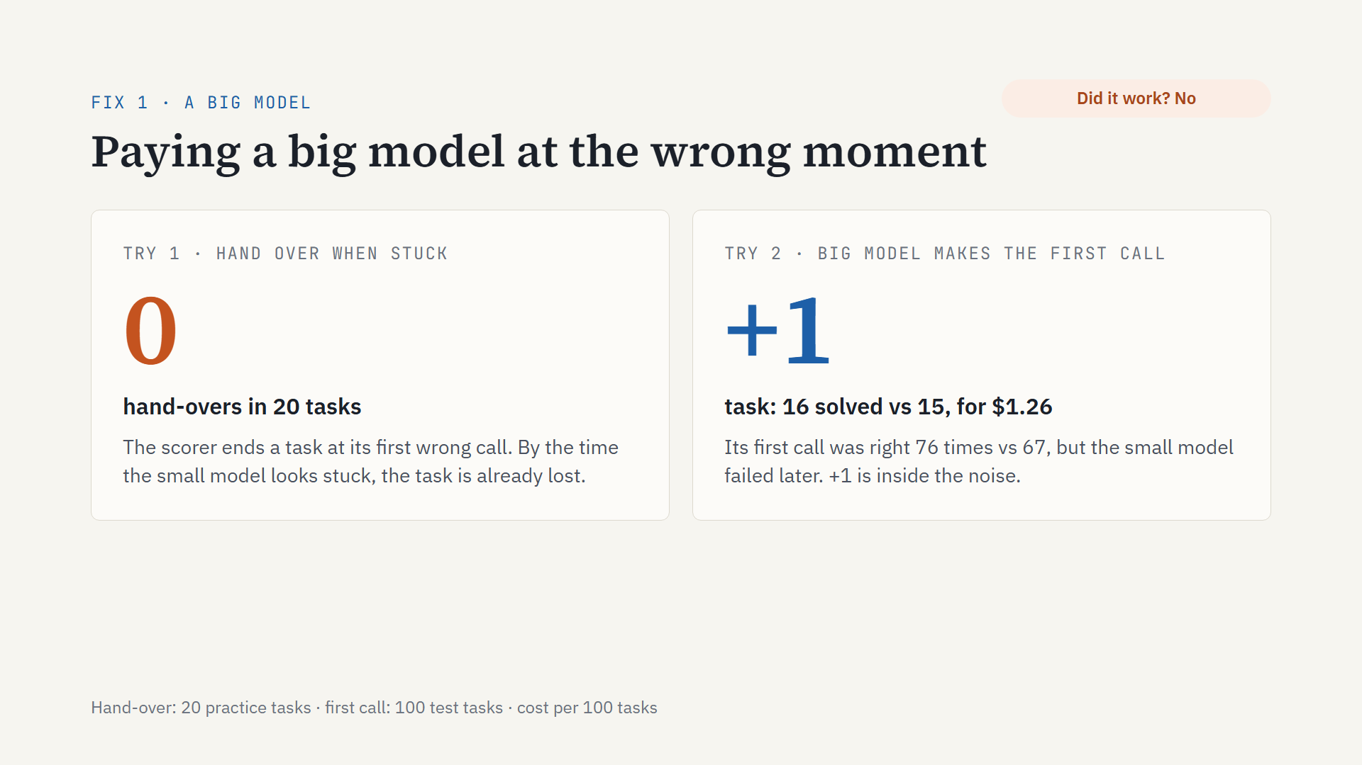
Notes:
The obvious fix: bring in the big model. First try: hand over to GPT-4o when the small model gets stuck. It never fired, not once in 20 tasks, because the scorer ends a task at the first wrong call, before any “stuck” signal appears. Second try: GPT-4o makes each task’s first call, from the wide list. Its first call was right more often, 76 against 67, but the small model fails later anyway. Net: one task, for $1.26 per 100 tasks, and one task is well inside what any change moves by chance; I will show that band on the scorecard. Did it work? No.

Slide 15
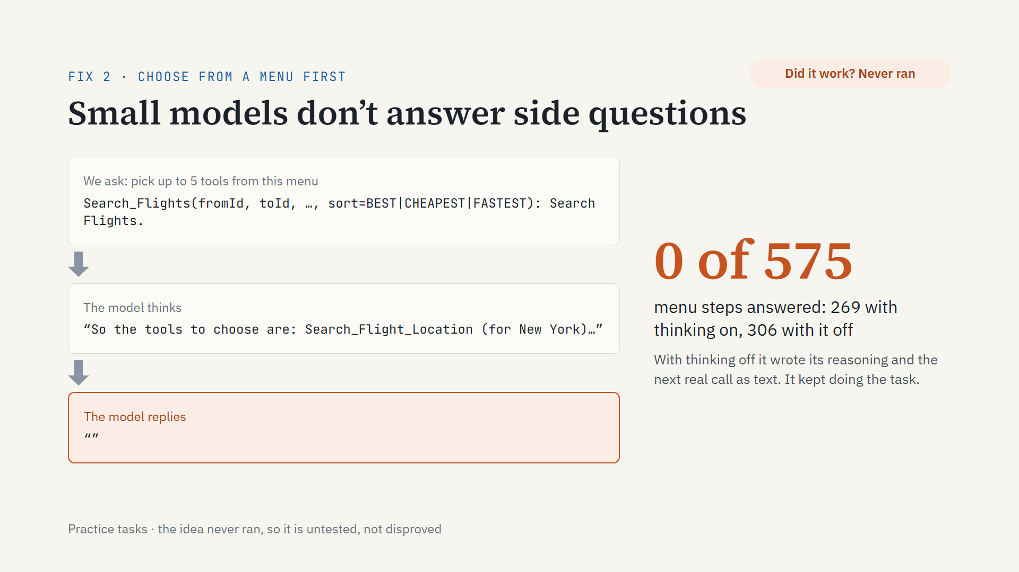
Notes:
The second idea: let the small model choose first. Show it a menu of names, parameters and one-line descriptions, let it pick up to five, then act on their full definitions. It never answered. With thinking on, it reasoned its way to an answer and then sent an empty reply. With thinking off, it wrote its reasoning and the next real call as text. Zero of 575 menu steps: 269 with thinking on, 306 with it off. A small model does not take a side question: it keeps doing the task. So this idea was never actually tested; it is closed, not refuted.

Slide 16
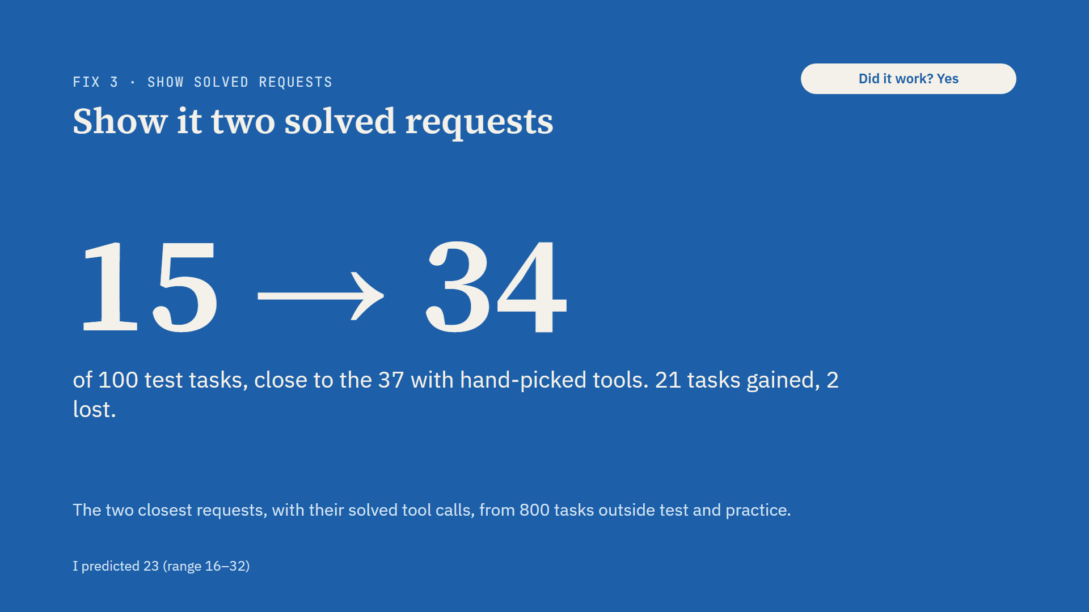
Notes:
Before the task, show the model the two most similar requests from other tasks, with the tool calls that solved them.
15 becomes 34, close to the 37 it got with hand-picked tools. 21 tasks gained, only 2 lost.
It is not free. It takes about 2.5 times as long. The example shows a chain: find the airport, search flights, get the details. The model sends all three calls at once. The later calls need ids that only the earlier answers contain, so it makes them up. The checks reject those, and it redoes them one at a time.
And there is a catch, on the next slide.

Slide 17
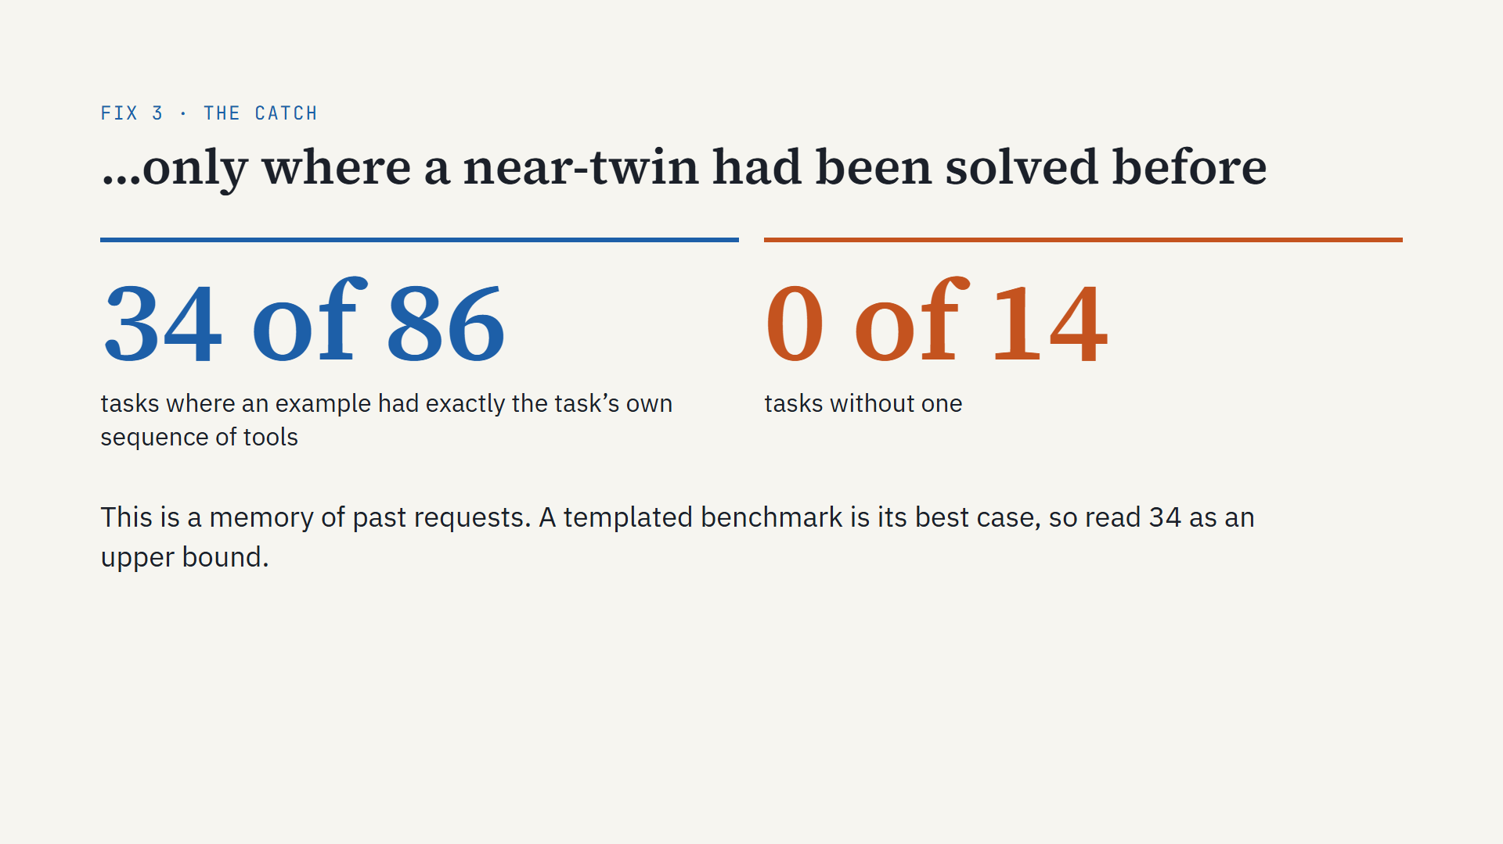
Notes:
Here is the honest part. For 86 of the 100 test tasks, one of the two examples used exactly the same sequence of tools as the task itself. The benchmark is templated: the median similarity between a request and its closest example is 0.84. Every one of the 34 solved tasks came from those 86. The 14 tasks with no twin: zero solved. So worked examples are a memory of past requests. In production that memory is real and cheap, but this benchmark is its best case, so treat 34 as an upper bound.

Slide 18
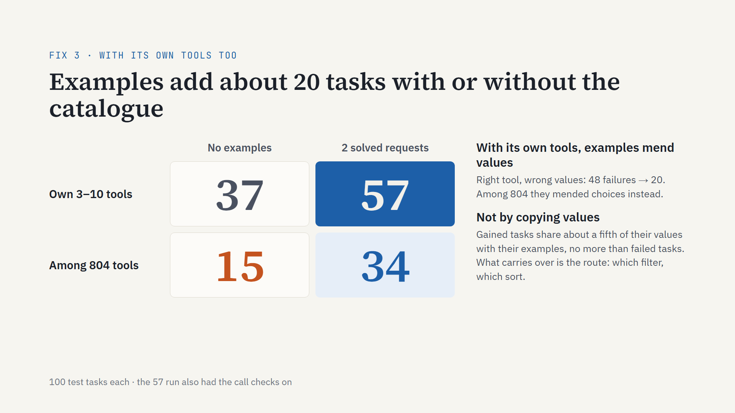
Notes:
Now the whole two-by-two on the same 100 test tasks. Own tools: 37, with two solved requests 57. Among 804 tools: 15, with examples 34. Examples add about 20 tasks either way, and the catalogue costs about 20 either way. With its own tools the model was already choosing right; there the examples fixed values, wrong-value failures fell from 48 to 20. I checked whether it simply copied values from the examples: the tasks it gained share only about a fifth of their values with their examples, the same as the tasks it failed. What carries over is the route and its conventions. The near-twin caveat still holds: 50 of the 86 twin tasks solved, and on the 14 without a twin it solved 7, exactly what it did without examples. Small print: the 57 run also had the call checks on; on practice the checks alone moved one task. What is left among 804 tools: 66 failures, and 19 of them are a tool that was never on the list. That is fix 4.

Slide 19
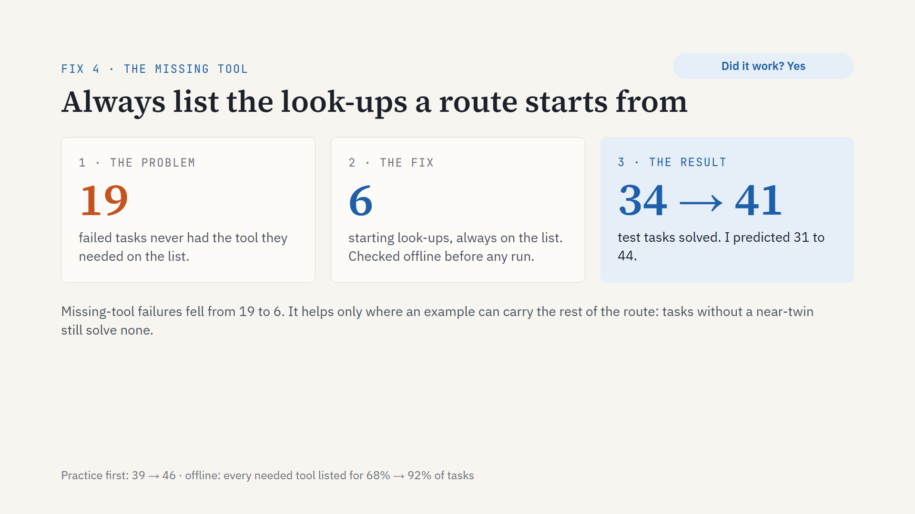
Notes:
Three beats.
The problem: with examples, 66 tasks still failed. In 19 of them, the tool the next step needed was never on the list. Mostly hotel searches near a landmark: the route starts from a look-up the shortlist had cut.
The fix: six tools in this catalogue are where routes start. Other tools name them as a source, and they need nothing themselves. Always put those six on the list. Before spending any GPU time I checked offline: every needed tool on the list for 92% of tasks instead of 68%.
The result: I set a rule in advance. Run it on test only if practice gains at least 5 tasks. Practice went 39 to 46, so it ran. Test went 34 to 41, inside my predicted 31 to 44.
The limit: it only helps where an example can carry the rest of the route. Tasks without a near-twin still solve none.

Slide 20
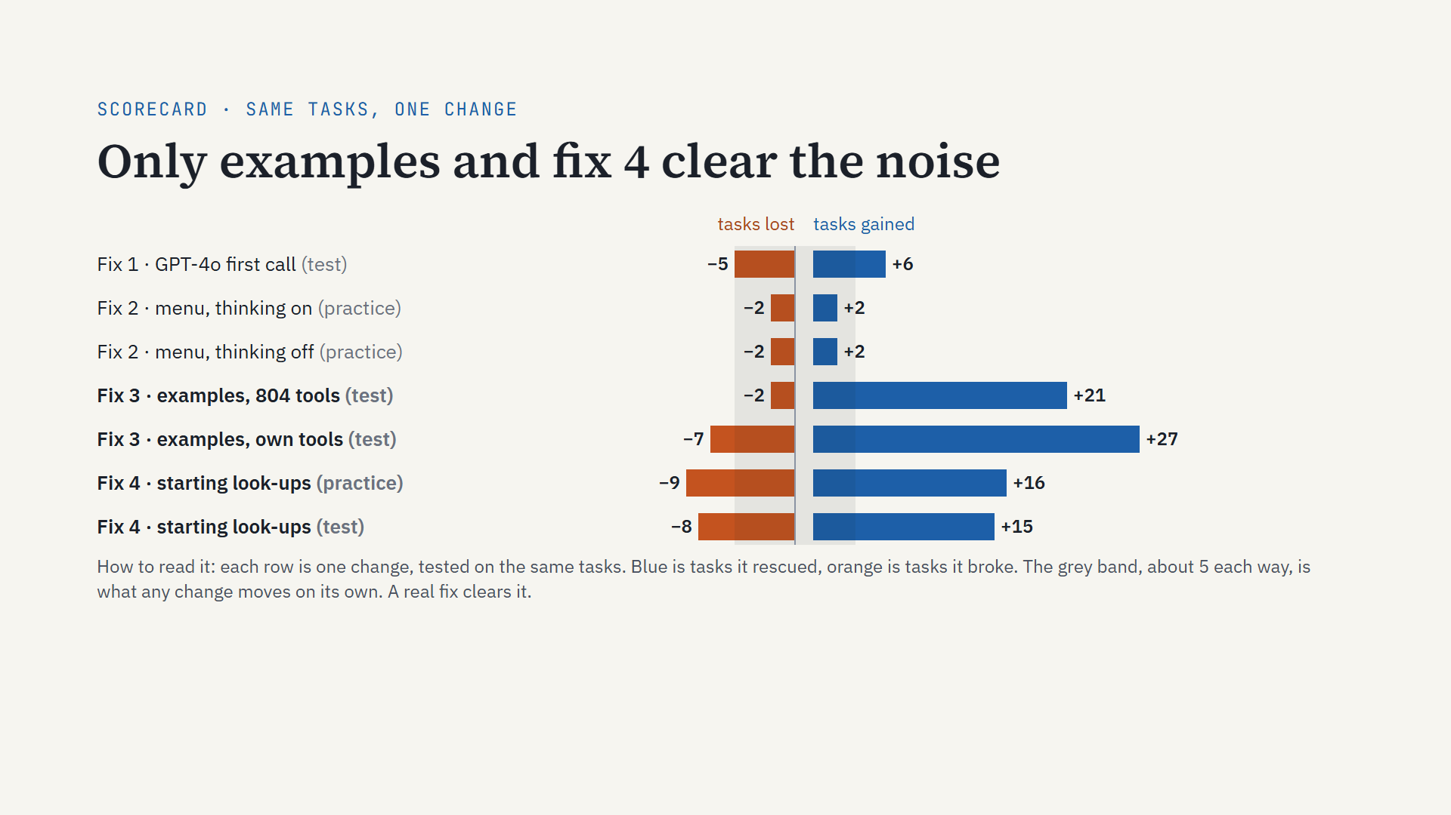
Notes:
The scorecard. Something I wish I had measured on day one.
The model gives the same reply to the same prompt. But any change, even a reworded error message, sends some conversations down a different path. About 5 tasks move each way.
So a change has to clear that band before I believe it.
GPT-4o on the first call: plus 6, minus 5. Inside the band.
The menu: it never ran, so plus 2, minus 2 is pure drift.
Worked examples clear it by a lot, with 804 tools and with the task’s own tools.
Fix 4 clears it too, on practice and on test. It gains 15 or 16 and loses 8 or 9, so the real effect is about 7 tasks.

Slide 21
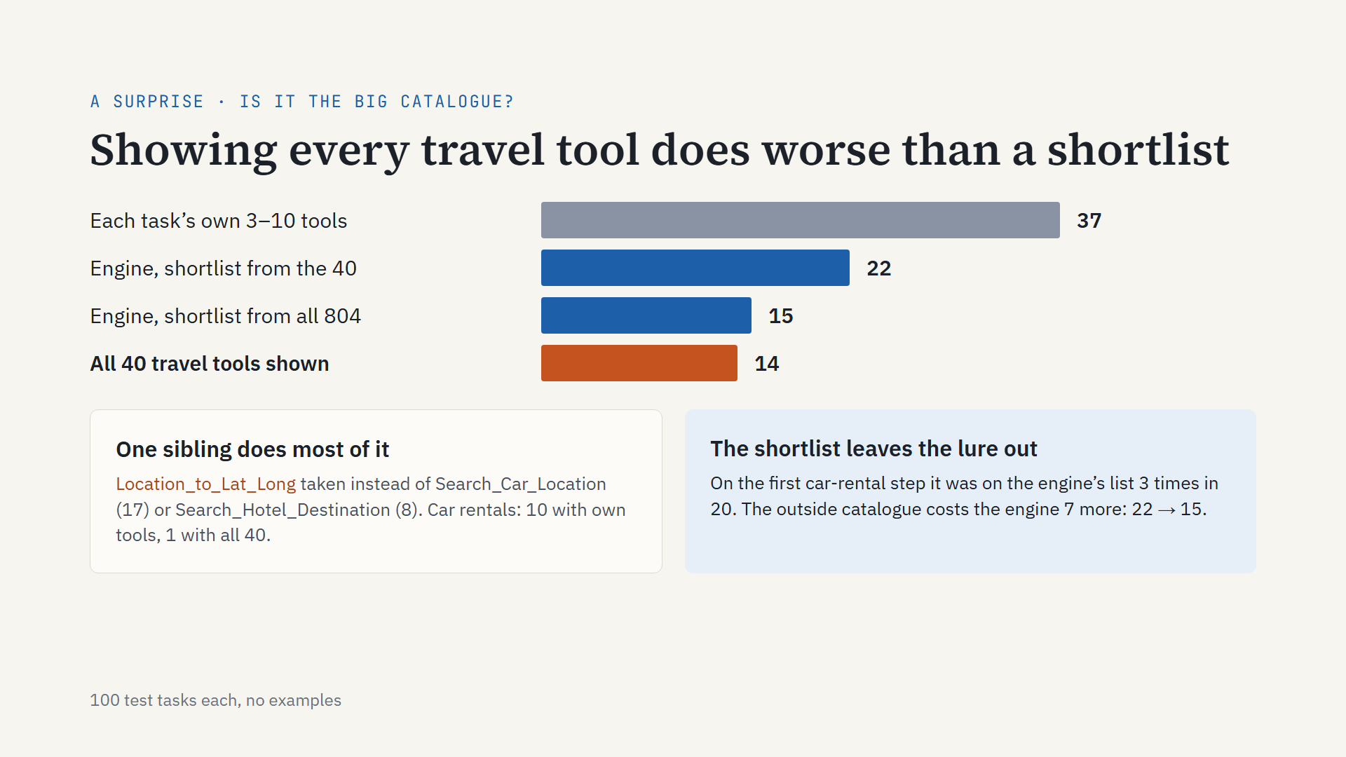
Notes:
Is the problem the 804-tool catalogue? To separate that out, I ran the benchmark’s own 40 travel tools two ways. Show all 40: 14 solved, no better than the engine among 804. Let the engine shortlist from the same 40: 22. I predicted the opposite, that showing everything would win slightly. Most of the damage is one sibling inside the benchmark itself: Location_to_Lat_Long, which the model takes when it should look up a car-rental or hotel location. Car rentals fall from 10 to 1. The engine’s shortlist keeps that lure off the first car-rental step most of the time. So on this benchmark most of the fall from 37 is the benchmark’s own look-alikes; the outside catalogue costs the engine another 7. “Just show every tool” is not the safe baseline it looks like. Next: why the model takes that tool, in its own words.

Slide 22
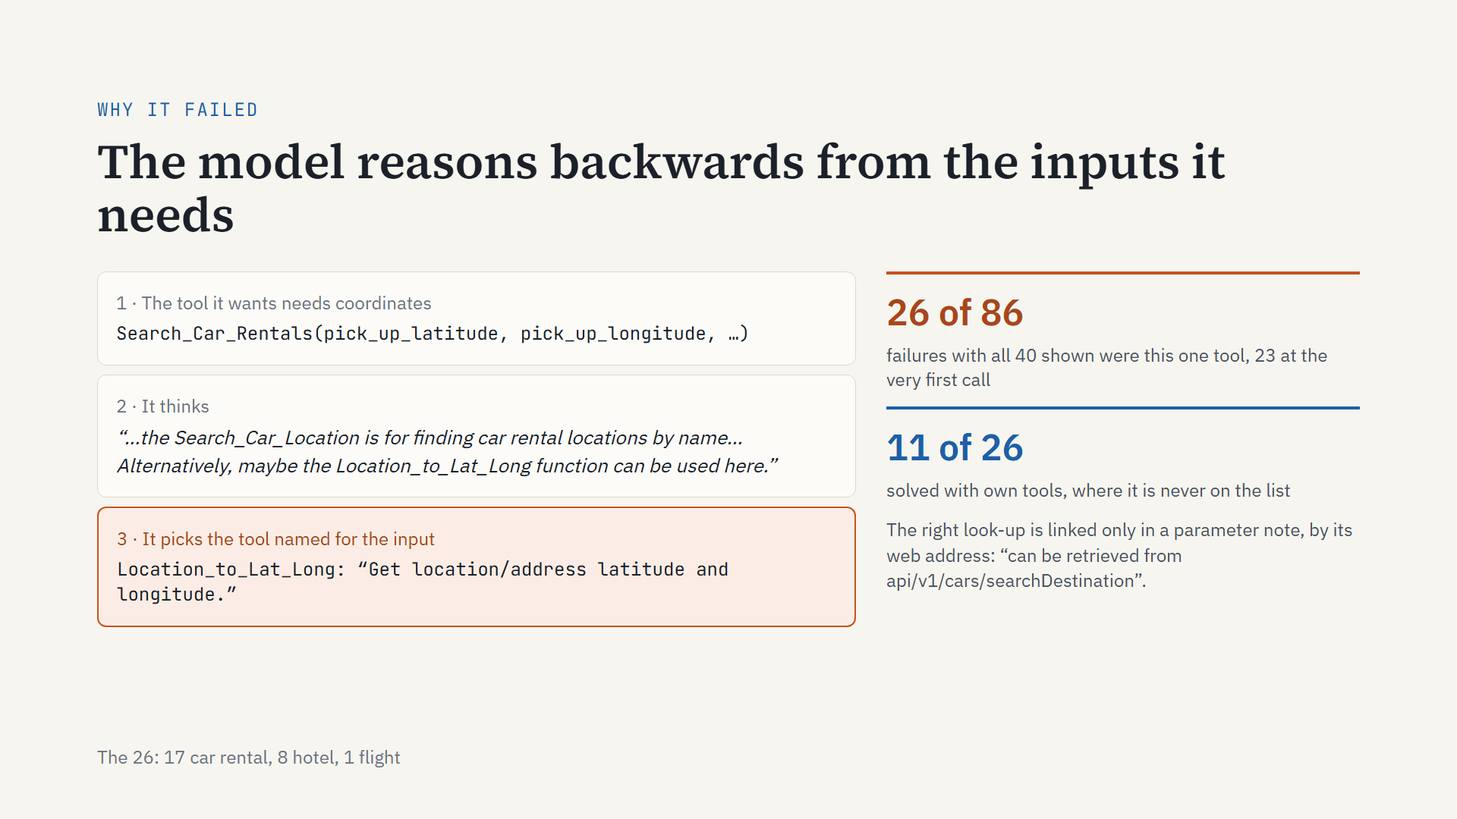
Notes:
Why does showing every tool do so badly? I read the model’s own reasoning on those failures. It works backwards: the tool it wants, Search_Car_Rentals, needs a pick-up latitude and longitude, so it looks for something that gives coordinates. The right look-up, Search_Car_Location, is described as finding car rental locations by name, and the only link to it is a note in the parameter, by web address. Location_to_Lat_Long says, in its first words, “latitude and longitude”. In this trace the model even considers the right tool, then says “alternatively”, and takes the one named for the input. That one tool is 26 of the 86 failures, 23 of them at the very first call. With its own tools, the lure is never on the list, and the same 26 tasks solved 11. To be fair to the model: on a live API those coordinates might well have worked. The benchmark only replays its own route. But the lesson for tool design stands: the model matches the input it needs to the tool whose name says it, so name and describe look-ups by what they return.

Slide 23
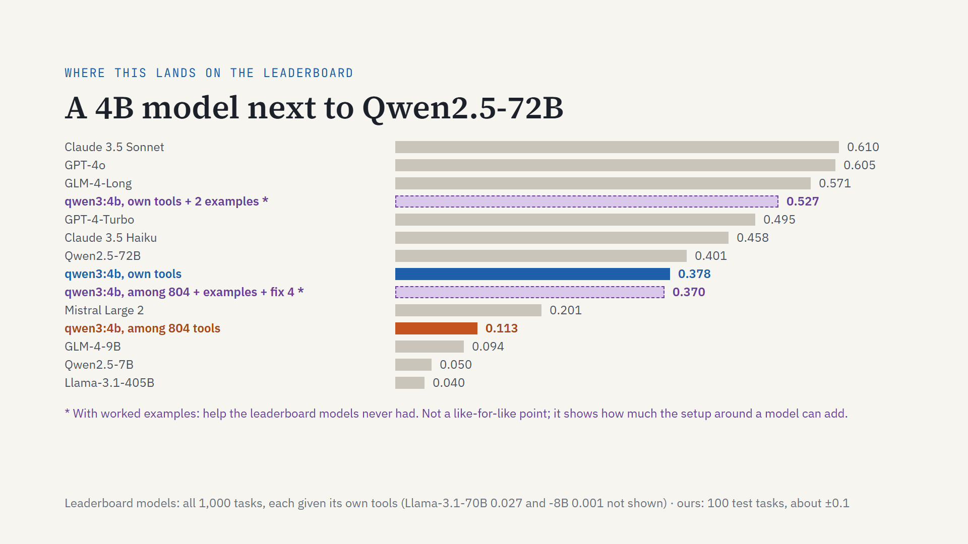
Notes:
Where does this land on the benchmark’s public leaderboard?
Grey bars are the published models. Every one of them was handed each task’s own tools.
With its own tools, our 4B model scores 0.378. That is level with Qwen2.5-72B, and far ahead of Mistral Large 2 and Llama 3.1 405B.
Among all 804 tools, with no help, it drops to 0.113, the problem this talk is about.
The two purple rows use worked examples. That is help the leaderboard models never had, so they are not a fair comparison. I show them for one reason: the setup around a model can add a lot. Own tools plus examples reaches 0.527, between Claude 3.5 Haiku and GLM-4-Long. And among 804 tools, examples plus fix 4 bring it back to 0.370.
Caveats: we ran 100 of the 1,000 tasks, so read about plus or minus 0.1. The grading model’s version may differ. And qwen3 is a newer generation than these models.

Slide 24
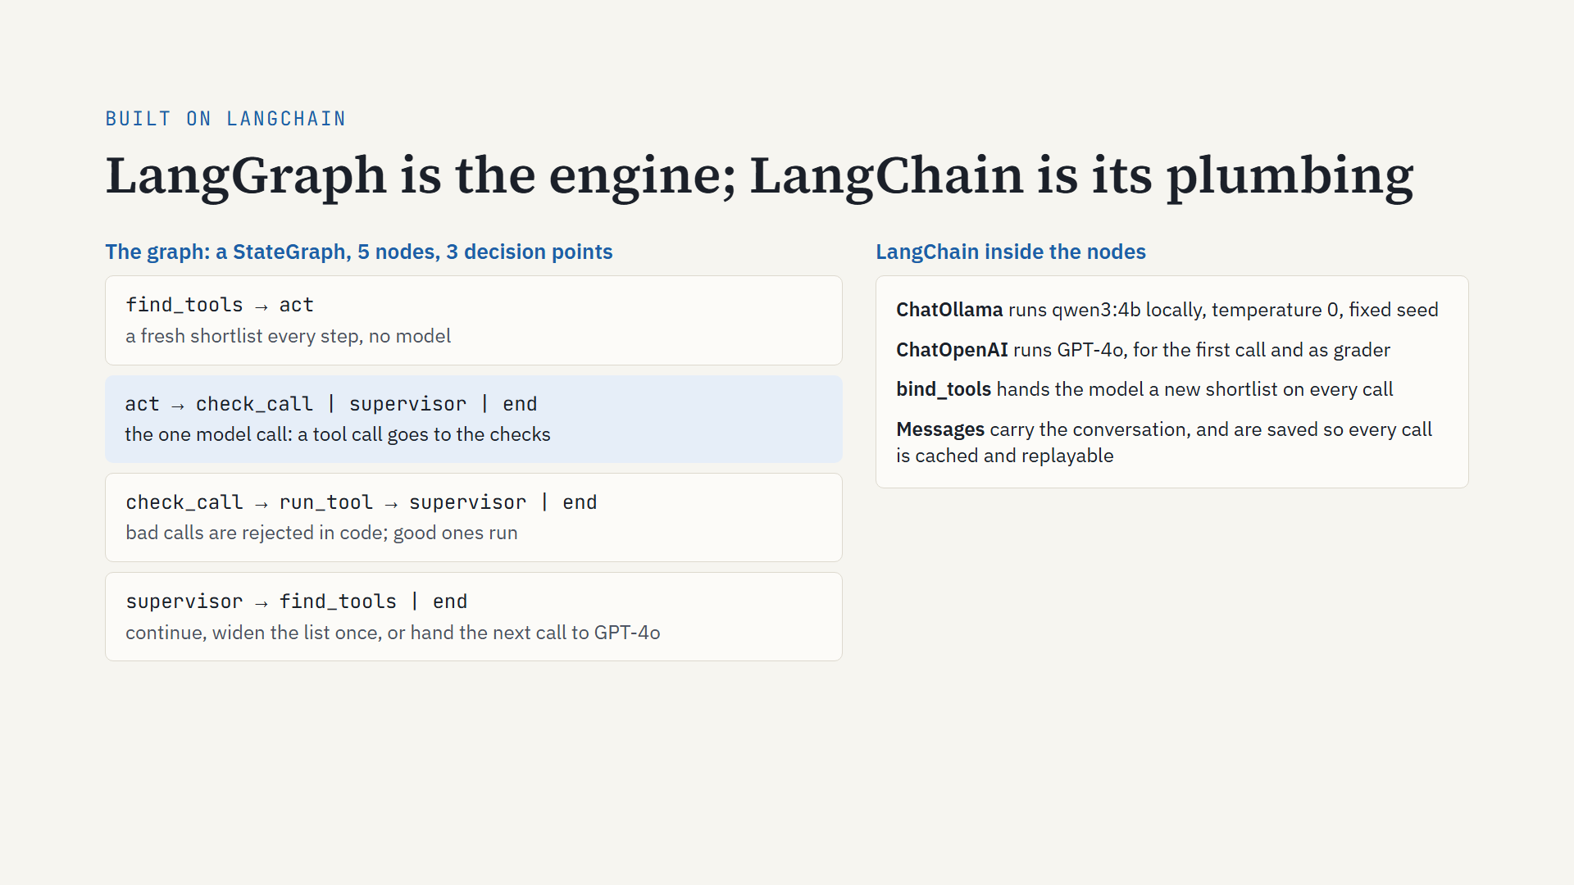
Notes:
My thesis did not use LangChain at all. Its harness was hand-written and called the model directly.
For this project I rebuilt it on LangChain and LangGraph. Only the retriever came over unchanged.
The engine is a LangGraph state graph: five nodes, and three places where it decides where to go next.
find_tools builds a fresh shortlist every step, with no model.
act is the one model call. If the model asks for a tool, the call goes to the checks.
check_call rejects bad calls in plain code. Good calls go to run_tool.
The supervisor decides: carry on, widen the list once if a tool was missing, hand the next call to GPT-4o, or stop.
Inside the nodes, LangChain does the plumbing. ChatOllama runs qwen3 locally; ChatOpenAI runs GPT-4o. bind_tools hands the model its shortlist on every call. And LangChain’s message objects carry the conversation. I save them, so every call is cached and every run can be replayed.

Slide 25
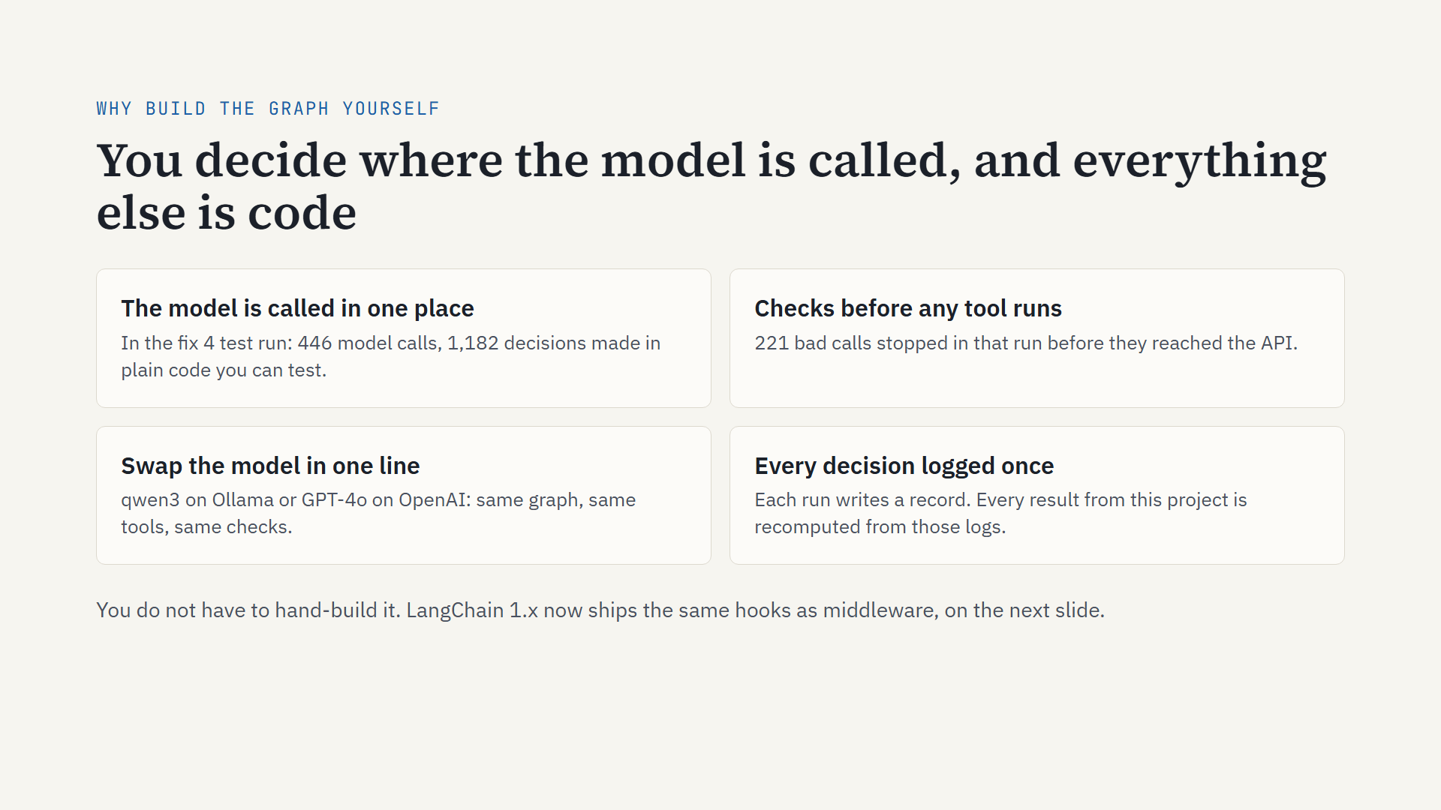
Notes:
Why build the graph yourself instead of using a ready-made agent? Four reasons.
One: the model is called in exactly one place. In the fix 4 test run that was 446 model calls, against 1,182 decisions made in plain code. Code you can test and log.
Two: checks run before any tool does. In that same run, 221 bad calls were stopped before they reached the API.
Three: swapping the model is one line. qwen3 on Ollama or GPT-4o on OpenAI, with the same graph, tools and checks. That is how the big-model experiment was done.
Four: every decision is logged once. Every result from this project is recomputed from those logs.
You do not have to hand-build it, though. LangChain 1.x now ships the same hooks as middleware. Next slide.

Slide 26
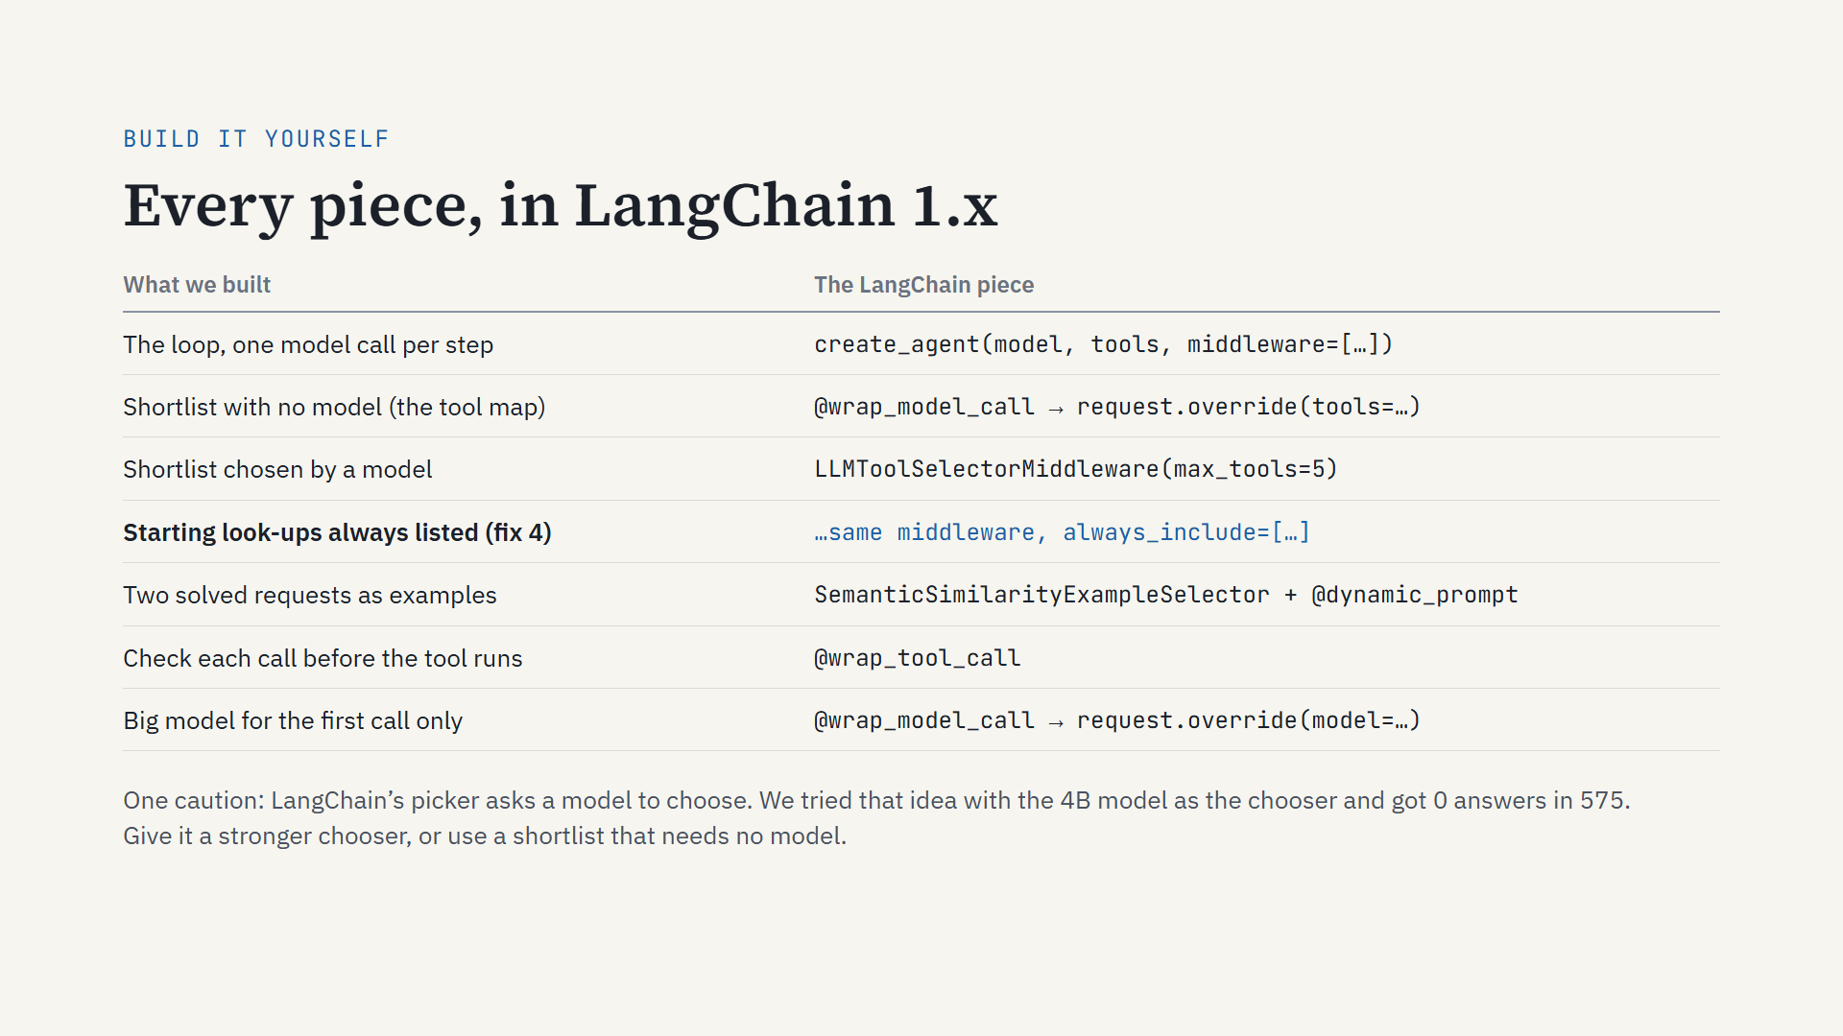
Notes:
If you want to build this yourself, LangChain 1.x has a piece for almost every part. create_agent gives you the loop as a LangGraph graph; we built ours directly on StateGraph, but it is the same shape. Middleware is where the ideas from this talk go. A wrap_model_call middleware can replace the tool list before each model call, which is where a no-model shortlist goes. LangChain also ships LLMToolSelectorMiddleware, which asks a model to pick the tools, and it has an always_include option: that is exactly fix 4, the starting look-ups always on the list. Worked examples: SemanticSimilarityExampleSelector to find the closest solved requests, and dynamic_prompt to put them in the prompt. Call checks: wrap_tool_call. And putting the big model only at the first decision is another wrap_model_call that swaps the model on the first call. One caution from our own data: the picker asks a model a side question. With our 4B model as the chooser, that idea got zero answers in 575 tries. So give the picker a stronger model, or use a shortlist that needs no model at all.

Slide 27
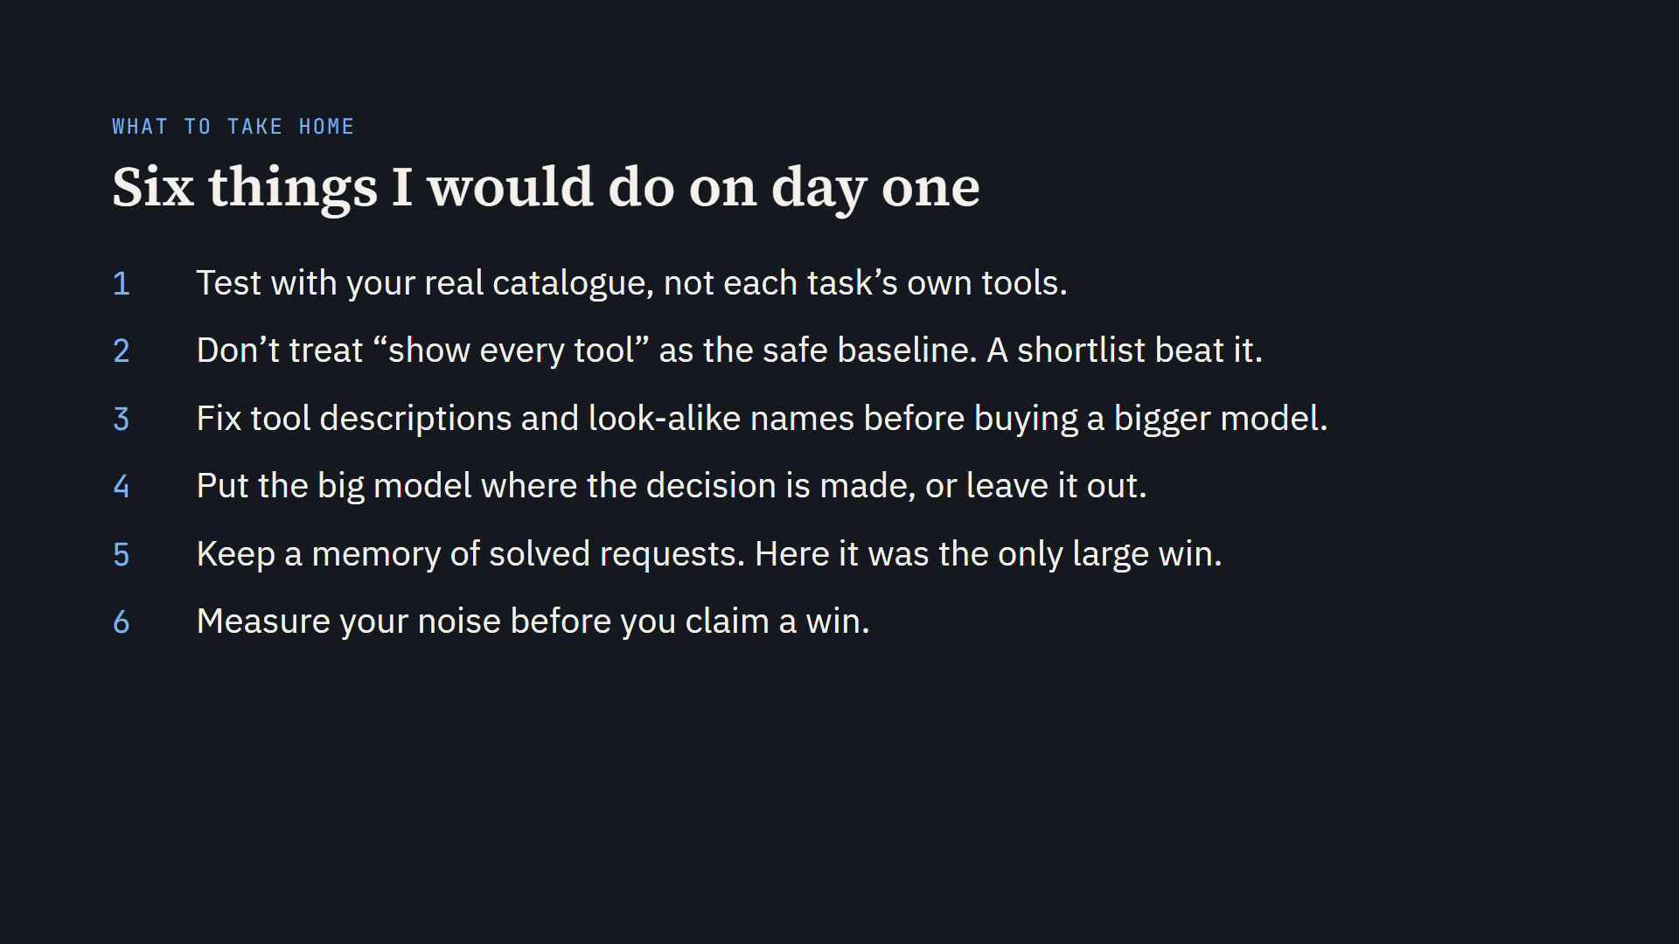
Notes:
Six things. Test with the catalogue you will actually ship, not the benchmark’s hand-picked tools. Don’t assume that showing every tool is the safe choice: with all 40 travel tools in front of it the small model solved 14, and a shortlist from the same 40 solved 22. Most of the damage came from look-alike tools, so fix descriptions and names before paying for a bigger model. If you do pay for one, put it where the decision is made; “when stuck” came too late. Keep a memory of solved requests: here it was the only large win, with the caveat that it needs a near-twin. And measure how much your results move by chance before you announce a gain.

Slide 28

Notes:
Thank you. Happy to take questions, now or by email.

