Slide 1
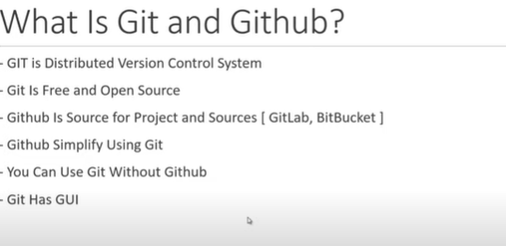

Slide 2
What is GitHub
GitHub is a web-based platform built around Git, a version control system. It allows you to host, manage, and collaborate on code and projects with other developers.

Slide 3
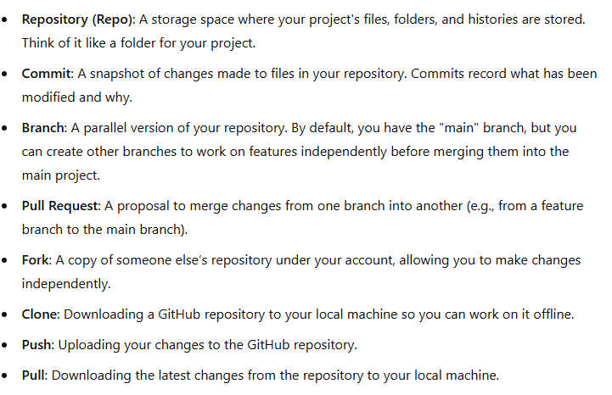
KeyConcept

Slide 4
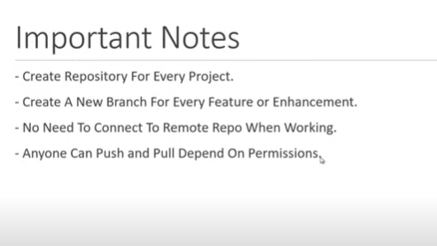

Slide 5
3. Getting Started with GitHub
Step 1: Create a GitHub Account
-Go to github.com.
-Sign up for an account.

Slide 6
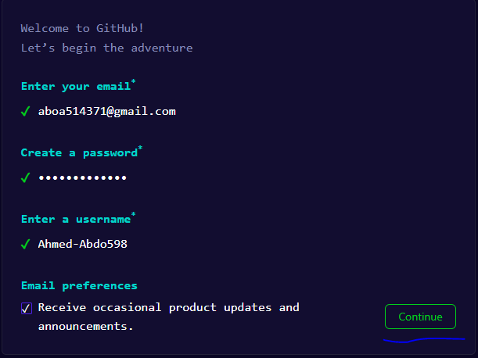
Sign-Up

Slide 7
Step 2: Install Git
Download and install Git on your computer: Git Download.
After installation, open a terminal (Command Prompt on Windows) and set up your Git username and email:
git config --global user.name "Your Name"
git config --global user.email "youremail@example.com"

Slide 8
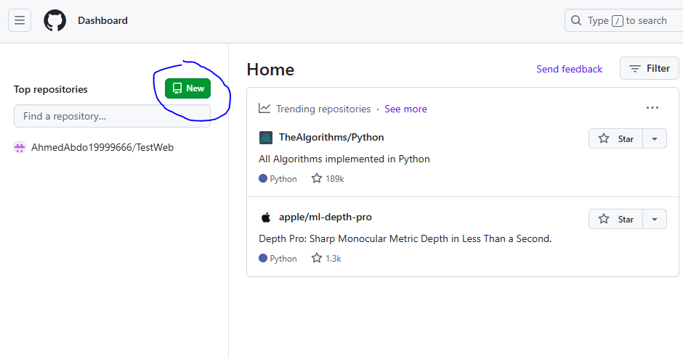
Create a Repository
Step 2: Install Git
Download and install Git on your computer: Git Download.
After installation, open a terminal (Command Prompt on Windows) and set up your Git username and email:
git config --global user.name "Your Name"
git config --global user.email "youremail@example.com"

Slide 9
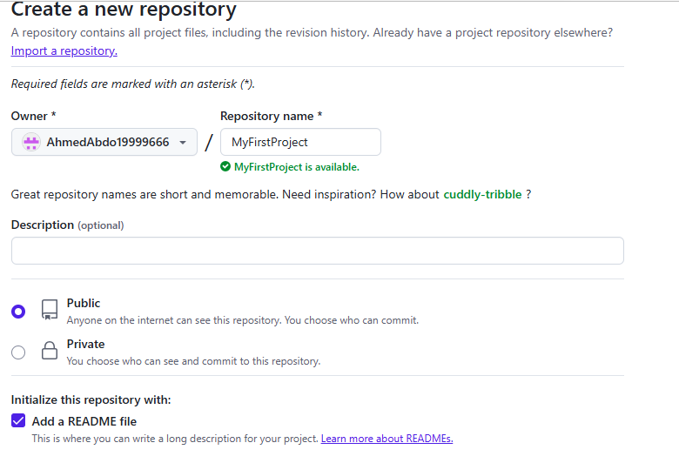
Create a Repository

Slide 10
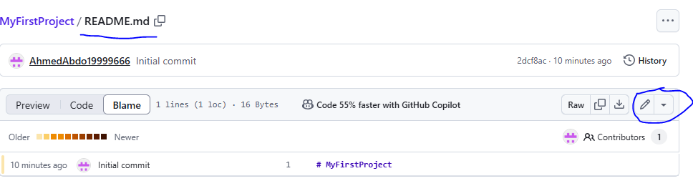
Edit RedMe file

Slide 11
Edit RedMe file
The language used in RedMe file is called Markdown
Markdown Guide

Slide 12
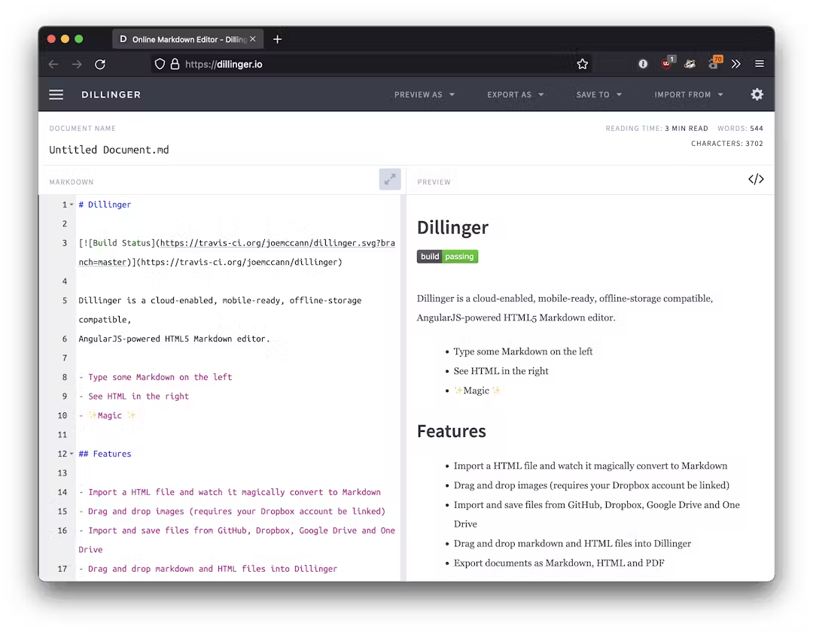
Edit RedMe file
The language used in RedMe file is called Markdown
Markdown Guide

Slide 13
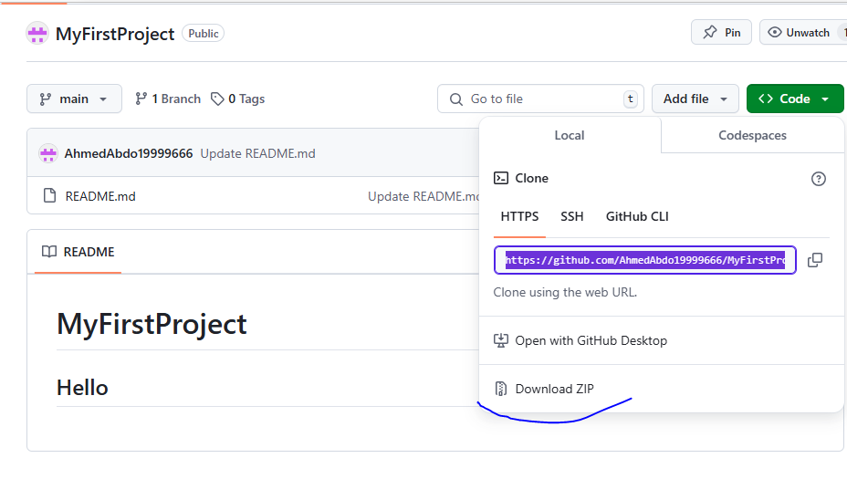
Clone or download project

Slide 14
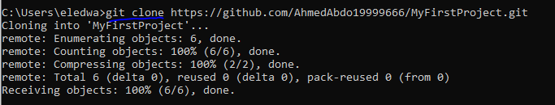
Clone or download Using CMD

