Slide 1
Smart home
Embedded systems

Slide 2
Ahmed Abo Raya
Student at Modern Academy for Engineering and Technology
Studying in the Department of Computer Engineering
Specialized in the field of Embedded Systems

Slide 3
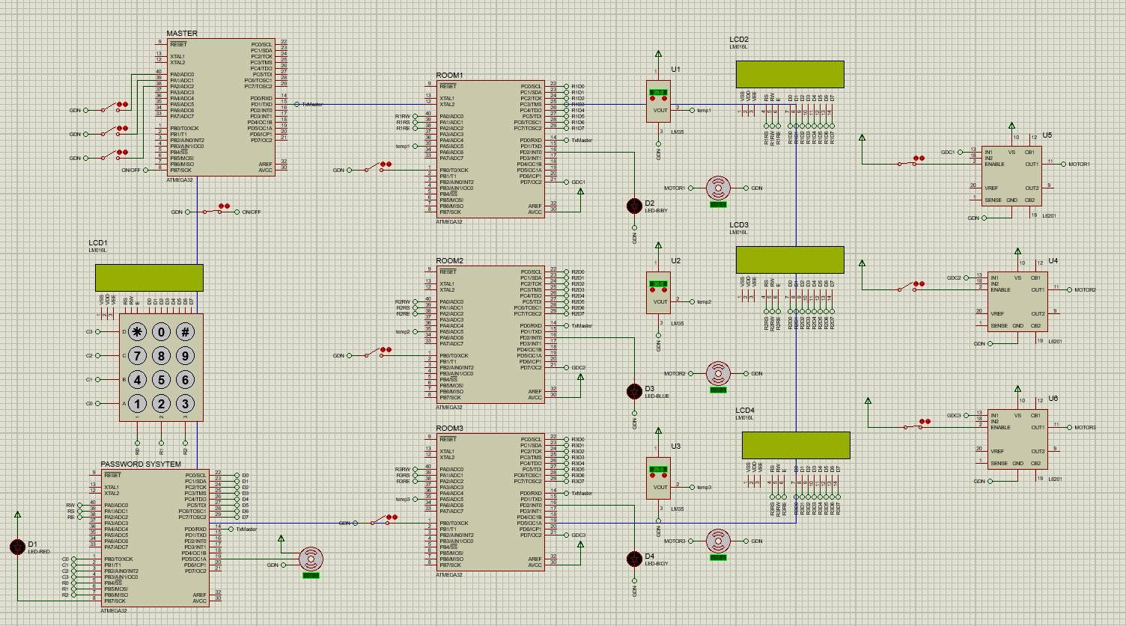
Hardware components

Slide 4
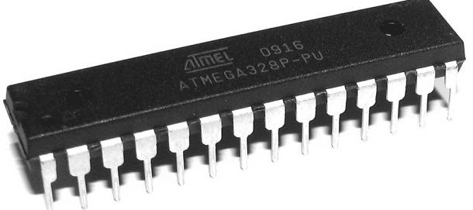
Microcontroller
Atmega32 used to store and execute instructions

Slide 5
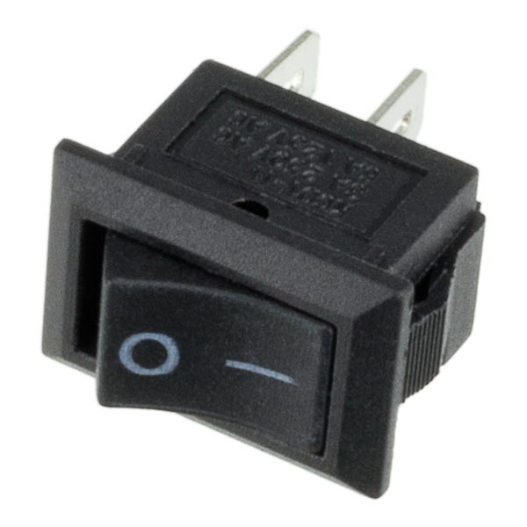
mechanical switch
Master Switch
LED Control

Slide 6
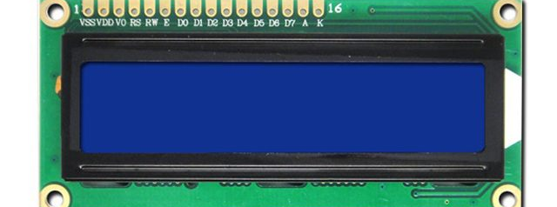
LCD (lm016l)
Used to display some information about system

Slide 7
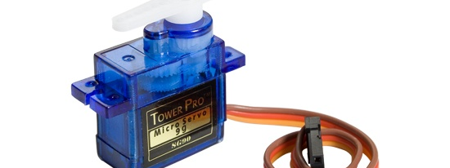
Servo motor
Used PWM to rotate and it rotate 180 degree (called servo system)

Slide 8
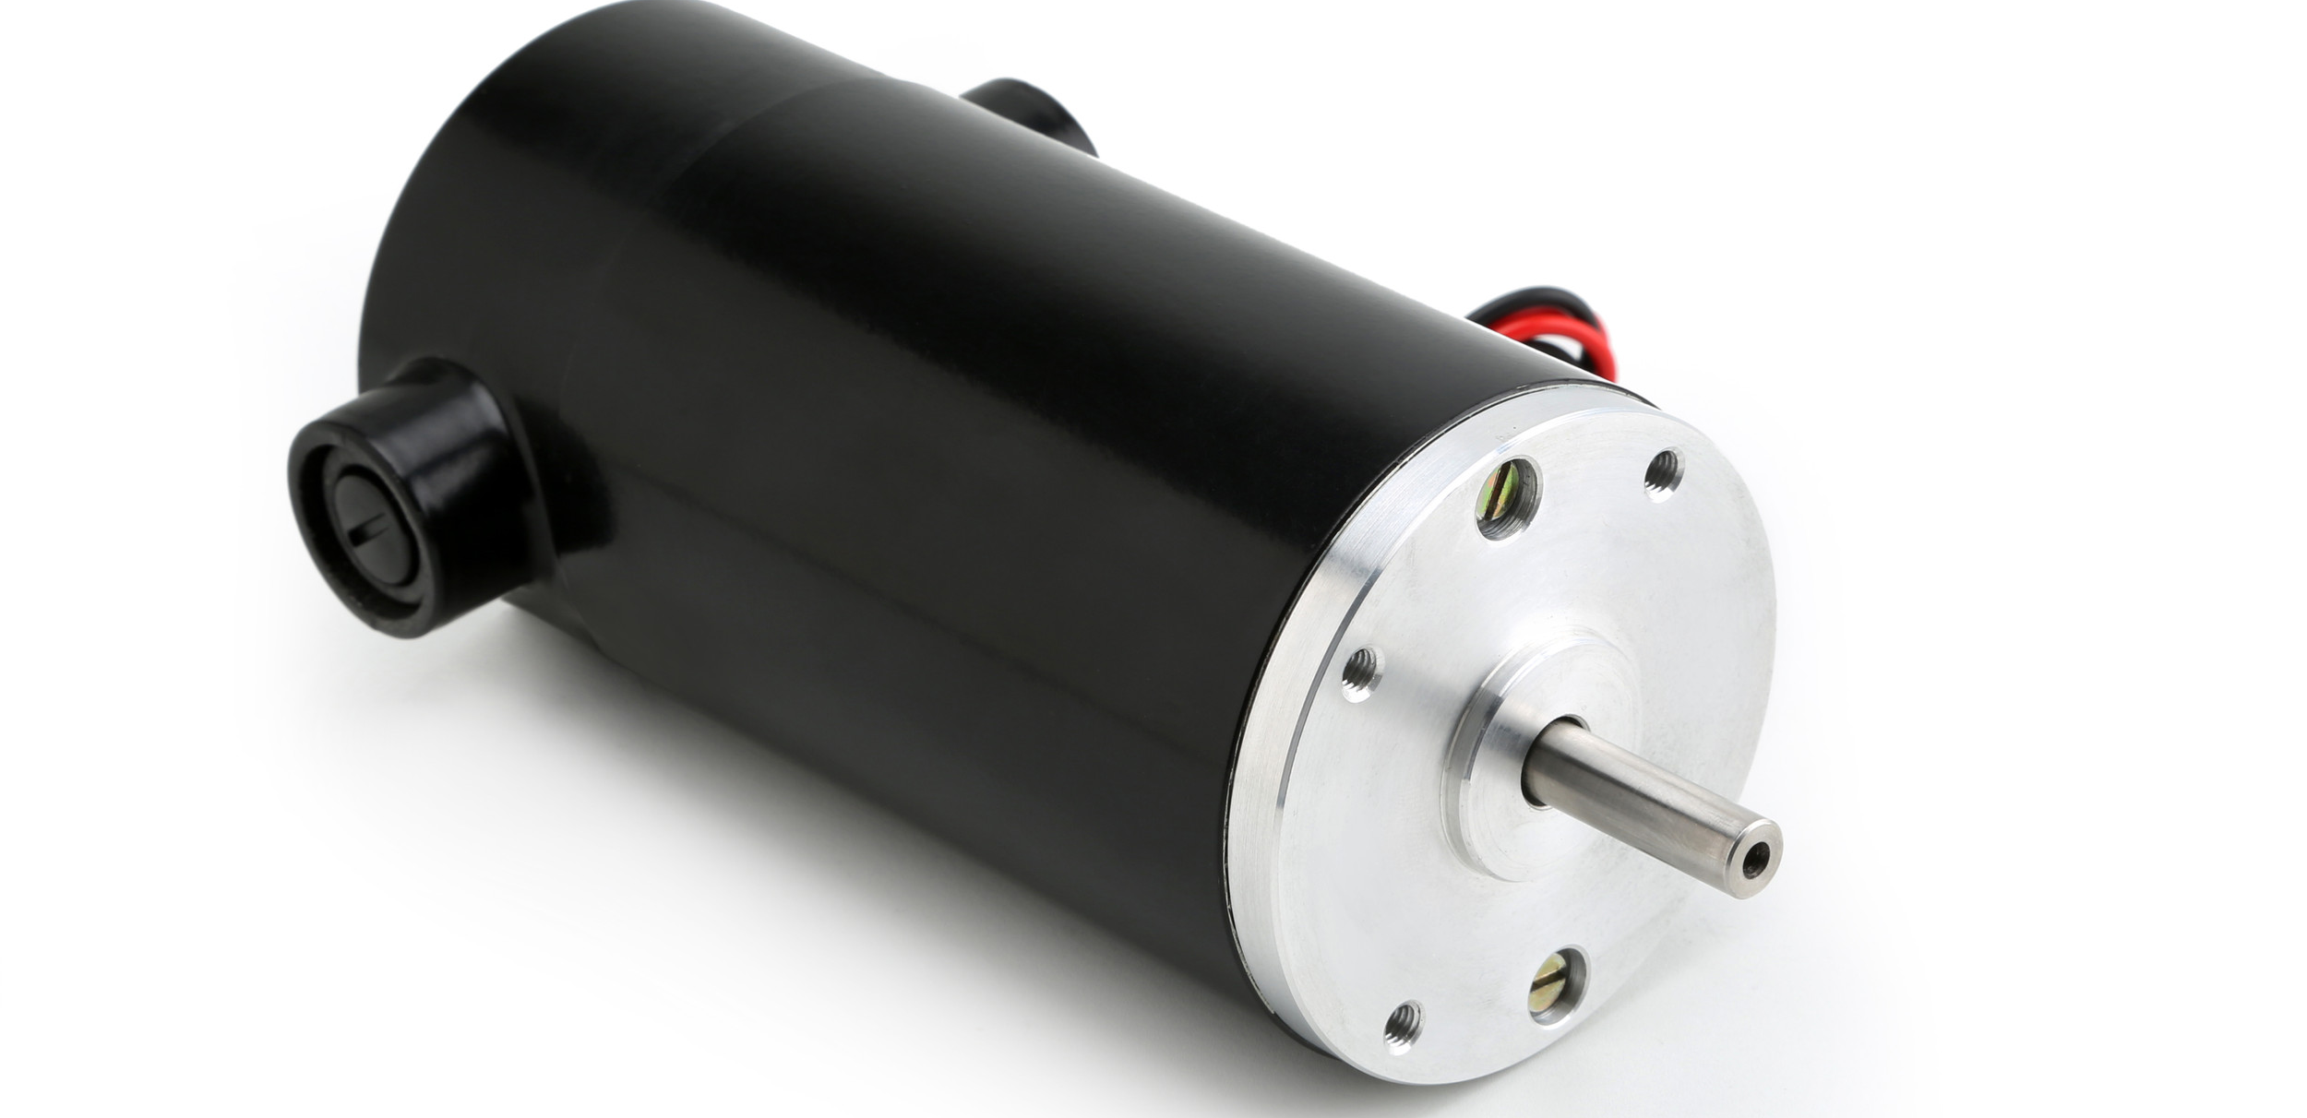
DC motor
Used when temperature is greater than 30 C

Slide 9
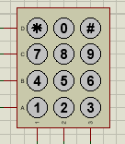
Keypad (7-pins)

Slide 10
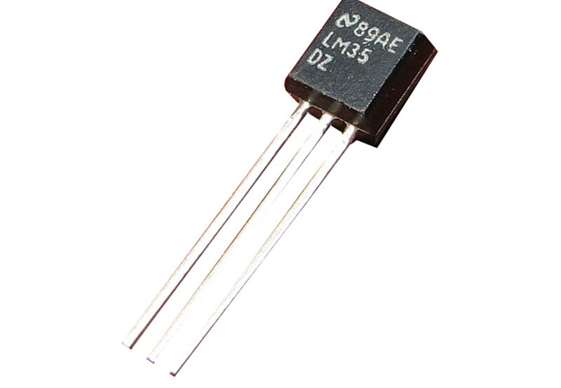
Temperature sensor
Used to detected temperature and send send analog data to microcontroller

Slide 11
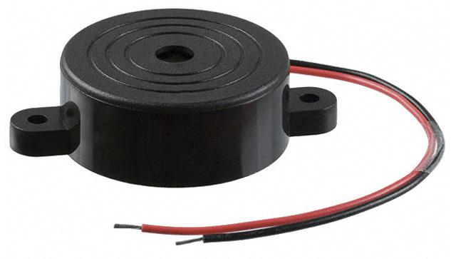
buzzer
it makes a sound when user enter wrong password 3 times

Slide 12
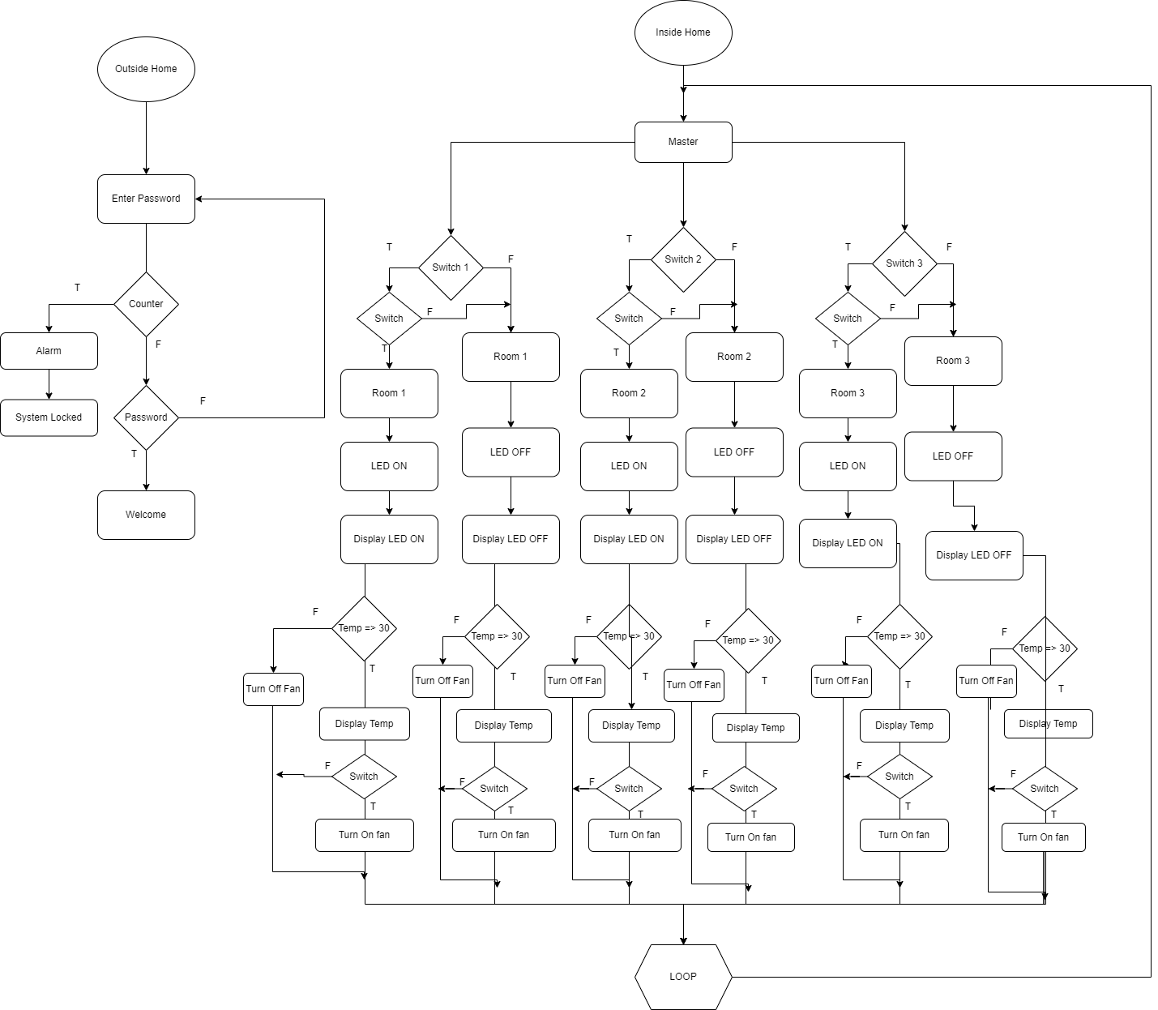

Slide 13
Thank you

