Slide 1
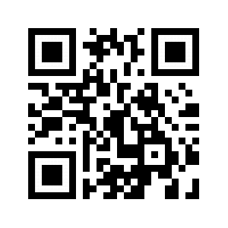
Why must we pick sides? The new poster format is a revolution, or the new poster format is garbage! Take the good parts of the new format, keep the useful aspects of the traditional format, add in your own ideas, and create something better.
Evaluation of Machine Learning Methods That Identify Colorectal Lesions with Microbiota-Associated Biomarkers
B. D. Topçuoğlu¹, J. Wiens², M. T. Ruffin³, P. D. Schloss¹
1. Department of Microbiology and Immunology, University of Michigan, 2. Department of Computer Science and Engineering, University or Michigan , 3. Department of Family Medicine and Community Medicine, Penn State Hershey Medical Center
Non-Cognitive Predictors of Student Success: A Predictive Validity Comparison Between Domestic and International Students
Non-Cognitive Predictors of Student Success: A Predictive Validity Comparison Between Domestic and International Students
Introduction
Mike Morrison created a template for a “Better Scientific Poster” (BSP) (https://osf.io/ef53g/)
The BSP format has been praised by many, yet disparaged by others.
The current project had 2 goals:
Create a template that I think could be useful.
Point out that we don’t need to either love or hate the new format—the middle is just fine.
Methods
To create a new template, I identified strengths of the BSP template and the traditional format.
BSP strengths: clear take-away message, minimal text, QR code
Traditional format strengths: room for figures, reasonable text size on sides, large title to make finding posters in poster session easy, web link and email for people who don’t like QR codes
RESULTS
Preregistered analysis: 78% increase in liking compared to traditional format and 24% increase compared to the BSP format.
Exploratory analysis: room for improvement in this template (Arial font, seriously?!?!).
DISCUSSION
Sometimes it makes sense to pick a side; this is not one of those times.
Praise what you like, make suggestions for improvement, and then make something better.
Take Mike’s ideas, incorporate some of mine, be creative, and let’s make posters more useful.
Notes:
Notes:
In Powerpoint, click View > Guides
Keep text within gutter guides.
Author list: Don’t split names onto two lines (e.g., “Jimmy [break] Smith”). If that happens, use a new line, unless you need the space. Bold the first names of anybody who’s presenting in person.
Intro/methods/result: Do not drop below font size 28, but if you have extra space, jack up the font size until the space is full.
Do not use color in the sidebars except in graphs/figures. It’ll pull attention from the center and slow interpretation for passersby.

