Slide 1

Creating a Flask app
Virtual Internship – Ahmed Abubekr Elageib
Ahmedkata@Gmail.com
20-Jan-2023

Slide 2
Background
Objective :
Creating Flask Web app using a simple dataset to do a simple task
The guide has been divided into several parts:
Model building
App building
deployment

Slide 3
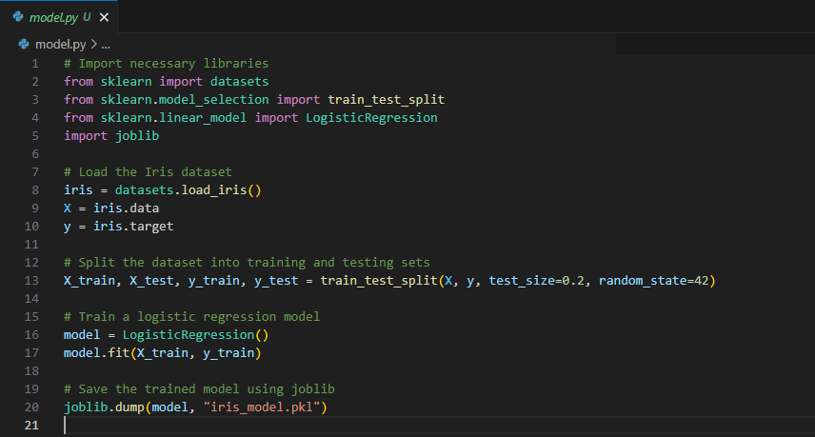
Model Building
Firstly we create a python file to build our classification model
Here's a breakdown of the code you provided:
1. Import Libraries:
sklearn.datasets: This library provides access to various datasets, including the Iris dataset.
sklearn.model_selection: This library contains tools for splitting datasets into training and testing sets.
sklearn.linear_model: This library houses linear models for classification and regression, including LogisticRegression.
joblib: This library is used for saving and loading machine learning models.
2. Load the Iris Dataset:
iris = datasets.load_iris(): This loads the Iris dataset, which contains data about three different Iris flower species.
X = iris.data: This extracts the features (sepal length, sepal width, petal length, petal width) from the dataset.
y = iris.target: This extracts the target variable (the species of the Iris flower) from the dataset.
3. Split the Dataset:
X_train, X_test, y_train, y_test = train_test_split(X, y, test_size=0.2, random_state=42): This splits the dataset into two parts:
Training set (80% of the data): Used to train the model.
Testing set (20% of the data): Used to evaluate the model's performance.
4. Train the Model:
model = LogisticRegression(): This creates an instance of the LogisticRegression model.
model.fit(X_train, y_train): This trains the model using the training data.
5. Save the Model:
joblib.dump(model, "iris_model.pkl"): This saves the trained model to a file named "iris_model.pkl" using joblib.
If the code is executed correctly, a new file named iris_model.pkl should be created

Slide 4
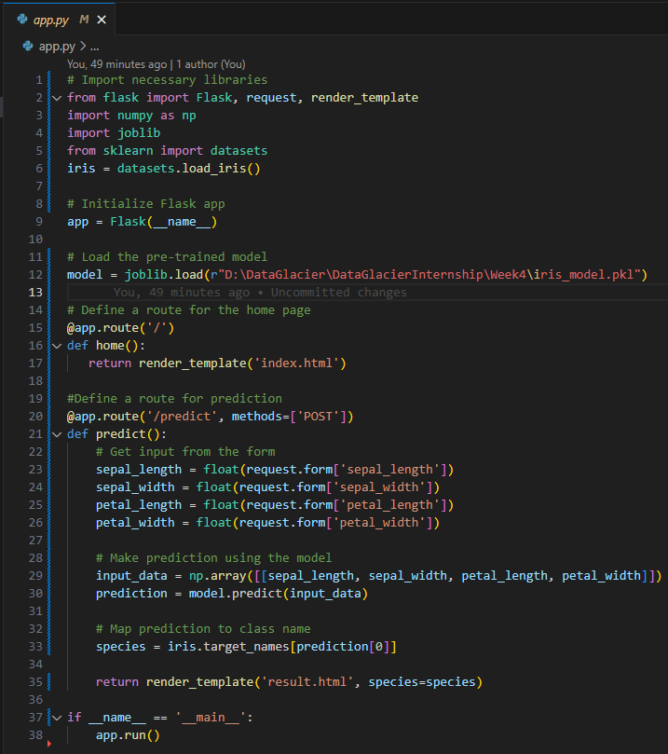
App Building-Flask functions
Secondly we write the web app code, which builds a web application using Flask to deploy a machine learning model:
1. Import Libraries:
flask: This library is used to create web applications in Python.
request: A Flask object that allows you to access form data submitted by the user.
render_template: A Flask function that renders HTML templates.
numpy: This library is used for numerical computations and array operations.
joblib: This library is used to load the saved machine learning model.
sklearn.datasets: This library is used to load the Iris dataset to access target names.
2. Initialize Flask App:
app = Flask(__name__): This creates an instance of the Flask application.
3. Load the Model:
model = joblib.load(r"D:\DataGlacier\DataGlacierInternship\Week4\iris_model.pkl"): This loads the previously trained Iris flower classification model from a file.
4. Define Routes:
Homepage (/):
@app.route('/'): This defines a route for the home page of the web application.
render_template('index.html'): This renders an HTML template named "index.html", which likely contains a form for user input.
Prediction (/predict):
@app.route('/predict', methods=['POST']): This defines a route for handling predictions, specifically POST requests (which typically send form data).
Get Input:
The code retrieves the values of sepal length, sepal width, petal length, and petal width from the submitted form data.
Make Prediction:
It creates an array with the input data and uses the loaded model to make a prediction about the Iris flower species.
Map Prediction to Class Name:
It uses the iris.target_names to get the actual species name corresponding to the predicted class.
Render Result:
It renders an HTML template named "result.html", passing the predicted species as a variable to be displayed.
5. Run the App:
if __name__ == '__main__':: This ensures the code within this block runs only when the script is executed directly, not when imported as a module.
app.run(): This starts the Flask development server, making the web application accessible.

Slide 5
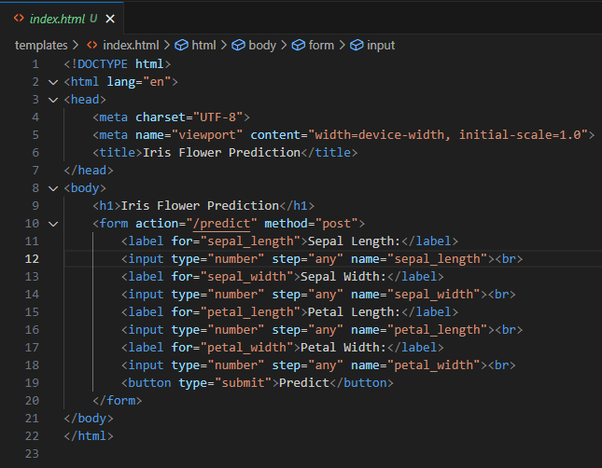
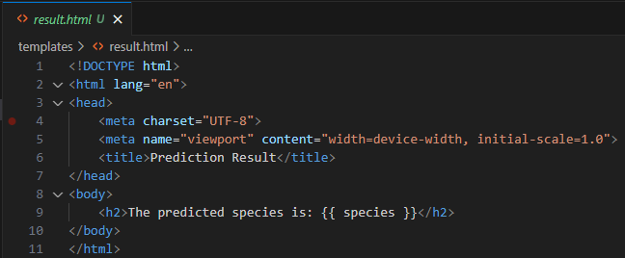
App Building-html directories
Next we have to create two simple html pages to, one to receive values and the other to give the prediction. Let's break down each file:
index.html:
Defines the main structure of the homepage.
Includes a title (Iris Flower Prediction) and a heading (<h1>).
Provides a form with four input fields for sepal and petal measurements:
Each field has a clear label and accepts numerical input with any decimal precision (step="any").
A submit button allows users to send their input for prediction.
predict.html:
Defines the structure of the result page.
Includes a title (Prediction Result) and a heading (<h2>).
Uses Jinja2 template syntax to display the predicted species name dynamically using the {{ species }} variable passed from the Flask app.
Overall, these HTML files provide a user-friendly interface for your web application, allowing users to easily input flower measurements and see the predicted species in a clear and concise format.

Slide 6
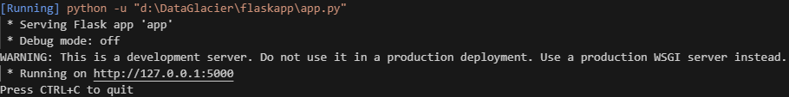
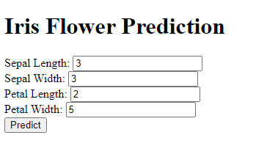

Deployment
To deploy the app you simply run the flask app code from your IDE of choice, in your terminal a local host will pop up, you can copy that to your browser or simply (CTRL + click)
A page like below should open, enter the parameters you want to predict the flower type for
A prediction like the following image should appear

Slide 7
Thank You

