Slide 1
Smart Warehouse System
Computing Algorithms
Presented by:
- Abdelrahman mostafa (231027174)
- Yassin eslam (231017683)
- Ahmed adel (231007728)
Omar wael (231007796)
Github link: https://github.com/AhmedAdelMohamedAbouhussein/Smart-Warehouse-Analytics

Slide 2
Project Overview & Objectives
Goal: Design an automated Warehouse Management System (WMS) for complete product lifecycle.
Inbound Receiving: Efficient intake of new inventory.
Slotting (Bin Packing): Optimizing product storage locations.
Outbound Picking (TSP): Shortest sequence item collection.
Replenishment: Automated restocking triggers.
Challenge: High-velocity items must be near packing stations.

Slide 3
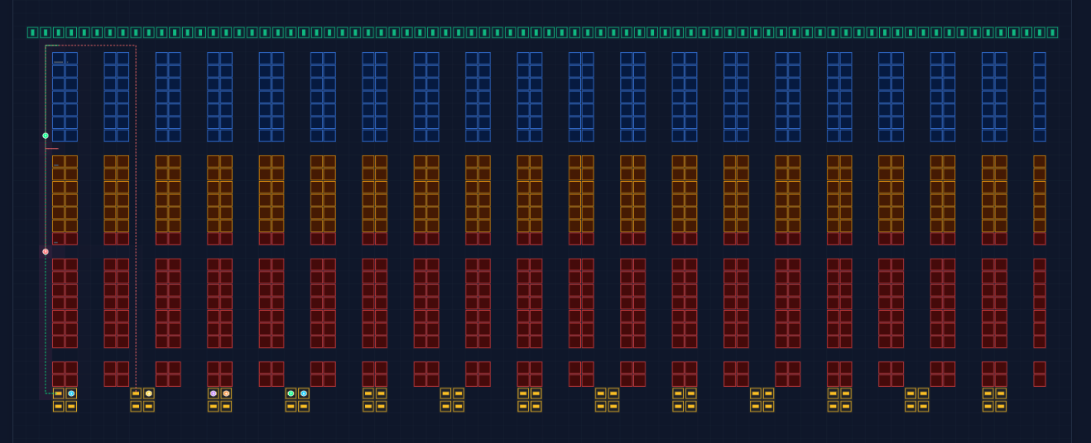
Warehouse Model
Modeled as a Spatial Graph.
Nodes: Shelf locations, pick stations, and packing docks.
Edges: Aisle segments with travel-time weights.
Layout: 30x80 grid with clearly defined zones.

Slide 4
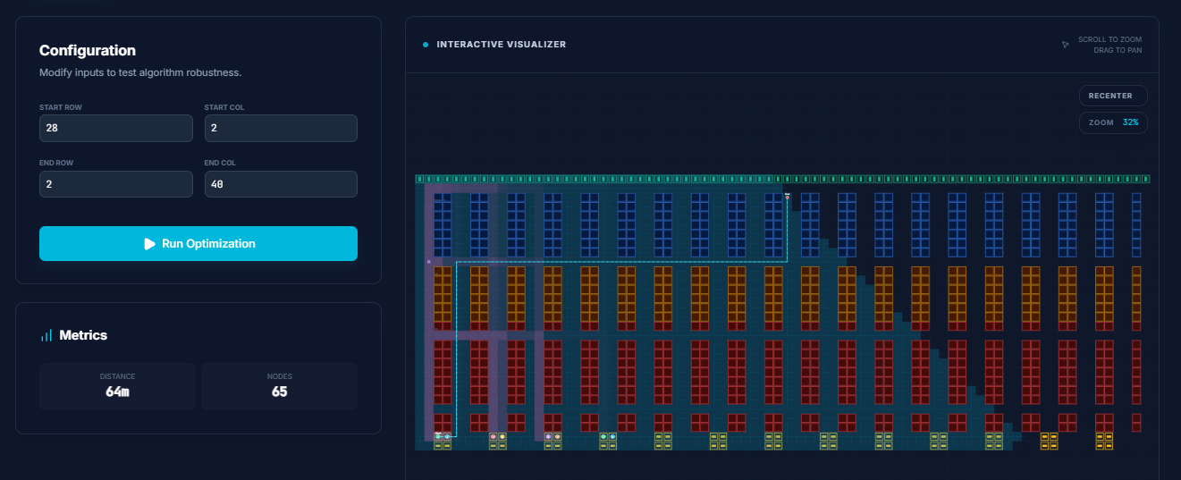
Algorithm 1 - Dijkstra’s Algorithm
Role: Shortest-path navigation.
Applied to find minimum distance between any two points.
Accounts for turns and aisle congestion via weights.
Technical Detail: Uses a Min-Heap (Priority Queue).
Complexity: O((V + E) log V) for real-time responsiveness.

Slide 5
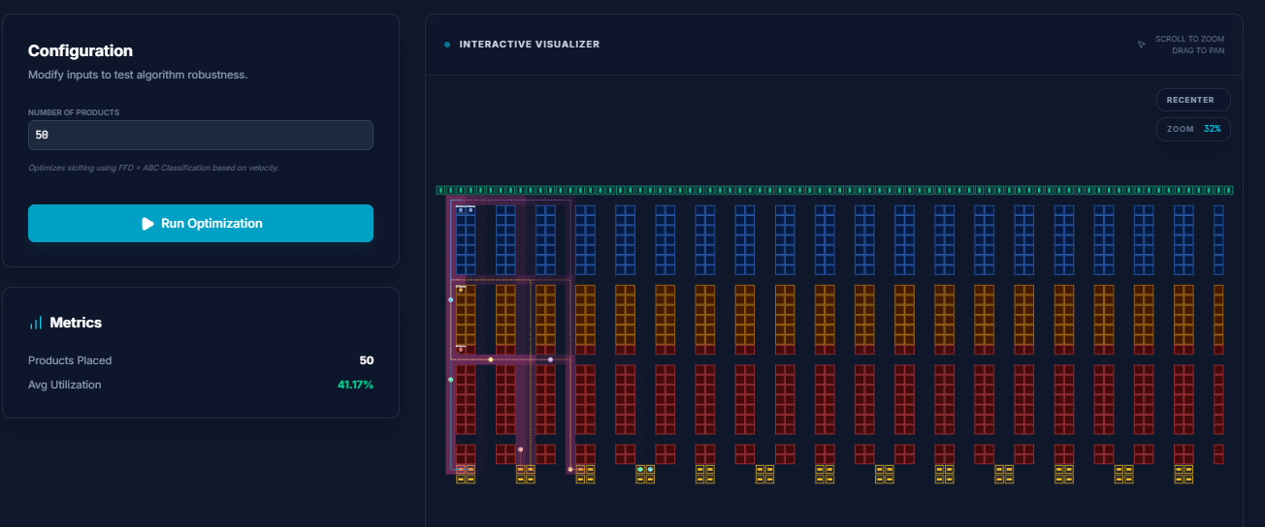
Algorithm 2 - Bin Packing (Slotting)
Role: Product placement strategy using Velocity.
ABC Strategy:
- Class A (Top 20%): High demand, closest to stations.
- Class B (Next 30%): Medium demand, mid-range zones.
- Class C (Remaining 50%): Low demand, far zones.
FFD Approach: First-Fit Decreasing ensures shelf efficiency.

Slide 6
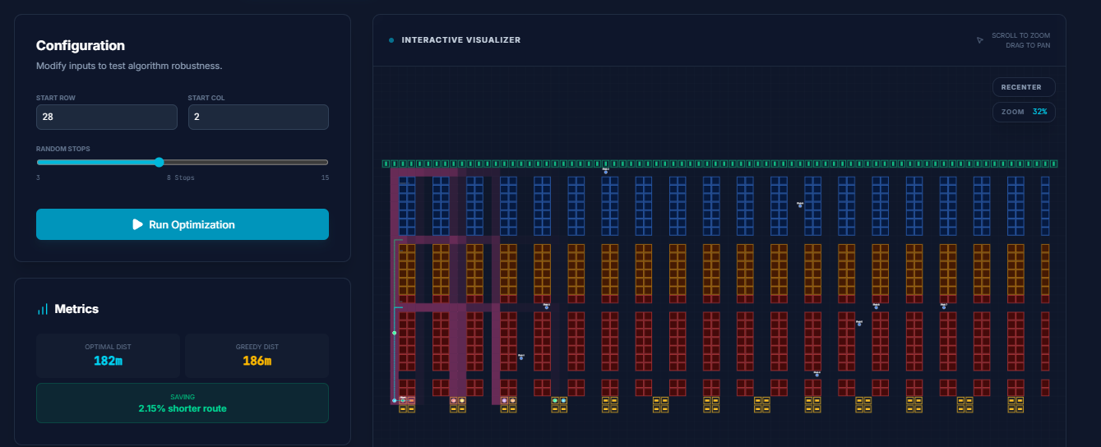
Algorithm 3 - DP Pick Route Optimization
Role: Multi-order 'Wave Picking' optimization.
The Problem: Traveling Salesperson Problem (TSP).
The Solution: Held-Karp Dynamic Programming.
Memoization: Uses a memo table to avoid redundant calculations.
Benefit: Guaranteed mathematically optimal route.

Slide 7
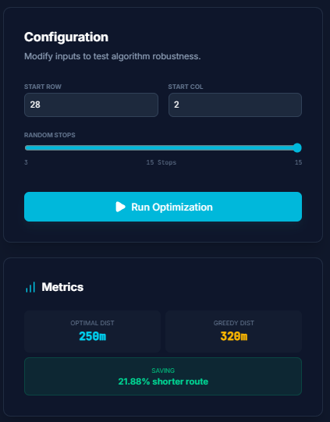
Held-Karp vs. Greedy Nearest Neighbor
Greedy: Always picks next closest item (Fast but suboptimal).
Held-Karp (DP): Looks at the whole trip at once.
Performance Gap: DP typically reduces distance by 10%–25%.

Slide 8
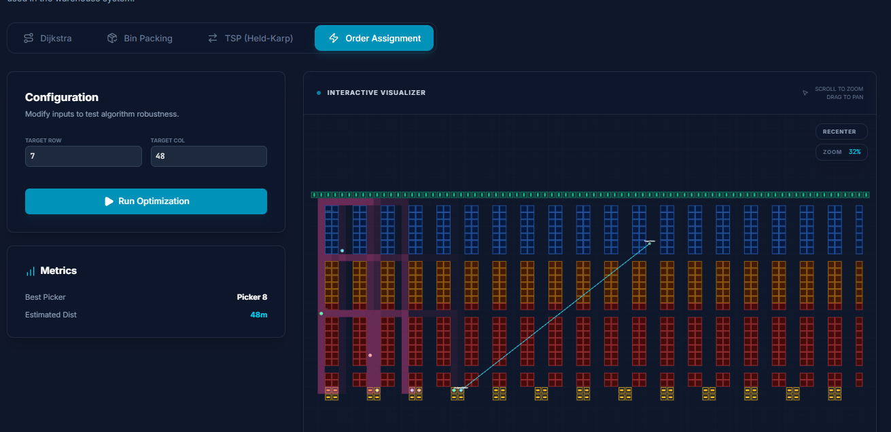
Algorithm 4 - Greedy Order Assignment
Role: Real-time workload balancing.
Rule: Assign to picker with shortest distance to first item.
Efficiency: Prevents bottlenecks and balances utilization.
Real-time Logic: Triggers new picking waves if window is missed.

Slide 9
Replenishment & Simulation
Automation: Stock < 5 units triggers replenishment.
Carts follow Dijkstra-optimized paths from Receiving.
Simulation: Real-time ticker with WebSocket updates.
Animates multiple pickers simultaneously.

Slide 10
Results & Picker Efficiency
Total Orders Completed: Success throughput.
Average Cycle Time: From creation to completion.
Average Utilization %: Picking time vs. idle time.
Total Walking Distance: Savings from DP optimization.

Slide 11
Conclusion
Efficiency Gains: Rank-based Slotting + Optimal TSP.
Scalability: Handles real-time arrivals and dynamic assignments.
Future Work: Machine learning for demand prediction.

Slide 12
Q&A
Thank You!
Questions?

