Slide 1
FOOD PRINT
Ahmed Afif Monrat
Madhubala Ganesan
Syed Asif Iqbal

Slide 2
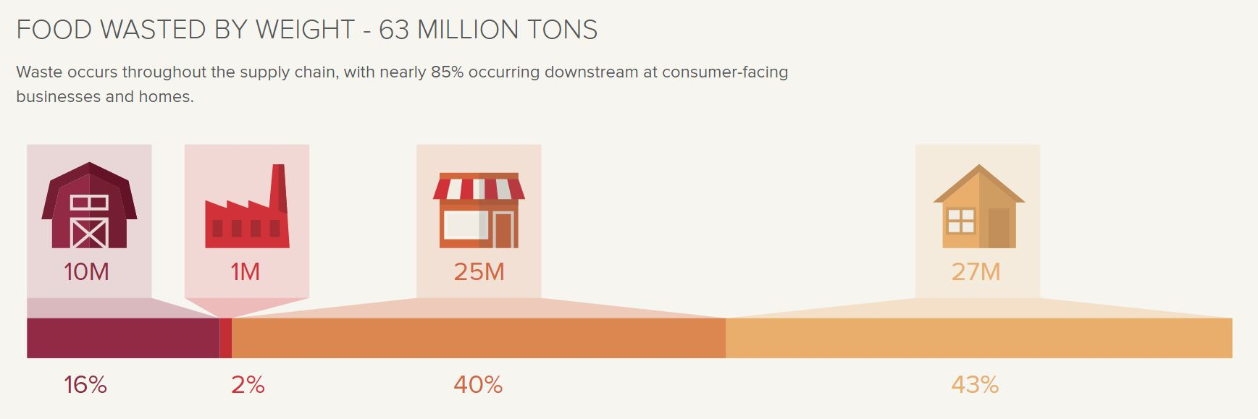
FOOD WASTE
Food waste is one of the biggest problems facing mankind today
If food waste were a country it would be the 3rd largest emitter of greenhouse gases (after China & the USA)
Over 1/3 of all food produced globally goes to waste
In developed countries, over half of all food waste takes place in the home

Slide 3
Our Idea
A set of services that will gather information about left over or unused food, home grown vegetables and fruits from people of the city
Browse through the food items that take your fancy
Display information about Calories of the food item
Show the carbon footprint if the food goes for waste
Show interesting top rated recipes with the left over ingredients to avoid waste

Slide 4
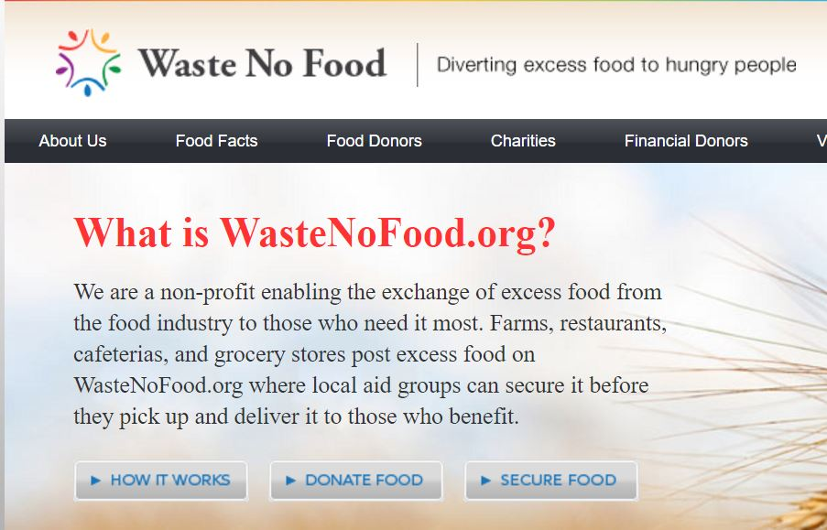
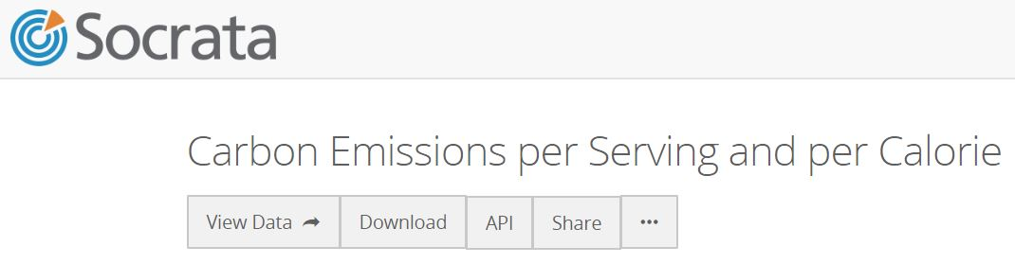
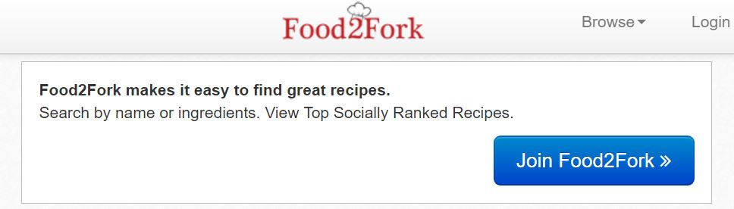

Web Services Used

Slide 5
Architecture
WasteNoFood.Org
FOOD PRINT
(Java Struts
Ajax, Jquery)
FOOD ANALYSIS
(Web Service - PHP)
Socrata CO2 API
Food2Fork API

Slide 6
Application of Principles of SOA
Service Description (RSDL)
Loose Coupling
Service Discoverability
Statelessness
Service Autonomy
Service Reusability
Service Abstraction
Service Composability
Service Interoperability
Food Print

Slide 7
Sustainability
A contemporary approach for the food supply chain
Better communication between the producers of food, traders and consumers means that less food will be wasted and supplies will be more reliable
Encourages small scale farmers and improves local market with least investment
Less food waste → Less landfills → Less carbon emission

Slide 8
Thank You

