Slide 1
Sparse Distributed Memory
Developed by
Carl Kugblenu | Furkat Gofurov | Ida McSey| Md Tawseef Alam Farniba Khan| Ahmed Afif Munrat| Syed Asif Iqbal

Slide 2
Outline
Problem Statement
Our Solution
Solution Architecture
Class Diagram
Pseudo Code
Process Flow Diagram
System Implementation
Testing
Benefits
References

Slide 3
Problem Statement
“To design a distributed networking system implementing a special kind of storage. Architecturally the storage system is a hybrid peer-to-peer network with peer nodes that will preform the actual task of storage and reconstruction of data and the infrastructure nodes implementing helper functions. Also the software architecture should be able to support a potentially large number of peers.”

Slide 4
Our Solution
Sparse Distributed Memory
Hybrid P2P System
socket.io Server (javascript)
Amazon ElastiCache (REDIS Cluster) – cache.t2.micro

Slide 5
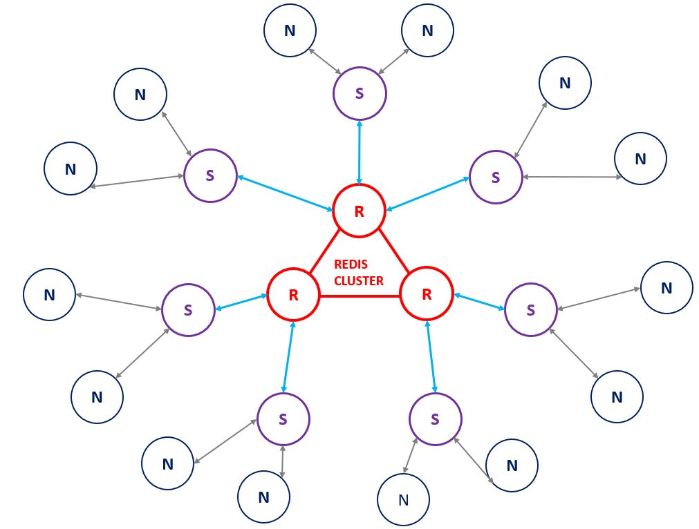
ARCHITECTURE OF THE SPECIAL KIND OF DATA STORAGE
N
Node (Web Browser)
S
SuperNode (NGINX Server, socket.io Server)
Redis Cluster (Amazon ElastiCache Redis)
R

Slide 6
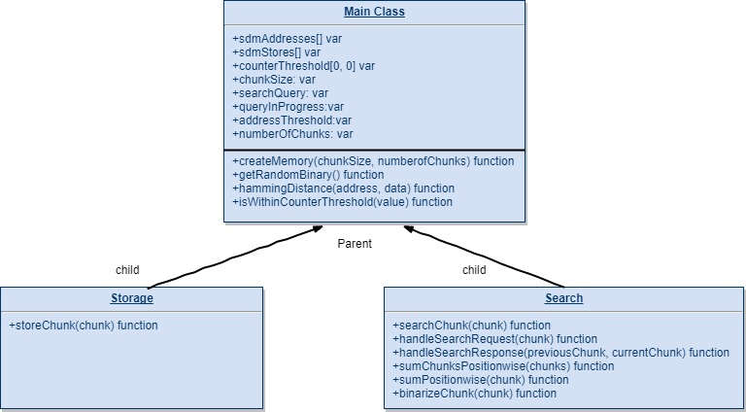
Class Diagram

Slide 7
Pseudo Code(for 1 Node)
Search Procedure:
for i=0 to n do
Hd = get_hamming_distance(storAdd[i], searchReqArray)
If (hd is less or equal to Ta)
then addressSum=positionWiseSum(storAdd[i])
ENDIf
ResponseArray=convertSumtoBinary(addressSum)
If(get_hamming_distance(ResponseArray,searchReqArray) is equal to 0)
than result found
else set responseArray as searchReqArray
do iteration until n/2
ENDIf
set chunk limit n=10000
set threshold for address Ta
set threshold for content Tc
declare an array for storage address, storAdd
declare an array for storage content, storCon
declare an array for user Input, InputContent
declare an array to get user request, searchReqArray
Storage Procedure:
for i=0 to n do
hd= get_hamming_distance(storAdd[i],inputContent[])
if (hd is less or equal to Ta)
then if (storCon[i] is between -Tc and Tc)
then setInput(inputContent,i)
ENDIf

Slide 8
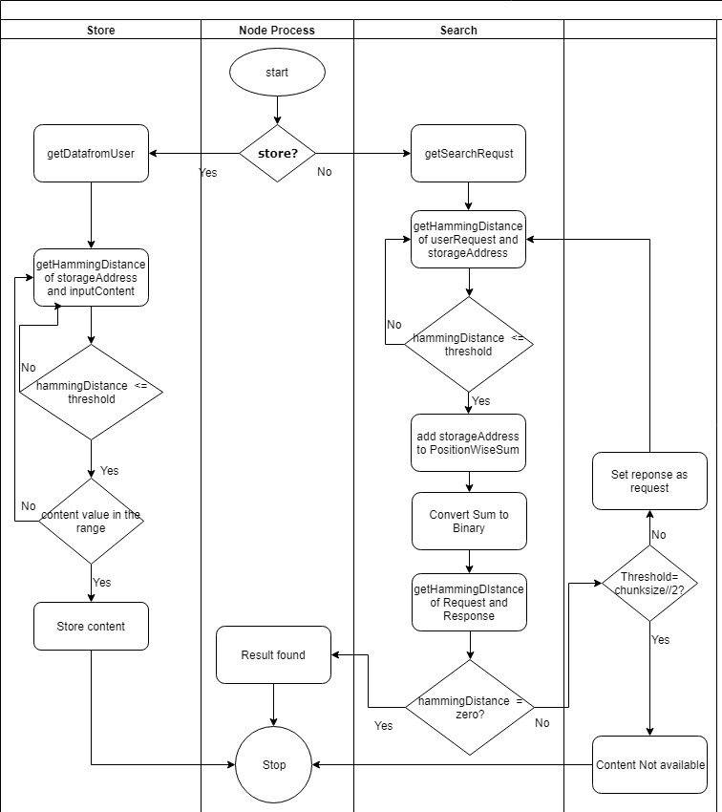
Process flow diagram

Slide 9
System Implementation

Slide 10
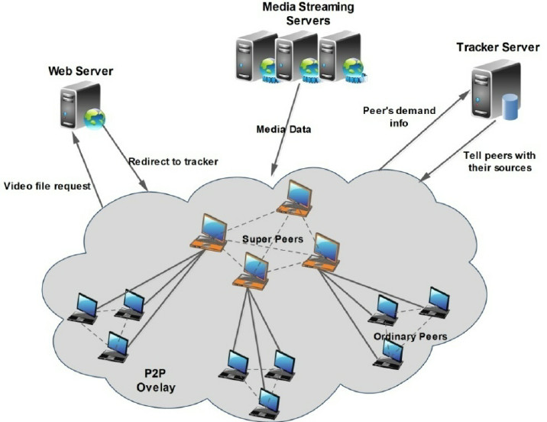
Hybrid P2P System
Hybrid Model uses Super nodes which results in faster resource locating
A common hybrid model is to have a central server that helps peers find each other.

Slide 11
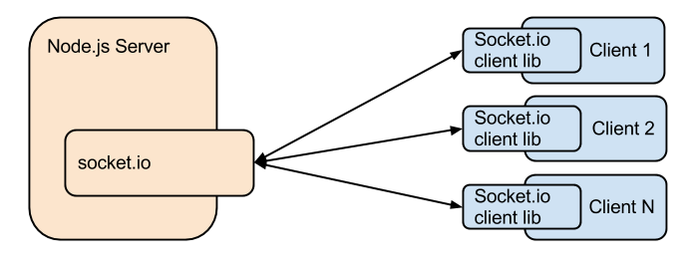

socket.io Server (javascript)
Socket.IO enables real-time bidirectional event-based communication. It works on every platform, browser or device, focusing equally on reliability and speed.
On the server-side, Socket.IO works by adding event listeners to an instance of http.Server

Slide 12
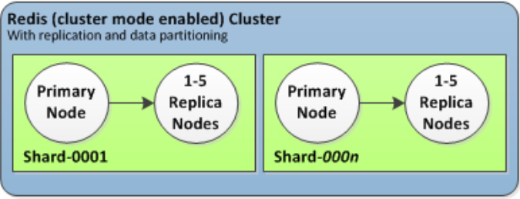

Amazon ElastiCache (REDIS) – cache.t2.micro
Amazon ElastiCache is a web service that makes it easier to set up, operate, and scale a distributed cache in the cloud.
Amazon ElastiCache for Redis is a Redis-compatible in-memory data structure service that can be used as a data store or cache.

Slide 13
WEB WORKER
It is a JavaScript script executed from an HTML page that runs in the background, independently of other user-interface scripts that may also have been executed from the same HTML page.
SERVICE WORKERS
It is a script that a browser runs in the background, separate from a web page, opening the door to features that don't need a web page or user interaction.

Slide 14
References
https://www.sics.se/~seif/Publications/paper3.pdf
(https://www.npmjs.com/package/socket-io-server)
https://socket.io/docs/server-api/
http://docs.aws.amazon.com/AmazonElastiCache/latest/APIReference/API_CreateCacheCluster.html

