Slide 1
Udacity CI/CD

Slide 2
Overview
CI/CD Principles
CI/CD Pipeline
CI/CD challenges
CI/CD Security

Slide 3
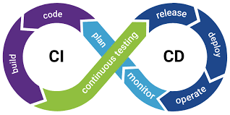
CI/CD

Slide 4
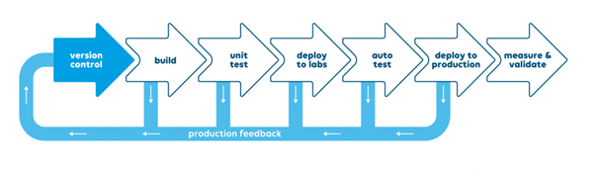
CI/CD principles

Slide 5
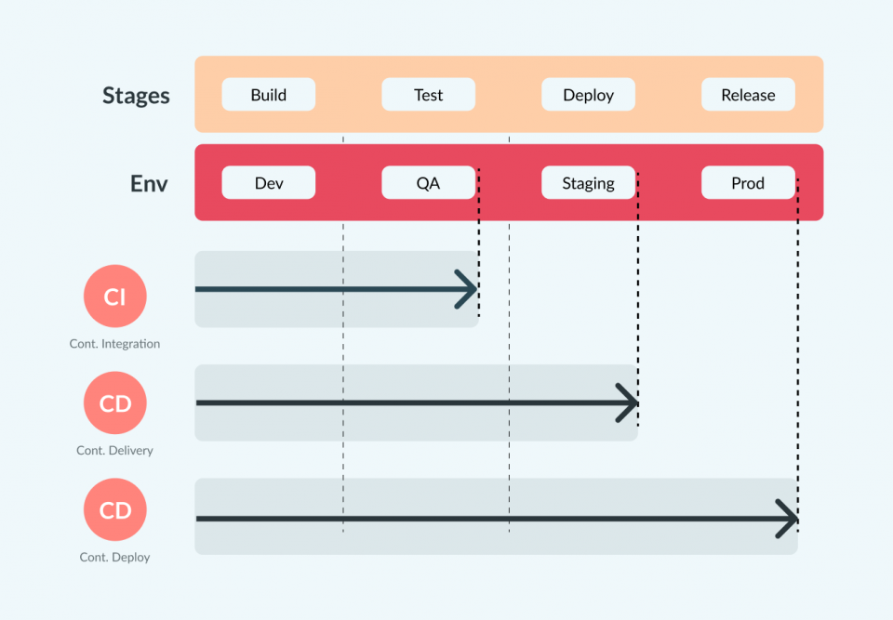
CI/CD Pipeline

Slide 6
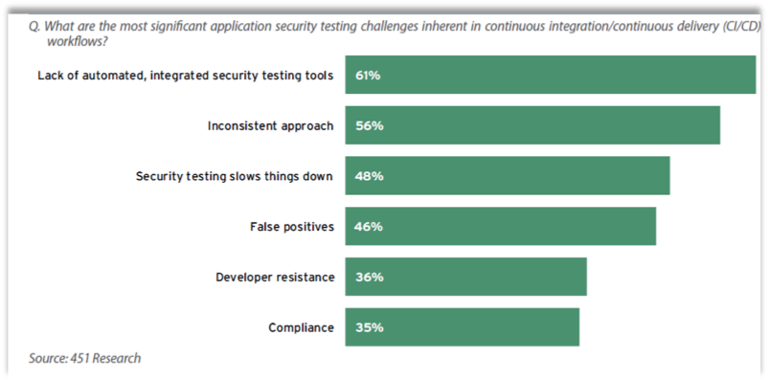
CI/CD Challenges

Slide 7
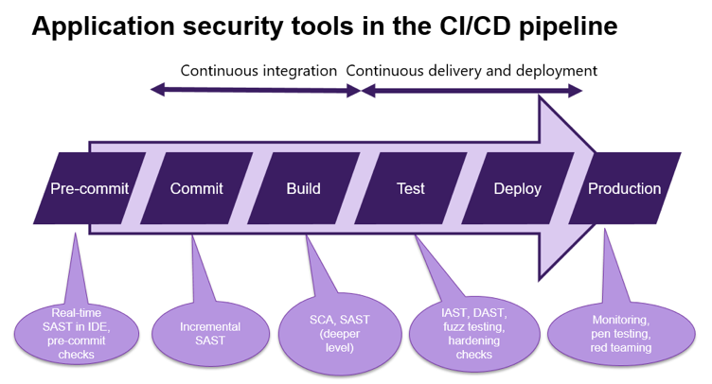
CI/CD Security

