Slide 1
Project Team
Section: 2
-أحمد محمد محمد مرسي.
-أحمد محمد أحمد محمد حسن.
-أحمد علاء الدين أحمد حسين.
-أحمد محمود محمد شعبان.
-أحمد محمد عارف عبد الرحيم.
-أحمد محمد علي عثمان.

Slide 2
Project name:
Car Sales
Project description:
The goal of this project is to organize the customer's search for the product and to identify the appropriate product for him in the program.

Slide 3
Project Charter
A project charter is a formal, typically short document that describes your project in its entirety-including what the objectives are, how it will be carried out, and who the stakeholders are. It is a crucial ingredient in planning the project because it is used throughout the project lifecycle. A project charter includes Official project name, Project sponsor and contact information, Project manager and contact information, Purpose of the project, Business case for the project, Key deliverables of the project, Project resources, budget, staff, and vendors, Summary budget, and milestone plan and timeline.

Slide 4
Project scope
1-Project scope discretion:
*It is an application used to display cars for sale so that the customer can find the car he wants.
*The application will show you all available car makes and models.
*The application will display the available cars and will provide the electronic reservation feature.
* The application will show the price of each type of car.
* The application will show advantages and disadvantages for each type of car.
* The application will show the country in which the cars were made.
* The application will show the person responsible for the sale and delivery.
* The application will show the power of the motor for each car.

Slide 5
2-Project acceptance criteria:
*The application should be easy to use, fast and convenient.
* Beautiful user interface.
*Online car booking feature.
*The application should display the shape of the car and color.

Slide 6
3-Project deliverables:
*Project plan, reports, documents and resources which return to the company.
*Save time and effort in searching for the car that the customer wants.
*Show the final look of the car.

Slide 7
4-Project exclusion:
* Manufacturing defects that may appear when the vehicle is delivered to the customer.
*One of the workers wanted the application to show all kinds of cars around the world, but the manager refused that because it needed a lot of cost and time.

Slide 8
5-Project constraints:
* Rules of company and policies.
* The budget where the cost should not exceed the predetermined budget.
* Time of submit.
* Provides the required resources and technology.

Slide 9
6-Project assumptions:
* This application can run on The IOS, Android and windows operating systems.
*In the event of discovering any error in the car, it must be fixed before the car reaches the customer
*In the event of any shortage of resources or equipment used, the person responsible for the shortage must be reported to provide it as soon as possible.

Slide 10
Work Breakdown Structure(WBS)
A WBS is a deliverables-oriented collection of project components. It is a categorization and decomposition of the project scope statement. And yes, it’s called decomposition because you’re breaking down the massive project scope statement into smaller, more manageable components. Each component is subdivided again and again until you reach the smallest element of the WBS, A WBS is important in all projects. It is necessary because it serves as input to five key project management activities, Cost estimating, Cost budgeting, Resource planning, Risk management planning, Activity definition

Slide 11
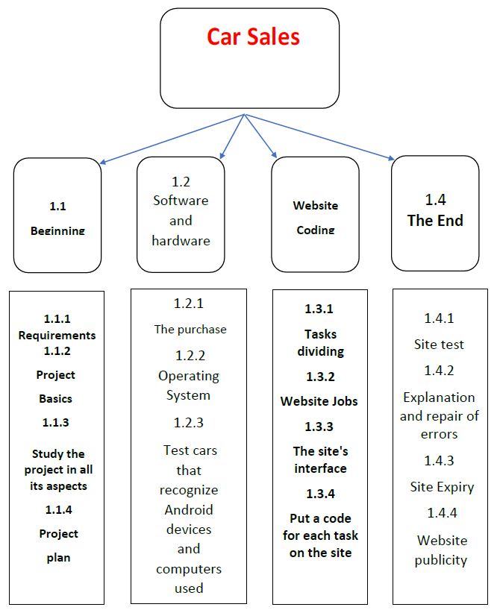

Slide 12
WBS Dictionary
A WBS dictionary is where the details of the tasks, activities, and deliverables of the work breakdown structure are located. The content includes whatever milestones are related, the project scope and in some instances dates, resources, cost and quantity.
The WBS dictionary allows you to define each of the steps on the WBS and how to execute them to reach the final deliverable of the project. The document includes a work package, which defines the related tasks, and control accounts, which integrate the scope, budget, actual cost and schedule for those tasks.
The definitions in the WBS dictionary are not lengthy, though. They’re a brief scope or statement of work. This makes one foot on the tripod of your scope baseline. The other two feet are the scope statement for the whole project and the WBS that you are fleshing out with the WBS dictionary. All three are essential to measure and monitor the scope of a project.

Slide 13
1.1 BEGINNING: from 1\1\2022
To
20\3\2022.
1.1.1 | Work package id:
requirements | Work package name:
Searching about require resources (PCs, software, cables …etc.) . | Description:
Project Manager with team | Person:
1\1\2022 | Strat date:
20\1\2022 | End date:
1.1.2 | Work package id:
Project basics | Work package name:
Collect enough information's from (organization assists) Search from ridable | Description:
Project Manager with team | Person:
21\1\2022 | Strat date:
10\2\2022 | End date:
1.1.3 | Work package id:
Study the project in all aspects | Work package name:
Identify number of streets that available for parking. | Description:
Business analyst | Person:
11\2\2022 | Strat date:
28\2\2022 | End date:

Slide 14
1.1.4 | Work package id
Project plan | Work package name:
Organize and manage sells the cars and satisfy customers. | description:
1\3\2022 | Start date
20\3\2022 | End date:
1.2Software and hardware: from 21\3\2022 To 20\5\2022.
1.2.1 | Work package id:
The purchase | Work package name:
2 Android, 5 iOS and 2 windows. | Description:
Maintained workers | Person:
21\3\2022 | Start date:
10\4\2022 | End date:
1.2.2 | Work package id:
Operating System | Work package name:
Writing Functions | Description:
Programmers | Person:
11\4\2022 | Strat date:
30\4\2022 | End data:

Slide 15
1.2.3 | Work package id:
Test cars that recognize Android device and computer used | Work package name:
Model of cars | Description:
customer | Person:
1\5\2022 | Start date:
20\5\2022 | End date:
1.3 website coding:
from 21\5\2022 To 10\8\2022.
1.3.1 | Work package id:
Tasks diving | Work package name:
Dividing project into tasks | Description:
Programmers with Project manager | Person:
21\5\2022 | Strat date:
10\6\2022 | End date:

Slide 16
1.3.2 | Work package id:
Website jobs | Work package name:
Display and organize information of cars | Description:
Programmers | Person:
11\6\2022 | Strat date:
30\6\2022 | End date:
1.3.3 | Work package id:
The site’s interface | Work package name:
Design of cars | Description:
Programmers | Person:
31\6\2022 | Strat date:
20\7\2022 | End date:

Slide 17
1.3.4 | Work package id:
Put a code for each task on the site | Work package name:
Different icons for achieving the desired | Description:
Members of team | Person:
21\7\2022 | Strat date:
10\8\2022 | End date:
1.4The end:
from 11\8\2022 To 30\9\2022.
1.4.1 | Work package id:
Site test | Work package name:
Put Specifications for cars that ordered | Description:
Upper management | Person:
11\8\2022 | Strat date:
20\8\2022 | End date:

Slide 18
1.4.2 | Work package id:
Explanation and repair of errors | Work package name:
Use feedback to repair errors. | Description:
Ui manager | Person:
21\8\2022 | Strat date:
31\8\2022 | End date:
1.4.3 | Work package id:
Site Expiry | Work package name:
Check the display of site | Description:
Manager | Person:
1\9\2022 | Strat date:
10\9\2022 | End date:

Slide 19
1.4.4 | Work package id:
Website publicity | Work package name:
Share the link of site | Description:
Sponsor | Person:
11\9\2022 | Strat date:
30\9\2022 | End date:

Slide 20
Responsibilities Matrix
A roles and responsibilities matrix is a method to identify all of the roles within a project and the associated responsibilities to the project work. This matrix is an excellent way to identify the needed roles of the project participants, identify what actions they’ll need in the project, and ultimately determine if you have all of the roles to complete the identified responsibilities. Here’s a quick example of a matrix for a software roll-out project: Project Manager Application Developer Network Engineer ZenWork.

Slide 21
Responsibilities Matrix In My Project
Delivery Company Employees | Client Representative | Zen Works Expert | Financial Analyst | Network Engineering | Developer | Design Director | UI Designer | Project Manager
 |  |  |  | P | C |  |  | A | Create the application
 |  |  |  |  | R | C | A | A | Approved Drawing
 |  |  |  | P | P |  |  | A | Site test
 | A |  | R |  |  |  |  | A | budgeting
 |  | P |  | R |  |  |  | R | Package the application
 |  | C |  |  | R |  |  | R | Test the application release
 |  | C |  | P |  | A |  | A | Website publicity
 | A |  |  |  | R |  |  | A | Quality of the car
 |  |  |  |  | C | A | R |  | Complete Site Survey
P |  |  |  |  |  |  |  | A | Car Delivery
A = Approves R = Reviews p = Participant C = creator

Slide 22
Project Network Diagram
One of the most satisfying accomplishments in IT project management is to step back and, looking at the PND, follow the project conception through each task to the final deliverable of the project. Don’t get too infatuated—this network diagram will likely change. Now that the PND has been constructed, you can find the critical path. The critical path is the sequence of events that determine the project completion date. The critical path is the longest duration from project start to project completion. For example, imagine that you have created and analyzed your network diagram. Most likely there are multiple paths from project start to completion. Usually, just one of the project paths will take longer than any of the other paths. This is the critical path. I say usually it’s just one, as you could have two or more paths that tie for the longest paths in the project network diagram. It’s called the critical path because if any activities on it are delayed, the project completion date is also going to be late.

Slide 23
Project Network Diagram In My Project
ID | Description | Predecessor | Time (weeks)
A | Collect enough information's from organization assists | None | 2
B | Collect and manage and select the information of cars | A | 4
C | Design of cars and other requirements | B | 3
D | Design program that delivers for clients | B | 5
E | Testing of cars, and the program | C, D | 3
F | Car delivery to the customer | E | 1
G | Taking money from the customer and supplying it to the company | F | 1
C
A
B
E
F
G
D

Slide 24
Project resources
* Budget: 200,000,000$.
* Hardware: 3 laptops, 3 servers.
* Software: Software licenses.
* Staff: 2 designers, 2 Android developers and 2 iOS developers.
* Vendor: Marketing companies, and internet markets
(like Amazon, and Google play).

Slide 25
2 | B | 6
0 | 3p | 0
2 | 4 | 6
6 | E | 9
0 | 2p | 0
6 | 3 | 9
0 | A | 2
0 | 2p | 0
0 | 2 | 2
2 | C | 5
1 | 2p | 1
3 | 3 | 6
9 | G | 10
0 | 1p | 0
9 | 1 | 10
7 | F | 8
1 | 3p | 1
8 | 1 | 9
2 | D | 7
1 | 1p | 1
3 | 5 | 8

Slide 26
0 1 2 3 4 5 6 7 8 9 10
ID | RES | DUR | ES | LF | SL
A | 2p | 2 | 0 | 2 | 0 | 2p | 2p
B | 3p | 4 | 2 | 6 | 0 |  |  | 3p | 3p | 3p | 3p
C | 2p | 3 | 2 | 6 | 1 |  |  | 2p | 2p | 2p
D | 1p | 5 | 2 | 8 | 1 |  |  | 1p | 1p | 1p | 1p | 1p
E | 2p | 3 | 6 | 9 | 0 |  |  |  |  |  |  | 2p | 2p | 2p
F | 3p | 1 | 7 | 9 | 1 |  |  |  |  |  |  |  | 3p
G | 1p | 1 | 9 | 10 | 0 |  |  |  |  |  |  |  |  |  | 1p
Total Resource Load |  |  |  |  |  | 2p | 2p | 6p | 6p | 6p | 4p | 3p | 5p | 2p | 1p
Resource Available

Slide 27
Time-Phased Budget Baseline
The importance of a time-phased budget is to ensure the money is available when the team needs to spend it. The baseline budget tracks cash flow – not when the project team gets a bill but when the company has to disburse money to pay vendors, consultants or marketers.
Time-phased budgeting allows project managers to allocate costs for project activities over the anticipated timeline in which those expenditures are planned to take place. By doing this, the project manager is then armed with an accurate timeline that predicts project spend patterns.

Slide 28
Matrix of Activity with cost
ID
A | 15
B | 5
C | 6
D | 6 | 8 | 6
E | 10 | 5
F | 3 | 2 | 5
G | 3 | 4

Slide 29
Baseline Budget
ID | Budget | 1 | 2 | 3 | 4 | 5 | 6 | 7 | 8 | 9 | 10
A | 15 | 15
B | 20 |  | 5
C | 6 |  | 6
D | 20 |  | 6 | 8 | 6
E | 15 |  |  |  | 10 | 5
F | 10 |  |  |  |  |  | 3 | 2 | 5
G | 7 |  |  |  |  |  |  |  |  | 3 | 4
Total | 93 | 15 | 17 | 23 | 16 | 5 | 3 | 2 | 5 | 3 | 4
commutative |  | 15 | 32 | 55 | 71 | 76 | 79 | 81 | 86 | 89 | 93

Slide 30
Risk Management and Monitoring
Risk monitoring is the process which tracks and evaluates the levels of risk in an organization. As well as monitoring the risk itself, the discipline tracks and evaluates the effectiveness of risk management strategies. The findings which are produced by risk monitoring processes can be used to help to create new strategies and update older strategies which may have proved to be ineffective.

Slide 31
Negative risks:
Interruption of the Internet.
hackers.
One of our employees leave the Work.
Another competitive Program make the same technology with better quality than us.
Damage in the receivers.
Increase in the cost.
The lack of efficiency sufficient in the receiver or the teams.
Not to satisfy the users of product.
Positive risk:
There is only our program in the market.
Make a change in program that may improve our technology.
This application works The IOS and Android and windows operating system.

