Slide 1
Analyze NYSE Data Project presentation

Slide 2
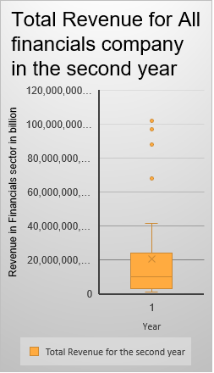
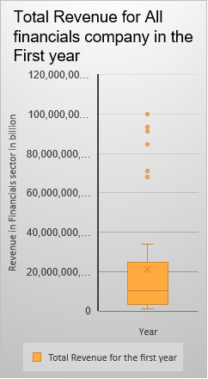
How the Total revenue changed from first to second year in Financials GICS Sector ?
The analytics for the histogram.
The histogram represent the revenue of all companies in financials sector. The mean of the revenue of the financials sector in the first year is about “21,419,213,414.63”, and the median of the revenue of the first year of the financials sector is about “10,259,000,000.00” , the standard deviation in the first year is about “ 28,272,226,523.63”
And The mean of the Total revenue in the Banks sub sector is 33,492,406,400 is higher than the mean of Total revenue of all financials sector.
The mean of the second year is decreased to “ 20,570,560,097.56 ” but the median is slightly increased to “10,381,653,000.00 ”.and the standard deviation decreased to “26,616,859,732.49 ”.
The maximum for the first year for The revenue is 100,078,000,000.00 and the minimum is 1,287,577,000.00. then.
The range will be in the first year 98,790,423,000.00 and the range increased to 100,350,900,000.00 for the second year.

Slide 3
The profit and losses statement for “MTB” Company
Profit & Losses stastement
 | Historical
 | Year 1 | Year 2 | Year 3 | Year 4
Revenue | 4,608,955,000 | 4,822,539,000 | 4,736,150,000 | 4,995,881,000
Cost of Goods Sold | 116,586,000 | 83,692,000 | 63,083,000 | 73,814,000
Sales, General and Admin | 2,448,629,000 | 2,540,954,000 | 2,655,650,000 | 2,796,508,000
Other operating expenses | 264,631,000 | 231,912,000 | 157,824,000 | 196,424,000
R&D | - | - | - | -
Gross Profit | 4,492,369,000 | 4,738,847,000 | 4,673,067,000 | 4,922,067,000
Total operating expenses | 2,713,260,000 | 2,772,866,000 | 2,813,474,000 | 2,992,932,000
Operating income/ EBIT | 1,779,109,000 | 1,965,981,000 | 1,859,593,000 | 1,929,135,000
The gross profit is not constant for the first 4 years. First year was 4,492,269,000 and increased to 4,738,847,000.00 then decreased to 4,673,067,000.00 for the third year.
The total operating expenses was A slight increase for each year. From 2,713,260,000 to 2,772,866,000 for the second year and keep slightly increased for the third and fourth years.
About the operating income the second year was the highest operating profit with 1,965,981,000.00 and was not constant for the first 4 years and the worst operating profit was in the first year with 1,779,109,000.00.

Slide 4
The profit and losses forecast for AYI Company for the year 5 and 6
Profit & Loss Statement
 | Historical |  |  |  | Forecast
 | Year 1 | Year 2 | Year 3 | Year 4 | Year 5 | Year 6
Revenue | 2,089,100,000 | 2,393,500,000 | 2,706,700,000 | 3,291,300,000 | 3,831,671,819 | 4,499,079,617
Cost of Goods Sold | 1,251,500,000 | 1,414,300,000 | 1,561,100,000 | 1,855,100,000
Sales, General and Admin | 607,600,000 | 680,300,000 | 756,900,000 | 946,000,000
Other operating expenses | - | - | - | -
R&D | - | - | - | -
Gross Profit | 837,600,000 | 979,200,000 | 1,145,600,000 | 1,436,200,000 | 1,599,392,267.57 | 1,922,968,214.43
Total operating expenses | 607,600,000 | 680,300,000 | 756,900,000 | 946,000,000
Operating income/ EBIT | 230,000,000 | 298,900,000 | 388,700,000 | 490,200,000 | 505,320,740.33 | 638,329,252.63
Revenue Growth |  | 0.145708678 | 0.130854397 | 0.215982562 | 0.164181879 | 0.174181879
Gross Margin | 0.400938203 | 0.409108001 | 0.423246019 | 0.436362532 | 0.417413689 | 0.427413689
Operating Margin | 0.110095256 | 0.124879883 | 0.143606606 | 0.14893811 | 0.131879964 | 0.141879964

Slide 5
The profit and losses forecast for AYI Company for the year 5 and 6
This is the forecast for AYI company for their 5th and 6th years . From the table previous slide in the Base case scenarios we are expecting an increased with the revenue to 3,831,671,819 for the 5th year and 4,499,079,617 for the 6th year.
Also we are expecting increase for the gross profit from 1,599,392,267 for the 5th year to 1,922,968,214 for the 6th year.
For the operating income / EBIT also we expecting an increase for the base case for the 5th year 505,320,740 to 638,329,252 for the 6th year.

