Slide 1
ML Classification Algorithm

Slide 2
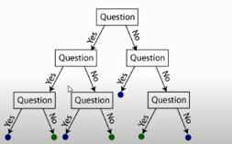
Decision Tree
Random Forest

Slide 3
Should I hire this candidate?
Has Experience?
Y
N
Salary< 15 SAR
Know ML
N
Y
N
Y
Hire
UPM Graduate?
Hire
Salary< 10 SAR
Y
N
Y
N
Hire
NO
Hire
NO

Slide 4

Training Dataset

