Slide 2
Data Collection
Data Pre-Processing
Model Training
Model Evaluation
Parameter Tuning/ optimization
Prediction

Slide 3
Types of Machine Learning
Supervised
Labelled data
Direct feedback
Known outcomes
Types:
Classification
(Predict Categories)
Regression
(Predict Continuous values)
Unsupervised
No Labels/targets
No feedback
Find hidden structure in the data
Notes:
upervised refers to a set of samples where the desired output signals (labels) are already known.

Slide 4
Supervised Learning
The main goal in supervised learning is to make the model learn from labelled training data that allows us to make predictions about unseen or future data.
Two Types:
Notes:
Imagine a teacher supervising a class.
The teacher already knows the correct answers
But the learning process doesn’t stop until the students learn the answers as well.
This is the essence of Supervised Machine Learning Algorithms.
Here, the algorithm is the student that learns from a training dataset and makes predictions that are corrected by the teacher.
This learning process continues until the algorithm achieves the required level of performance.

Slide 5





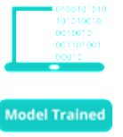



Slide 6
Unsupervised - Clustering
Organize a pile of information into meaningful subgroups (clusters)
We don’t any prior knowledge of their group memberships.
Find hidden structure in the data
Clustering

Slide 8
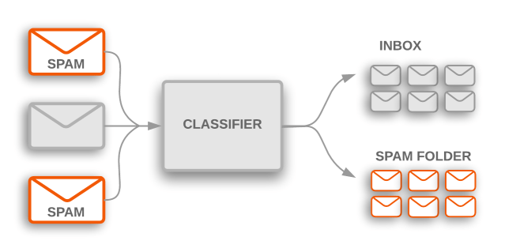
Supervised ML-Classification
Data Collection
Data Pre-Processing
Model Training
Model Evaluation
optimization
Prediction
Prediction of Discrete Labels

Slide 9
ML-Classification Example
Data Collection
Data Pre-Processing
Model Training
Model Evaluation
optimization
Prediction
Arabic Coffee vs American Coffee
Color | Caffeine | Coffee Type
2.2 | 1.5 | American
3.1 | 2.9 | Arabic
0.5 | 2.3 | American
2.7 | 1.7 | Arabic
1.9 | 1.5 | Arabic

Slide 10
Data Collection
Data Pre-Processing
Model Training
Model Evaluation
optimization
Prediction
Caffeine
Color

Slide 11
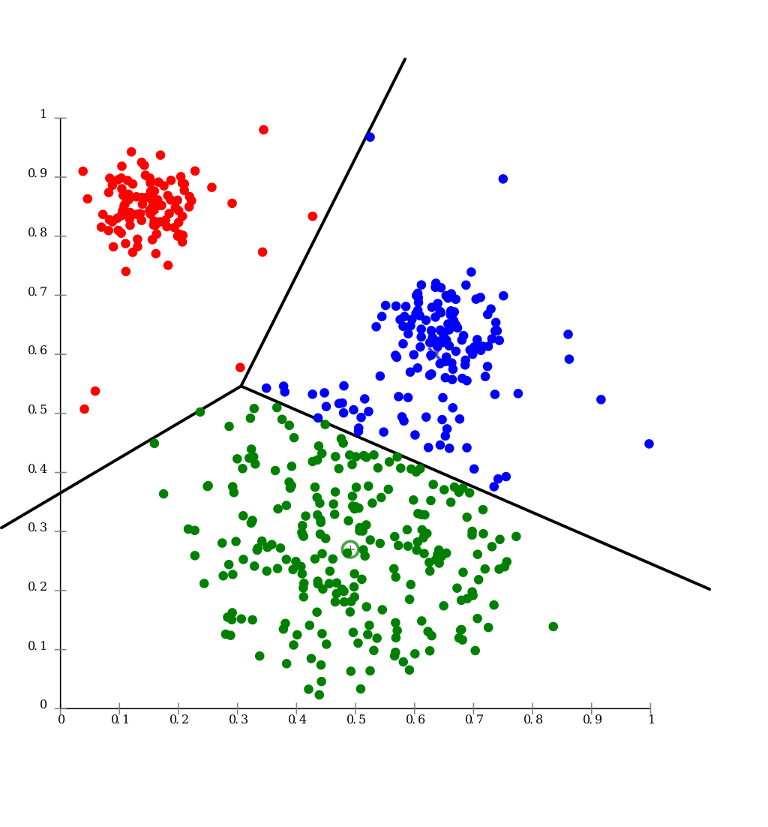
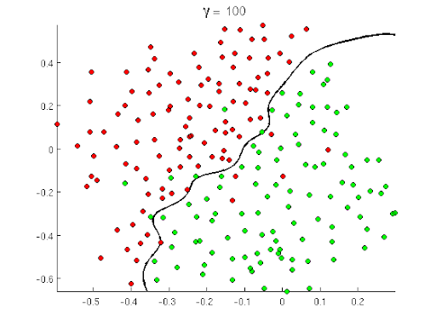
Data Collection
Data Pre-Processing
Model Training
Model Evaluation
optimization
Prediction

Slide 12
Supervised ML- Regression
Data Collection
Data Pre-Processing
Model Training
Model Evaluation
optimization
Prediction
Prediction of Continues numerical values
Stock Market
Real Estates
Sales

Slide 13
R-ML Example
Data Collection
Data Pre-Processing
Model Training
Model Evaluation
optimization
Prediction
A model that predicts properties’ prices
It uses historical data:
Sale price
Area

Slide 14
Rooms Area (thousands of square meters) | Sale Price (hundreds of thousands SAR)
1 | 0.3
2 | 0.7
3 | 1
4 | 1.2
5 | 1.7
6 | 1.6
7 | 2
2 | 1
2 | 1.5
2 | 2.6
3 | 2
4 | 1.8
3.6 | 2.1
5 | 2.1
6 | 2.3
7 | 2.3
3 | 1.6

Slide 15
Price
Rooms Area

Slide 16
Price
Rooms Area

Slide 17
Price
Rooms Area

Slide 18
Price
Rooms Area

Slide 19
Price
Rooms Area

Slide 20
Price
Rooms Area

Slide 21
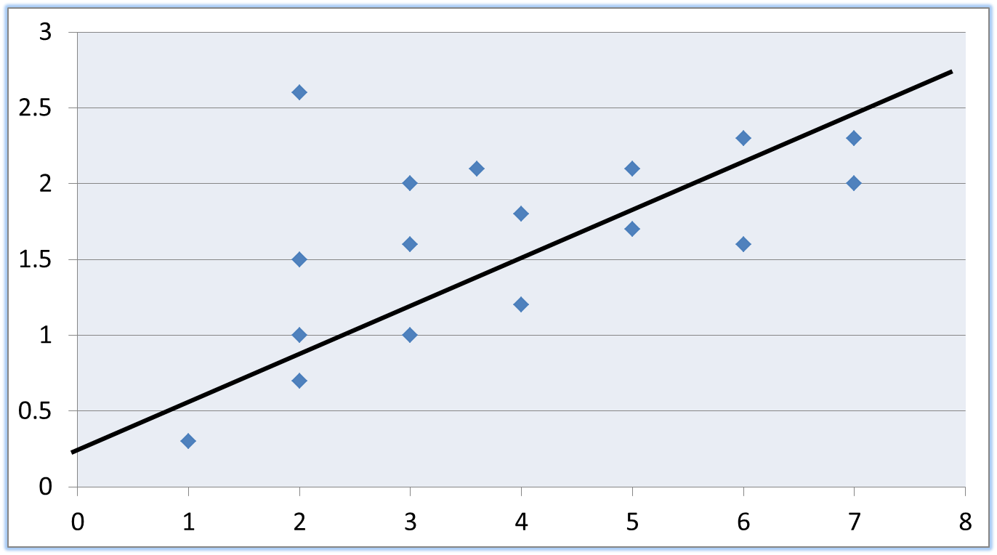
y = w0 + w1 x
• y is a dependent variable
• x is an independent variable
• w0 and w1 are weights (parameters) of the model
• In this case,
• w0 is the intercept of the line
• w1 is the slope of the line

Slide 22
Heart.csv
Heart Disease UCI
https://archive.ics.uci.edu/ml/datasets/Heart+Disease
https://www.kaggle.com/ronitf/heart-disease-uci

