Slide 1


SHOCK
Supervised by
Dr/ Nora Ramadan
Prepared by
Group A7

Slide 2
Prepared By\ Group (A7):
– Ahmed Ali Abdel Azim Mohamed - Ziad Mahmoud Ramadan
- Ahmed Omar Abdel Azim Zaki - Ziad Mohamed Ali
- Ahmed Magdy Ibrahim Ahmed - Ziad Hisham Ramadan
-Ahmed Mohamed Tawfiq Ragab - Shahd Abdullah Mohamed
-Ahamd Muhammad Rajab Ibrahim Ali - Shahd Ali Sayed
- Aml Hassan Mahmoud Abdulaziz - Shahd Mohamed Ali
- Aml Khaled Awad Mahmoud - Shahd Mohamed Mahmoud
- Aml Mohamed Ibrahim Ghoneim Shahd Nasr Abu Al-Fadl
- Aml Mustafa Abdulaziz Issawi
- Aml Wael Ahmed Mahmoud
- Tasneem Syed Abdul Rahman Ali
- Tasneem Muhammad Abdul-Wadud Muhammad
- Tahani Jamal Fathi Saleh
- Jumma Muhammad Yunus Ahmad
- Jihad Ahmed Mohamed Abdel Tawab
– Doaa Nady Salah
– Doaa Nady Abdel Fattah
– Doaa Hany Saad Abdel Baqi
– Doaa Yahia Muhammed Hussien
– Demiana Atef Mikhail Nakhleh
– Sara Essam Ahmed
– Dina Tarek Muhammed Saeed

Slide 3
Introduction
Shock is a life-threatening condition with a variety of underlying causes.
Shock affects all body systems. It may develop rapidly or slowly, During shock, the body struggles to survive, calling on all its homeostatic mechanisms to restore blood flow and tissue perfusion.

Slide 4
Introduction
blood pressure is inadequate to deliver oxygen and nutrients to support vital organs and cellular function.
inadequate blood flow to the tissues results in poor delivery of oxygen and nutrients to the cells, cellular starvation, cell death, organ dysfunction progressing to organ failure, and eventual death.

Slide 5
Definition
- Is a life-threatening condition of circulatory failure , causing inadequate oxygen delivery to meet cellular metabolic needs.

Slide 6
Significance of Shock
Shock affects all body systems. It may develop rapidly or slowly, depending on the underlying cause. During shock, the body struggles to survive, calling on all its homeostatic mechanisms to restore blood flow and tissue perfusion. Any insult to the body can create a cascade of events resulting in poor tissue perfusion.

Slide 7
Significance of Shock
Therefore, almost any patient with any disease state may be at risk for developing shock. Nursing care of the patient with shock requires ongoing systematic assessment. Many of the interventions required in caring for the patient with shock call for close collaboration with other members of the health care team and a physician’s orders. The nurse must anticipate such orders because they need to be executed with speed and accuracy.

Slide 8
Classification
Hypovolemic: caused by loss of fluid and blood volume Cardiogenic: due to failure of the heart to pump Distributic: caused by sever peripheral vasodilation
a) Septic: due to infection
b) Anaphylactic: due to allergic reaction
c) Neurogenic: due to spinal cord injury

Slide 9
Classification
Obstruction: caused by physical obstruction in the flow of
blood, pulmonary embolism and tension pneumothorax

Slide 10
Compensatory stage
In the compensatory stage of shock, the patient’s blood pressure remains within normal limits. Vasoconstriction, increased heart rate, and increased contractility of the heart contribute to maintaining adequate cardiac output. This results from stimulation of the sympathetic nervous system and subsequent release of catecholamines (epinephrine and norepinephrine).

Slide 11
Compensatory stage
The patient displays the often-described “fight or flight” response. The body shunts blood from organs such as the skin, kidneys, and gastrointestinal tract to the brain and heart to ensure adequate blood supply to these vital organs. As a result, the patient’s skin is cold and clammy, bowel sounds are hypoactive, and urine output decreases in response to the release of aldosterone and ADH.

Slide 12
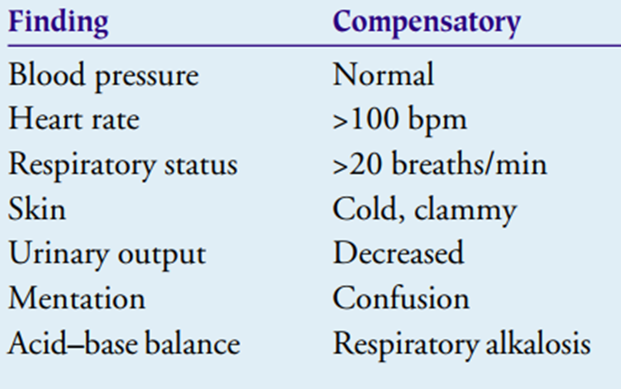
Compensatory stage

Slide 13
Compensatory stage
Clinical Manifestations: Despite a normal blood pressure, the patient shows numerous clinical signs indicating inadequate organ perfusion the result of inadequate perfusion is anaerobic metabolism and a buildup of lactic acid, producing metabolic acidosis. The respiratory rate increases in response to metabolic acidosis. This rapid respiratory rate facilitates removal of excess carbon dioxide but raises the blood pH and often causes a compensatory respiratory alkalosis. The alkalotic state causes mental status changes, such as confusion or combativeness, as well as arteriolar dilation. If treatment begins in this stage of shock, the prognosis for the patient is good.

Slide 14
Compensatory stage
Medical Management: Medical treatment is directed toward identifying the cause of the shock, correcting the underlying disorder so that shock does not progress, and supporting those physiologic processes that thus far have responded successfully to the threat. Because compensation cannot be effectively maintained indefinitely, measures such as fluid replacement and medication therapy must be initiated to maintain an adequate blood pressure and reestablish and maintain adequate tissue perfusion.

Slide 15
Compensatory stage
Nursing Management: Early intervention along the continuum of shock is the key to improving the patient’s prognosis. Therefore, the nurse needs to assess systematically those patients at risk for shock to recognize the subtle clinical signs of the compensatory stage before the patient’s blood pressure drops.

Slide 16
Compensatory stage
MONITORING TISSUE PERFUSION: In assessing tissue perfusion, the nurse observes for changes in level of consciousness, vital signs (including pulse pressure), urinary output, skin, and laboratory values. In the compensatory stage of shock, serum sodium and blood glucose levels are elevated in response to the release of aldosterone and catecholamines.

Slide 17
Compensatory stage
The role of the nurse at the compensatory stage of shock is to monitor the patient’s hemodynamic status and promptly report deviations to the physician, assist in identifying and treating the underlying disorder by continuous in-depth assessment of the patient, administer prescribed fluids and medications, and promote patient safety.

Slide 18
Compensatory stage
Vital signs are key indicators of the patient’s hemodynamic status; however, blood pressure is an indirect method of monitoring tissue hypoxia. Pulse pressure correlates well to stroke volume, the amount of blood ejected from the heart with systole.

Slide 19
Compensatory stage
Pulse pressure is calculated by subtracting the diastolic measurement from the systolic measurement; the difference is the pulse pressure. Normally, the pulse pressure is 30 to 40 mm Hg (Mikhail, 1999). Narrowing or decreased pulse pressure is an earlier indicator of shock than a drop in systolic blood pressure. Decreased or narrowing pulse pressure, an early indication of decreased stroke volume,

Slide 20
Compensatory stage
is illustrated in the following example:
Systolic BP - Diastolic BP = Pulse Pressure
120mmHg - 80mmHg = 40mmHg
Narrowing of pulse pressure:
Systolic BP - Diastolic BP = Pulse Pressure
90mmHg - 70mmHg = 20mmHg

Slide 21
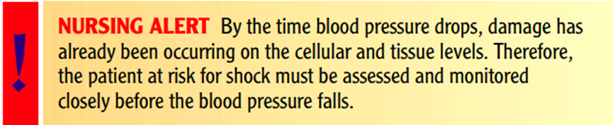
Compensatory stage
Elevation in the diastolic blood pressure with release of catecholamines and attempts to increase venous return through vasoconstriction is an early compensatory mechanism in response to decreased stroke volume, blood pressure, and overall cardiac output.

Slide 22
Compensatory stage
Although treatments are prescribed and initiated by the physician, the nurse usually implements them, operates and troubleshoots equipment used in treatment, monitors the patient’s status during treatment, and assesses the immediate effects of treatment. Additionally, the nurse assesses the response of the patient and the family to the crisis and to treatment.

Slide 23
Compensatory stage
REDUCING ANXIETY: While experiencing a major threat to health and well-being and being the focus of attention of many health care providers, the patient often becomes anxious and apprehensive. Providing brief explanations about the diagnostic and treatment procedures, supporting the patient during those procedures, and providing information about their outcomes are usually effective in reducing stress and anxiety and thus promoting the patient’s physical and mental well-being.

Slide 24
Compensatory stage
PROMOTING SAFETY: Another nursing intervention is monitoring potential threats to the patient’s safety, because a high anxiety level and altered mental status typically impair a person’s judgment. In this stage, patients who were previously cooperative and followed instructions may now disrupt intravenous lines and catheters and complicate their condition. Therefore, close monitoring is essential.

Slide 25
Pathophysiology
In shock, the cells lack an adequate blood supply and are deprived of oxygen and nutrients; therefore, they must produce energy through anaerobic metabolism. This results in low energy yields from nutrients and an acidotic intracellular environment. Because of these changes, normal cell function ceases.

Slide 26
Pathophysiology
The cell swells and the cell membrane becomes more permeable, allowing electrolytes and fluids to seep out of and into the cell. The sodium-potassium pump becomes impaired; cell structures, primarily the mitochondria, are damaged; and death of the cell results.

Slide 27
Pathophysiology
Vascular Response
Oxygen attaches to the hemoglobin molecule in red blood cells, and the blood carries it to body cells. The amount of oxygen that is delivered to cells depends both on blood flow to a specific area and on blood oxygen concentration. Blood is continuously re-cycled through the lungs to be re-oxygenated and to eliminate end products of cellular metabolism, such as carbon dioxide.

Slide 28
Pathophysiology
The heart muscle is the pump that propels the freshly oxygenated blood out to the body tissues. This process of circulation is facilitated through an elaborate and dynamic vasculature consisting of arteries, arterioles, capillaries, veins, and venules. The vasculature can dilate or constrict based on central and local regulatory mechanisms.

Slide 29
Pathophysiology
Central regulatory mechanisms stimulate dilation or constriction of the vasculature to maintain an adequate blood pressure. Local regulatory mechanisms, referred to as autoregulation, stimulate vasodilation or vasoconstriction in response to biochemical mediators (also called cytokines) released by the cell, communicating its need for oxygen and nutrients

Slide 30
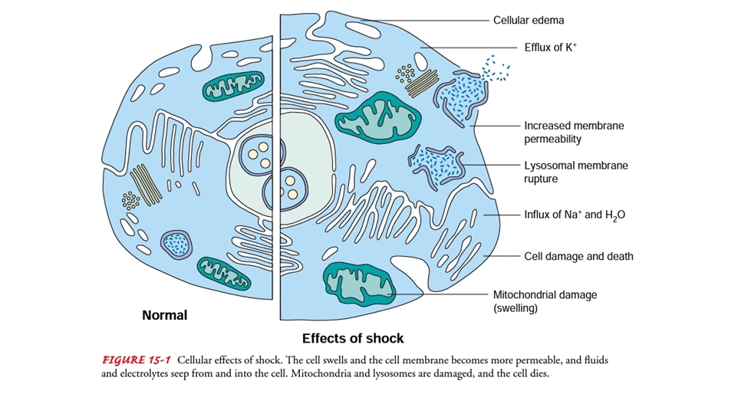
Pathophysiology
A biochemical mediator is a substance released by a cell or immune cells such as polymorph nuclear leukocytes (PMNs) or macrophages; the substance triggers an action at a cell site or travels in the
bloodstream to a distant site, where it triggers action.

Slide 31
Pathophysiology
Blood Pressure Regulation
Three major components of the circulatory system—blood volume, the cardiac pump, and the vasculature—must respond effectively to complex neural, chemical, and hormonal feedback systems to maintain an adequate blood pressure and ultimately perfuse body tissues. Blood pressure is regulated through a complex interaction of neural, chemical, and hormonal feedback systems affecting both cardiac output and peripheral resistance.

Slide 32
Pathophysiology
This relationship is expressed in the following equation: Mean arterial blood pressure = cardiac output × peripheral resistance Cardiac output is determined by stroke volume (the amount of blood ejected at systole) and heart rate. Peripheral resistance is determined by the diameter of the arterioles.

Slide 33
Pathophysiology
Tissue perfusion and organ perfusion depend on mean arterial pressure (MAP). The MAP is the average pressure at which blood moves through the vasculature. Although true MAP can be calculated only by complex methods, Chart 15-1 displays a convenient formula for clinical use in estimating MAP. MAP should exceed 70 to 80 mm Hg for cells to receive the oxygen and nutrients needed to metabolize energy in amounts sufficient to sustain life.

Slide 34
Pathophysiology
Blood pressure is regulated by the baroreceptors (pressure receptors) located in the carotid sinus and aortic arch. These pressure receptors convey impulses to the sympathetic nervous center in the medulla of the brain. When blood pressure drops, catecholamines (epinephrine and norepinephrine) are released from the adrenal medulla of the adrenal glands. This increases heart rate and vasoconstriction,

Slide 35
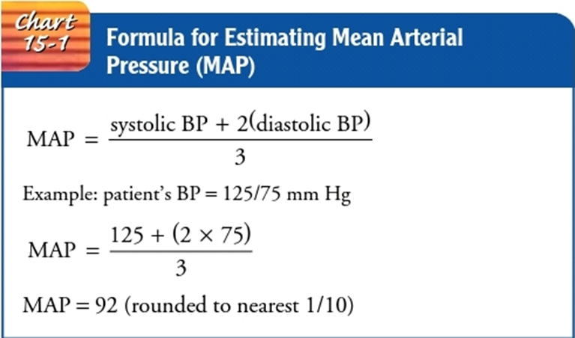
Pathophysiology
this restoring blood pressure. Chemoreceptors, also located in the aortic arch and carotid arteries, regulate blood pressure and respiratory rate using much the same mechanism in response to changes in oxygen and carbon dioxide concentrations in the blood.

Slide 36
Pathophysiology
These primary regulatory mechanisms can respond to changes in blood pressure on a moment-to-moment basis.
The kidneys also play an important role in blood pressure regulation. They regulate blood pressure by releasing renin, an enzyme needed for the conversion of angiotensin I to angiotensin II, a potent vasoconstrictor.

Slide 37
Pathophysiology
This stimulation of the renin-angiotensin mechanism and resulting vasoconstriction indirectly lead to the release of aldosterone from the adrenal cortex, which promotes the retention of sodium and water. The increased concentration of sodium in the blood then stimulates the release of antidiuretic hormone (ADH) by the pituitary gland. ADH causes the kidneys to retain water further in an effort to raise blood volume and blood pressure. These secondary regulatory mechanisms may take hours or days to respond to changes in blood pressure.

Slide 38
Pathophysiology
To summarize, adequate blood volume, an effective cardiac pump, and an effective vasculature are necessary to maintain blood pressure and tissue perfusion. When one of the three components of this system begins to fail, the body is able to compensate through increased work by the other two.

Slide 39
Pathophysiology
When compensatory mechanisms can no longer compensate for the failed system, body tissues are inadequately perfused, and shock occurs. Without prompt intervention, shock progresses, resulting in organ dysfunction, organ failure, and death.

Slide 40
PROGRESSIVE STAGE
In the progressive stage of shock, the mechanisms that regulate Blood pressure can no longer compensate and the MAP falls Below normal limits, with an average systolic blood pressure of Less than 90 mm Hg

Slide 41
PROGRESSIVE STAGE
Pathophysiology
First, the over- worked hear becomes dysfunctional, the body's inability to meet Increased oxygen requirements produces ischemia, and biochem ical mediators cause myocardial depression .
This leads to failure of the cardiac pump, even If the underlying cause of the shock is not of cardiac origin.

Slide 42
PROGRESSIVE STAGE
Second, the autoregulatory func tion of the microcirculation fails in response to numerous bio- chemical mediators released by the cells, resulting In increased capillary permeability, with areas of arteriolar and venous con- striction further compromising cellular perfusion. At this stage, the patient's prognosis wonens.

Slide 43
PROGRESSIVE STAGE
The relaxation of procapillary sphincters causes fluid to leak from the capillaries, creating inter stitial edema and return of less fluid to the heart. Even If the underlying cause of the shock is reversed, the breakdown of the circulatory system Itself perpetuates the shock state, and a vicinus circle ensues.

Slide 44
PROGRESSIVE STAGE
Assessment and Diagnostic
Chances of survival depend on the patient's general health before the shock state as well as the amount of time It takes to restore tis sue perfusion. As shock progresses, organ systems decompensate .

Slide 45
PROGRESSIVE STAGE
RESPIRATORY EFFECTS
The lungs, which become compromised early in shock, are affected at this stage. Subsequent decompensation of the lungs in-
creases the likelihood that mechanical ventilation will be needed
if shock progresses. Respirations are rapid and shallow. Crackles
are heard over the lung fields. Decreased pulmonary blood flow

Slide 46
PROGRESSIVE STAGE
to increase. Hypoxemia and biochemical mediators cause an in-
tense inflammatory response and pulmonary vasoconstriction,
perpetuating the pulmonary capillary hypoperfusion and hypox-
emia. The hypoperfused alveoli stop producing surfactant and subsequently collapse. Pulmonary capillaries begin to leak their
contents, causing pulmonary edema, diffusion abnormalities

Slide 47
PROGRESSIVE STAGE
(shunting), and additional alveolar collapse. Interstitial inflam-
mation and fibrosis are common as the pulmonary damage pro-gresses . This condition is
sometimes referred to as acute respiratory distress syndrome
, acute lung injury shock lung, or noncardiogenic
pulmonary edema

Slide 48
PROGRESSIVE STAGE
CARDIOVASCULAR EFFECTS
A lack of adequate blood supply leads to dysrhythmias and ischemia. The patient has a rapid heart rate, sometimes exceeding
150bpm. The patient may complain of chest pain and even suffer a myocardial Infarction. Cardiac enzyme levels (eg, lactate de Hydrogenase, CPK-MB, and cTn-I) rise. In addition,mmyocardia
Depression and ventricular dilation may further Impair the heart’s Ability to pump enough blood to the tissues to meet oxygen
Requirements.

Slide 49
PROGRESSIVE STAGE
NEUROLOGIC EFFECTS
As blood flow to the brain becomes Impaired, the patient’s mental status deteriorates. Changes in mental status occur as a result of decreased cerebral perfusion and hypoxia; the patient
May initially exhibit confusion or a subtle change in behavior.Subsequently, lethargy increases and the patient begins to lose consciousness. The pupils dilate and are only sluggishly reactive to light.

Slide 50
PROGRESSIVE STAGE
RENAL EFFECTS
When the MAP falls below 80 mm Hg (Guyton & Hall, 2000),
the glomerular filtration rate of the kidneys cannot be maintained, and drastic changes in renal function occur. Acute renal
failure (ARF) can develop. ARF is characterized by an increase in

Slide 51
PROGRESSIVE STAGE
blood urea nitrogen (BUN) and serum creatinine levels, fluid and
electrolyte shifts, acid–base imbalances, and a loss of the renal-
hormonal regulation of blood pressure. Urinary output usually
decreases to below 0.5/mL/kg per hour (or below 30 mL per
hour) but can be variable depending on the phase of ARF.

Slide 52
PROGRESSIVE STAGE
HEPATIC EFFECTS
Decreased blood flow to the liver impairs the liver cells’ ability to perform metabolic and phagocytic functions. Consequently, the patient is less able to metabolize medications and metabolic waste products, such as ammonia and lactic acid

Slide 53
PROGRESSIVE STAGE
The patient becomes more susceptible to infection as the liver fails to filter bacteria from the blood. Liver enzymes (aspartate aminotransferase [AST], formerly serum glutamic-oxaloacetic transaminase [SGOT]; alanine aminotransferase [ALT], formerly serum glutamate pyruvate transaminase [SGPT]; lactate dehydrogenase) and bilirubin levels are elevated, and the patient appears jaundiced.

Slide 54
PROGRESSIVE STAGE
HEMATOLOGIC EFFECTS
The combination of hypotension, sluggish blood flow, metabolic Acidosis, and generalized hypoxemia can interfere with normal Hemostatic mechanisms. Disseminated intravascular coagulation (DIC) can occur either as a cause or as a complication of shock.

Slide 55
PROGRESSIVE STAGE
In this condition, widespread clotting and bleeding occur simultaneously. Bruises (ecchymoses) and bleeding (petechiae) may appear In the skin. Coagulation times (prothrombin time, partial Thromboplastin time) are prolonged. Clotting factors and Platelets are consumed and require replacement therapy to Achieve hemostasis.

Slide 56
PROGRESSIVE STAGE
GASTROINTESTINAL EFFECTS
Gastrointestinal ischemia can cause stress ulcers in the stomach placing the patient at risk for gastrointestinal bleeding. In the small intestine, the mucosa can become necrotic and slough off,causing bloody diarrhea. Beyond the local effects of impaired perfusion, gastrointestinal ischemia leads to bacterial toxin translocation, in which bacterial toxins enter the bloodstream through the lymph system. In addition to causing infection, bacterial toxins can cause cardiac depression, vasodilation, increased capillary permeability, and an intense inflammatory response with activation of additional biochemical mediators. The net result is interference with healthy cells and their ability to metabolize nutrients.

Slide 57
PROGRESSIVE STAGE
Medical Management
Specific medical management in the progresive stage of shock depends on the type of shock and its underlying cause. It is also based on the degree of decompensation in the organ systems. Medical management specific to each type of shock Is discussed in later sections of this chapter. Although there are several differ- ences in medical management by type of shock, some medical In- terventions are common to all types.

Slide 58
PROGRESSIVE STAGE
These Include use of appropriate intravenous fluids and medications to restore tie perfusion by:
(1) optimizing intravascular volume
(2) supporting the pumping action of the heart.
(3) improving the compe tence of the vascular system
Other aspects of management may include curly enteral nutritional support and use of antacids histamine 2 blockers, or antipeptic agents to reduce the risk of gastrointestinal ulceration and bleeding.

Slide 59
PROGRESSIVE STAGE
Nursing Management
Nursing care of the patient In the progressive stage of shock requires expertise in assessing and understanding shock and the significance of changes In assessment data. The patient in the Progressive stage of shock Is often cared for In the intensive care Setting to facilitate close monitoring (hemodynamic monitoring,electrocardiograp-hic monitoring, arterial blood gases, serum electrolyte levels, physical and mental status changes),

Slide 60
PROGRESSIVE STAGE
rapid and frequent administration of various prescribed medications and Fluids, and possibly intervention with supportive technologies Such as mechanical ventilation, dialysis, and Intra-aortic balloon Pump. Working closely with other members of the health care team The nurse carefully documents treatments

Slide 61
PROGRESSIVE STAGE
, medications, and fluids that are administered by members of the team, recording the Time, dosage or volume, and the patient’s response. Additionally The nurse coordinates both the scheduling of diagnostic proce-dures that may be carried out at the bedside and the flow of health Care personnel involved In the patient’s care.

Slide 62
PROGRESSIVE STAGE
PREVENTING COMPLICATIONS
If supportive technologies are used, the nurse helps reduce the Risk of related complications and monitors the patient for early Signs of complications. Monitoring includes evaluating blood levels of medications, observing invasive vascular lines for signs of Infection, and checking neurovascular status if arterial lines are Inserted, especially in the lower extremities.

Slide 63
PROGRESSIVE STAGE
Simultaneously, the Nurse promotes the patient’s safety and comfort by ensuring that All procedures, including invasive procedures and arterial and venous punctures, are carried out using correct aseptic techniques And that venous and arterial puncture and infusion sites are maintained with the goal of preventing infection. Positioning and Repositioning the patient to promote comfort, prevent pulmonary complications, and maintain skin integrity are integral to Caring for the patient In shock.

Slide 64
PROGRESSIVE STAGE
PROMOTING REST AND COMFORT
Efforts are made to minimize the cardiac workload by reducing The patient’s physical activity and fear or anxiety. Promoting rest And comfort is a priority In the patient’s care. To ensure that the Patient gets as much uninterrupted rest as possible, the nurse performs only essential nursing activities.

Slide 65
PROGRESSIVE STAGE
To conserve the patient’s Energy, the nurse protects the patient from temperature extremes (excessive warmth or shivering cold), whichh can increase the Metabolic rate and subsequently the cardiac workload. The patient should not be warmed too quickly, and warming blankets Should not be applied becausee they can cause vasodilation and a subsequent drop in blood pressure.

Slide 66
PROGRESSIVE STAGE
SUPPORTING FAMILY MEMBERS
Because the patient In shock Is the object of intense attention by The health care team, the family members may feel neglected; however, they may be reluctant to ask questions or seek information For fear that they will be In the way or will Interfere with the attention given to the patient. The nurse should make sure that the Family is comfortably situated and kept informed about the patient’s status.

Slide 67
PROGRESSIVE STAGE
Often, family members need advice from the health Care team to get some rest; they are more likely to take this advice If they feel that the patient Is being well cared for and that they will Be notified of any significant changes in the patient’s status. A visit From the hospital chaplain may be comforting to the family and Provides some attention to the family while the nurse concentrates on the patient.

Slide 68
IRREVERSIBLE STAGE
The irreversible (or refractory) stage of shock represents the point along the shock continuum at which organ damage is so severe that the patient does not respond to treatment and cannot survive . Despite treatment , blood pressure remains low. Complete renal and liver failure , compounded by the release of necrotic tissue toxins , creates on overwhelming lactic acidosis.

Slide 69
IRREVERSIBLE STAGE
Reserves of ATP are almost totally depleted, and mechanisms for storing new supplies of energy have been destroyed. Multiple organ dysfunction progressing to complete organ failure has occurred, and death is imminent. Multiple organ dysfunction can occur as a progression along the shock continuum or as a syndrome unto itself and is further described in this chapter.

Slide 70
IRREVERSIBLE STAGE
It is the terminal phase of shock and once the patient progresses into this phase it is the point of no return because there is a rapid deterioration of the cardiovascular system. The patient will present with severe decreases in cardiac output , blood pressure and tissue perfusion.

Slide 71
IRREVERSIBLE STAGE
Medical Management:- Medical management during the irreversible stage of shock is usually the same as for the progressive stage . Although the patient's condition may have progressed from the progressive to the irreversible stage , the judgment that the shock is irreversible can be made only retrospectively on the basis of the patient's failure to respond to treatment. Strategies that may be experimental (ie ,investigational medications, such as antibiotic agents and immunomodulation therapy) may be tried to reduce or reverse the severity of shock.

Slide 72
IRREVERSIBLE STAGE
●High-flow oxygen is indicated, even if the patient is still mentating and has a pulse oximetry of 94% or higher.
●keep the patient warm ,decreases in body temperature impair the body's ability to control bleeding secondary to Impaired platelets function .

Slide 73
IRREVERSIBLE STAGE
Nursing Management:-
■As in the progressive stage of shock ,the nurse focuses on carrying out prescribed treatments, monitoring the patient, preventing complications, protecting the patient from injury, and providing comfort .Offering brief explanations to the patient about what is happening is essential even if there is no certainty that the patient hears or understands what is being said.
■As it becomes obvious that the patient is unlikely to survive the family needs to be informed about the prognosis and likely outcome.

Slide 74
IRREVERSIBLE STAGE
■Opportunities should be provided, throughout the patient's care for the family to see ,touch ,and talk to the patient. A close family friend or spiritual advisor may be of comfort to the family in dealing with the inevitable death of the patient. Whenever possible and appropriate, the family should be approached regarding any living will , advance directive ,or other written or verbal wishes the patient may have shared in the event that he or she cannot participate in end-of-life decisions.
■In some cases, ethics committees may assist the family and health care team in making difficult decisions.

Slide 75
IRREVERSIBLE STAGE
■During this stage of shock, families may misinterpret the actions of the health care team . They have been told that nothing has been effective in reversing the shock and that the patient's survival is very unlikely, yet the health care team continues to work feverishly on the patient. A distraught, grieving family may interpret this as a chance for recovery when none exists. As a result, family members may become angry when the patient dies. Conferences with all members of the health care team and the family will promote better understanding by the family of the patient's prognosis and the purpose from the measures being taken.

Slide 76
IRREVERSIBLE STAGE
■During the conferences it is essential to explain that the equipment and treatments being provided are for the patient's comfort and do not suggest that the patient will recover.
■Families should be encouraged to Express their wishes concerning the use of life-support measures.

Slide 77
Overall Management Strategies in Shock
Fluid replacement to restore intravascular volume:
The type of fluids administered and the speed of delivery vary, but fluids are given to improve cardiac and tissue oxygenation.
The fluids administered may include :
crysalloids (electrolyte solutions that move freely between intravascular and interstitial spaces)
colloids (large-molecule intravenous solutions), or blood components.
Ringer’s lactate, albumin solution, hetastarch and dextran solution.

Slide 78
Overall Management Strategies in Shock
Complications of Fluid Administration:
The most common and serious side effects of fluid replacement are cardiovascular over-load and pulmonary edema.
Fluid replacement must be monitored fre-quently for adequate urinary output, changes in mental status, skin perfusion, and changes in vital signs. Lung sounds are aus-cultated frequently to detect signs of fluid accumulation. Adven-titious lung sounds, such as crackles, may indicate pulmonary edema
Right atrial pressure line (also known as a central ve-nous pressure line)….Normal right atrial pressure value is 4 to 12 mm Hg .

Slide 79
Overall Management Strategies in Shock
VASOACTIVE MEDICATION THERAPY:
Vasoactive medications are administered in all forms of shock. These medications help to increase the strength of myocardial contractility, regulate the heart rate, reduce myocardial resistance, and initiate vasoconstriction. Vasoactive medications are selected for their action on recep-tors of the sympathetic nervous system. These receptors are known as alpha-adrenergic and beta-adrenergic receptors. Beta-adrenergic receptors are further classified as beta1- and beta2-adrenergic recep-tors.

Slide 80
Overall Management Strategies in Shock
When alpha-adrenergic receptors are stimulated, blood vessels constrict in the cardiorespiratory and gastrointestinal systems, skin, and kidneys. When beta1-adrenergic receptors are stimulated, heart rate and myocardial contraction increase. Whenbeta2-adrenergic receptors are stimulated, vasodilation occurs in the heart and skeletal muscles, and the bronchioles relax. The medications used in treating shock consist of various combina-tions of vasoactive medications to maximize tissue perfusion by stimulating or blocking the alpha- and beta-adrenergic receptors.

Slide 81
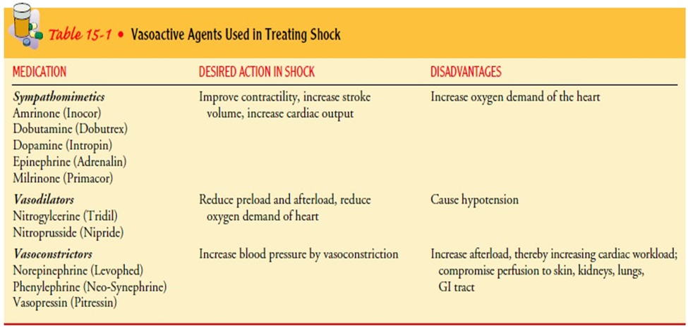
Overall Management Strategies in Shock
NUTRITIONAL SUPPORT:
Increased metabolic rates during shock increase en-ergy requirements and therefore caloric requirements. The release of catecholamines early in the shock continuum causes glycogen stores to be depleted in about 8 to 10 hours. The pa-tient in shock requires more than 3,000 calories daily. In this catabolic process, skeletal muscle mass is bro-ken down even when the patient has large stores of fat or adipose tissue. Loss of skeletal muscle can greatly prolong the recovery time for the patient in shock. Parenteral or enteral nutritional sup-port should be initiated as soon as possible.

Slide 82
Hypovolemic Shock
Definition:
Hypovolemic shock is the most common type of shock, is characterized by a decreased intravascular volume. Body fluid is contained in the intracellular and extracellular compartments. Intracellular fluid accounts for about two thirds of the total body water. The extracellular body fluid is found in one of two compartments: intravascular (inside blood vessels) or interstitial (surrounding tissues). The volume of interstitial fluid is about three to four times that of intravascular fluid. Hypovolemic shock occurs when there is a reduction in intravascular volume of 15% to 25%. This .would represent a loss of 750 to 1,300 mL of blood in a 70-kg (154-lb) person

Slide 83
Hypovolemic Shock
Pathophysiology:
Hypovolemic shock can be caused by external fluid losses, such as traumatic blood loss, or by internal fluid shifts, as in severe dehydration, severe edema, or ascites. Intravascular volume can be reduced both by fluid loss and fluid shifting between the intravascular and interstitial compartments. The sequence of events in hypovolemic shock begins with a decrease in the intravascular volume. This results in decreased venous return of blood to the heart and subsequent decreased ventricular filling. Decreased ventricular filling results in decreased stroke volume (amount of blood ejected from the heart) and decreased cardiac output. When cardiac output drops, blood pressure drops and tissues cannot be adequately perfused

Slide 84
Hypovolemic Shock
Risk Factors for Hypovolemic Shock:
External (Fluid Losses): Trauma, Surgery, Vomiting, Diarrhea, Diuresis and Diabetes .insipidus .Internal (Fluid Shifts): Hemorrhage, Burns, Ascites, Peritonitis and Dehydration

Slide 85
Hypovolemic Shock
Medical Management:
Major goals in treating hypovolemic shock are to restore in travascular volume to reverse the sequence of events leading to ,inadequate tissue perfusion redistribute fluid volume, and correct the underlying cause of the fluid loss as quickly as pos. sible Depending on the severity of shock and the patient’s con dition, it is likely that efforts will be made to address all three .goals simultaneously

Slide 86
Hypovolemic Shock
TREATMENT OF THE UNDERLYING CAUSE
-If the patient is hemorrhaging, efforts are made to stop the bleed ing. This may involve applying pressure to the bleeding site or surgery to stop internal bleeding. If the cause of the hypovolemia -is diarrhea or vomiting, medications to treat diarrhea and vomit -ing are administered as efforts are made simultaneously to iden tify and treat the cause. In the elderly patient, dehydration may .be the cause of hypovolemic shock

Slide 87
Hypovolemic Shock
FLUID AND BLOOD REPLACEMENT
Beyond reversing the primary cause of the decreased intravascular volume, fluid replacement (also referred to as fluid resuscitation) is of primary concern. At least two large-gauge intravenous lines are -inserted to establish access for fluid administration. Two intra -venous lines allow simultaneous administration of fluid, medica tions, and blood component therapy if required. Because the goal

Slide 88
Hypovolemic Shock
-of the fluid replacement is to restore intravascular volume, it is nec -essary to administer fluids that will remain in the intravascular com partment and thus avoid creating fluid shifts from the intravascular .compartment into the intracellular compartment

Slide 89
Hypovolemic Shock
-Lactated Ringer’s and 0.9% sodium chloride solutions are iso tonic crystalloid fluids commonly used in treating hypovolemic -shock (Jindal et al., 2000). Large amounts of fluid must be ad -ministered to restore intravascular volume because isotonic crys talloid solutions move freely between the fluid compartments of .the body and do not remain in the vascular system Colloids (eg, albumin, hetastarch, and dextran) may also be used. Dextran is not indicated if the cause of the hypovolemic .shock is hemorrhage because it interferes with platelet aggregation

Slide 90
Hypovolemic Shock
,Blood products, also colloids, may need to be administered -particularly when the cause of the hypovolemic shock is hemor rhage. Because of the risk of transmitting bloodborne viruses and the scarcity of blood products, however, these products are used only if other alternatives are unavailable or blood loss is extensive and rapid. Packed red blood cells are administered to replenish the patient’s oxygen-carrying capacity in conjunction with other fluids that will expand volume. Current recommendations are to ,base the need for transfusions on the patient’s oxygenation needs -which are determined by vital signs, blood gas values, and clini .cal appearance rather than using an arbitrary laboratory value -Synthetic forms of blood (ie, compounds capable of carrying oxy .gen in the same way that blood does) are potential alternatives

Slide 91
Hypovolemic Shock
REDISTRIBUTION OF FLUID
-In addition to administering fluids to restore intravascular vol .ume, positioning the patient properly assists fluid redistribution A modified Trendelenburg is recommended in hypovolemic shock. Elevating the legs promotes the return of venous blood. Positioning the patient in a full Trendelenburg position, however, makes breathing difficult and therefore is not .recommended

Slide 92
Hypovolemic Shock
PHARMACOLOGIC THERAPY
If fluid administration fails to reverse hypovolemic shock, then the same medications given in cardiogenic shock are used because unreversed hypovolemic shock progresses to cardiogenic shock .)the vicious circle( ,If the underlying cause of the hypovolemia is dehydration -medications are also administered to reverse the cause of the de hydration. For example, insulin is administered if dehydration is -secondary to hyperglycemia; desmopressin (DDAVP) is admin ,istered for diabetes insipidus, antidiarrheal agents for diarrhea .and antiemetic medications for vomiting

Slide 93
Hypovolemic Shock
Nursing management
.Primary prevention of trauma is an essential focus of nursing intervention Hypovolemic shock can be prevented in some cases by careful monitoring of patients at risk of hypovolemia. In other cases, hypovolemic shock cannot be expected, and nursing care focuses on assisting with treatment aimed at addressing its causes and restoring volume within the blood vessels. General nursing measures include the safe administration of prescribed fluids and medications and documentation of their administration and effects. Another important nursing role is to monitor for signs of complications and side effects of treatment and to report these signs early in .treatment

Slide 94
Hypovolemic Shock
Managing blood and fluids
safely Managing blood transfusions safely is a vital nursing role. In emergencies, it is important to obtain blood samples quickly for baseline blood counts and for sorting and comparing blood in anticipation of transfusions. The patient receiving blood transfusions should be monitored closely for adverse effects. Complications of fluid replacement can occur, often when large amounts are given quickly. Therefore, the nurse closely monitors the patient for cardiovascular overload and pulmonary edema. The risk of this complication is increased in the elderly and in patients with preexisting heart disease. Hemodynamic pressure, vital signs, arterial blood gases, hemoglobin and hematocrit levels, fluid intake and fluid output were among the factors monitored.

Slide 95
Hypovolemic Shock
The patient's temperature should also be closely monitored to ensure that rapid fluid resuscitation does not result in hypothermia. Intravenous fluids .may need to be heated while large volumes are being given The physical evaluation focuses on monitoring the jugular veins for distension and monitoring the jugular venous pressure. Jugular venous pressure is low in hypovolemic shock. It increases with active treatment and increases significantly with fluid overload and heart failure. The nurse needs to closely monitor the condition of the heart and compare blood in anticipation of transfusions. The patient receiving blood transfusions should be closely monitored for adverse effects (see Respiratory System) and report changes in blood pressure, pulse pressure, heart rate and rhythm, and lung sounds to the physician

Slide 96
Hypovolemic Shock
IMPLEMENTING OTHER MEASURES
Oxygen is administered to increase the amount of oxygen given carried by available hemoglobin in the blood. A patient who is con-fused may feel apprehensive with an oxygen mask or cannula in place, and frequent explanations about the need for the mask may reduce some of the patient's fear and anxiety. Simultaneously, the nurse must direct efforts to the safety and comfort of the patient.

Slide 97
Cardiogenic shock
Cardiogenic shock occurs when the heart’s ability to contract and to pump blood is impaired and the supply of oxygen is inadequate for the heart and tissues. The causes of cardiogenic shock are known as either coronary or noncoronary. Coronary cardiogenic shock is more common than noncoronary cardiogenic shock and is seen most often in patients with myocardial infarction. Coronary cardiogenic shock occurs when a significant amount of left ventricular myocardium destroyed

Slide 98
Cardiogenic shock
Pathophysiology
In cardiogenic shock, cardiac output, which is a function of both stroke volume and heart rate, is compromised. When stroke volume and heart rate decrease or become erratic, blood pressure drops and tissue perfusion is compromised. Along with other tissues and organs being deprived of adequate blood supply, the heart muscle itself receives inadequate blood.

Slide 99
Cardiogenic shock
Clinical Manifestations
Patients in cardiogenic shock may experience angina pain anddevelop dysrhythmias and hemodynamic instability
Medical Management
Goals of it.
What achieved these goals.
Correction of underlying causes:
The underlying cause of cardiogenic shock must be corrected at first.
The first necessary treat is oxygenation.

Slide 100
Cardiogenic shock
INITIATION OF FIRST-LINE TREATMENT
First-line treatment of cardiogenic shock involves the following
Actions:
.Supplying supplemental oxygen
Controlling chest pain.
. Providing selected fluid support
.Administering vasoactive medications
Controlling heart rate with medication or by implementation of a transthoracic or intravenous pacemaker.

Slide 101
Cardiogenic shock
Implementing mechanical cardiac support (intra-aortic balloon counterpulsation therapy, ventricular assist systems, or extracorporeal cardiopulmonary bypass Oxygenation. In the early stages of shock, supplemental oxygen is administered by nasal cannula at a rate of 2 to 6 L/min to achieve an oxygen saturation exceeding 90%

Slide 102
Cardiogenic shock
Pain Control. If the patient experiences chest pain, morphine sulfate is administered intravenously for pain relief Hemodynamic Monitoring. Hemodynamic monitoring is initiated to assess the patient’s response to treatment. In many institution this is performed in the intensive care unit, where an arterial line can be inserted.

Slide 103
Cardiogenic shock
PHARMACOLOGIC THERAPY:
Vasoactive medication therapy consists of multiple pharmacologic strategies to restore and maintain adequate cardiac output.In coronary cardiogenic shock, the aims of vasoactive medicationtherapy are improved cardiac contractility, decreased preload andafterload, or stable heart rate.
This medication includes dobutamine,dopamine,nitroglycerin

Slide 104
Cardiogenic shock
Dobutamine. Dobutamine (Dobutrex) produces inotropic effects by stimulating myocardial beta receptors, increasing the strength of myocardial activity and improving cardiac output, myocardial alpha adrenergic receptors are also stimulated, resulting in decreased pulmonary and systemic vascular resistance (decreased afterload)

Slide 105
Cardiogenic shock
Nitroglycerin:
The main action of nitroglycerin : Nitroglycerin acts as a venous vasodilator
Dopamine:
It used to improve tissue perfusion. Low dose dopamine increase renal and mesenteric blood flow. It increase cardiac output. High dose dopamine predominantly causes vasoconstriction wich increase cardiac workload.

Slide 106
Cardiogenic shock
Other Vasoactive Medications:
All vasoactive medications have adverse effects, making specific medications more useful than others at different stages of shock.
Antiarrhythmic Medications. Antiarrhythmic medication is also
part of the medication regimen in cardiogenic shock.
Fluid Therapy. In addition to medications, appropriate fluid is
necessary in treating cardiogenic shock.

Slide 107
Cardiogenic shock
MECHANICAL ASSISTIVE DEVICES:
If cardiac output does not improve despite supplemental oxygen,vasoactive medications, and fluid boluses, mechanical assistive devices are used temporarily to improve the heart’s ability to pump.

Slide 108
Cardiogenic shock
Nursing management:
Preventing cardiogenic shock
Nursing management includes working with other members of the health care team to prevent shock from progressing and to restore adequate cardiac function and tissue perfusion.

Slide 109
Cardiogenic shock
MONITORING HEMODYNAMIC STATUS
A major role of the nurse is monitoring the patient’s hemodynamic and cardiac status, documenting the changes in them and reporting any abnormal physical assessment immediately.

Slide 110
Cardiogenic shock
ADMINISTERING MEDICATIONS
AND INTRAVENOUS FLUIDS:
The nurse has a critical role in safe and accurate administration of intravenous fluids and medications. Fluid overload and pulmonary edema are risks because of ineffective cardiac function and accumulation of blood and fluid in the pulmonary tissues.

Slide 111
Cardiogenic shock
The nurse documents and records medications and treatments that are administered as well as the patient’s response to treatment The nurse needs to be knowledgeable about the desired effects as well as the side effects of medications. For example, it is important to monitor the patient for decreased blood pressure after administering morphine or nitroglycerin.

Slide 112
Cardiogenic shock
MAINTAINING INTRA-AORTIC
BALLOON COUNTERPULSATION
The nurse plays a critical role in caring for the patient receiving intraaortic balloon counterpulsation . The nurse makes ongoing timing adjustments of the balloon pump to maximize its effectiveness by synchronizing it with the cardiac cycle The nurse plays a critical role in caring for the patient receiving intraaortic balloon counterpulsation .

Slide 113
Cardiogenic shock
The nurse makes ongoing timing adjustments of the balloon pump to maximize its effectiveness by synchronizing it with the cardiac cycle.
ENHANCING SAFETY AND COMFORT
Throughout care , the nurse must take an active role in safeguarding the patient, enhancing comfort and reducing anxiety.

Slide 114
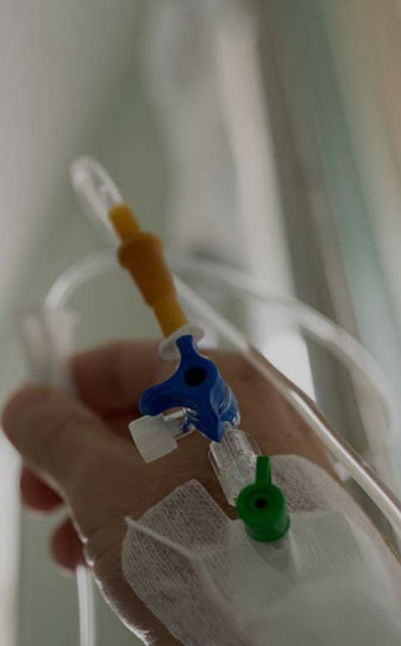
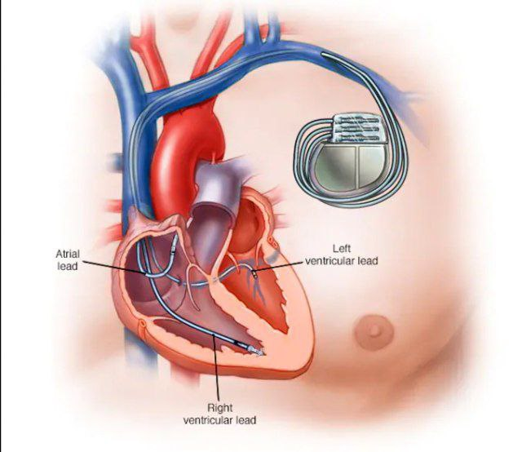
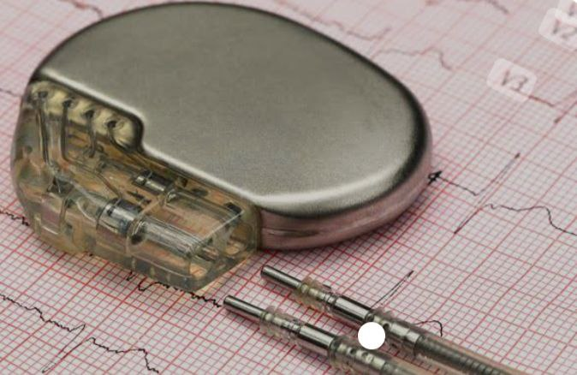
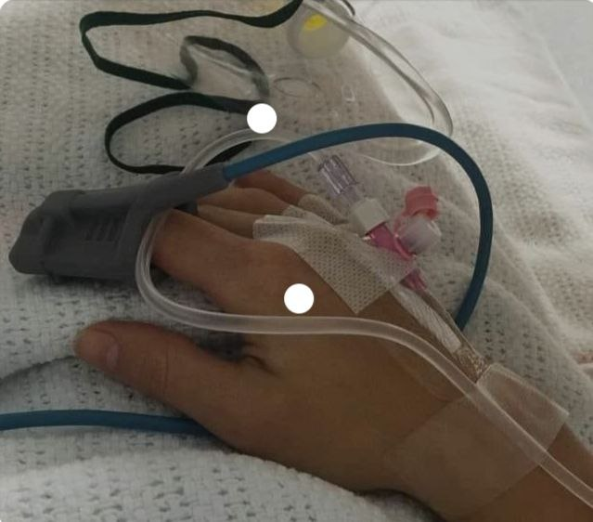
Cardiogenic shock

Slide 115
Septic Shock
Definition:
Septic shock is a serious condition that can occur when an infection in your body causes extremely low blood pressure and organ failure due to sepsis. Septic shock is life threatening and requires immediate medical treatment .it’s the most severe stage of sepsis.

Slide 116
Septic Shock
:Causes
It occurs when certain bacterial produce their own toxins which lead to the release of substances from the body's cells that cause an imflammatory reactions .theses substances are known as cytokins.although cytokins help the immune system fight infection ,they can cause harmful effects may cause blood vessels to widen and blood pressure to drop.

Slide 117
Septic Shock
Risk factors:
Your septic shock risk increases if you have awakened immune system which increases your risk for sepsis. People with weakened immune system
Include:
Procedures invasive :
They can introduce microorganism inside the body that could lead to sepsis.

Slide 118
Septic Shock
Malnourishment can lower the body's defenses, making it susceptible to the invasion of pathogens.
Newborns
Those over age 65
Peoplehood are pregnant
People who use recreational drugs
People with artificial joints , heart valves , transplant or medical devices

Slide 119
Septic Shock
People with chronic medical conditions and have increased risk of sepsis in clued :
AIDS
Diabetes because the body's immune system is already weakened by the existing pathogens.
Leukemia or lymphoma
Immune disorders
People who 've had Recent infections or surgeries

Slide 120
Septic Shock
Vasodilation
Decreased stroke volume
Maldistribution of blood volume
Decreased cardiac output
Decreased venous return
Decreased tissue perfusion

Slide 121
Septic Shock
Nursing Management
The nurse caring for any patient in any setting must keep in mind the risks of sepsis and the high mortality rate associated with septic shock, All invasive procedures must be carried out with aseptic technique after careful hand hygiene. Additionally, intravenous lines, arterial and venous puncture sites, surgical incisions, traumatic wounds, urinary catheters, and pressure ulcer are monitored for signs of infection in all patients. The nurse identifies patients at particular risk for sepsis and septic shock (ie, elderly and immunosuppressed patients or patients with extensive trauma or burns or diabetes), keeping in mind that these high-risk patients may not develop typical or classic signs of infection and sepsis.

Slide 122
Septic Shock
Confusion, for example, may be the first sign of infection and sepsis in elderly patients.
When caring for the patient with septic shock, the nurse collaborates with other members of the health care team to identify the site and source of sepsis and the specific organisms involved.
Elevated body temperature (hyperthermia) is common with sepsis and raises the patient’s metabolic rate and oxygen consumption. Fever is one of the body’s natural mechanisms for fighting infections.

Slide 123
Septic Shock
This, an elevated temperature may not be treated unless it reaches dangerous levels(more than 40 C or unless the patient is uncomfortable. Efforts may be made to reduce the temperature by administering acetaminophen or applying hypothermia blankets. During these therapies, the nurse monitors the patient closely for shivering, which increases oxygen consumption.
The nurse administers prescribed intravenous fluids and medications, including antibiotic agents and vasoactive medication to restore vascular volume. Because of decreases perfusion to the kidneys and liver, serum concentration of antibiotic agents that are normally cleared by these organs may increase and produce toxic effects.

Slide 124
Septic Shock
Therefore, the nurse monitors blood levels (antibiotic agent, creatinine, white blood count) and reports increased levels to the physician.
As with other types of shock, the nurse monitors the patient’s hemodynamic status, fluid intake and output, and nutritional status. Daily weights and close monitoring of serum albumin levels help determine the patient’s protein requirements.

Slide 125
Septic Shock
Signs and symptoms of Septic Shock:
• Fever or hypothermia (low body temperature)
• Fast heart rate
• Shaking or chills
• Warm, clammy or sweaty skin
• Hyperventilation (rapid breathing)
• Shortness of breath
• Confusion or disorientate

Slide 126
Septic Shock
Medical Management:
Current treatment of septic shock involves identifying and eliminating the cause of infection. Specimens of blood, sputum, urine, wound drainage, and invasive catheter tips are collected for culture using aseptic technique.

Slide 127
Septic Shock
Any potential routes of infection must be eliminated. Intravenous lines are removed and reinstructed at other body sites. Antibiotic-coated intravenous central lines may be placed to decrease the risk of invasive line-related bacteremia in high risk patients, such as elderly (Engelmann & Pitter 2001). If possible, urinary catheters are removed. Any abscess are drained and necrotic areas debrided.

Slide 128
Septic Shock
Fluid replacement must be instructed to correct the hypovolemia that results from the incompetent vascular and inflammatory response. Crystalloids, colloids, and blood products may be administered to increase the intravascular volume.

Slide 129
Neurogenic Shock
In neurogenic shock, vasodilation occurs as a result of a loss of sympathetic tone. This can be caused by spinal cord injury, spinal anesthesia, or nervous system damage. It can also result from the depressant action of medications or lack of glucose (eg, insulin re action or shock).

Slide 130
Neurogenic Shock
Neurogerousogenic shock may have a prolonged course (spinal cord Injury) or a short one (syncope or fainting). It is characterized by Dry, warm skin rather than the cool, moist skin seen in hypoVolemic shock. Another characteristic is bradycardia, rather than The tachycardia that characterizes other forms of shock

Slide 131
Neurogenic Shock
Medical management :
1-Brestoring The sympathetic Tone either Through: •Stablization of Spinal cord injury • in The instance of spinal aneThesia by Positioning The Patient Properly
2- Treatment The cause •if The cause hypoglycemia (insulin shocks) is The Cause glucose rapidly administrated. • if spinal cord injury is The case Surgery or others interventions may be necessary to repair The damage.
3- order several deffirent medication Including: Phenylephrine, Norepine Phrine,Depinephrin,Atrophine, Dolycopyrrolate, Theophylline and Aminophylline

Slide 132
Neurogenic Shock
Nursing management
- Nursing assessment:
1-ABC assess ment
2- Neurologic assessment
-Nursing intervension:
1)elevate and maintain The head of the bed aTleast 30 degree
2) immobilizing The Patient To prevent further damage To spinal cord.
3) su PPorT Cardiovascular and neurologic function

Slide 133
Neurogenic Shock
4) Applying elastic compression Stock-ings and elevation The foot of The bed.
5)check Patient daily for any redness Tenderness, warmth of The calves and positive Homan's sign.
6)Administration oredered medication
7)applying elastic compression Trocking Or Initiating Pneumatic compression of the legs

Slide 134
Neurogenic Shock
8) Performing Passive range of motion of the immobile extremities helps promote Circulation
9) Monitoring closely for signs of internal bleeding that could lead To hypovolemic shock especially for The Patient who expeperienced aspinal cord injury.
10) provide skin care
11) Monitoring urine output
12) managing The Patient's airway.

Slide 135
Neurogenic Shock
Evaluation.
1) evaluate vital signs and level. Of consciousness to ensure adequate. Perfusion and oxygenation.
2)Assess for improvement in sensory and motor deficits 3)evalute patient and family Satisfaction with care provided.

Slide 136
ANAPHYLACTIC SHOCK
Anaphylactic shock is caused by a severe allergic reaction when a patient who has already produced antibodies to a foreign substance (antigen) develops a systemic antigen–antibody reaction. This process requires that the patient has previously been exposed to the substance. An antigen–antibody reaction provokes mast cells to release potent vasoactive substances, such as histamine or bradykinin, that cause widespread vasodilation and capillary permeability. Anaphylactic shock occurs rapidly and is life-threatening. Because anaphylactic shock occurs in patients already exposed to an antigen who have developed antibodies to it, it can often be prevented. Therefore, patients with known allergies need to understand the consequences of subsequent exposure to the antigen and should wear medical identification that lists their sensitivities. This could prevent inadvertent administration of a medication that would lead to anaphylactic shock. Additionally, the patient and family need instruction about emergency use of medications to treat anaphylaxis.

Slide 137
ANAPHYLACTIC SHOCK
Medical Management :
Treatment of anaphylactic shock require:
1- emoving the causative antigen (eg, discontinuing an antibiotic agent).
2- administering medications that restore vascular tone.
3- providing emergency support of basic life functions.

Slide 138
ANAPHYLACTIC SHOCK
●Epinephrine is given for its vasoconstrictive action. Diphenhydramine (Benadryl) is administered to reverse the effects of histamine, thereby reducing capillary permeability. These medications are given intravenously. Nebulized medications, such as albuterol (Proventil), may be given to reverse histamine-induced bronchospasm.
●If cardiac arrest and respiratory arrest are imminent or have occurred, cardiopulmonary resuscitation is performed. Endotracheal intubation or tracheotomy may be necessary to establish an airway. Intravenous lines are inserted to provide access for administering fluids and medications.

Slide 139
ANAPHYLACTIC SHOCK
Nursing Management
• The nurse has an important role in preventing anaphylactic shock:
1. Assessing all patients for allergies or previous reactions to antigens (eg, medications, blood products, foods, contrast agents, latex)
2. Communicating the existence of these allergies or reac-tions to others. Additionally

Slide 140
ANAPHYLACTIC SHOCK
3. The nurse assesses the patient’s un-derstanding of previous reactions and steps taken by the patientand family to prevent further exposure to antigen
4. When new allergies are identified, the nurse advises the patient to wear or carry identification that names the specific allergen or antigen.
5. When administering any new medication, the nurse observes
6. The patient for an allergic reaction. This is especially important With intravenous medication

Slide 141
ANAPHYLACTIC SHOCK
•Allergy to penicillin is one of the most common causes of anaphylactic shock. Patients who have apenicillin allergy may also develop an allergy to similar medica-tions. For example, they may react to cefazolin sodium (Ancef ) because it has a similar antimicrobial action of attaching to the penicillin-binding proteins found on the walls of infectious or-ganisms. Previous adverse drug reactions increase the risk that an elar medicationsderly patient will develop an undesirable reaction to a new medication. If the elderly patient reports an allergy to a medication, the nurse must be aware of the risks involved in the administra-toin of simil.

Slide 142
ANAPHYLACTIC SHOCK
In the hospital and outpatient diagnostic testing sites, the Nurse must identify patients ofmation must be conveyed to the staff at the diagnostic testing site, including x-ray personnel.
• The nurse must be knowledgeable about the clinical signs of Anaphylaxis, must take immediate action if signs and symptoms occur, and must be prepared to begin cardiopulmonary resusci-
• Tation if cardiorespiratory arrest occurs. In addition to monitorIng the patient’s response to treatment, the nurse assists with intubation if needed, monitors the hemodynamic status, ensures Intravenous access for administration of medications, administers Prescribed medications and fluids, and documents treatments And their effects.

Slide 143
ANAPHYLACTIC SHOCK
•Community health and home care nurses whose role includes Administering medications, including antibiotic agents, in the Patient’s home or other settings must be prepared to administer Epinephrine subcutaneously or intramuscularly in the event of a Anaphylactic After recovery from anaphylaxis, the patient and family require an explanation of the event. Further, the nurse provides instruc-toin about avoiding future exposure to antigens and administering emergency medications to treat anaphylaxis.

Slide 144
Multiple Organ Dysfunction Syndrome
Definition
Multiple organ dysfunction syndrome (MODS) is altered organ function in an acutely ill patient that requires medical intervention to support continued organ function. The disorder can be further categorized as primary or secondary MODS.

Slide 145
Multiple Organ Dysfunction Syndrome
Pathophysiology
Primary MODS is the result of direct tissue insult, which then leads to impaired perfusion or ischemia. Secondary MODS is most often a complication of septic shock or SIRS. However, MODS may be a complication of any form of shock because of inadequate tissue perfusion. As previously described, in shock all organ systems suffer damage from a lack of adequate perfusion that can result in organ failure. A syndrome of sequential organ failure has been further observed. The exact mechanism that triggers this syndrome is unknown.

Slide 146
Multiple Organ Dysfunction Syndrome
Although various causes of MODS have been identified, including dead or injured tissue, infection, and perfusion deficits, it is not yet possible to predict which patients will develop MODS. This is partly because much of the organ damage occurs at the cellular level and therefore cannot be directly observed or measured. The organ failure usually begins in the lungs and is followed by failure of the liver, gastrointestinal system, and kidneys (Balk, 2000b). Advanced age, malnutrition, and coexisting diseases ap- pear to increase the risk of MODS in an acutely ill patient.

Slide 147
Multiple Organ Dysfunction Syndrome
Clinical manifestation
The clinical course of MODS follows one of two patterns. In both patterns, there is an initial event that results in low blood pressure. The cause of the drop in blood pressure is treated, and the patient appears to respond. In the first pattern of MODS (primary MODS), which occurs most often when the initiating event is a pulmonary one such as lung injury, the patient experiences respiratory compromise that necessitates intubation. This usually occurs within 72 hours of the initiating event. Respiratory failure leads rapidly to MODS, resulting in a mortality rate of 30% to 75% (Fein & Calalag-Colucci, 2000).

Slide 148
Multiple Organ Dysfunction Syndrome
In secondary MODS, the pattern is more insidious. It occurs most often in the patient with septic shock and progressively unfolds over about 1 month. The patient also experiences respiratory failure and requires intubation. The patient remains hemodynamically stable for about 7 to 14 days. Despite this ap- parent stability, the patient exhibits a hypermetabolic state characterized by hyperglycemia (elevated blood glucose level), hyperlacticacidemia (excess of lactic acid in the blood), and polyuria (excessive urinary output). The metabolic rate is 1.5 to 2 times basal metabolic rate. Infection is usually present, and skin breakdown begins to occur.

Slide 149
Multiple Organ Dysfunction Syndrome
During this stage, there is a severe loss of skeletal muscle mass (autocatabolism). If the hyper- metabolic phase can be reversed, patients may survive with some damage to affected organ systems (Mizock, 2000). If the hypermetabolic process cannot be halted and cells do not receive adequate oxygen and nutrients, irreversible organ failure and death occur.

Slide 150
Multiple Organ Dysfunction Syndrome
If the hypermetabolic phase cannot be reversed, MODS progresses and is characterized by jaundice, hyperbilirubinemia (liver failure), and oliguria progressing to anuria (renal failure), often requiring dialysis. The patient becomes less hemodynamically stable and begins to require vasoactive medications and fluid sup- port. Because of a lack of consistent definitions to describe organ failure, the exact incidence of MODS is hard to define (Balk, 2000b; Vincent & Ferreira, 2000). However, it is reasonable to say that the onset of organ dysfunction is an ominous prognostic sign; the more organs that fail, the worse the outcome.

Slide 151
Multiple Organ Dysfunction Syndrome
Medical Management
Prevention remains the top priority in managing MODS. Elderly patients are at increased risk of MODS because of the lack of physiologic reserve associated with aging and the natural degenerative process, especially immune compromise (Balk, 2000b). Early detection and documentation of initial signs of infection are essential in managing elderly patients with MODS. Subtle changes in mentation and a gradual rise in temperature are early warning signs. Other patients at risk of MODS are those with chronic illness, malnutrition, immunosuppression, and surgical traumatic wounds.

Slide 152
Multiple Organ Dysfunction Syndrome
If preventive measures fail, treatment measures to reverse MODS are aimed at:
(1) controlling the initiating event,
(2) promoting adequate organ perfusion,
(3) providing nutritional support.

Slide 153
Multiple Organ Dysfunction Syndrome
Nursing Management
The general plan of nursing care for the patient with MODS is the same as that for the patient in septic shock. Primary nursing interventions are aimed at supporting the patient and monitoring organ perfusion until primary organ insults are halted. Providing information and support to family members is a critical role of the nurse in caring for patients with MODS. Addressing end-of-life decisions is an important role of the health care team to ensure that supportive therapies are congruent with the patient's wishes.

