Slide 1
PROJECT NAME
MEDICAL CENTER

Slide 2
TEAM MEMBERS
1- AHMED MOHAMED ALI MOHAMED
2-MOHAMED HAMADA MOHAMED
3-ABANOUB NABIL THABET
4-AASEM AHMED AHMED BARAKAT

Slide 3
THE PROJECT IDEA
A SYTEM OF MEDICAL CENTER FOR EXAMINE PATIENT `S DISEASES.
AND TREAT THOSE DISEASES.
FOLLOW-UP OF THE PATIENT`S CONDITION.

Slide 4
PROJECT DATA COLLECTION METHOD :
SOURCES:
https://www.codezone-eg.com/en/product/myelin?gclid=Cj0KCQiA_c-OBhDFARIsAIFg3ey_SyeXtYMafV1dYxaVybr9vJf766PZebQ49cfUecYvagSszZZ6bqkaApPFEALw_wcB
MYELIN is a hospital management information system designed to manage the work of medical.
WIKIPEDIA:
UCLA MEDICAL CENTER : is a hospital located on the campus of the university CALIGORNIA , LOS ANGELES
BY attending the sessions, the idea was developed and implemented under the supervision of DR/ NAHED .

Slide 5
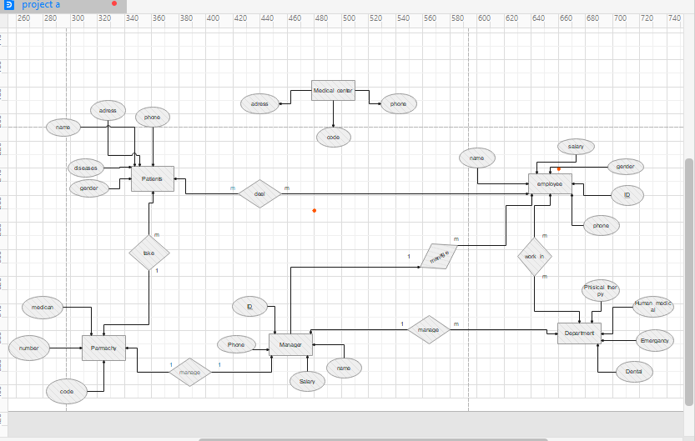

Slide 6
