Slide 1
Emotion recognition using facial expressions
SUPERVISED BY
Dr. Yasser Omar

Slide 2
PRESENTED BY
1-Ahmed Ali Ahmed Abd Al Mowla 16108676
2-Mohamed Omar Mohamed 16108727
3-Ziad hamdy El-nouby adam 16108596
4- Mohmed Ebrahim Abdallah Morsy 17208519
5-Youssef khaled 16108655

Slide 3
Table Of Contents
1-introduction 10-Future work
2-background 11-References
3-Motivation
4-Problem Statement
5-objective
6-related work
7- Proposed Model
8-Results
9-Conclusion

Slide 4
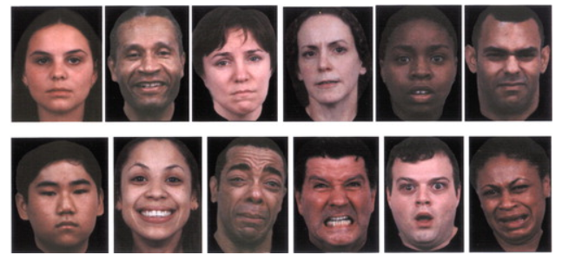
1-introduction
Facial emotion recognition is the process of detecting human emotions from facial expressions. The human brain recognizes emotions automatically, and software has now been developed that can recognize emotions as well. This technology is becoming more accurate all the time, and will eventually be able to read emotions as well as our brains do.
Figure 1..1 Examples of Emotional Facial Expressions
Source : ReasearchGate site

Slide 5
2-background
Emotion recognition in this work has four stages: Face detection, Feature extraction, feature selection and classification.
Base features and statistics were computed in feature extraction.
Feature components were analysed in feature selection.
Classification was made by using various classifiers based on model

Slide 6
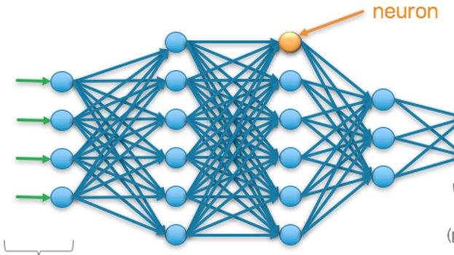
2-background
Neural networks (NN):
is based on a collection of connected units or nodes.
It mimics the human brain neurons .

Slide 7
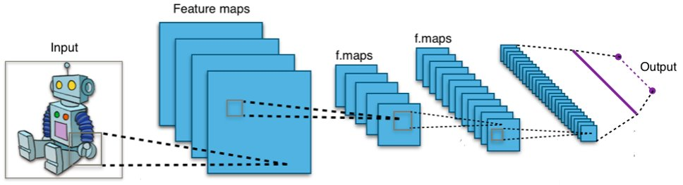
2-background
CNN(convolutional neural network):
is a class of deep neural networks, most commonly applied to analysing visual imagery.
They have applications in image and video recognition, image classification and self driving cars.

Slide 8
2-background
Convolutional neural network architecture :
A convolutional neural network consists of an input and an output layer, as well as multiple hidden layers. The hidden layers of a CNN typically consist of
Convolution
Non Linearity (ReLU)
Pooling or Sub Sampling
Classification (Fully Connected Layer)

Slide 9
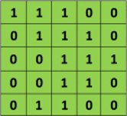
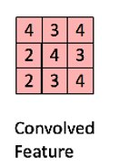

2-background
Convolution:
ConvNets derive their name from the “convolution” operator. The primary purpose of Convolution in case of a ConvNet is to extract features from the input image
*
=

Slide 10
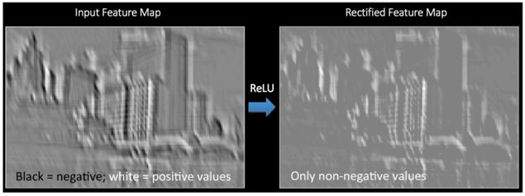
2-background
Non Linearity (ReLU):
An additional operation called ReLU has been used after every Convolution operation .
ReLU is an element wise operation (applied per pixel) and replaces all negative pixel values in the feature map by zero. The purpose of ReLU is to introduce non-linearity in our ConvNet

Slide 11
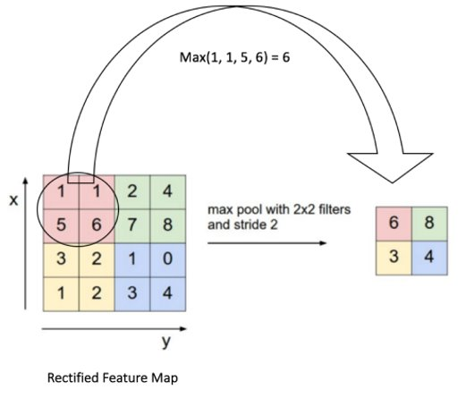
2-background
Pooling or Sub Sampling:
Spatial Pooling reduces the dimensionality of each feature map
but retains the most important information.
Spatial Pooling can be of different types: Max, Average, Sum.

Slide 12
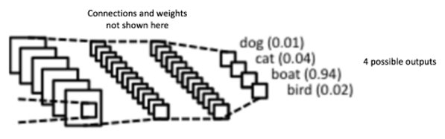
2-background
Classification (Fully Connected Layer):
The purpose of the Fully Connected layer is to use these features for classifying the input image into various classes based on the training dataset.
it is uses a softmax activation function in the output layer

Slide 13
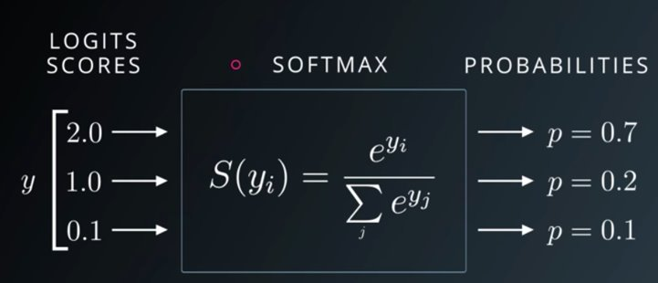
2-background
the softmax function is a more generalized logistic activation function which is used for multiclassification predict.

Slide 14
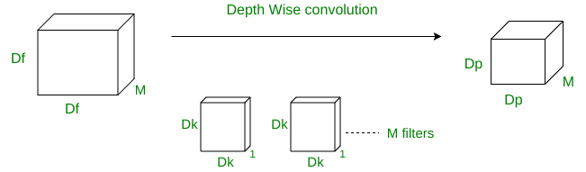
2-background
Depth-wise separable convolutions neural networks:
In depth-wise operation, convolution is applied to a single channel at a time unlike standard CNN’s in which it is done for all the M channels. So here the filters/kernels will be of size Dk x Dk x 1. Given there are M channels in the input data, then M such filters are required. Output will be of size Dp x Dp x M.

Slide 15
2-background
Residual modules:
In order to solve the problem of the vanishing/exploding gradient, this architecture introduced the concept
called Residual Network. In this network we use a technique called skip connections . The skip connection
skips training from a few layers and connects directly to the output.

Slide 16
2-background
The advantage of adding this type of skip connection is because if any layer hurt the performance of architecture then it will be skipped by regularization. So, this results in training very deep neural network without the problems caused by vanishing/exploding gradient.

Slide 17
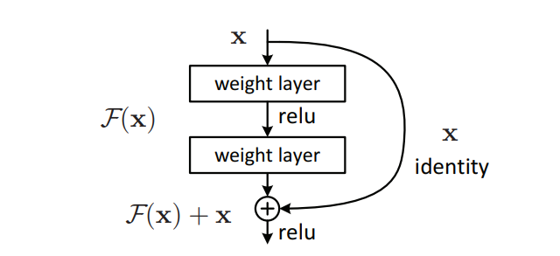
2-background
The approach behind this network is instead of layers learn the underlying mapping, we allow network fit the residual mapping.

Slide 18
3-Motivation
Emotion recognition can be used in many applications to solve a lot of problems in many fields like :
Automotive industry : Emotion recognition can be used for detecting sleeping drivers and then take actions to alarm the driver or stop the car to save passengers life.
Learning applications : Emotion recognition may be used to monitor concentration of learners and to analyse their satisfaction of the content and instructor.
Digital advertising and market research : Emotion recognition can be used to measure target users subjective satisfaction of the displayed advertisement in a real-time manner

Slide 19
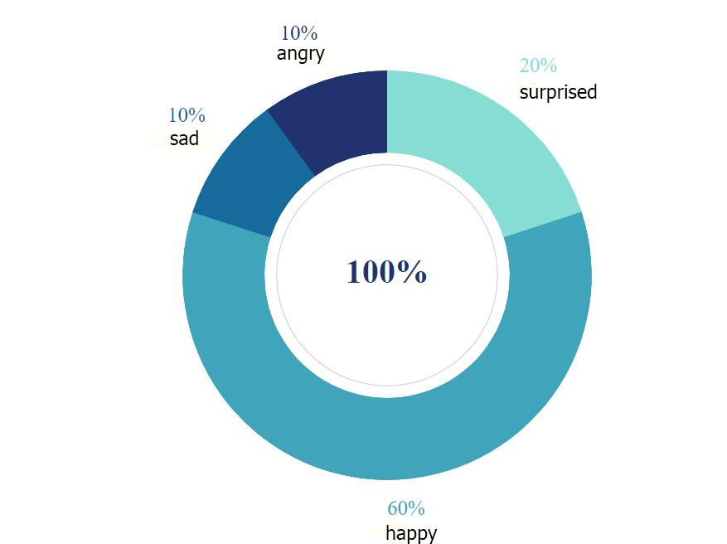
3-Motivation
figure 1.1 the company APL make a survey about Advertisement using emotion recognition
Source :the company APL

Slide 20
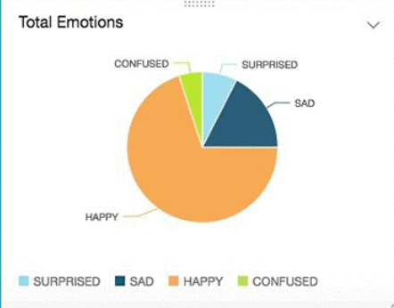
3-Motivation
Figure 1.3 Shopper Sentiment: Analysing in-store customer experience
Source :blog In aws by Bastien LeBlanc and Imran Dawood

Slide 21
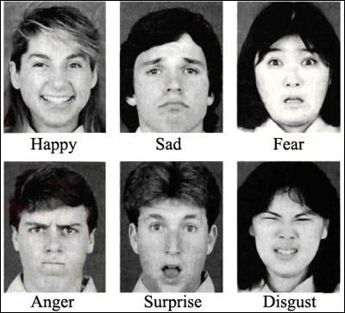
4-Problem Statement
Most of CNN architectures have tons of parameters in their last fully connected layers and this leads to heavy computations that affects performance speed .
Figure 1.4 emotion that model can extract it

Slide 22
5-objective
We aim to build a real-time system that combines speed performance and high accuracy emotion recognition which can implemented and integrated in multiple business applications with low computing power.

Slide 23
6-related works
Many current research in automatic facial expression analysis
based on the following four approaches :
1-Categorical model
2-FACS (Facial Action Coding System ) model
3-Dimensional mode
4-FEC-16d

Slide 24
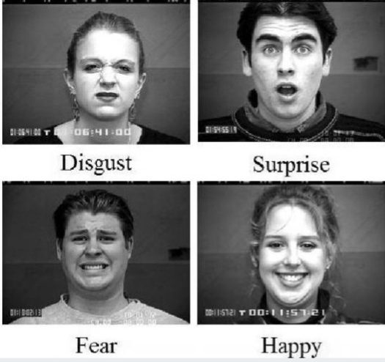
6-related works
1- Categorical model: appoint discrete emotions class labels.

Slide 25
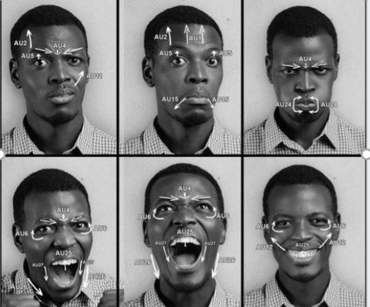
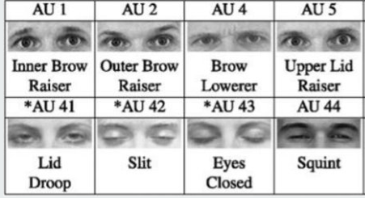
6-related works
2-FACS model: refers to a collection of facial muscle movements
which corresponds to the emotion displayed.
Surprise: inner brow raise, outer brow raise, upper lid raise, jaw drop

Slide 26
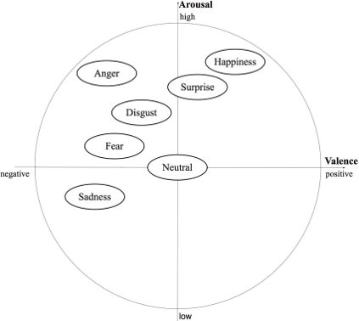
6-related works
3- Dimensional model : describing emotions using dimensional models
like valence-arousal .In valence-arousal dimensional model
emotions can be described by two factors:
Valence: positive or negative affectivity
Arousal: how calming or exciting

Slide 27
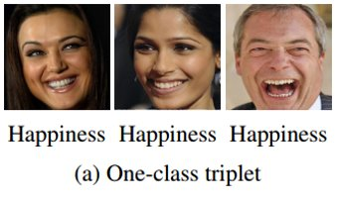
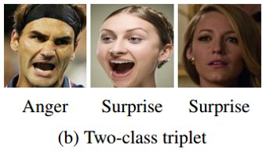
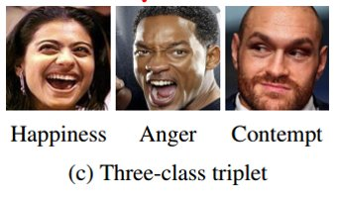
6-related works
Expression Embedding(FEC-16d):
it is a fully-supervised network for learning 16-dimensional
embedding based on FEC dataset that solved this problem by
including expression comparison annotations

Slide 28
6-related works
Approach | research
Categorical model | Real-time Convolutional Neural Networks for Emotion and Gender Classification.Octavio Arriaga, Matias Valdenegro-Toro, Paul Plöger,Oct 2017
FACS model | P. Ekman, W. V. Friesen, and J. C. Hager. Facial Action Coding System - Manual. A Human Face, 2002
Dimensional model | J. A. Russell. A circumplex model of affect. Journal of Personality and Social Psychology, 39(6):1161–1178, 1980.
FEC-16d model | A Compact Embedding for Facial Expression Similarity,Raviteja Vemulapalli, Aseem Agarwala,Nov 2018

Slide 29
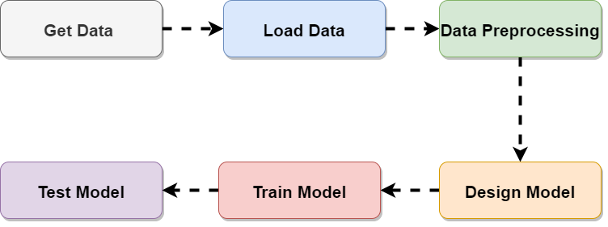
Machine learning life cycle

Slide 30
Dataset -FER2013
Kaggle facial expression recognition challenge
data set contains 35,887 rows
The data consists of 48x48 pixel grayscale images of faces
Seven emotion categories :
Angry, Disgust, Fear, Happy, Sad, Surprise and Neutral
The data set was divided into 80% training and 20% testing

Slide 31
Dataset description
train.csv contains two columns, "emotion" and "pixels“
The "emotion" column contains a numeric code ranging from 0 to 6
(0=Angry, 1=Disgust, 2=Fear, 3=Happy, 4=Sad, 5=Surprise, 6=Neutral)
The "pixels" column contains a space-separated values string which represents the color intensity in each pixel

Slide 32
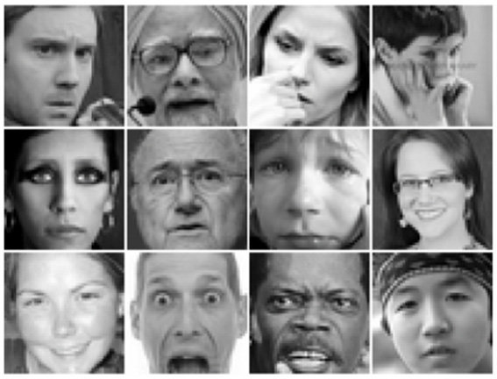
Sample of FER-2013

Slide 33
Data Loading & preprocessing
Read CSV file
Reshape “pixels” string to be a 48 X 48 matrix
Resize the image
Normalize pixels’ values to be in the range of [-1,1] , inclusively.

Slide 34
Proposed Model Architecture :
- The architecture is a CNN model combines the deletion of the fully connected
layer and the inclusion of the combined:
1- depth-wise separable convolutions
2-residual modules.
- Architecture used Global Average Pooling to completely remove
any fully connected layers.
- Model used Categorical cross – entropy loss function
- Model was trained with the ADAM optimizer

Slide 35
Proposed Model Architecture :
Reason for deletion of fully-connected layers:
We aim to use this model in a real time system so we want to reduce computations as much as possible and this conflicts with the tons of parameters in the fully connected layers
For example VGG16 contains approximately 90% of all its parameters in their last fully connected layers
This architecture has approximately 60,000 parameters; which corresponds to a reduction of
80× when compared to the original CNN

Slide 36
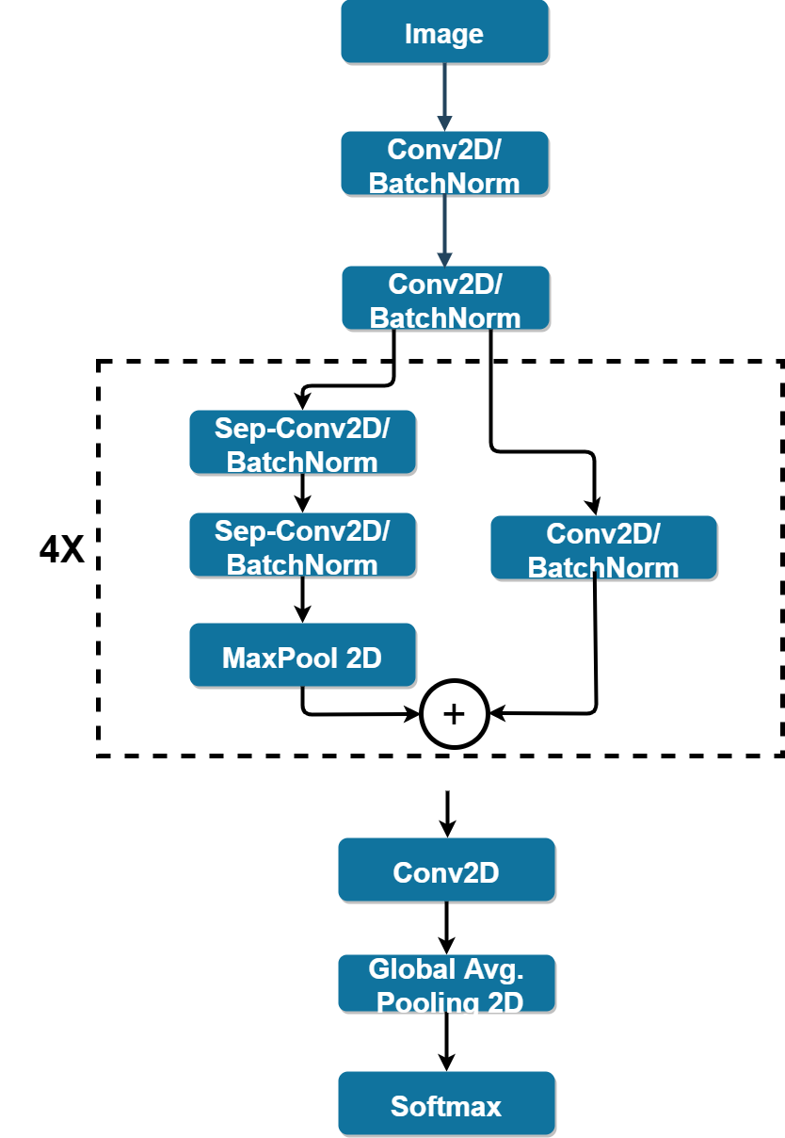
Proposed Model Architecture :
fully-convolutional neural network that contains 4 residual depth-wise separable convolutions
each convolution is followed by a batch normalization operation and a ReLU activation function
The last layer applies a global average pooling and a soft-max activation function to produce a prediction

Slide 37
Proposed Model Architecture:
depth-wise separable convolutions neural networks:
These type of CNN’s are widely used because of the following two reasons :
- They have lesser number of parameters to adjust as compared to the standard CNN’s, which reduces overfitting
- They are computationally cheaper because of fewer computations which makes them
suitable for mobile vision applications

Slide 38
Proposed Model Architecture
Residual modules:
Residual modules allow to train much deeper neural networks
Residual modules use Skip connection technique to solve the problem of exploding gradient

Slide 39
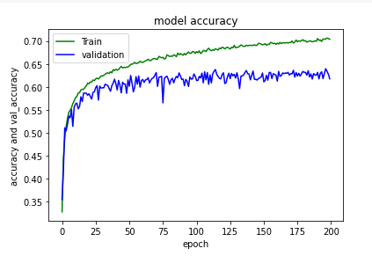
Model Evaluation
- Accuracy =70%
As you can see in this plot there is a direct proportion between accuracy and the number of epochs

Slide 40
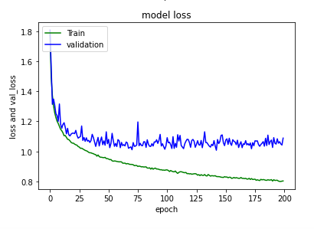
Model Evaluation
Loss function
As you can see in this plot there is a reversed proportion between loss function and the number of epochs

Slide 41
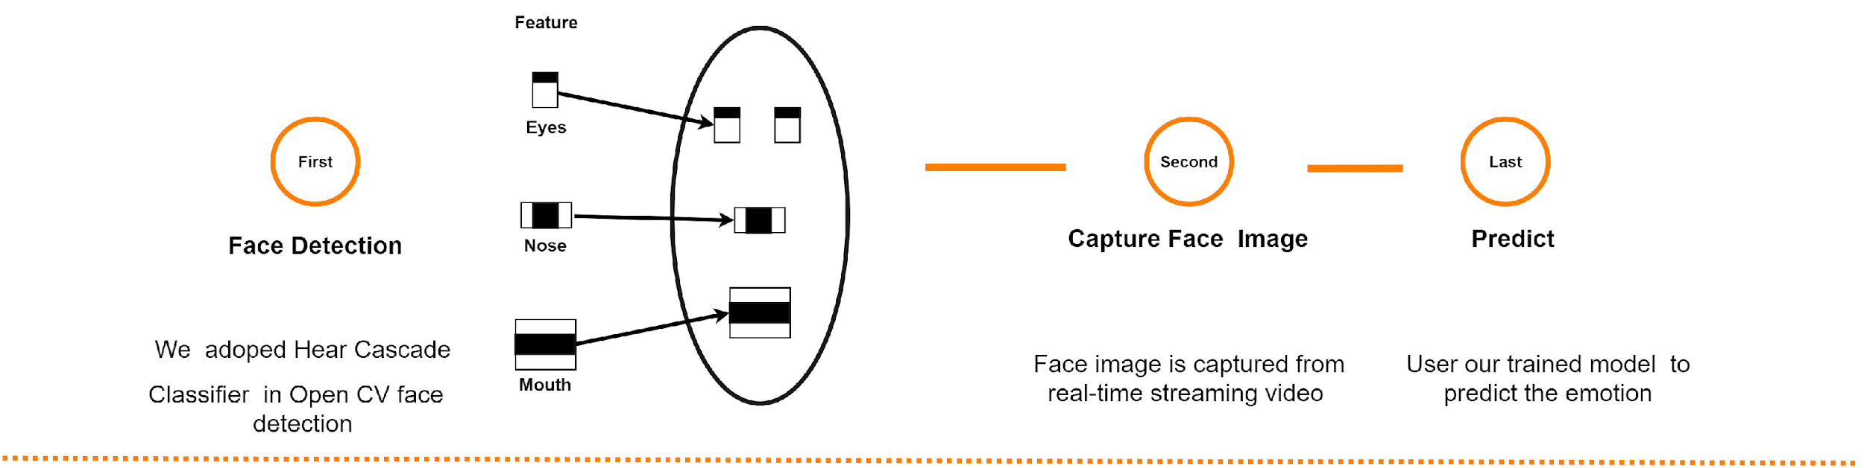
Apply our model to streaming video:

Slide 42
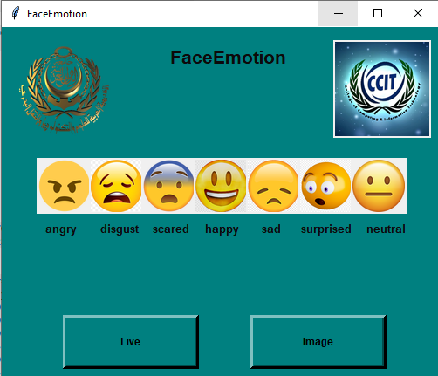
GUI:
-image: load image already
Saved in your pc.
-live: open camera live

Slide 43
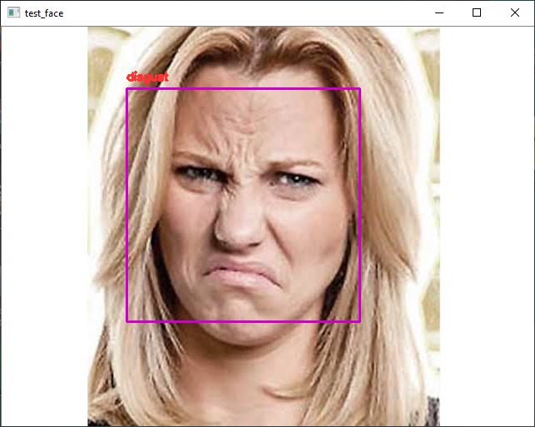
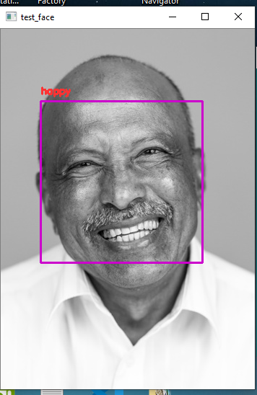
GUI:

Slide 44
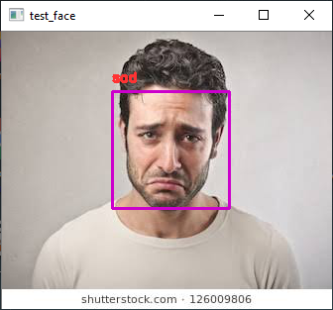
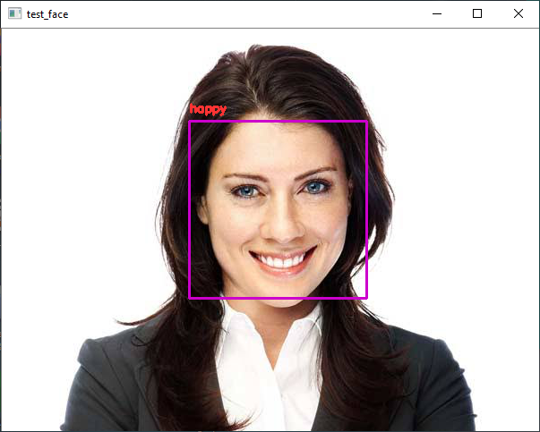
GUI:

Slide 45
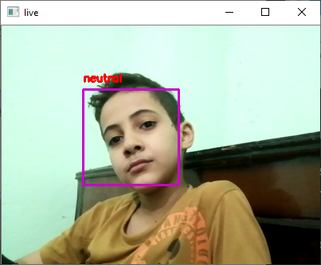
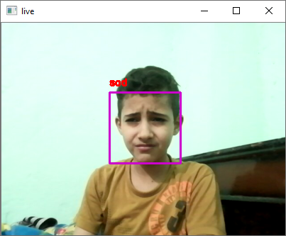
GUI:

Slide 46
9-Conclusion
We have proposed and tested a general building designs for creating real-time CNNs. Our proposed architectures have been systematically built in order to reduce the number of parameters. We began by eliminating completely the fully connected layers and by reducing the number of parameters in the remaining convolutional layers via depth-wise separable convolutions. We have shown that our proposed models can be stacked for multi-class classifications while maintaining real-time inferences. Specifically, we have developed a vision system that performs face detection, and emotion classification in a single integrated module. We have achieved human-level performance in our classification's tasks using a single CNN that leverages modern architecture constructs .and In the carried-out experiments, for 7 emotional states, we achieved a very good classification

Slide 47
10-Future work
As future work, we plan to improve your results analysing through train the CNNs on more than one data set to avoid classification interference and Increases the Accuracy. Furthermore, we present a glass type wearable device to detect emotions from a human face response from the user face naturally and continuously while the user is wearing it. take responses from face through sensors the device can capture the image region representing facial expressions

Slide 48
11-References
-Real-time Convolutional Neural Networks for Emotion and Gender Classification
https://arxiv.org/pdf/1710.07557.pdf
-residual modules:
https://www.geeksforgeeks.org/residual-networks-resnet-deep-learning/
- Batch normalization:
https://machinelearningmastery.com/batch-normalization-for-training-of-deep-neural-networks/
--cnn
https://ujjwalkarn.me/2016/08/11/intuitive-explanation-convnets/

Slide 49
11-References
-ReLU and Softmax Activation Functions:
https://github.com/Kulbear/deep-learning-nano-foundation/wiki/ReLU-and-Softmax-Activation-Functions
-Adam optimizer:
https://machinelearningmastery.com/adam-optimization-algorithm-for-deep-learning/
-pooling types:
https://www.machinecurve.com/index.php/2020/01/30/what-are-max-pooling-average-pooling-global-max-pooling-and-global-average-pooling/#global-average-pooling_1
-Under standing neural network
https://towardsdatascience.com/understanding-neural-networks-19020b758230

