Slide 1
QuickSort & HoarePartition
By Ahmed ABDULRAZZAQ

Slide 2
How does it work?
Works by initializing two indexes that start at two ends, the two indexes move toward each other until an inversion is found.

Slide 3
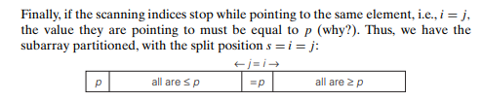

Slide 4
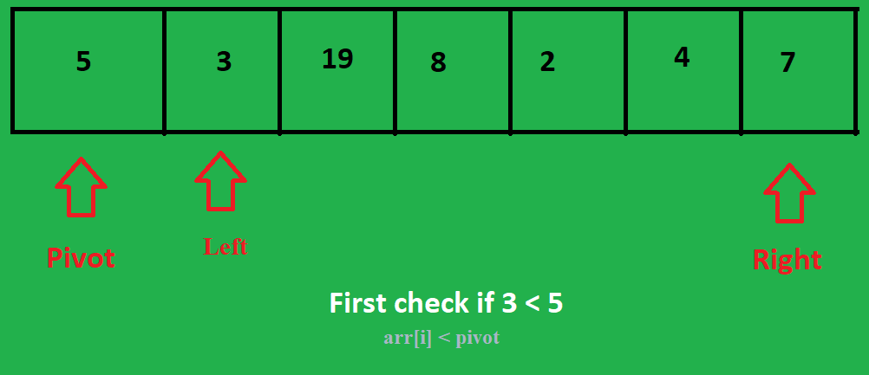

Slide 5
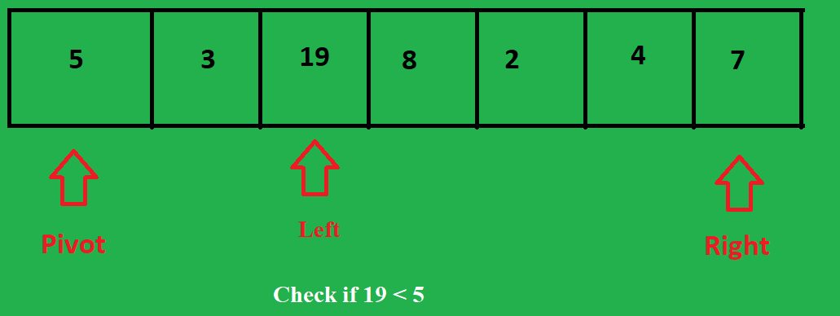

Slide 6
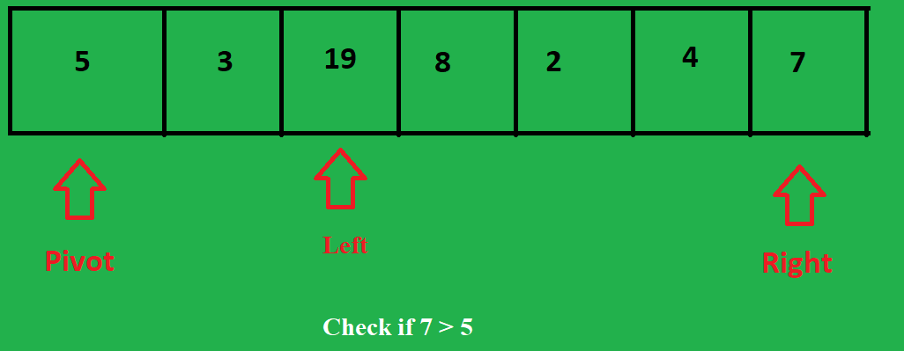

Slide 7
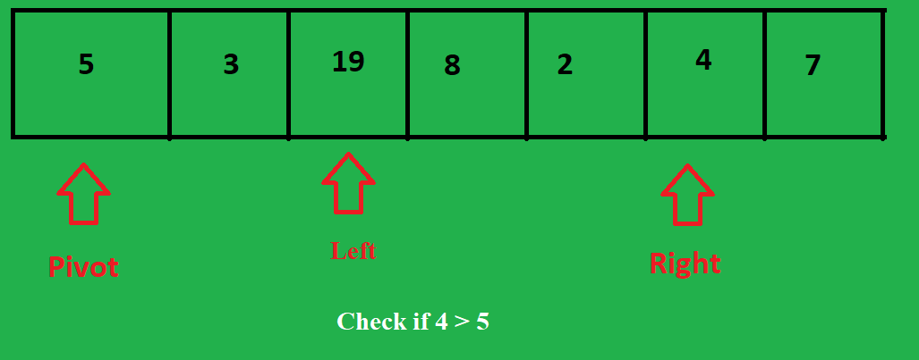

Slide 8
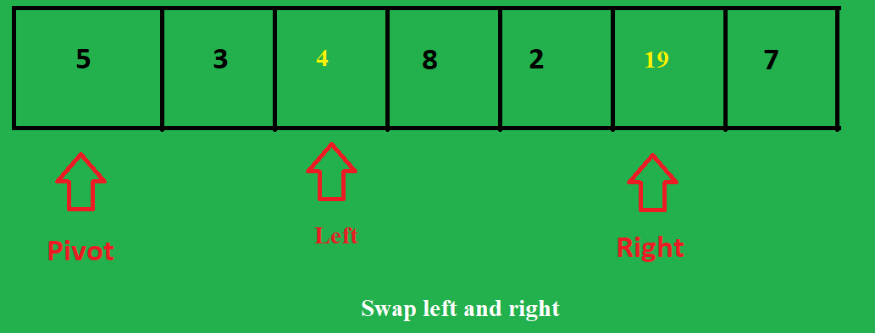

Slide 9
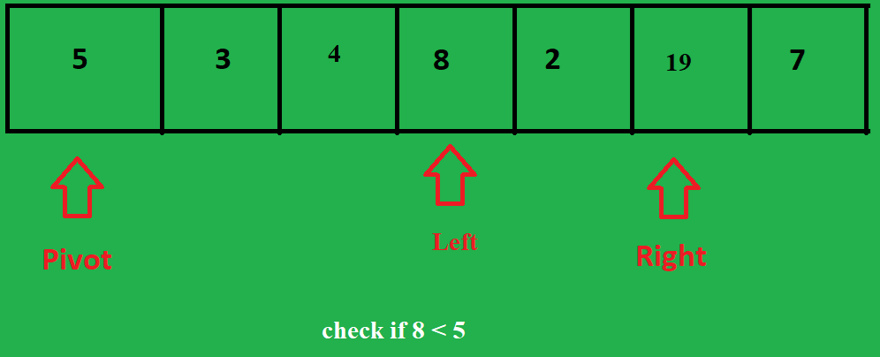

Slide 10
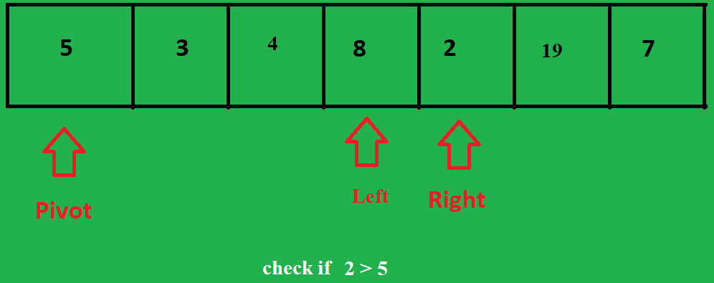

Slide 11
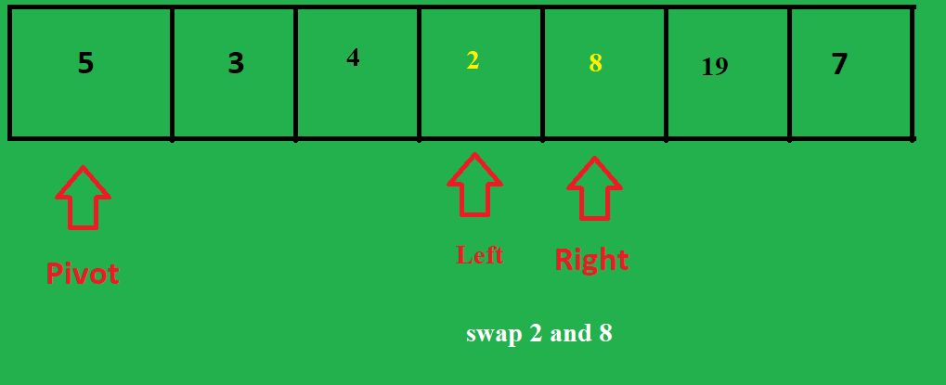

Slide 12
The HoarePartition will return the index of the pivot

