Slide 1
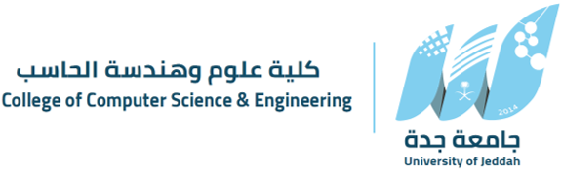
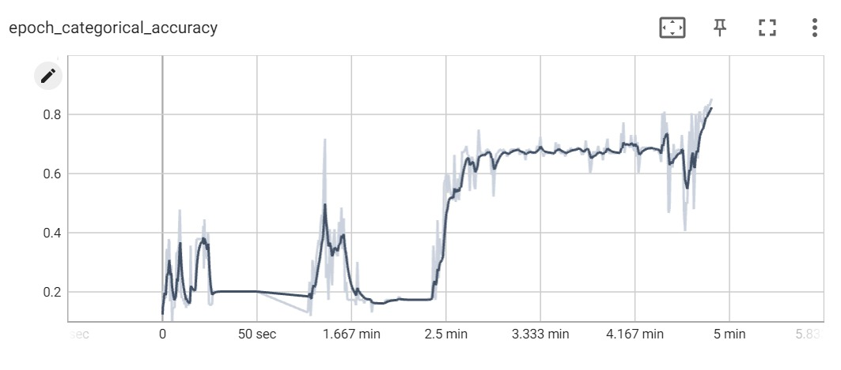

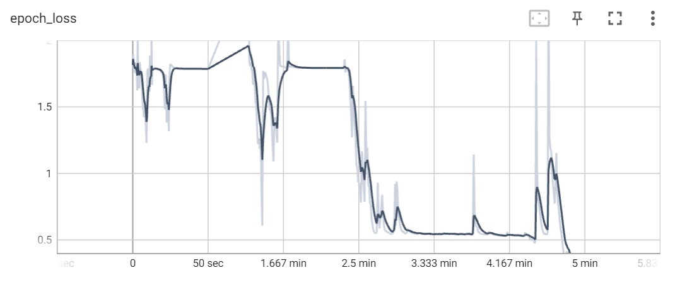
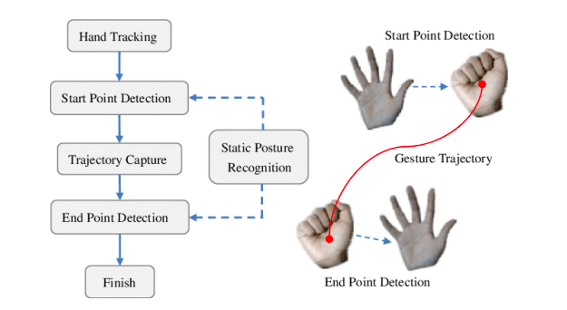
Connect (Real-time Arabic Sign-Language Interpreter)
Waddah Hassan, Sultan Alharbi and Ahmed Alamri .
Supervised by: Dr. Usman Saeed.
Department of Computer Science and Artificial Intelligence at University of Jeddah
Introduction
Results
Deaf and hearing-impaired people utilize sign language as their primary language in daily life, and they have talented and productive people, but most of normal people cannot see this category of society since the mainstream media doesn’t make interviews with deaf people due to the insufficiency of sign-language interpreters available to help deaf individuals to communicate with others. But these interpreters are neither practical nor available in all situations.
In this project we will be using deep learning and computer vision to create an Arabic sign language interpreter in order to break the communication barrier between deaf people and others, in this project we will use TensorFlow, TensorBoard,Keras libraries and we will implement it using Python programming language, finally Draw.io .
Our results was as we can notice from the figures bellow, the categorical accuracy was 0.92 and epochs loss was 0.27
Objectives
Conclusion
To disseminate the project's findings and resources to a wider audience, such as through conferences, publications, and social media, in order to raise awareness about the challenges faced by deaf and hearing-impaired individuals who use sign language, and to promote the importance of supporting their communication needs.
To work with deaf and hearing-impaired individuals, as well as experts in the field of sign language interpretation, to test and refine the project's solutions and ensure they are effective and user-friendly. 3.To conduct research and evaluation to measure the impact of the project on the target audience, and to identify opportunities for improvement and further development.
In conclusion, the development of a standardized structure for Arabic Sign Language (ArSL) and the creation of a bilingual education program are critical steps towards addressing the challenges faced by deaf and hearing-impaired individuals who use sign language in Arabic-speaking countries. By leveraging technology and working with experts in the field, we can create digital platforms and resources that make learning and using ArSL more accessible and user-friendly. By partnering with local organizations and institutions, we can ensure that our efforts are aligned with the needs and priorities of the communities we aim to serve. Through research and evaluation, we can measure the impact of our work and identify opportunities for further development and improvement. By promoting the use and recognition of ArSL, we can help ensure that all individuals, regardless of their hearing ability, have the opportunity to communicate and thrive.
Methodology
Utilize computer vision to create and extract data points related to Arabic Sign Language (ArSL).
Process and analyze videos of sign language to identify key features and patterns.
Use an LSTM model to train the data, allowing for a more accurate and robust system for recognizing and translating ArSL.
Use an LSTM model to train the data, allowing for a more accurate and robust system for recognizing and translating ArSL.
Store and save the data for further improvement and development.
Promote the use and recognition of ArSL in Arabic-speaking communities by developing a more comprehensive understanding of the language.
References
S. C. W. Ong and S. Ranganath, —Automatic sign language analysis: A survey and the future beyond lexical meaning, IEEE Trans. Pattern Anal. Mach. Intell., vol. 27, no. 6, pp. 873– 891, Jun. 2005.
N.B. Ibrahim et al. / Journal of King Saud University – Computer and Information Sciences 30 (2018) 470–477
L. Ding and A. M. Martinez, —Modelling and recognition of the linguistic components in American sign language, Image Vis. Comput., vol. 27, no. 12, pp. 1826– 1844, Nov. 2009.
https://pypi.org/project/arabic-reshaper/
https://docs.opencv.org/4.x/
https://www.youtube.com/@AmlSaqer/videos
https://www.youtube.com/@tawasol9282
Acknowledgements
We would like to express our special thanks and gratitude to Dr. Mohammad Alqahtani , Dr. Hattan Omrani, Dr. Sakhr Ghanem and Dr. Usman Saeed for their guidance and advice during this challenging journey.

