Slide 1

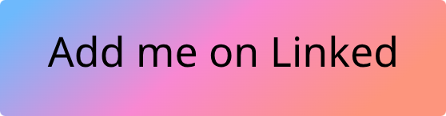
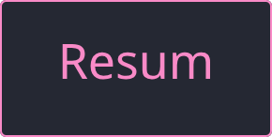
[Ahmed Amin]
Flutter Developer
Welcome to my portfolio! I’m a Computer Science student and Flutter developer. I love building colorful, fast, and easy-to-use apps that feel great on any device. With Flutter, I can create apps for mobile and desktop, giving clients more comfort and flexibility. My goal is simple: apps that make people smile while keeping their data safe.

Slide 2
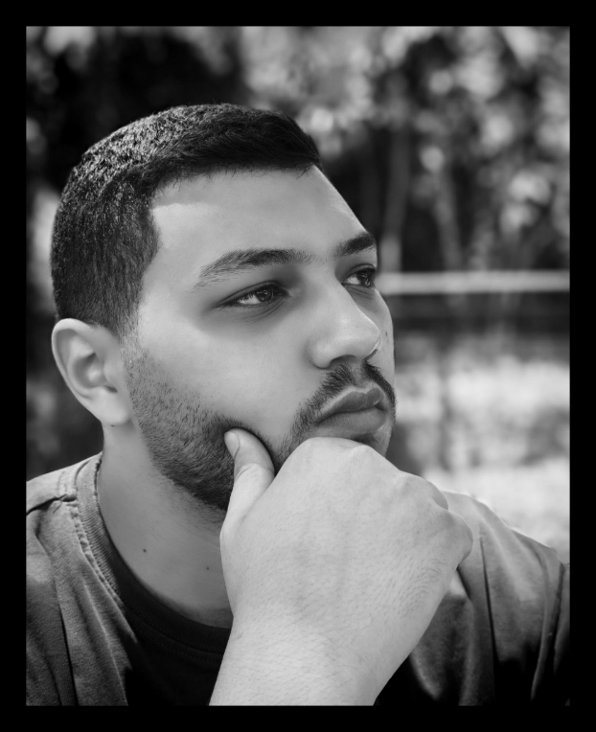
About Me
I’m a Computer Science student and a Flutter mobile app developer. I’ve always been fascinated by apps that are colorful, easy to use, and super fast. That passion pushed me into learning mobile development—and now I get to build apps that bring those same good vibes to others.
I make this happen by creating friendly UI designs, managing app state, and connecting apps with Firebase and APIs. I mainly code in Dart, but I also enjoy working with Java and C++ to expand my skills.
One of my goals is to build apps that are responsive, so users feel comfortable moving between devices. Thanks to Flutter, I can even provide desktop versions of apps in addition to mobile ones—making the experience even smoother and more convenient for clients.
Besides coding, I love working closely with people. I’m good at communicating clearly, managing time effectively, and collaborating in a team. Listening carefully to ideas and transforming them into real apps is something I truly enjoy.
At the end, my mission is simple: to craft apps that make people smile while giving them a secure, smooth experience.

Slide 3


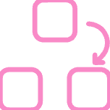

Skills
Programming & Frameworks
UI/UX & Design
Development Practices
Other Tools
Figma, Prototyping, Interaction Design, Usability Testing
Flutter, Dart, Firebase
Agile Development, Product Prioritization, Roadmapping
AR & 3D Modeling (Unity basics from Hackathon)
REST APIs, State Management (Provider, Bloc basics)
User Research, Wireframing, Responsive Design
Version Control

Slide 4

Education
75%
30%
Tanta University
DEPI 6-Month Flutter Program
Faculty of Computers and Informatics
Currently enrolled in an intensive Flutter training program focusing on cross-platform mobile app development using Flutter and Firebase. The program covers UI/UX design, state management, and API integration, providing hands-on experience in building responsive apps while applying agile practices, prototyping, and usability testing. It also develops technical and collaborative skills through real-world projects.
B.Sc. in Computer Science
2022 – 2026
July – Present

Slide 5



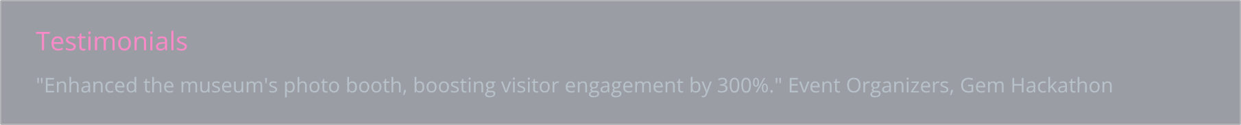
Experience & Expertise
July 2025 - in progress
Dec 2024
Digital Egypt Pioneers Initiative - DEPI
Participant
At Gem Hackathon Research AND Training
Flutter Trainee
At SkillsDynamix Company
• Participating in an intensive cross-platform mobile app development program using Flutter and Firebase.
• Built a photo booth solution using AR (Unity) and 3D modeling.
Gaining hands-on experience with UI/UX design, state management, and integrating APIs.
Rapidly learned and applied new tools after a short internship and self-study.
Learning agile development practices, product prioritization, and roadmap planning.
Languages & Frameworks
UI/UX & Tools
Development Practices
Figma
Agile
Flutter
Prototyping
State Management
Dart
Interaction design
API Integration
Firebase
Usability testing

Slide 6

Testimonials
"Enhanced the museum's photo booth, boosting visitor engagement by 300%."
"Contributed to increasing visitor numbers from 4,500 to 18,000 through innovative solutions."
Event Organizers, Gem Hackathon
Gem Hackathon Management Team

Slide 7
Projects:

Slide 8

[ToDo]
Flutter project for managing daily tasks. Implemented core features including task creation, editing, deletion, completion tracking, and local storage. Applied state management and continuous UI/UX improvements while learning best practices in Flutter development.
( Sep 2025 )
GitHub

Slide 9
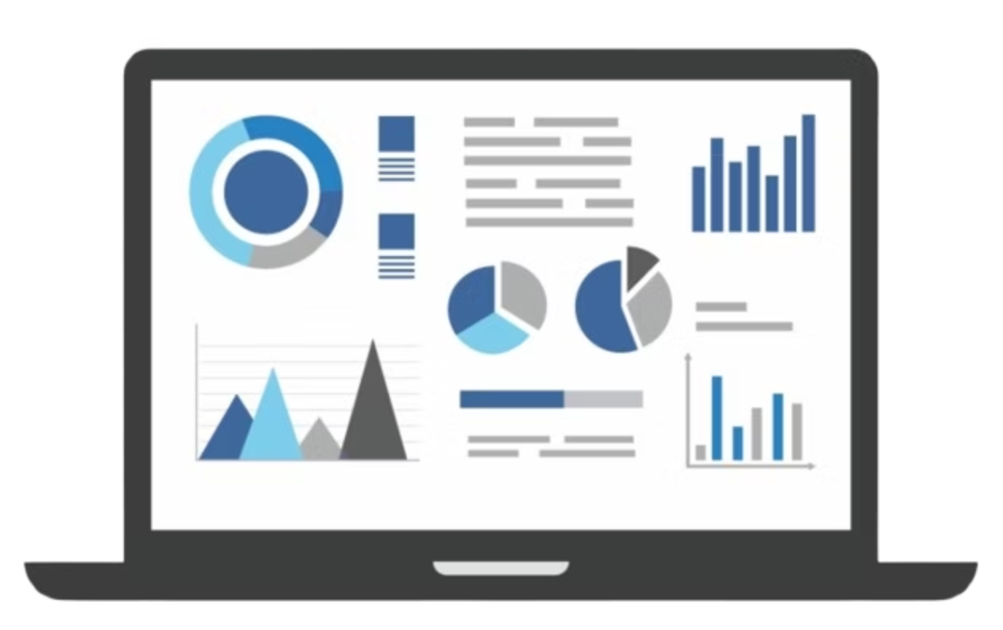
[Dashboard]
Developed a responsive and adaptive dashboard application designed for companies to track and visualize data effectively. The system incorporates intuitive flowcharts and detailed data analysis features, presented through a user-friendly interface that simplifies navigation and enhances employee adoption and understanding.
(Feb 2024)
Prototype

Slide 10

[easyPark]
Developed as a college team project to solve parking problems in crowded cities. Built with Flutter, integrating a database for reservations and user data. Implemented real-time parking availability, booking, payments, and an AI-powered chatbot. Led the team and conducted client interviews to define requirements.
(Apr 2025 - In progress)
Prototype

Slide 11

[3D Photo Booth Enhancement]
Participated in a college hackathon project improving the Photo Booth experience using Unity and 3D modeling. Designed and developed interactive 3D models, delivered the final presentation, and collaborated on a business proposal. Served as team leader, managing task distribution and workflow.
(Dec 2024)
Prototype

Slide 12
Services

Slide 13
App Development (Flutter)
Build cross-platform mobile apps for Android and iOS using Flutter.
Create responsive UI designs that adapt to different screen sizes.
Integrate APIs and connect apps with backends like Firebase.
Implement state management (Provider, Bloc basics) for efficient app functionality.

Slide 14
UI/UX Design & User Experience
Design engaging UI/UX interfaces using Figma.
Create interactive prototypes and conduct usability testing.
Perform user research to gather feedback and improve app experience.

Slide 15
Additional / Value-Added Services
Improve existing apps or add new features.
Develop simple AR or 3D experiences (e.g., photo booth projects).
Support projects in agile workflows, contributing to planning and organization.

Slide 16
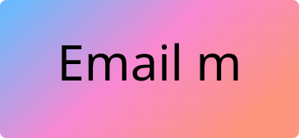
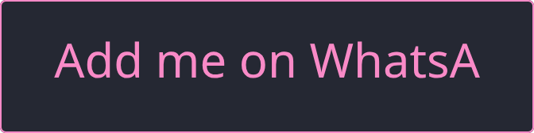
Keep in touch
Have a question about my work, want to collaborate on an exciting project, or just want to say hi?I’m always excited to connect with developers and creative minds. Let’s make something awesome!

