Slide 1
CS140E: embedded OS
Dawson Engler, prof
Holly Chiang, TA
Stanford winter 2020

Slide 2
Outline
What
Why

Slide 3
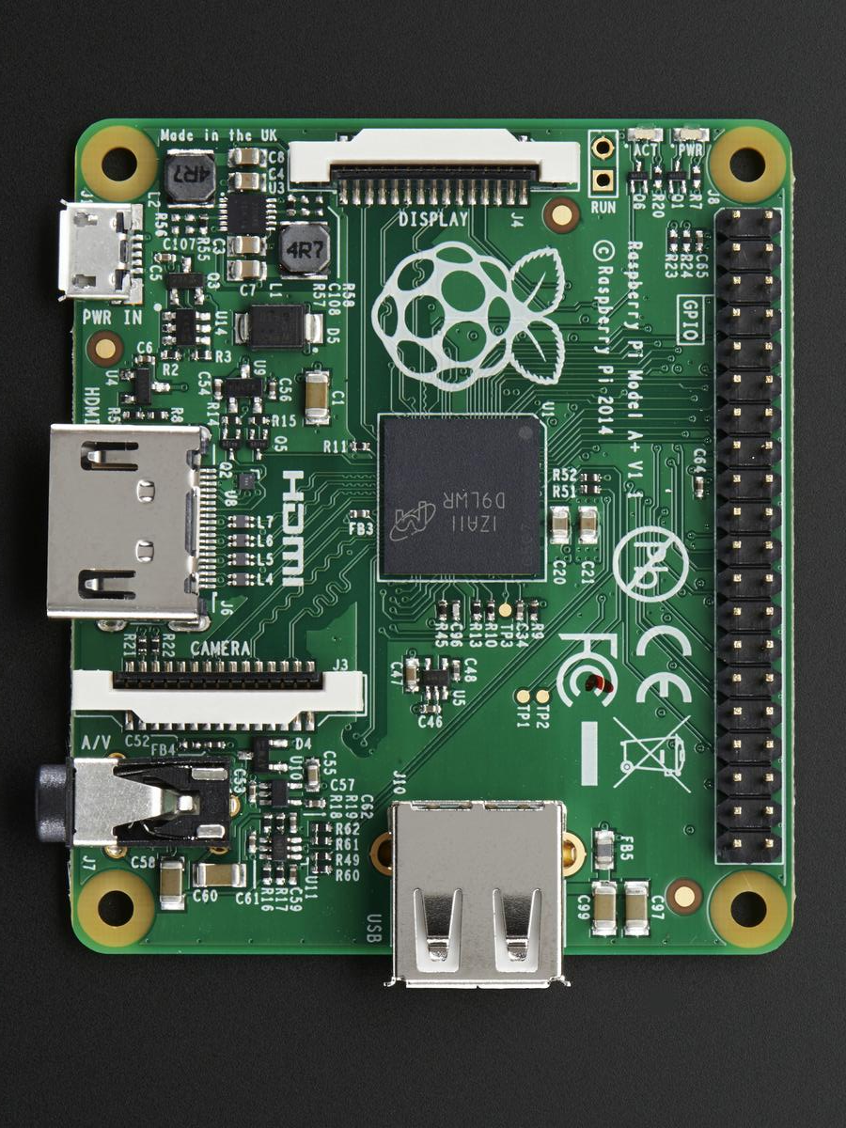
What
Write small, clean OS on an r/pi A+:
https://en.wikipedia.org/wiki/Raspberry_Pi

Slide 4
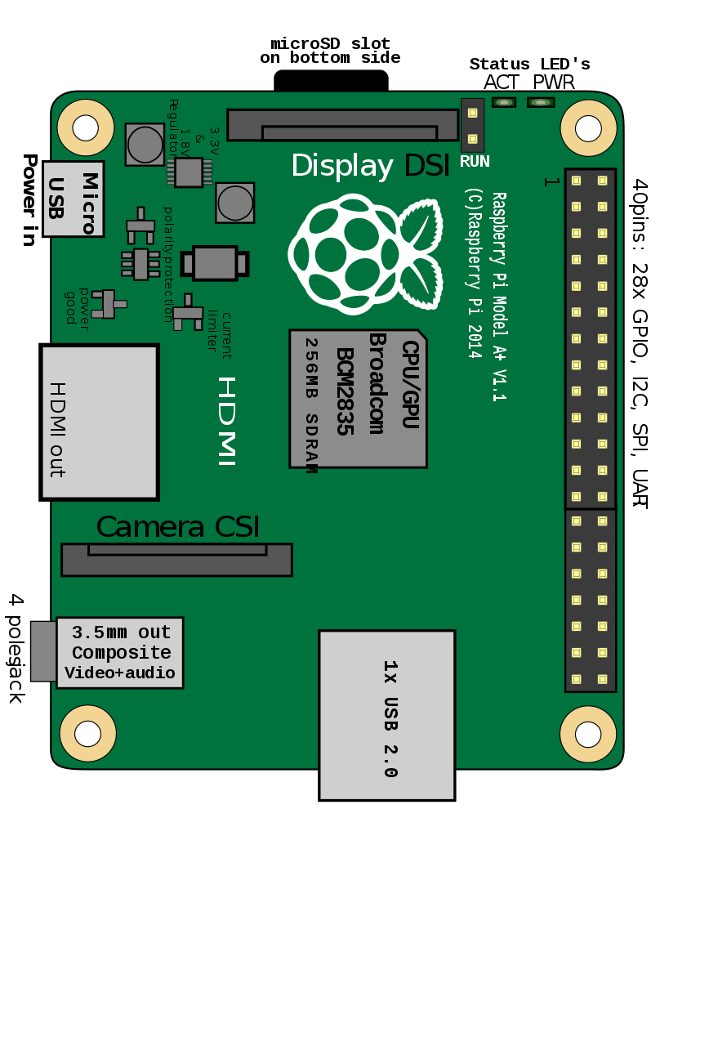
What
Write small, clean OS on an r/pi A+:
https://en.wikipedia.org/wiki/Raspberry_Pi

Slide 5
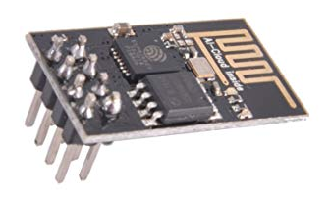
What you will build (tentative)
Bootloader (ship code from your laptop to the pi)
Device drivers
Threads + interrupts
Virtual Memory
Fuse file system to export pi to laptop
Simple file system on SD card.
Networking code that uses the cheap esp8266 chip
End result: simple, clean OS where you wrote (almost) every line.

Slide 6
Why OS?
If you can write a real OS, you can write almost anything (non-math-y).
Once you get this, easy to delta to something else.
Classes are fake: real world is not a clean, textbook of systematized knowledge
Difficult to understand documents
Wrong
Incomplete
Not written to be used
You will learn to operate in such a world without a lot of panic/drama.

Slide 7
Why R/PI A+?
Most OSes write code on a fake simulator
Alot of work, not that cool at the end.
R/pi = real computer for about $20 and an ounce of weight.
Many examples / blog posts of how to do various things.
Unlike most machines, makes interacting with the real world easy.
Can build many interesting systems b/c can use weird hardware easily (motion sensors, IR sensors, accelerometer, gyroscope, light sensor…)

Slide 8
Class philosophy
Write a complete, narrow OS all the way down to the bare metal.
We cover less material than most OS classes (multi-level schedulers, multi-level page tables)
However, you will understand much more thoroughly
Hope: easy to do delta off of your knowledge to more fancy things.
Labs vs lectures:
Always try to have you be writing code. You will actually understand what is going on.
Common tragedy of OS: missing a key sentence, mistake in key document. We will use lab to fill this in, saving you many hours/days.
Goal: you do pre-work to pre for lab, walk in, by the end of the lab, you have a complete working simple version of a key trick.

Slide 9
Goal: you will develop two super-powers
Power 1: Differential debugging.
Efficiently answering “why doesn’t work” for complex things.
Swap working pieces + Binary search
Power 2: Epsilon development.
Foundational paradox: When building systems, the smaller the step you take, the faster you can run.

Slide 10
Differential debugging
You write code, it doesn’t work, the error could be:
The code you wrote
Hardware fault (bad manufacturing, smoked something)
Wiring mistake
Subtle cache issue
Compiler problem (more on this)
…
You will get good at breaking down problems by swapping pieces between a working system (yesterday’s code, your partners lab) and a non-working system (today’s code, your lab)

Slide 11
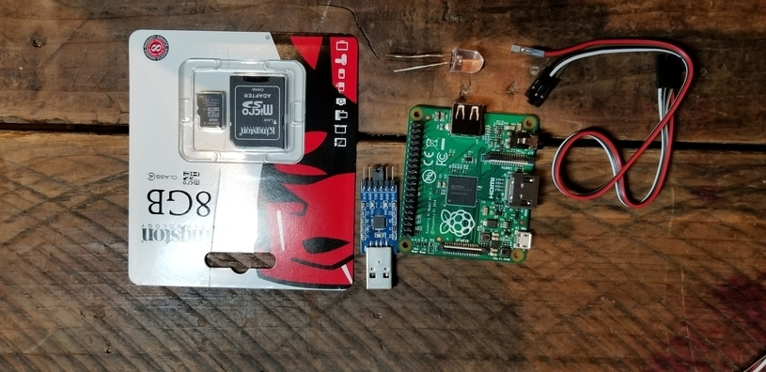
Example from next lab.
You get the following set of stuff:
To run you:
Copy blink.bin to sd
Wire up led
Wire up serial device
Plug into your laptop
It doesn’t work.
But your partner’s does

Slide 12
Example from next lab.
You get the following set of stuff:
To run you:
Copy blink.bin to sd
Wire up led
Wire up serial device
Plug into your laptop
It doesn’t work.
But your partner’s does

Slide 13
Example from next lab.
You get the following set of stuff:
To run you:
Copy blink.bin to sd
Wire up led
Wire up serial device
Plug into your laptop
It doesn’t work.
But your partner’s does

Slide 14
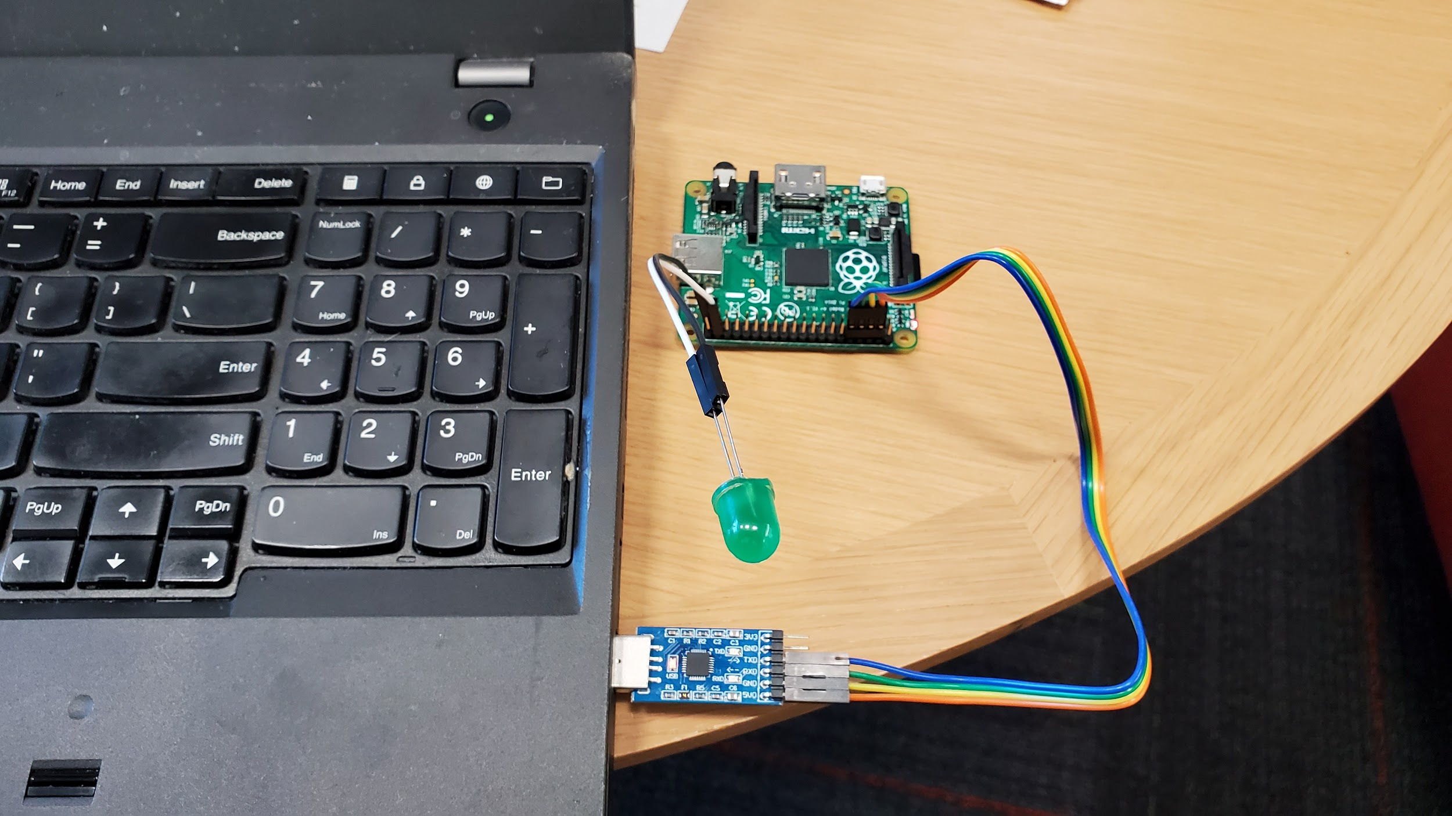
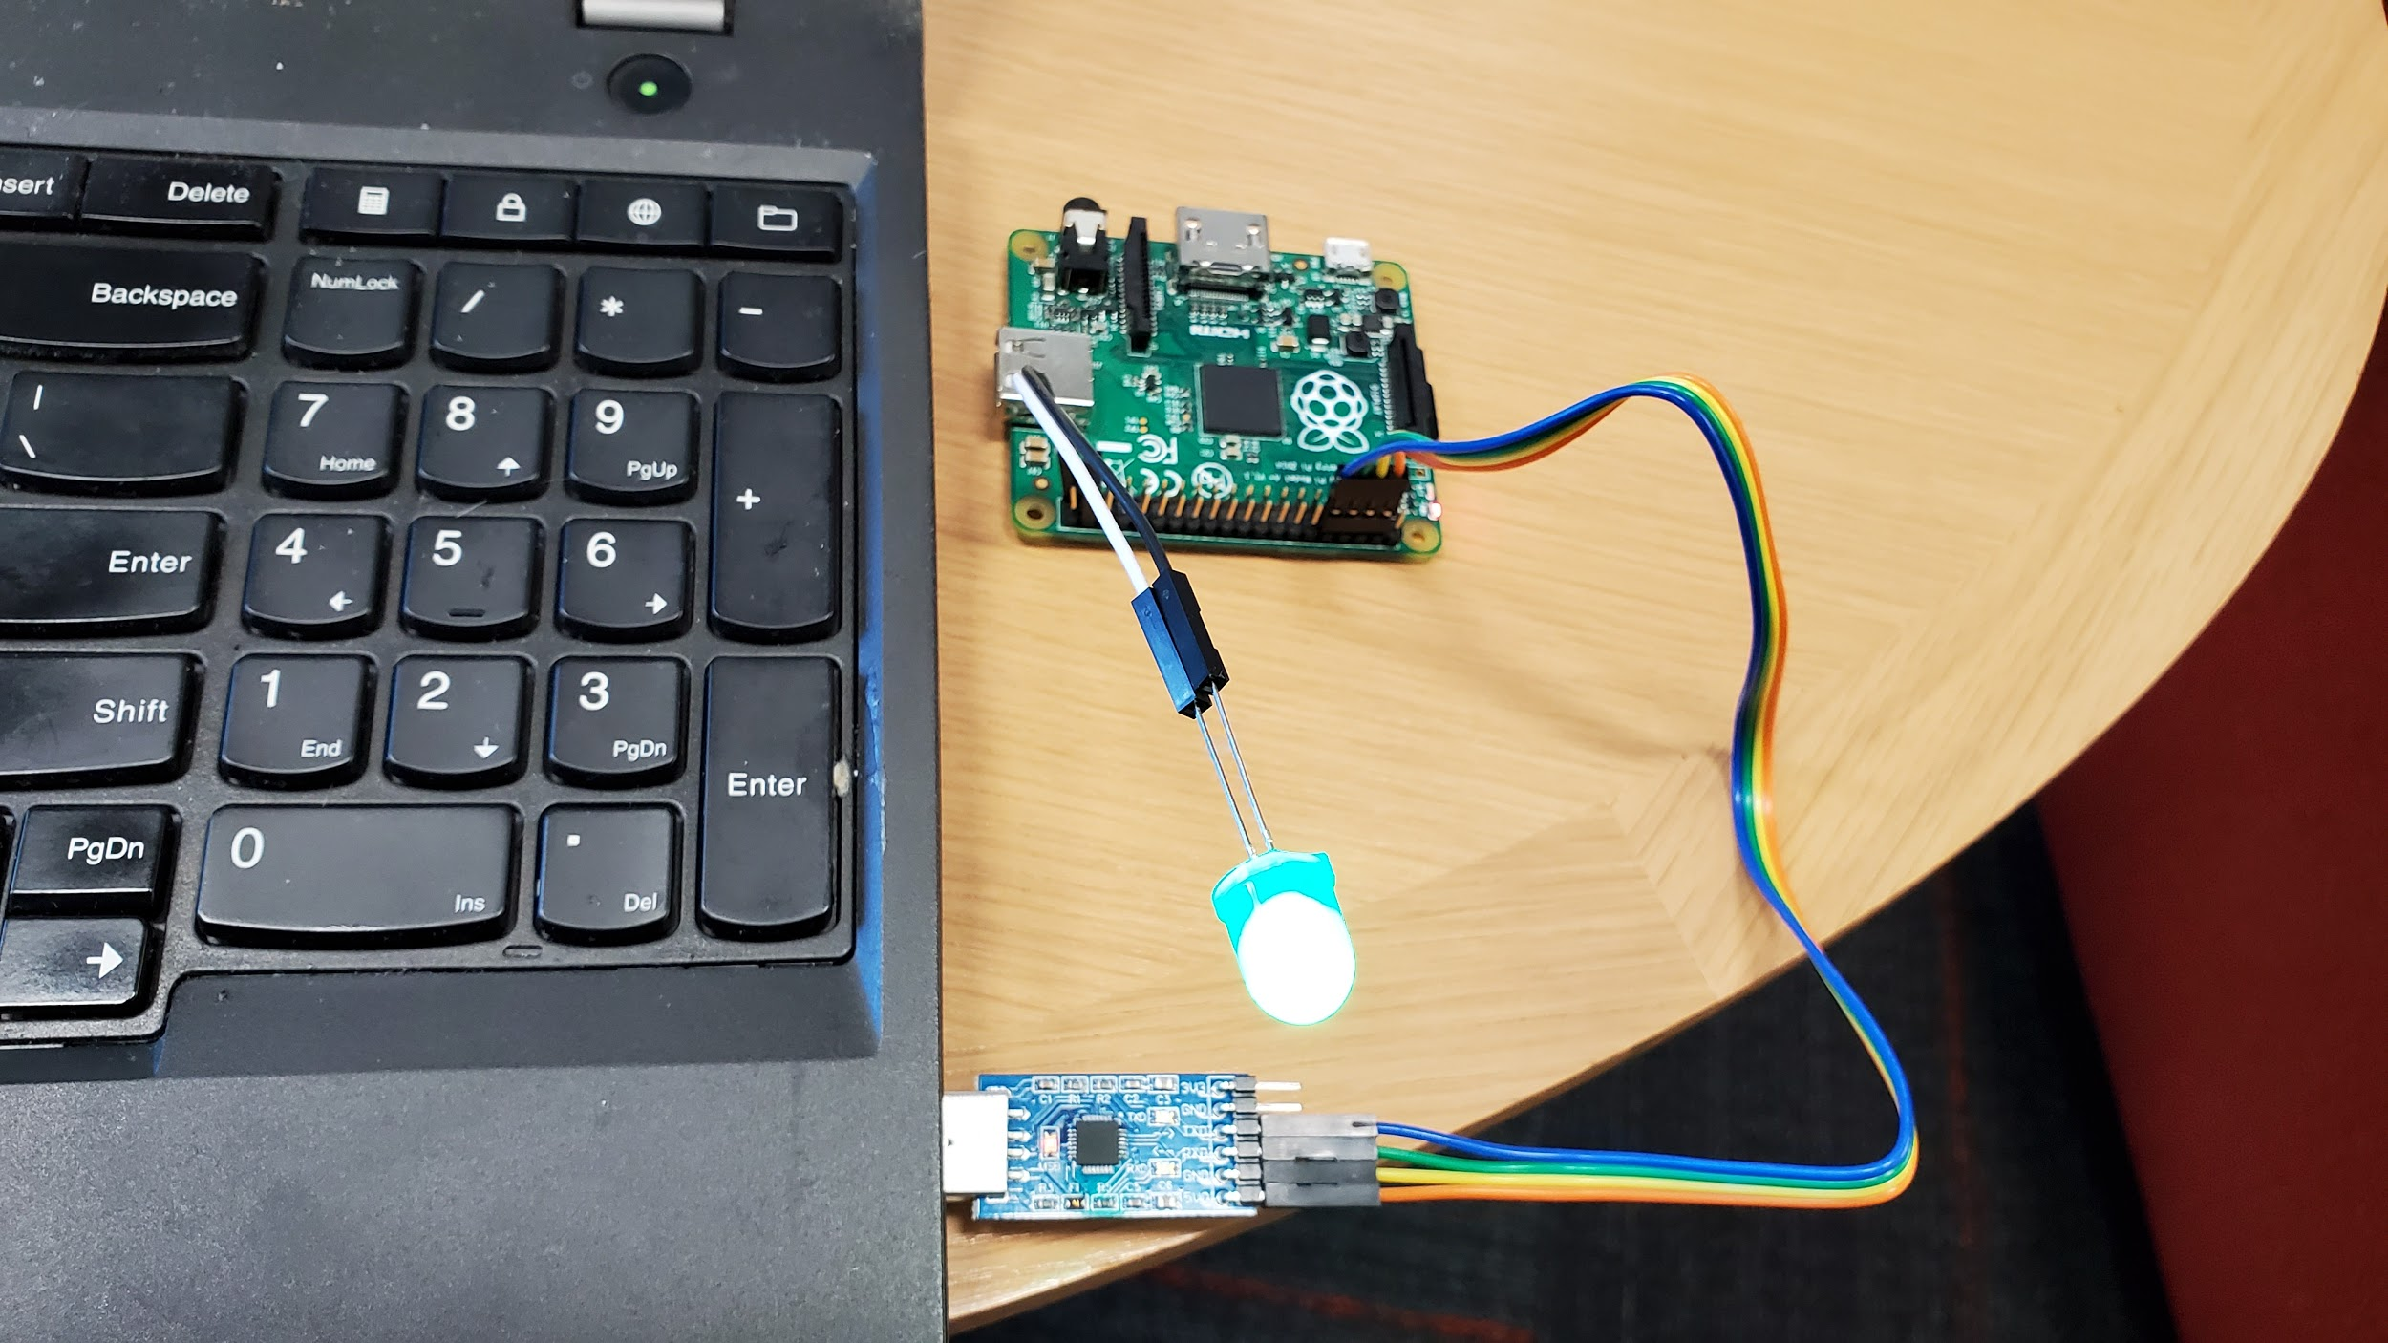
What is messed up?
Yours: Not working
Partner’s: Working
What to do first?

Slide 15
What is messed up?
Yours: Not working
Partner’s: Working
What does swapping tell you if doesn’t work?
What does swapping tell you if works?

Slide 16
What is messed up?
Yours: Not working
Partner’s: Working
Swapping works: how to narrow down with least work?

Slide 17
What is messed up?
Yours: Not working
Partner’s: Working
Entire class: whenever we control device, has some software component S (can be wrong) and some hardware component H (can be broken).
Doesn’t work = linear equation solving with two variables. How to isolate?

Slide 18
Slow is fast.
What is wrong?
If I did X, it’s X.
If I did X1+X2+...+Xn it could be any, or some combination.
Inverting crash / bug to root cause is much harder in the latter case.
The epsilon-sprint theorem:
Given a working system Wₖ and a change C, then as |C| ⟾ 𝞊, the time + computation it takes to figure out why { Wₖ + C } doesn’t work goes to 0.
Related claim: the time it takes to debug why a change broke the system increases non-linearly with the size of the change.

Slide 19
Administrivia
We may or may not have a final project. Depends on how the class goes.
I am currently rewriting about 50% of the code / labs.
Grade breakdown if no final project:
Labs = 60%, HW = 30%, participation = 10%.
If final project:
Labs = 50%, Hw = 20%, project = 20%, participation = 10%.

Slide 20
Administrivia
Two labs each week.
Each lab will have pre-lab work you should turn in before lab.
Ideally finish during the lab period (I will stay til everyone is done).
Must finish within a week of the lab, or start losing a letter grade each day.
Must pre-arrange missed labs. It’s a problem to miss more than a couple.
½ the time we will provide food.
There (tentatively) will be three “capstone” homework assignments that consolidate a chunk of labs together.
If you’ve done the lab, this shouldn’t be a big deal.

Slide 21
Administrivia
You can work with other people!
However, you *must* type and turn in everything yourself.
Please post to the newsgroup.

Slide 22
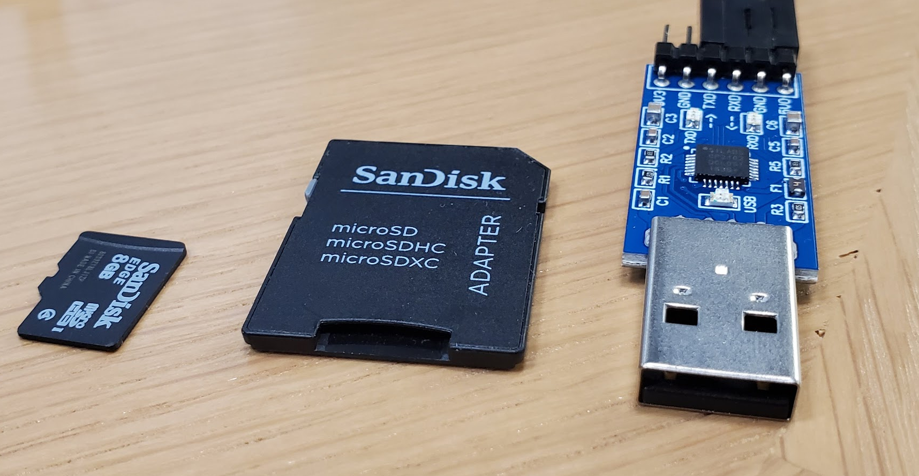
What to do now
Go to / clone the class git repository:
https://github.com/dddrrreee/cs140e-20win
Go to the newsgroup, or let me know if you don’t have an invitation.
https://groups.google.com/forum/#!forum/cs140e-win20
For lab wednesday, make sure you:
have a way to write either a micro-SD or SD card.
Have a way to plug in a standard USB device
Read labs 0-blink and 1-gpio and do the pre-lab homework.

