Slide 1
Lecture # 7
Inheritance

Slide 2
Inheritance is probably the most powerful feature of object oriented programming which is used in achieving software reusability.
Inheritance is the process of creating new classes, called derived classes from existing or base classes.
The derived class inherits all the capabilities of the base class but can add its own functionalities and refinements.
Consider the following figure.

Slide 3
Base class
( e.g. Animal )
Function a
Function b
        Arrow means “Derived from”
Function a
Derived class
(e.g. Horse )
Function b
        defined only in
        derived class
Function c

Slide 4
Base class does not inherit any class.
Derived class does inherit any other class or classes.
Single inheritance
    Derived class only Inherits from one base class
Multiple inheritance
    Derived class can Inherit from multiple base classes
      In this case base classes may be possibly unrelated from real life point of view

Slide 5
“is-a” vs. “has-a” relationship
  “is-a”
    Inheritance
    Derived class object treated as base class object
    Example: Car is a vehicle
      Car (derived class) inherits vehicle (base class)
  “has-a”
    Composition
    Object contains one or more objects of other classes as members
    Example: Car has a steering wheel
      ( car and wheel are classes )

Slide 6
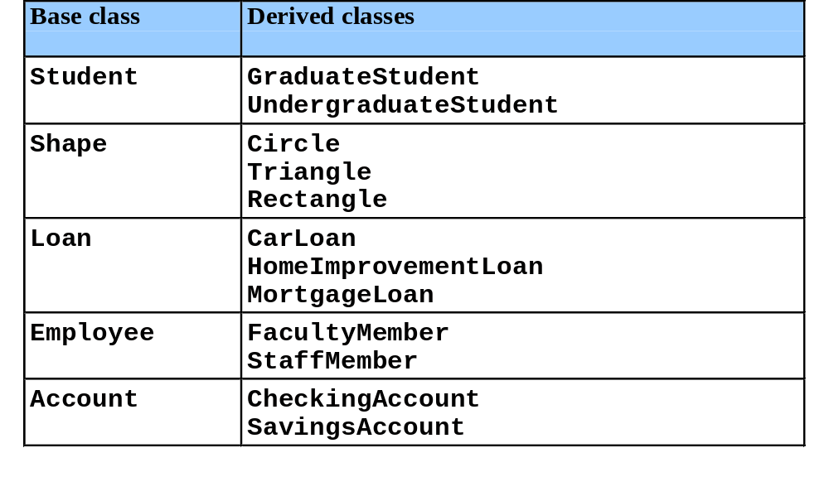
Base Classes and Derived Classes

Slide 7
Inheritance hierarchy for Shapes.
Shape
TwoDimensionalShape
ThreeDimensionalShape
Circle
Square
Triangle
Sphere
Cube
Tetrahedron

Slide 8
Example: Inheritance
#include <conio.h>
#include <iostream.h>
class arithmatic
{
protected :
int a,b;
public :
void add(int x, int y)
{
a=x;
b=y;
cout<<" \n Addition of a & b is : "<<a+b;
}
};

Slide 9
class operation1 : public arithmatic
{
public :
void mul(int x, int y)
{
a=x;
b=y;
cout<<" \n Multiplication of a & b is :”<<a*b;
}
};

Slide 10
void main()
{
operation1 op1;
int m,n;
cout<<" Enter number 1 :";
cin>>m;
cout<<" Enter number 2 :";
cin>>n;
op1.mul(m,n);
op1.add(m,n);
getch();
}

Slide 11
Important Note:
One thing is to be noted that whenever the object of derived class is created the constructor of both, the derived and base classes are called automatically.

Slide 12
Constructors and Destructors in Derived Classes
Instantiating derived-class object
  Chain of constructor calls
    Derived-class constructor invokes base class constructor
      Implicitly or explicitly
    Base class of inheritance hierarchy
      Last constructor called in chain
      First constructor body to finish executing
    Initializing data members
      Each base-class constructor initializes data members
        Inherited by derived class

Slide 13
Destroying derived-class object
  Chain of destructor calls
    Reverse order of constructor chain
    Destructor of derived-class called first
    Destructor of next base class up hierarchy next
      Continue up hierarchy until final base reached
        After final base-class destructor, object removed from memory

Slide 14
protected Access Specifier
A protected member can be accessed by member functions in its own class or
In any class derived from its own class.
It cannot be accessed from functions outside these classes such as main( ) function.

Slide 15
class Counter{
protected: //NOTE: not private
unsigned int count; //count
public:
Counter() : count() {} //constructor, no args
Counter(int c) : count(c) {} //constructor, one arg
unsigned int get_count() const //return count
{ return count; }
Counter operator ++ () //incr count (prefix)
{ return Counter(++count); }
};
class CountDn : public Counter{
public:
CountDn() : Counter() {} //constructor, no args
CountDn(int c) : Counter(c) {} //constructor, 1 arg
CountDn operator -- () //decr count (prefix)
{ return CountDn(--count); }
};

Slide 16
The moral is that if you are writing a class that you suspect might be used at any point in the future, as a base class for other classes, then any functions or data that the derived class might need to access should be made protected rather than private. This ensures that class is “Inheritance Ready”.
Table summarizes the above situation as follows.

Slide 17
Inheritance and Accessibility
Access Specifier | Accessible from own class | Accessible from derived class | Accessible from objects outside class
public | yes | yes | yes
protected | yes | yes | no
private | yes | no | no

Slide 18
Overriding member functions

Slide 19
You can use member functions in a derived class that have the same name as those in the base class.
You might want to do this so that calls in your program work the same way for objects of both base and derived classes.

Slide 20
Example: function overriding
#include <conio.h>
#include <iostream.h>
class arithmatic
{
protected :
int a,b;
public :
void add(int x, int y)
{
a=x;
b=y;
cout<<" \n Addition of a & b is : "<<(a+b);
}
};

Slide 21
class operation1 : public arithmatic
{
public :
void add(int x, int y)
{
cout<<"\n Derived class add function called.\n";
arithmatic :: add(x,y);
}
};

Slide 22
void main()
{
operation1 op1;
arithmatic arith1;
int m,n;
cout<<" Enter number 1 :";
cin>>m;
cout<<" Enter number 2 :";
cin>>n;
op1.add(m,n);
cout<<"\n**************************\n";
arith1.add(m,n);
getch();
}

Slide 23
The arithmatic and operation1 classes has same functions with the name, the same arguments and same return type.
When we call the function from main() as op1.add(m,n); how does the compiler know which function to follow?
Answer is when the same function(s) exists in both the base and derived class, the function in the derived class will be executed.

Slide 24
Objects of the base class donot know anything about the derived class and will always use the base class functions as in program the call : arith1.add(m,n);
When the functions with the same name appears in base and derived classes we say that derived class function overrides the base class function.

Slide 25
Multiple Inheritance

Slide 26
A class can be derived from more than one base class. This is called multiple inheritance.
Figure shows the above comment.
    Base class A Base class B
    Derived class C

Slide 27
The syntax for multiple inheritance is similar to that for single inheritance. The above figure relationship is expressed like this :
class A // Base Class A
{
};
class B // Base Class B
{
};
class C : public A, public B // C is derived from A and B
{
};

Slide 28
Example: Multiple Inheritance
#include <conio.h>
#include <iostream.h>
class operation1
{
protected :
int a,b;
public :
void add(int x, int y)
{
a=x;
b=y;
cout<<" \n Addition of a & b is : "<<(a+b);
}
};

Slide 29
class operation2
{
protected :
int a,b;
public :
void sub(int x, int y)
{
a=x;
b=y;
cout<<“\n subtraction of a & b is: "<<(a-b);
}
};

Slide 30
class arithmatic : public operation1, public operation2
{
private :
int a,b;
public :
void mul(int x, int y)
{
a=x;
b=y;
cout<<" \n Multiplication of a & b is : "<<a*b;
}
};

Slide 31
void main()
{
arithmatic arith1;
int m,n;
cout<<" Enter number 1 :";
cin>>m;
cout<<" Enter number 2 :";
cin>>n;
arith1.mul(m,n);
arith1.add(m,n);
arith1.sub(m,n);
getch();
}

Slide 32
In the above program arithmatic class inherits two other classes i.e. operation1 and operation2 as follows :
class arithmatic : public operation1, public operation2
operation1 class implements addition and operation2 class implements subtraction
        While
arithmatic class implements multiplication which inherits already made classes for addition and subtraction.

Slide 33
What are the possible alternatives to implement division operation (function) in the previous approach of multiple inheritance. Give at least two alternatives?

Slide 34
Ambiguity in Multiple Inheritance
Consider the scenario(situation) if two base classes have functions with the same name, while a class derived from both base classes has no function with this name.
How do objects of the derived class access the correct base class function?
The name of the function alone is insufficient, since the compiler cannot figure out which of the two functions are meant. Next example demonstrates this situation.

Slide 35
class A
{
public :
void show()
{ cout<<“\n Class A :”; }
};
class B
{
public :
void show()
{ cout<<“\n Class B :”; }
};
class C : public A, public B
{
};

Slide 36
void main()
{
C obj;
obj.show( ); // Ambiguous statement--- will not compile
obj.A :: show( );
obj.B :: show( );
getch();
}
The problem is resolved using the scope –resolution operator to specify the class in which the function lies. Thus
obj.A :: show( );
refers to the version of show( ) that is in the A class while
obj.B :: show( );
refers to the function show( ) that is in the B class.
The scope resolution operator resolved the ambiguity and the compiler is happy now.

