Slide 1
Object Oriented Analysis & Design (OOAD)
Case Studies, Inception Phase & Evolutionary Requirements

Slide 2
Chapter 3
Case Studies

Slide 3
Point of Sale (POS)
records sales, handles payments and returns, etc
input devices: computers, barcode reader, fancy client terminals (Home Depot), PDA (Personal Digital Assitant)?
external interfaces: tax calculator
susceptible to communication failure like not access to credit card database
individualized client logic (if you want to sell to many businesses)

Slide 4
Monopoly
domain modeling, object design and patterns
run as a simulation; very little “player” interaction

Slide 5
Example 1: Point of Sale (POS)
Focus on core logic, not GUI.
  other layers are technology dependent
  core is similar across technologies
  skills learned are applicable everywhere
  design patterns of other layers not constant

Slide 6
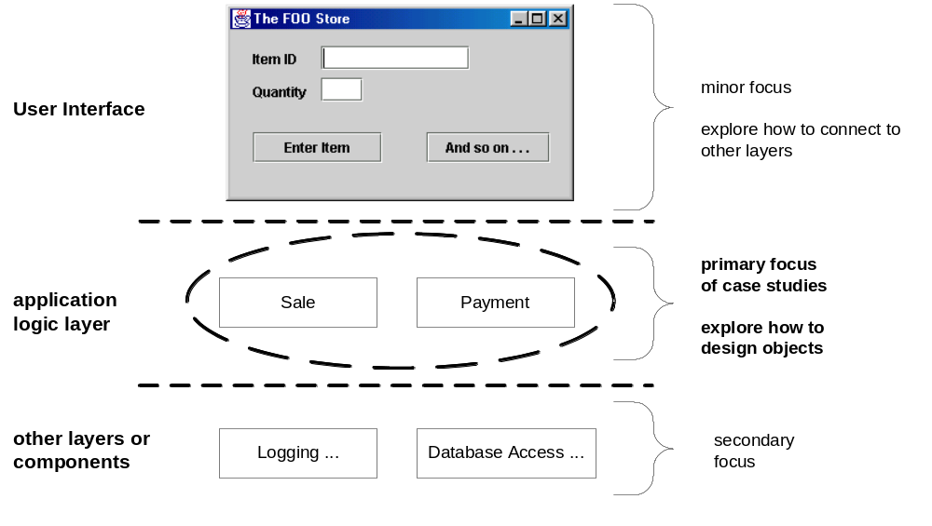
Fig. 3.1

Slide 7
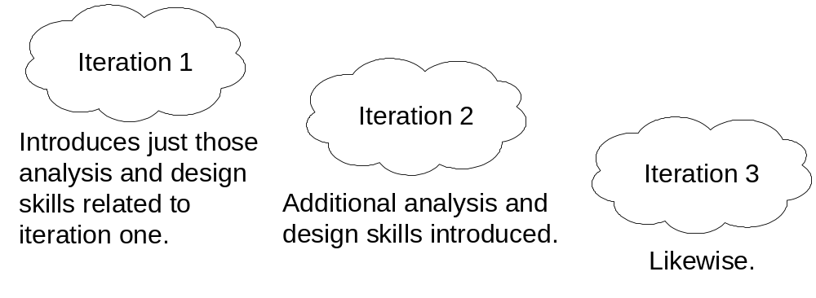
Fig. 3.2
Iteration as a tool and environment
In Iteration 1 only certain techniques used so only these are introduced at this time
In Iteration 2, we look at more UML tools, etc

Slide 8
Chapter 4
Inception Phase

Slide 9
Inception is NOT Requirements:
Inception is a short, initial stage. Its purpose is a common vision and scope measurement.
needed to do:
  analyze 10% of use cases
  analyze critical non-functional requirements
  create a business case
  prepare development environment

Slide 10
What is Inception?
Time to explore:
  Why are we doing this? Does it make business sense?
  Is it feasible?
  Should we build or buy?
  O(cost)?
  Should we go forward or stop now?
Keep it brief.
NOTE: UP is not “waterfall”. This first stage is not
intended to gather all requirements. We do most of
our requirements analysis in the next phase – Elaboration.

Slide 11
Inception Artifacts:
Artifact | Comment
Vision and Business Case | High-level goals, executive summary
Use-Case Model | Name all, detail 10%
Supplementary Spec | Other specs; non-functional
Glossary | Somewhere on the wiki
Risk List | What are the risks?
Prototypes | validation
Iteration Plan | Just the 1st elaboration iteration
Phase plan | O(elaboration phase duration)
Development Case | UP steps we’ll follow

Slide 12
You Don’t Understand When:
it takes more than a few weeks
becomes an attempt to define most requirements
estimates are expected to be reliable
you “define the architecture”
you are thinking sequentially
there is no business case or vision
all use cases are written in detail
none of the use cases are written in detail

Slide 13
Chapter 5-6
Evolutionary Requirements & Use Cases

Slide 14
Requirements
These are the capabilities and conditions that the system or broadly the project and the product must provide and meet.
Managing requirements is a best practice for project managers.
Requirement issues are the leading cause of project failure. Even if you do a perfect job of building the wrong thing, its no good!

Slide 15
Managing Requirements
Customer/User requirements are frequently unclear and change over time. Frequently new requirements are discovered as part of the development process.
There must be a “systematic approach to finding, documenting, organizing, and tracking the changing requirements of a system.” (RUP)

Slide 16
UP FURPS+ Requirement Model
Functional (features, capabilities, security)
Usability (human factors, help, documents)
Reliability (failures, recovery, predictable)
Performance (response, throughput, etc)
Supportability (maintainability, configuration)
+ ancillary and sub-factors (next slide)
Notes:
UP requirements are STRUCTURED in FURPS+ model

Slide 17
Ancillary and sub-factors
Implementation (includes limitations e.g. resource, language, tools, hardware etc)
Interface (Constraints for interfacing external systems)
Operations (Configurations, System management)
Packaging (e.g. a physical box)
Legal Requirements (Licensing etc.)

