Slide 1
Memory Management Introduction

Slide 2
Memory Management
A programmer will like to have memory
  Infinitely large
  Infinitely fast
  Non volatile
However, we have Memory Hierarchy:
Registers
Cache
Main Memory
Disk
Operating Systems -

Slide 3
Memory Manager
The part of the OS that manages the Memory Hierarchy
  Which part of memory is in use and which is not in use
  Allocate memory
  De-allocate memory
  Swapping between main memory and disks
Operating Systems -

Slide 4
Uni-programming
Run just one program at a time
Memory is shared between
  A User program
  Operating system
User Program
Operating System
The user types a command on the prompt
The OS
  Copies the program from the disk to memory
  Executes the program
  After execution, prompt is available again
The new program is copied into RAM, overwriting the previous one
Operating Systems -

Slide 5
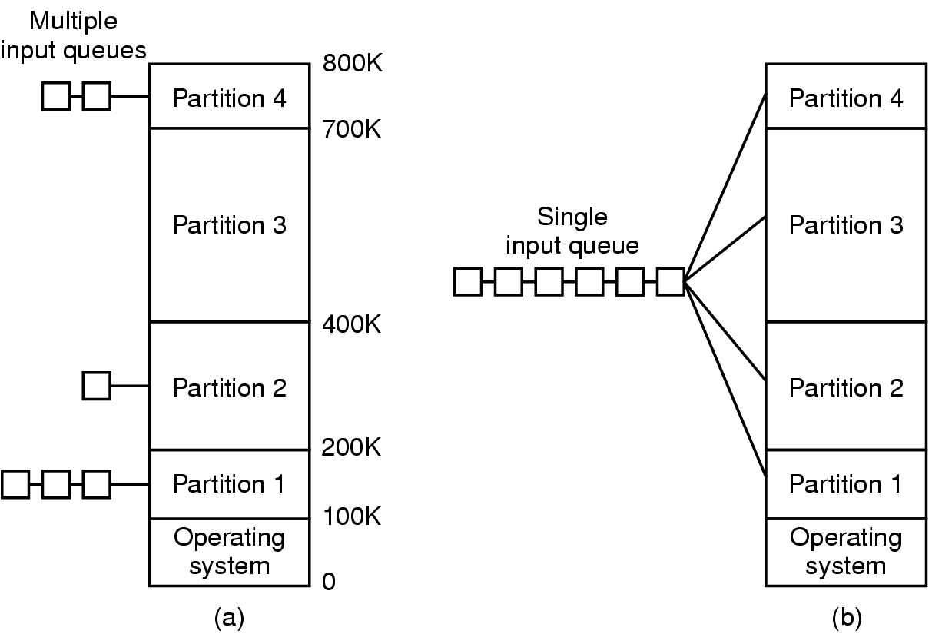
Multiprogramming with Fixed Partitions
Multiprogramming:
  When one process blocks due to I/O
  Another one can use the CPU
Divide memory into n (usually unequal partitions)
If the job size < Partition size, memory is wasted
When a job arrives
  its put into the input queue of
The smallest partition large enough to hold the job
Operating Systems -

Slide 6
Multiprogramming with Fixed Partitions
Disadvantage of Multiple Queues:
  When a large partition is empty
  And queues for small partition is full
  Small jobs have to wait, even though plenty of memory is free
Alternative: Maintain a single Queue
Operating Systems -

Slide 7
Multiprogramming with Fixed Partitions
Whenever a partition becomes free, a job is selected
  Closest to the front of the queue
  Smaller than the partition size
Undesirable to waste a large partition for smaller job
  Search the queue, find the largest job that fits is
Unfair for smaller jobs
  A job may not be skipped more than k times
800K
Partition 4
700K
Partition 3
400K
Partition 2
200K
Partition 1
Operating System
100K
0
Operating Systems -

Slide 8
Relocation and Protection
800K
Partition 4
700K
Different jobs will run at different addresses
Linker:
  Combines the user procedures and the library procedures
  Produces a single binary file
Suppose, the first instruction is
  call a procedure at absolute address 10 within the binary file
If the process is loaded in 1st partition
Partition 3
400K
Partition 2
200K
Partition 1
Operating System
100K
0
This call will jump inside the Operating system
Operating Systems -

Slide 9
Relocation and Protection
800K
Partition 4
700K
Solution:
If the program is loaded in 1st partition, then
  Call 100k + 10
If the program is loaded in 2nd partition, then
  Call 200k + 10
So on…
This is called Relocation problem
Partition 3
400K
Partition 2
200K
Partition 1
Operating System
100K
0
Operating Systems -

Slide 10
Relocation and Protection
800K
Partition 4
700K
Solution:
  Add an offset to each address in the program
  The offset depends on the partition, e.g.,
    if the Program is loaded in partition 1, add 100k to every address
    if the Program is loaded in partition 2, add 200k to every address
Partition 3
400K
Partition 2
200K
Partition 1
Operating System
100K
0
A program can still generate an address that jumps in the OS or other user’s code
We need to Protect the code
Operating Systems -

Slide 11
Relocation and Protection
Solution:
  Base and Limit Registers
When a process is scheduled
Base Register
  Loaded with the starting address of the Partition
Limit Register
  Loaded with the length of the Partition
Before referring to memory
  Add the base register contents to generated memory address
Also check against the Limit register for protection
Operating Systems -

Slide 12
Relocation and Protection
Addition and comparison has to be performed on every address
Use a hardware module
Interrupt
800K
Partition 4
Absolute Address
Physical Address
700K
Limit Register
Comparator
Partition 3
400K
Partition 2
Base Register
Adder
200K
Partition 1
Memory Management Unit (MMU)
Operating System
100K
Relative Address
Logical Address
0
Operating Systems -

Slide 13
Internal Fragmentation
Memory that is internal to a partition but not being used
800K
Partition 4
B
Internal Fragmentation
700K
A
Partition 3
Internal Fragmentation
400K
Partition 2
200K
Partition 1
Operating System
100K
0
Operating Systems -

Slide 14
Swapping
If not enough space in memory for all the currently active processes
Excess processes must be kept on disk
  Fully ➔ Swapping
  Partially ➔ Virtual Memory
Example of Swapping
  Round Robin Scheduling
When the quantum expires
  Swap out the currently running process
  Swap in another process to freed memory space
Operating Systems -

Slide 15
Swapping
Another Example:
  Priority based scheduling
If a higher priority process arrives
  Swap out a lower priority process
  Swap in the higher priority process
When the higher priority process exits
  Swap in the lower priority process
Operating Systems -

Slide 16
Swapping
C
The number, size and location of the partition is decided dynamically.
D
B
B
A
C
A
A
D
Operating System
D is of Higher Priority, A is of Lower Priority!!!
B exits now, Swap in A
Operating Systems -

Slide 17
Swapping
Its possible to combine all the holes into one big hole
This is called COMPACTION
E
EXTERNAL FRAGMENTATION
Memory External to all partitions is Fragmented
Enough total memory exists to satisfy the request
But is not Contiguous
C
A
E
Swapping has created Holes
D
Operating System
D exits now
No Space for E !!!
Now E has enough space
Operating Systems -

Slide 18
Swapping
Compaction involves CPU overhead
If addresses are not generated relative to the partition location:
  Then Compaction is not possible
How much memory should be allocated for a process?
  If all the memory is allocated statically in a program
  Then, OS knows exactly the amount of memory to be allocated: executable code + variables
However, if memory is allocated dynamically (say using new)
Operating Systems -

Slide 19
Swapping
Problem may occur whenever a process tries to grow
If a hole is adjacent to the growing process then it can be allowed to grow
If another process is adjacent to the growing process, then
  The growing process should be moved to a larger hole
  If a larger hole is not available, then, one or more processes should be swapped out
  If a process cannot be swapped out (say, there is not enough space on disk
    The growing process has to wait
    Or should be killed!!!
Operating Systems -

Slide 20
Swapping
If most of the processes grow as they run,
It is better to allocate a little extra memory for a process
B
Room for growth
Actual in use
A
Room for growth
Actual in use
Operating System
Operating Systems -

Slide 21
Swapping
If processes have two growing segments
  Data
    (as heap for dynamically allocated variables)
  Stack
B-Stack
B-Data
B-Program
Room for growth
The memory can be used by either of the two segments
If it runs out the process either
  Has to be moved to a larger hole
  Or swapped out
  Or Killed
A-Stack
A-Data
A-Program
Room for growth
Operating System
Operating Systems -

