Slide 1

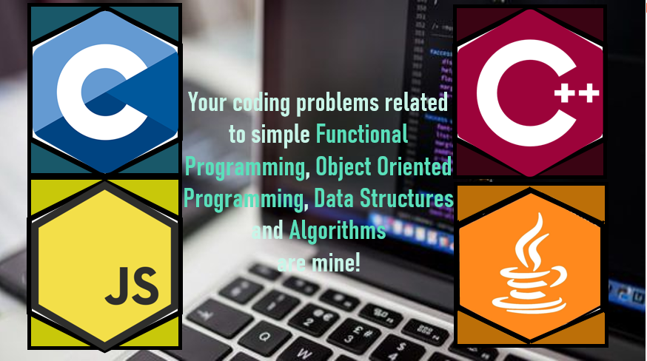

Your coding problems related to simple Functional Programming, Object Oriented Programming, Data Structures and Algorithms are mine!

