Slide 1
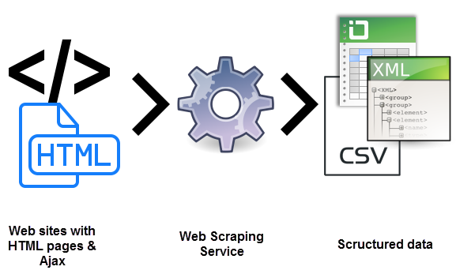
Web Scraping and Web Automation

